Slide 1
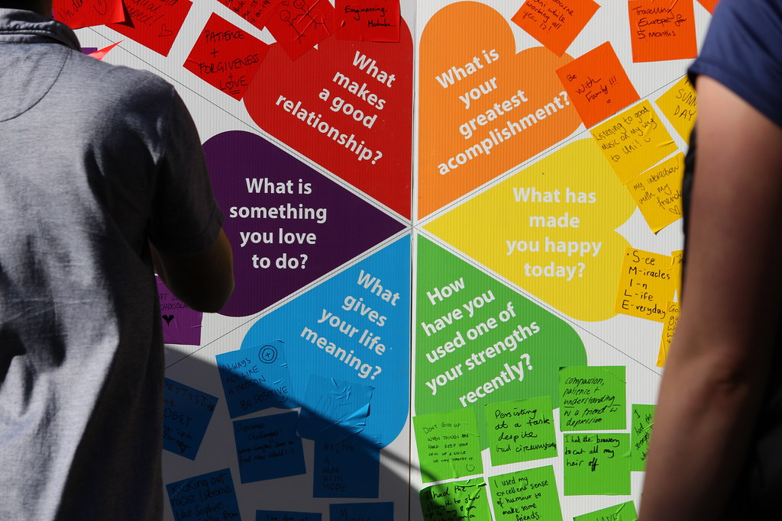
Wellbeing Session

Slide 2

Wellbeing
What does it mean? What is our understanding of wellbeing?
Thriving. When people thrive, they operate from the state that is the best version of themselves.
Feeling good and functioning well and comprises an individual’s experience of their life; and a comparison of life circumstances with social norms and values.
WHO states: "Health is a state of complete physical, mental and social well-being and not merely the absence of disease or infirmity."
Put simply is about “How we are doing” as individuals, as colleagues, in communities and as a nation and how sustainable this is for the future.

Slide 3
What factors can affect our wellbeing
Physical
Emotional
Environmental
Social
Financial

Slide 4

What factors can affect our wellbeing
Physical - encompasses strength and stability, form and function.

Slide 5
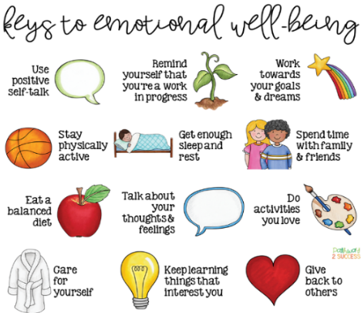
What factors can affect our wellbeing
Emotional - ability to produce positive emotions, moods, thoughts, and feelings and adapt.

Slide 6

What factors can affect our wellbeing
Environmental - good health by occupying pleasant, stimulating environments.

Slide 7
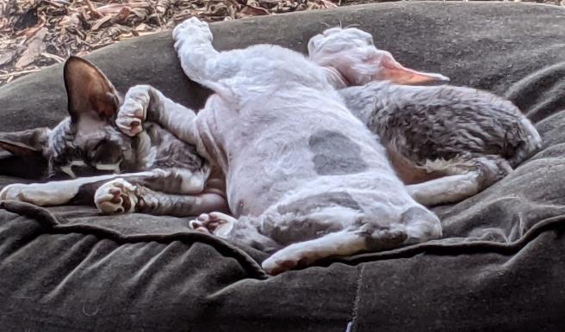
What factors can affect our wellbeing
Social - your relationships, how you connect with others and social standards.

Slide 8

What factors can affect our wellbeing
Financial - having a good relationship with money.

Slide 9
Exercise – Reflection on our Personal Wellbeing
Individually, or in pairs, rate yourself between 1 (lowest) and 10 on how satisfied you are with the following elements of your personal wellbeing:
Physical
Emotional
Environmental
Social
Financial
Then in pairs/small groups, discuss, based on these ratings, what do you think is impacting both positively and negatively on your wellbeing most at moment?
What strategies do you/can you employ and share with others? Write your ideas/strategies on post it notes and stick them on the appropriate flipchart papers
Notes:
explore your wellbeing as an individual, explore what this brings up for you, discover what you are learning about yourself, receive compassionate support and challenge from your peers

Slide 10
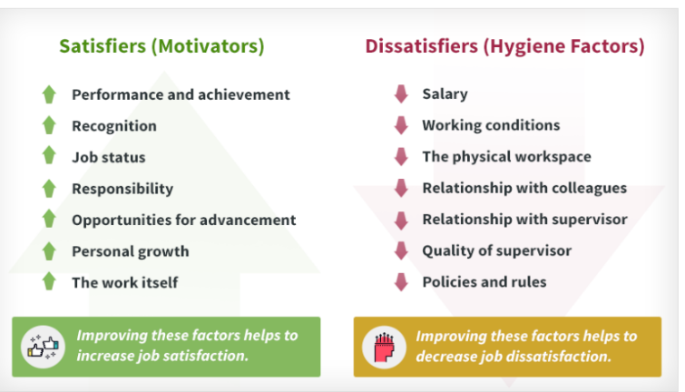
Your Wellbeing at Work
Herzberg – Motivation-Hygiene Theory

Slide 11
Exercise – Support for our wellbeing at work
In small groups, discuss and think of ideas about what the following:
What more can we do to support ourselves at work?
What support do we need from each other at work?
What support do we need from our managers at work?
What more do we need from ELFT to support us at work?
Write your ideas on flipchart paper and be prepared to feedback to the wider group
Notes:
explore your wellbeing as an individual, explore what this brings up for you, discover what you are learning about yourself, receive compassionate support and challenge from your peers

Slide 12
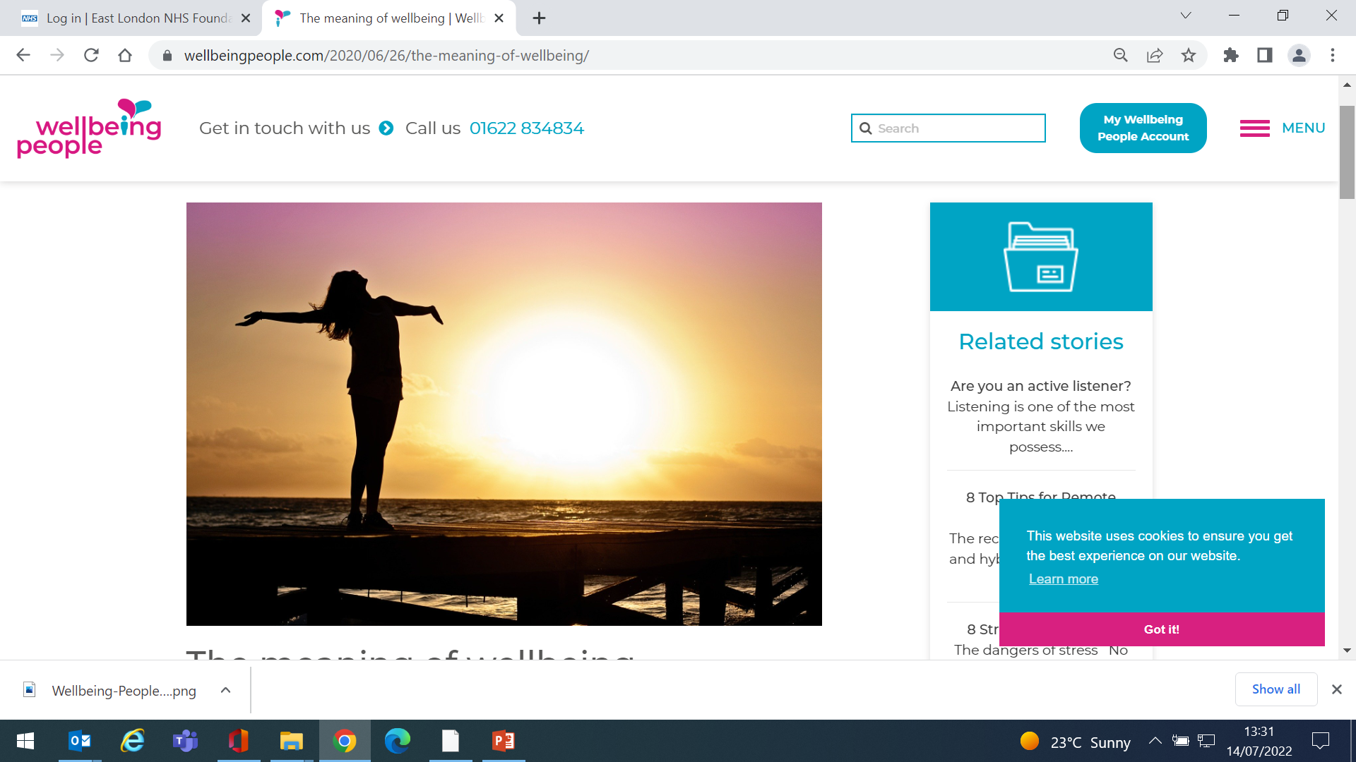
Wellbeing
Why Is It so important?
Linked to:
Improved physical health
Greater productivity
Increases life expectancy
Faster recovery times from illness
Improved mental health
Associated with positive health behaviours

Slide 13

Burnout
Burnout? What is it?
A state of emotional, physical and mental exhaustion caused by excessive of prolonged stress
Symptoms
Exhaustion/Tired/Drained
Feeling detached from work
Lack of personal identity
Self doubt/reduced confidence in ability to do your job
Procrastination
Helpless/Trapped
Cynical/Negative Outlook
Work characteristics where more likely
Unpredictable work environment
Lack of control over work
Unclear work/job expectations
Dysfunctional work dynamics
Lack of social support/unheard/unfair treatment
Extreme/unrealistic timelines
Work life imbalance
Lack of communication
Consequences
Insomnia, Anger, Irritability, Excess Stress, Sadness, Heart Disease, High blood pressure, Type II diabetes, vulnerability to other illnesses, Relationship breakdown, Conflict.

Slide 14
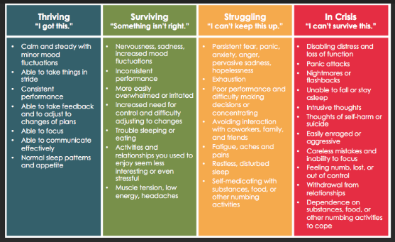
Stress & Responses to Stress

Slide 15
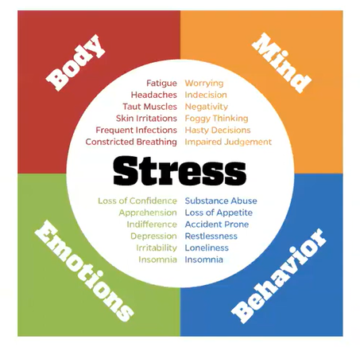
Stress & Responses to Stress

Slide 16
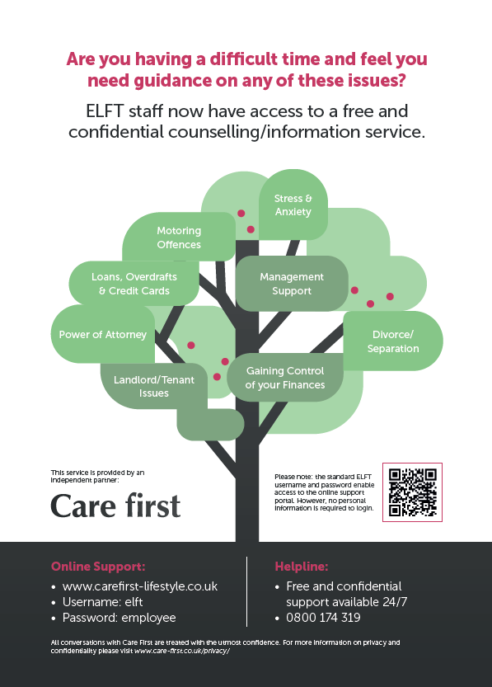
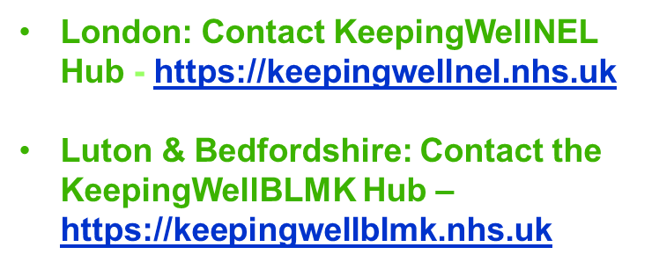
Our Employee Assistance Programme
Care First
0800 174 319

Slide 17

What factors can affect our Wellbeing
Our Wellbeing Wheel

Slide 18
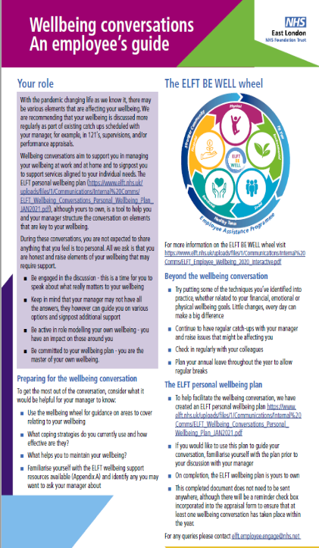
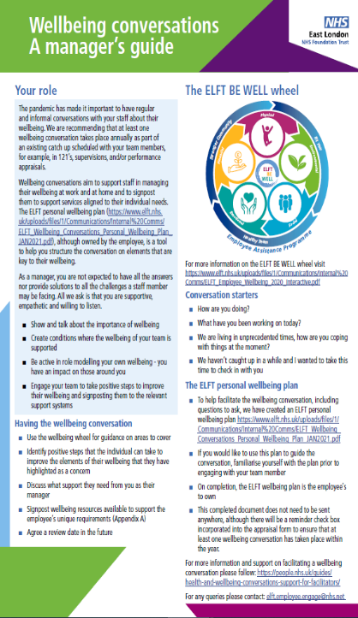
ELFT Wellbeing Conversations

Slide 19

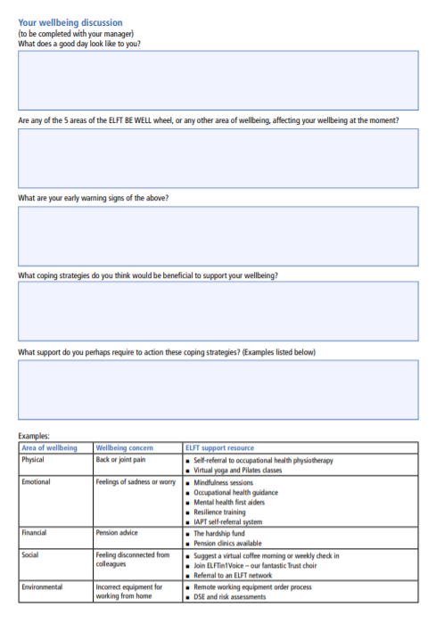
Wellbeing Plan

Slide 20
Your staff/people’s wellbeing
  Lead by example (take an interest in your own wellbeing, manage overtime etc.)
  Check in on your teams & signpost them to necessary Trust support
  Ensure your teams have access to the basics (breaks, correct equipment, clear roles & responsibilities)

Slide 21
ELFT Benefits
Cycle to work scheme | Holiday Play-scheme Subsidy | Lease car scheme
Subsidised wellbeing initiatives (the Trust offers a subsidy towards Pilates/yoga courses, these are run for 10 weeks and are great fun!) | Welcome back pack for maternity/paternity returners (£50.00 high street vouchers to welcome staff on their return to work after having a baby) | Home technology scheme (order windows open: Easter, Summer & Christmas)
Exceptional leave | Free massage sessions | Annual staff awards
Employee/team of the month scheme | Holiday of a life time scheme | Wellbeing Offers – FW, NHS Discounts

