Slide 1


Recruitment Pack: Chair of Compass Wellbeing CIC
Compass Wellbeing is a Community Interest Company wholly owned by the East London NHS Foundation Trust.
This information has been prepared for potential candidates for the role of Chair of the Board of Compass Wellbeing CIC.
24 June 2024

Slide 2
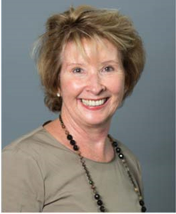



Welcome from Eileen Taylor, Chair of ELFT
Thank you for your interest in joining the Compass Wellbeing CIC Board as its Chair. Compass is a community interest company wholly owned by the East London NHS Foundation Trust (ELFT). Its primary focus is to work to improve the wider determinants of health for the populations which we serve, in line with our commitment as the first NHS Marmot Trust.
Compass Wellbeing has helped shape the Trust’s work as an anchor organisation in Bedfordshire, East London, and Luton enabling significant grant programmes to the local community and voluntary sector.
We are keen to appoint an exceptional individual to chair our community interest company as it enters the next stage of its development. As the new Chair you will working closely with the main ELFT Board to agree the direction and strategy for the Compass Wellbeing’s future, focusing on providing the best possible support to the voluntary and community organisations that service our local communities. You will play a key role in our appointment of the new permanent Chief Executive for Compass.
We warmly welcome applications from members of our vibrant and diverse communities who bring an understanding of some of the challenges faced by our local populations and are hoping that the successful candidate will be able to bring non-executive director or Trustee experience from the community interest company or charitable sectors. This is an exciting time to join Compass Wellbeing.

Slide 3
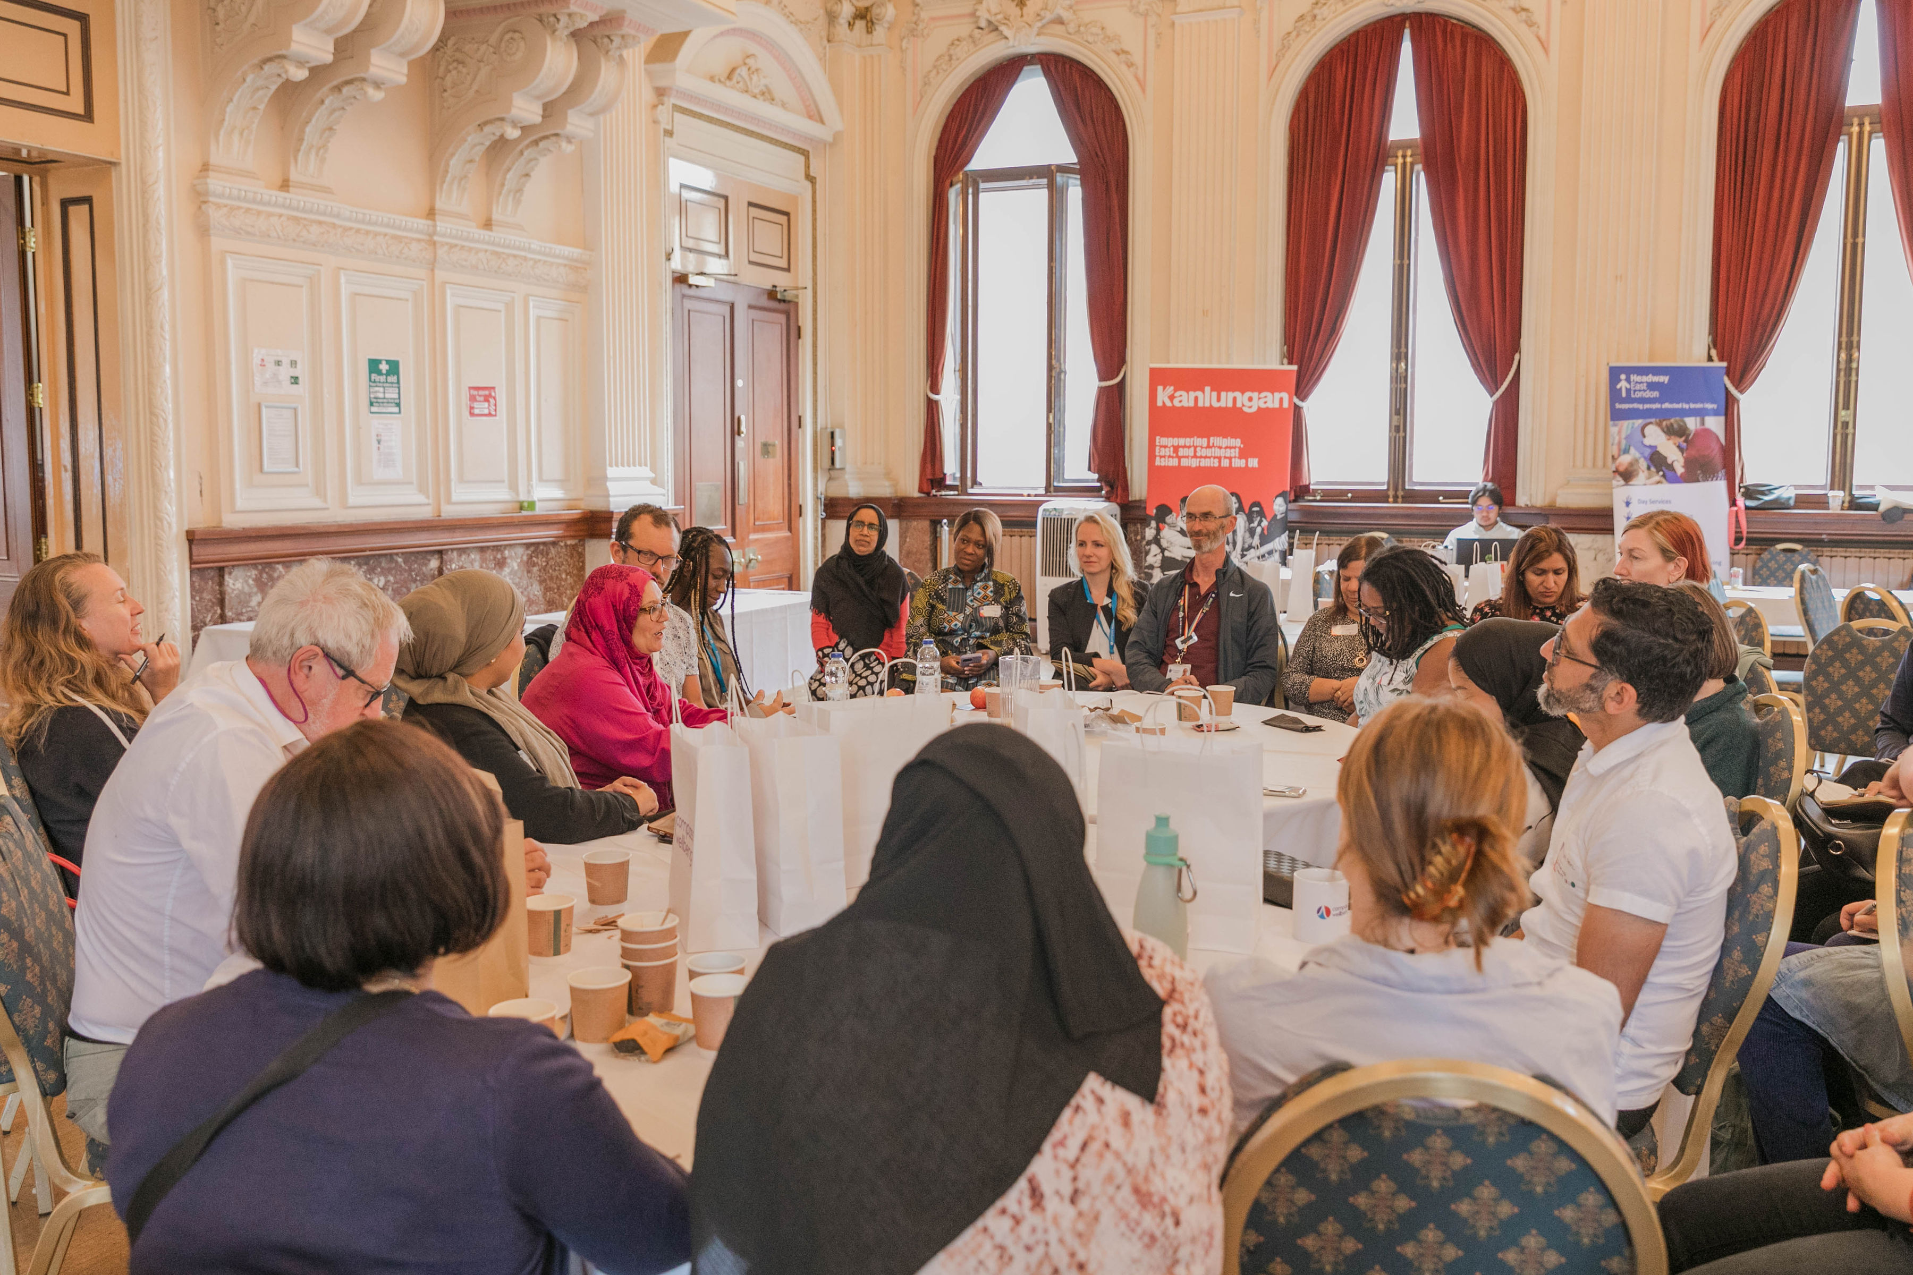
About us

Slide 4
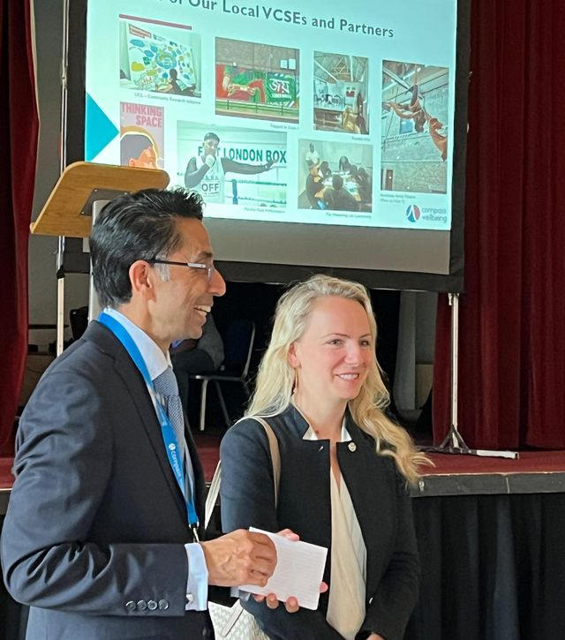
Introduction
Compass Wellbeing CIC is a community interest company (CIC) wholly owned by the East London NHS Foundation Trust (ELFT). We have exciting opportunities to influence the field of social justice, and to promote ELFT’s mission as a Marmot Trust. The Board of Compass Wellbeing has set its aim high and aspires to grow the organisation to deliver a sustainable turnover and significant social impact.
Our mission is to carry the mantel of social justice so that the organisation is able to positively impact on the outcomes for the disadvantaged and vulnerable in society.
We are looking for a motivated individual to lead our Board into the next stage of our development. Ideally we’re looking for an established Board level leader with experience in the social entrepreneurial, voluntary or charity sectors. Are you that person?

Slide 5
Our mission and vision
Mission: Our mission is to reduce inequalities, enhancing community wellbeing and tackling social inequalities. We support the ambition of the East London NHS Foundation Trust to be a Marmot Trust. We work to empower individuals and the third sector through innovation. We strive to bridge these community-focused organisations with institutions like the NHS, advocating for holistic health solutions and fostering resilient, supportive environments for marginalised groups.
Vision: We envisage a future where communities across England are not only empowered but also enjoy a high level of wellbeing and equity. Our foundation in both the VCSE sector and the NHS uniquely positions us to deliver seamless collaboration between the third sector and larger institutions. This leads to robust health and social support systems, ensuring that every individual, especially in under-represented groups, has access to the resources and care they need to thrive.

Slide 6
Our values
Collaboration: We unite with diverse partners to achieve common goals in health and social care, valuing teamwork at the heart of our mission.
Empathy: Our actions are guided by a deep understanding of and compassion for the communities we serve.
Integrity: We lead with openness and honesty, ensuring transparency and inclusivity in our pursuit of social justice and wellbeing.
Quality: Excellence in our services and impact is our priority, ensuring meaningful differences in people’s lives.
Innovation: We are committed to embracing new ideas and approaches in our work, constantly seeking out creative solutions to improve population health outcomes.

Slide 7
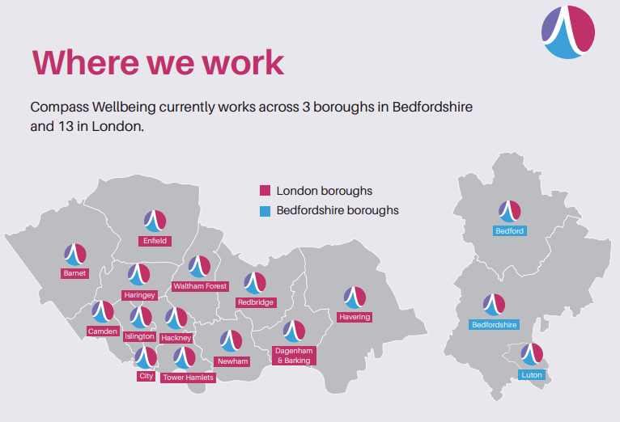
Where we work

Slide 8
Some of our achievements in 2023/24
£5,381,471 of funding passed to VCSEs
94 projects commissioned
3,000+ VCSEs in the Compass Wellbeing network
584 meetings with VCSEs in our network
9 mental health service users completed work placements at Compass Wellbeing
8,000 medical devices serviced
£43,837 of funding managed on behalf of the ELFT Charity

Slide 9
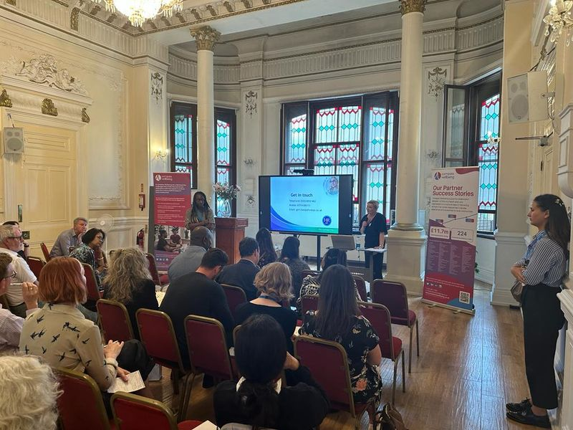
The role of Chair

Slide 10

Role overview
The Chair of Compass Wellbeing is responsible for providing leadership to the Board of Directors of the CIC, and in particular to provide line management support and development to the Chief Executive. The Chair will be expected to ensure that the Board fulfils its scrutiny functions effectively, enabling constructive challenge, monitoring the organisation’s delivery against its objectives, and will be expected to lead by example.
The Chair is responsible for ensuring the running of Board meetings, and for enabling the Board to work effectively ensuring that Board members collaborate and learn from each other’s contributions and expertise. The Chair will be the key link with the ELFT Board and will support the ELFT Board in its appointment of the Chief Executive of Compass Wellbeing.
The Chair will lead by example through compassionate, inclusive and inspirational leadership, and will be expected to ensure that the Board uphold the ethical standards outlined in the Nolan Principles, and demonstrate the values of Compass Wellbeing. In particular, the Chair will be expected to ensure that equity and diversity are promoted across the organisation, to enable those with lived experience of health and care issues to participate fully in the work of the CIC, and to promote good relationships with the organisation’s partners and stakeholders.

Slide 11
Role description
1. Operation of the Compass Wellbeing CIC Board
To work with the Chief Executive of Compass Wellbeing to ensure that appropriate issues are discussed by the Board of Directors in a timely manner, supported by the necessary information and advice, and to ensure that key decisions are made at Board meetings
To ensure the Board can offer independent scrutiny and advice on issues of strategy, vision, performance, resources and standards of conduct and constructively challenge, influence and help management develop proposals on such strategies
To enable Board members to monitor the performance of the organisation in meeting its agreed goals and objectives and its statutory responsibilities, including the preparation of annual reports and annual accounts
To ensure that financial information is accurate, and that financial controls and risk management systems are robust and defensible.
To set up any Board committees and take an active part in determining the membership of any committees established by the Board to exercise delegated responsibilities
2. Relationship with the East London NHS Foundation Trust
To work with the ELFT Board of Directors to ensure the appointment and induction of the Chief Executive of Compass Wellbeing, and to take responsibility for their line management, development and support
To meet with the Chair (or Vice-Chair) of the ELFT Board on a regular basis to update them on any relevant issues
To attend ELFT Board meetings as appropriate, and at least annually when the Compass Wellbeing annual report is presented, to ensure that its obligations to its stakeholders and the wider community are understood and fairly balanced at all times

Slide 12
Role description (2)
3. Board development
To be responsible for leadership of the Board of Directors, ensuring their effectiveness on all aspects of the role and setting their agenda
To assist fellow Directors in providing entrepreneurial leadership to Compass Wellbeing within a framework of prudent and effective controls, which enable risk to be assessed and managed
To assist fellow Directors in setting Compass Wellbeing’s values and standards, and ensure that its obligations to its stakeholders and the wider community are understood and fairly balanced at all times
4. Culture and values
To uphold the values of Compass Wellbeing and to ensure the organisation promotes its articles and shareholder’s interests
To support a positive culture throughout the organisation and adopt behaviours in the Boardroom and elsewhere that exemplify the corporate culture and the Nolan Principles
To ensure the appointment of a safeguarding lead from amongst the other Board members as well as a lead for whistleblowing in the organisation
5. Acting as an ambassador for Compass Wellbeing CIC
To represent the organisation at any required meetings or events nationally, regionally and locally as needed
To harness and develop local and national connections to support the aims and objectives of Compass Wellbeing, and to develop a national and regional profile for the organisation

Slide 13
Role description (3)
6. General responsibilities of all Directors of Compass Wellbeing CIC
To commit to working to, and encouraging within Compass Wellbeing, the highest standards of probity, integrity and governance and contribute to ensuring that the organisation’s governance arrangements conform to best practice and statutory requirements
To support a positive culture throughout Compass Wellbeing and adopt behaviours in the Boardroom and elsewhere that exemplify the corporate culture
To bring independent judgement and experience based on commercial, financial, legal or governance expertise from outside to Compass Wellbeing and apply this to the benefit of the organisation its stakeholders and its wider community
To contribute to the determination of appropriate levels of remuneration for the Chief Executive and senior managers
To assist fellow Directors in providing entrepreneurial leadership to Compass Wellbeing within a framework of prudent and effective controls, which enable risk to be assessed and managed
To assist fellow Directors in setting Compass Wellbeing values and standards and ensure that its obligations to its stakeholders and the wider community are understood and fairly balanced at all times
To engage positively and collaboratively in Board discussion of agenda items
To provide independent judgement and advice on issues of strategy, vision, performance, resources and standards of conduct and constructively challenge, influence and help the management develop proposals on such strategies
In accordance with agreed Board procedures, monitor the performance and conduct of management in meeting agreed goals and objectives and statutory responsibilities, including the preparation of annual reports and annual accounts and other statutory duties

Slide 14
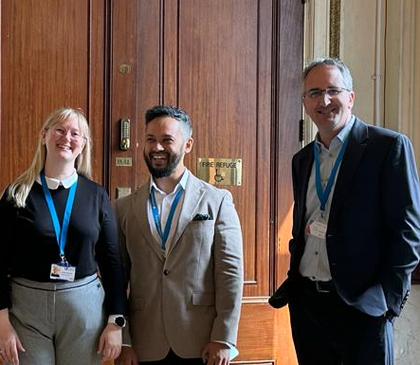
Candidate profile
Board level leadership experience within a public facing organisation
Experience of chairing Boards
Understanding of good governance and performance management of non-executive directors and CEOs
Ability to work collaboratively with, learn from, and build on the contributions and expertise of Board colleagues
Be skilled in asking open questions that create discussion
Highly organised, with timely and clear communication
The ability to think strategically and plan ahead, balancing needs and constraints
Be aligned to the values and mission of Compass Wellbeing CIC
Track record of improving services through service user engagement and co-production
Knowledge and experience of the ethical standards detailed in the Nolan Principles
Demonstrable and active commitment to the Compass Wellbeing values of courage, collaboration, integrity and inclusion
A high level of commitment to the community, especially to disadvantaged groups
Have a social entrepreneurial approach
Understand what it is like to run a small business, charity or non-profit organisation with a social mission
Have expertise of leading an organisation through growth
Understand and have practiced organisational design
Understand the context of our work, i.e. socio-economic factors, population health, Marmot principles
Have experience of overseeing or supporting co-production in service delivery
Understand the role of innovation and technologies in shaping the not-for-profit sector
A champion for the organisation
Well-networked in the health, public services or local government commissioning sectors
Willingness to use professional networks in support of our mission
Ability to represent Compass Wellbeing on external bodies or at external events
Support the senior team
Have experience of guiding senior leaders, helping them achieve their potential
Understand how to operate in a system-influencing way and be able to articulate this
Ability to signpost senior leaders to people and resources that help them solve their challenges
Experience of performance management processes

Slide 15
Additional information
Appointment and tenure of office
This appointment will be for a period of up to three years, subject to the satisfactory completion of the induction period and thereafter subject to satisfactory annual performance review. A further term of appointment can be considered at the end of the first period of office subject to consistently good performance and the needs of the organisation.
Time commitment
The Chair will be expected to devote roughly two days per month to the role. This will comprise a mixture of set commitments and more flexible arrangements for ad hoc events, reading and preparation. A degree of flexibility will be needed and some time commitment may also be required during the evening.
Remuneration
Competitive and will be on a per diem basis.
Fit & Proper Persons Test for Directors in the NHS
It is essential that those appointed inspire confidence of the public, patients, service users, carers and NHS staff at all times. A number of specific background checks will therefore be undertaken to ensure that those appointed are ‘fit and proper’ people to hold this important role. All candidates will be required to complete a self-declaration that they meet the requirements of the Fit & Proper Persons Test regulations; and the successful candidate will be required to meet these regulations on a continuing basis.
Support, induction and training
Compass Wellbeing will organise appropriate induction and training for the successful candidate. Board Directors have access to independent professional advice, at the CIC’s expense, where they judge it necessary to discharge their responsibility.

Slide 16
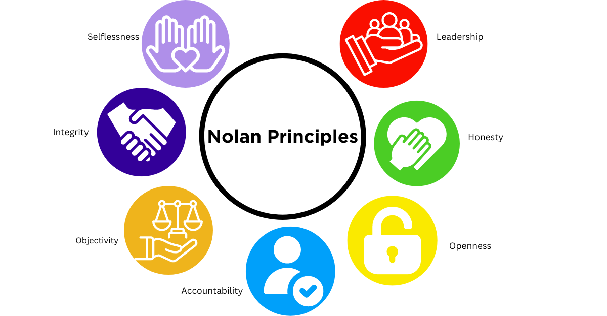
The Nolan Principles
Further detail on the seven Nolan Principles of Public Life can be found on: https://www.gov.uk/government/publications/the-7-principles-of-public-life

Slide 17
Delivering on ELFT’s commitment to be a Marmot Trust
To achieve its strategic ambition of improved population health, ELFT is working to become the first NHS ‘Marmot Trust’ and test the boundaries of what an NHS Trust can do to tackle some of the drivers of poor health, such as poverty and unemployment.
As a mental health, community service, and primary care provider, ELFT often sees service users whose conditions are caused or made worse by poverty, insecure jobs and living conditions. People with severe mental illness (SMI) are dying 15-20 years earlier than they should. NHS Trusts do not usually have the opportunity to try to influence these building blocks of health, as efforts are wholly usually focused on reactively delivering clinical care.
We see Compass Wellbeing as one of the key delivery vehicles for our ambitions around being a Marmot Trust. Compass’s work with the voluntary and community sector, on medical devices, and on employment for those with SMI are prime examples of the innovation that has come from working through a community interest company.
The Marmot principles are evidence-based policy objectives to reduce health inequalities, which were originally set out in Professor Sir Michael Marmot’s review “Fair Society Healthy Lives” published in 2010 (and amended to include Principles 7 and 8 more recently):
Give every child the best start in life
Enable all children, young people and adults to maximise their capabilities and have control over their lives
Create fair employment and good work for all
Ensure a healthy standard of living for all
Create and develop healthy and sustainable places and communities
Strengthen the role and impact of ill health prevention
Tackle racism and its outcomes
Tackle climate change and health equity in unison

Slide 18

Recruitment timeline
24 June 2024
30 July 2024 (tbc)
Applications open for the post of Chair
Stakeholder panel – details to be confirmed (on line via MS Teams)
12 July 2024
31 July 2024
Closing date for applications (12 noon closing time).
Date of interview – which will be face to face at Compass Wellbeing’s offices

Slide 19
How to apply
If you wish to be considered for this role, please provide:
Answers to the three application questions in no more than 500 words per question:
A comprehensive CV that includes your address and contact details, with full employment history as well as highlighting and explaining any gaps
The names, positions, organisations and contact details of two referees, one of which should be from a recent employment or volunteering role. Your references will be taken prior to interview and may be shared with the interview panel. References will not be taken without your permission
A completed Fit & Proper Person Test self-declaration form.
All applications should be sent via email to elft.compass@nhs.net by 12 noon on 12 July 2024
Question 1: Your experience in relation to the essential requirements of this role, focusing on your experience as a Chair, Trustee, Director or Board member and your experience of the voluntary, community or social enterprise sectors
Question 2: Your motivation for applying
Question 3: How you have demonstrated a commitment to equality, diversity and inclusion

Slide 20

Thank you for your interest
If you are interested in applying for this exciting role, please submit your application to elft.compass@nhs.net by 12 noon on Friday 12 July 2024.
If you wish to have an informal chat about the role, please contact Compass Wellbeing CIC interim Chief Executive, Simon Hall, via s.hall49@nhs.net to arrange an appropriate time to speak.
https://compasswellbeing.co.uk/
https://www.elft.nhs.uk/

