Slide 1

EQUALITY, DIVERSITY, AND INCLUSION
Workforce Equality Report
Author: Juliana Ansah, Head of EDI
Accountable Director Tanya Carter, Chief People Officer
2024

Slide 2
ELFT WORKFORCE RACE EQUALITY STANDARD (WRES)
Contents
High Impact Action Plan Targets
Workforce Race Equality Standard (WRES)
Workforce Disability Equality Standard (WDES)
WRES/WDES Staff Survey Analysis

Slide 3
ELFT WORKFORCE EQUALITY STANDARD (WES)
Introduction
East London NHS Foundation Trust wishes its staff to work in a safe and healthy environment which is inclusive and fair and where each employee feels respected and is encouraged to develop their full potential.
We are committed to meeting the requirements of the Workforce Equality Standard for NHS Trusts’ and to reporting the outcomes of all equality surveys. This report outlines our workforce equality data for 2024 as per our contractual obligations for:
NHS High Impact Equality Plan
Workforce Race Equality Standard (WRES)
Workforce Disability Equality Standard (WDES)
To ensure that this report plays a key role in our journey towards becoming an anti-racist, anti-discriminatory organisation, we have aligned action plans into four themes to reflect the Trust’s People Strategy.
New Ways of Works
Looking After Our People
Belonging in the NHS
Growing and Developing for the Future

Slide 4
Monitoring and Evaluation
The plan is designed to achieve a significant, measurable, change in advancing equality of opportunity for all staff coming into contact with the organisation.
The action plan will be monitored by the Equality Programme Board and reported to the Trust People and Culture Committee for end of year assessment and evaluation.
The Trust is required to ensure it complies with the law around equality, diversity and inclusion as well as NHS England’s requirements for NHS organisations. This means ensuring compliance with:
• Equality Act 2010
• Public Sector Equality Duty (PSED)
• NHS Five Year Forward View for Mental Health
• Equality Delivery System 2 (EDS)
• NHS Workforce Race Equality Standard (WRES)
• NHS National Staff Survey
• Sexual Orientation Monitoring Information Standard
• NHS Workforce Disability Equality Standard (WDES)
• Gender Pay Gap reporting
• Accessible Information Standard

Slide 5
ELFT WORKFORCE DEMOGRAPHIC
April 2023- March 2024

Slide 6
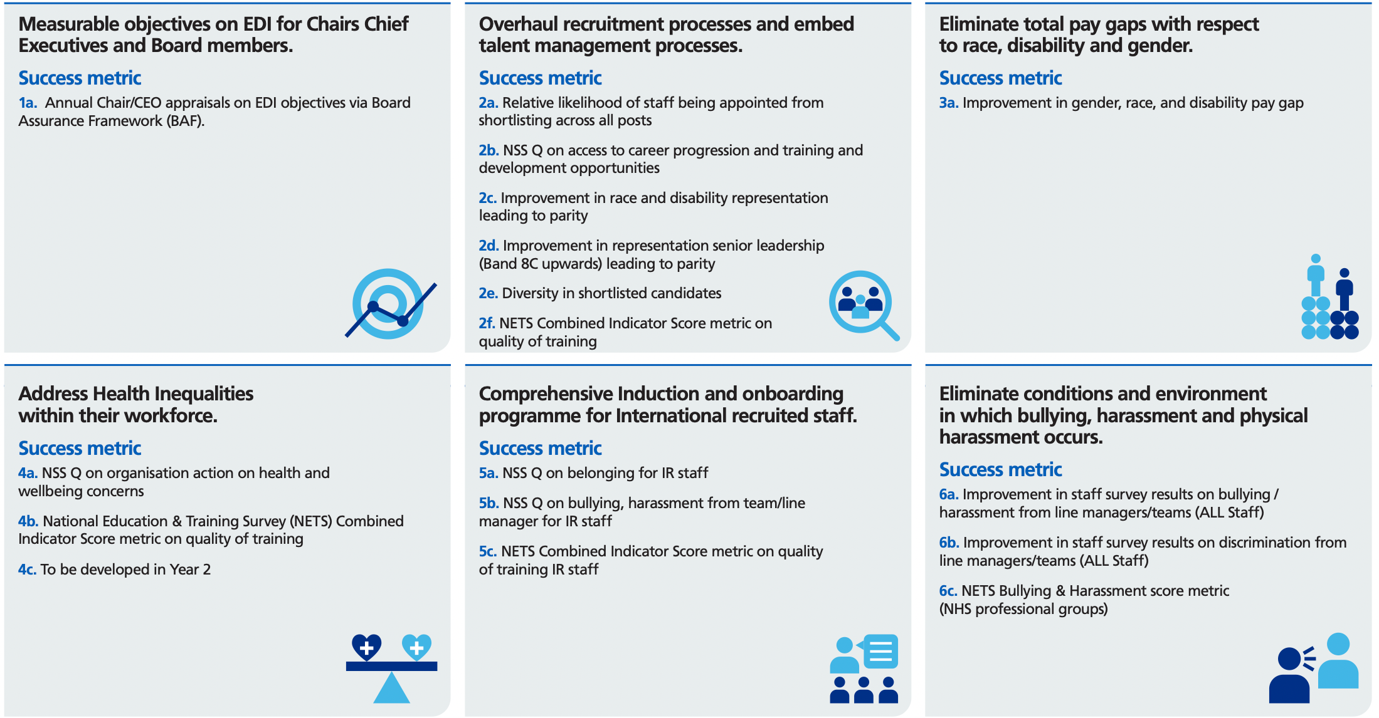
HIGH IMPACT INTERVENTIONS
1
2
3
Measurable objectives on EDI for Chairs, Chief Executives and Board members.
Overhaul recruitment processes and embed talent management processes.
Eliminate total pay gaps with respect to race, disability and gender.
4
5
Comprehensive Induction and onboarding programme for staff.
6
Eliminate conditions and environment
in which bullying, harassment and physical harassment occurs.
Address Health Inequalities within the workforce.

Slide 7
EDI targets for Intersectionality
ELFT's position on the following indicators ranked among the worst nationally in the 2022 NHS Staff Survey, irrespective of protected characteristics. The projected data reflects anticipated improvements based on focused initiatives.
Indicators from NHS National Staff Survey | 2023 | 2024
 | Actual | Estimate | Actual
Increase confidence in reporting of harassment, bullying or abuse experienced at work | 54.7% | 57% | 61.3%
Reduce experience of discrimination from line managers and colleagues | 13.4% | 11% | 10.2%
Improve fair experience to career progression, training and development opportunities | 57.7% | 60% | 59.6%
Reduce experience of musculoskeletal problems (MSK) as a result of work activities | 29.2% | 26% | 25.8%
Trust Strategy
Staff Experience

Slide 8
EDI Targets by protected characteristic
Protected Characteristics | Indicators from multiple sources | 2023 | 2024
 |  | Actual | Target | Actual
Age | Reduce experience of discrimination due to age | 17.76% | 19% | 10.31%
Religion or belief | Reduce experience of discrimination due to religion or belief | 15.02% | 8% | 11.15%
Sex and pregnancy and maternity | Reduce gender pay gap (median) | 4.8% | 4.5% | 1.12%
Gender reassignment and sexual orientation | Improve position on Stonewall Index (postponed until 2025) | 210 | Top 200 | -
Disability (WDES) | Improve ESR declaration rates for disabled staff | 7.3% | 8% | 7.5%
 | Reduce likelihood of disabled staff entering the formal capability process, compared to that of Non-disabled staff | 11.6 | 5.5 | 3.8
 | Increase percentage of Disabled staff saying that their employer has made adequate adjustment(s) to enable them to carry out their work | 71% | 76% | 76.4%
Race (WRES) | Reduce relative likelihood of BME staff entering formal disciplinary | 2.9 | 1.5 | 2.1
 | Equalise relative likelihood of white staff being appointed from shortlisting across all posts, compared to BME staff | 1.4 | 1.3 | 1.25
 | Reduce percentage of clinical BME staff experiencing harassment, bullying or abuse from patients, relatives or the public | 35.9% | 33% | 33%
Trust Strategy
Staff Experience

Slide 9
ELFT Workforce Race Equality Standard (WRES) 2023

Slide 10
WORKFORCE RACE EQUALITY STANDARD (WRES) REPORT
Workforce Metric 1
The following metric shows the representation of BME staff. Definitions are based on Electronic Staff Record (ESR) occupation codes, with the exception of medical and dental staff, which are based upon grade codes.
Metric 1 - Staff Representation |  | 2023 | 2024 |  | Comment
Percentage of BME staff in each of the AfC bands 1 - 9 or medical and dental subgroups and VSM (including executive board members) compared with the percentage of staff in the overall workforce. | Overall BME Percentage | 55.4% | 57.4% | ↑ | The arrows in this section illustrate the changes in BME representation since the previous year's reporting. These changes help us understand trends and identify areas for improvement in our recruitment and career progression processes. While our recruitment processes are designed to be as fair as possible, we recognise that disparities can still exist. The data presented here is crucial for highlighting where racial disparity may be occurring within our Trust. By analysing these trends, we can better target our career progression initiatives to support underrepresented groups and promote equity within the Trust. Medical and Dental Trainees It is important to note that Medical and Dental Trainees are allocated to the Trust through external processes over which we have no control. Although there has been a slight variation in the representation of BME trainees since the 2023 reporting, this is due to the allocation process rather than our internal recruitment practices.
 | Non-clinical Band 1 - 4 | 57.9% | 61.2% | ↑
 | Non-clinical Band 5 - 7 | 56.6% | 57.3% | ↑
 | Non-clinical Band 8A - 8B | 38.7% | 42.0% | ↑
 | Non-clinical Band 8C - VSM | 28.1% | 33.3% | ↑
 | Clinical Band 1 - 4 | 67.7% | 70.2% | ↑
 | Clinical Band 5 - 7 | 56.5% | 58.2% | ↑
 | Clinical Band 8A - 8B | 36.4% | 37.8% | ↑
 | Clinical Band 8C - VSM | 22.50% | 22.1% | —
 | Medical and Dental Consultants | 42.3% | 42.7% | —
 | Medical and Dental Non-Consultants | 58.7% | 68.9% | ↑
 | Medical and Dental Trainees | 56.2% | 54.0% | ↓
↓ Decreased ↑ Increased — No Change

Slide 11
WORKFORCE RACE EQUALITY STANDARD (WRES) REPORT
Workforce Metric 2 & 3
The following metric shows the relative likelihood for BME staff across all posts.
Metric 2 - Recruitment | 2023 | 2024 |  | Comment
Relative likelihood of White staff being appointed from shortlisting across all posts (A figure below 1.00 indicates that BME staff are more likely than white staff to be appointed from shortlisting) | 1.40 | 1.25 | ↑
Metric 3 - Disciplinary | 2023 | 2024 |  | Comments
Relative likelihood of staff entering the formal disciplinary process, as measured by entry into a formal disciplinary investigation Note: This indicator will be based on data from a two-year rolling average of the current year and the previous year. | 2.91 | 2.11 | ↑ | Headcount: White: 2023= 11 2024= 17 BME: 2023= 41 2024= 50 Unknown: 2023= 0 2024 = <5 Note: This indicator is based on year end data. It was previously collected 2 year rolling.
↓ Needs Improvement ↑ Improved — No Change

Slide 12
WORKFORCE RACE EQUALITY STANDARD (WRES) REPORT
Training Access Metric 4
The following metric shows the relative likelihood of BME staff accessing non-mandatory training and CPD.
Metric 4 - CPD | 2023 | 2024 |  | Comment
Relative likelihood of staff accessing non-mandatory training and CPD (A figure below 1.00 indicates that BME staff are more likely than white staff to be appointed from shortlisting) | 0.90 | 0.92 | —
↓ Needs Improvement ↑ Improved — No Change

Slide 13
WORKFORCE RACE EQUALITY STANDARD (WRES) REPORT
National NHS Staff Survey Metric 5 & 6
The following Staff Survey Metrics, compare the responses for both BME and white staff
Metric 5 - Bullying and Harassment |  | 2022 | 2023 | 2024 |  | Comment
KF25. Percentage of staff experiencing harassment, bullying or abuse from patients, relatives or the public in last 12 months | BME | 30% | 35.9 | 33% | ↑ | This metric was identified as a priority area in our previous 2023 reporting, where we observed an equity gap of 9.1% between white and BME staff. There has been a slight improvement, and the equity gap now stands at 8.2%.
 | White | 33% | 26.8% | 24.8% | ↑
Metric 6 - Bullying and Harassment |  | 2022 | 2023 | 2024 |  | Comment
KF26. Percentage of staff experiencing harassment, bullying or abuse from staff in last 12 months. | BME | 22% | 22.4% | 19% | ↑ | In 2022 the data showed a 1% equity gap for this metric. This then rose to an equity gap of 5.2% between white and BME staff in 2023. There has been a slight improvement, and the equity gap now stands at 4.7%. BME staff in Specialist Services reported the largest gaps in experience between white and BME staff.
 | White | 21% | 27.6% | 14.2% | ↑
↓ Needs Improvement ↑ Improved — No Change

Slide 14
WORKFORCE RACE EQUALITY STANDARD (WRES) REPORT
National NHS Staff Survey Metric 7 & 8
The following Staff Survey Metrics, compare the responses for both BME and white staff
Metric 7 - Career Progression |  | 2022 | 2023 | 2024 |  | Comment
KF21. Percentage believing that trust provides equal opportunities for career progression or promotion | BME | 50% | 48.2% | 52.7% | ↑ | There has been a noteworthy change since our last reporting cycle. In 2023, the equity gap stood at 15.1%, but it has now decreased to 7.5%. BME staff across the age groups of 66+ and 21-30 years old reported the highest levels of belief that the Trust provides equal opportunities for career progression.
 | White | 61% | 63.3% | 60.2% | ↓
Metric 8 – Discrimination |  | 2021 | 2022 | 2024 |  | Comment
Q17. In the last 12 months have you personally experienced discrimination at work from any of the following? b) Manager/team leader or other colleagues | BME | 15% | 17.2% | 12.6% | ↑ | Overall, this metric has increased each year since reporting began. This is the first year an improvement has been recorded. The equity gap was 6.9% in 2023 and is now 5% in 2023. BME staff working in Primary Care and and Forensics have reported the highest numbers of discrimination for this metric.
 | White | 9% | 10.3% | 7.6% | ↑
↓ Needs Improvement ↑ Improved — No Change

Slide 15
WORKFORCE RACE EQUALITY STANDARD (WRES) REPORT
Board Representation - Metric 9
This metric shows the percentage of BME staff on the organisations Board.
Metric 9 – Board Representation |  | 2023 | 2024 |  | Comment
Percentage difference between the organisations’ Board voting membership and its overall workforce. Note: Only voting members of the Board should be included when considering this indicator. | Overall Trust Board | 50% | 42.1% | ↓ | Nationally ELFT were ranked best 5% overall in 2021 and 2022. All Board members are encouraged to complete their diversity data; and Staff Networks members continue to be involves in the Non-Executive and Executive recruitment process. 2023 has seen a decrease in BME Board representation.
 | Voting Membership | 50% | 41.2% | ↓
 | Non-voting Executives | 50% | 50% | —
 | Executive Team | 60% | 50% | ↓
 | Non-executive Team | 37.5% | 33.3% | ↓
 | Difference (Total Board -Overall workforce ) | -5.4% | -15% | ↓
↓ Needs Improvement ↑ Improved — No Change

Slide 16
ELFT Workforce Disability Equality Standard (WDES) 2023

Slide 17
WORKFORCE DISABILITY EQUALITY STANDARD (WDES) REPORT
Workforce Metric 1
The following metric shows the representation of Disabled staff. Definitions are based on Electronic Staff Record (ESR) occupation codes, with the exception of medical and dental staff, which are based upon grade codes.
Metric 1 - Staff Representation |  | 2023 | 2024 |  | Comment
Percentage of staff in each of the AfC bands 1 - 9 or medical and dental subgroups and VSM (including executive board members) compared with the percentage of staff in the overall workforce. | Overall BME Percentage | 7.3% | 7.52% | ↑ | The arrows in this section illustrate the changes in BME representation since the previous year's reporting. These changes help us understand trends and identify areas for improvement in our recruitment and career progression processes. While our recruitment processes are designed to be as fair as possible, we recognise that disparities can still exist. The data presented here is crucial for highlighting where racial disparity may be occurring within our Trust. By analysing these trends, we can better target our career progression initiatives to support underrepresented groups and promote equity within the Trust. Medical and Dental Trainees It is important to note that Medical and Dental Trainees are allocated to the Trust through external processes over which we have no control. Although there has been a slight variation in the representation of BME trainees since the 2023 reporting, this is due to the allocation process rather than our internal recruitment practices.
 | Non-clinical Band 1 - 4 | 7.8% | 8.8% | ↑
 | Non-clinical Band 5 - 7 | 9.7% | 8.8% | ↓
 | Non-clinical Band 8A - 8B | 9% | 9.3% | ↑
 | Non-clinical Band 8C - VSM | 9% | 7.3% | ↓
 | Clinical Band 1 - 4 | 7.8% | 8% | ↑
 | Clinical Band 5 - 7 | 7.4% | 7.6% | ↑
 | Clinical Band 8A - 8B | 4.8% | 5.2% | ↑
 | Clinical Band 8C - VSM | 5.9% | 4.8% | ↓
 | Medical and Dental Consultants | 3.7% | 2.82% | ↓
 | Medical and Dental Non-Consultants | 6.7% | 8.40% | ↑
 | Medical and Dental Trainees | 4.9% | 5.59% | ↑
↓ Decreased ↑ Increased — No Change

Slide 18
WORKFORCE DISABILITY EQUALITY STANDARD (WDES) REPORT
Workforce Metric 2 & 3
The following metrics compares the difference for Disabled and non-disabled staff.
Metric 2 | 2023 | 2024 |  | Comment
Relative likelihood of Non-disabled staff being appointed from shortlisting compared to that of Disabled staff being appointed from shortlisting across all posts (A figure below 1.00 indicates that disabled staff are more likely than non- disabled staff to be appointed from shortlisting) | 0.7 | 1.1 | —
Metric 3 | 2023 | 2024 |  | Comment
Relative likelihood of disabled staff entering the formal capability process, compared to that of Non-disabled staff, as measured by entry into a formal capability procedure (A figure above 1.00 indicates that disabled staff are more likely than non- disabled staff to enter the formal capability process) | 11.65 | 3.82 | ↑
↓ Needs Improvement ↑ Improved — No Change

Slide 19
WORKFORCE DISABILITY EQUALITY STANDARD (WDES) REPORT
National NHS Staff Survey Metric 4
The following Staff Survey Metrics, compare the responses for both Disabled and non-disabled staff.
Metric 4 – Staff Survey Q.13a-d |  |  | 2022 | 2023 | 2024 |  | Comments
Percentage of staff experiencing harassment, bullying or abuse | 4a % experiencing harassment, bullying or abuse from Patients/service user, their relatives or members of the public in the last 12 months | Disabled | 34% | 35% | 37.8% | ↓ | Metric 4a was a 2023 priority for the Trust after placing in the bottom 10% nationally. In 2023 the equity gap was 5.3% between disabled and non-disabled staff. In 2024 this gap has seen significant improvement and is now 0.8%. Metric 4b was also identified as a priority in 2023 reporting. The equity gap has since improved from 8% to 5.3% in 2024. Nursing staff, Medical staff, and staff aged 66+ with disabilities are reporting the highest experiences of harassment, bullying or abuse across metrics 4a-4c. Although there has been an increase for both disabled and non-disabled staff reporting incidents of harassment, the equity gap has widened slightly from 1.2% in 2023, to 2% in 2024 reporting. Disabled staff aged 21-30 are reported as the highest group answering yes for this metric; staff aged 66+ are the lowest.
 |  | Non- Disabled | 30% | 30% | 38.7% | ↓
 | 4b % experiencing harassment, bullying or abuse from managers in the last 12 months | Disabled | 18% | 20% | 14.2% | ↑
 |  | Non- Disabled | 9% | 12% | 9% | ↑
 | 4c % of staff experiencing harassment, bullying or abuse from other colleagues in the last 12 months | Disabled | 23% | 26% | 23.1% | ↑
 |  | Non- Disabled | 14% | 16% | 14.6% | ↑
 | 4d % of staff saying that the last time they experienced harassment, bullying or abuse at work, they or a colleague reported it in the last 12 month | Disabled | 60% | 56% | 59.9% | ↑
 |  | Non- Disabled | 64% | 57% | 61.9% | ↑
↓ Needs Improvement ↑ Improved — No Change

Slide 20
WORKFORCE DISABILITY EQUALITY STANDARD (WDES) REPORT
National NHS Staff Survey Metric 5 & 6
The following Staff Survey Metrics, compare the responses for both Disabled and non-disabled staff
Metric 5 – Staff Survey Q.14 |  | 2022 | 2023 | 2024 |  | Comment
Percentage of Disabled staff compared to non-disabled staff believing that the Trust provides equal opportunities for career progression or promotion. | Disabled | 50% | 51% | 53.9% | ↑ | There have been notable improvements for disabled staff in this metric. In 2022, the equity gap stood at 8.3%, 2024, the gap has decreased to 3.6%. Disabled staff working in Community Health Services (Tower Hamlets, Specialist, Bedfordshire) reported the highest number of staff answering yes. However, disabled staff aged 21-30 and over 50 across the Trust represent the lowest yes responses.
 | Non- Disabled | 58% | 59% | 57.5% | ↓
Metric 6 – Staff Survey Q.11e |  | 2022 | 2023 | 2024 |  | Comment
Percentage of Disabled staff compared to non-disabled staff saying that they have felt pressure from their manager to come to work, despite not feeling well enough to perform their duties. | Disabled | 23% | 25% | 21.2% | ↑ | This metric has improved for all staff across the Trust. The equity gap has decreased from 8% in 2023 to 5.8% in 2024. Disabled staff working in Forensics services represent more than twice the Trust average for this metric (40% and 17% respectively).
 | Non- Disabled | 17% | 17% | 15.4% | ↑
↓ Needs Improvement ↑ Improved — No Change

Slide 21
WORKFORCE DISABILITY EQUALITY STANDARD (WDES) REPORT
National NHS Staff Survey Metric 7 & 8
The following Staff Survey Metrics, compare the responses for both Disabled and non-disabled staff
Metric 7 – Staff Survey Q.5f |  | 2022 | 2023 | 2024 |  | Comment
Percentage of Disabled staff compared to non-disabled staff saying that they are satisfied with the extent to which their organisation values their work. | Disabled | 47% | 43% | 49.3% | ↑ | In 2023 the equity gap was 10.5% between disabled and non-disabled staff. This gap has since decreased to 8.8% in 2024 reporting. Disabled staff reporting the highest for this metric include Nursing and Midwifery staff; age groups 21-30 and 51-65; and Specialist CHS.
 | Non- Disabled | 56% | 54% | 58.1% | ↑
Metric 8 – Staff Survey Q.26b | 2022 | 2023 | 2024 |  | Comment
Percentage of Disabled staff saying that their employer has made adequate adjustment(s) to enable them to carry out their work. | 76% | 71% | 76.4% | ↑ | This metric was identified as a priority in 2023. Disabled staff aged 51+ have reported the highest for this metric. Staff aged 31-50 have reported the lowest.
↓ Needs Improvement ↑ Improved — No Change

Slide 22
WORKFORCE DISABILITY EQUALITY STANDARD (WDES) REPORT
NHS Staff Survey and the engagement of Disabled staff – Metric 9a & 9b
Metric 9a compares the difference for Disabled and non-disabled staff (9a); and 9b is collection of evidence.
Metric 9a |  | 2022 | 2023 |  | Comment
The staff engagement score for Disabled staff, compared to non-disabled staff and the overall engagement score for the organisation. | Disabled | 6.7 | 6.96 | ↑ | The engagement score has improved across the Trust and particularly for disabled staff. The equity gap was 0.62 points in 2023 and is now 0.5 points difference. Engagement score for disabled staff in Bedford and Specialist CHS are higher than the overall Trust score.
 | Non- Disabled | 7.33 | 7.46 | ↑
Metric 9b | 2022 | 2023 |  | Comment
Has your Trust taken action to facilitate the voices of Disabled staff in your organisation to be heard? | YES | YES | —
↓ Needs Improvement ↑ Improved — No Change

Slide 23
WORKFORCE DISABILITY EQUALITY STANDARD (WDES) REPORT
Board Representation - Metric 10
This metric compares the difference for Disabled and non-disabled staff.
Metric 10 |  | 2023 | 2024 |  | Comments
Percentage difference between the organisation’s Board voting membership and its organisation’s overall workforce, disaggregated: By Voting membership of the Board By Executive membership of the Board | Total Board members | 11.11% | 15.79% | ↑ | Board members are encouraged to declare their disabilities and lead in communication campaigns around this topic.
 | Voting Board members | 12.5% | 11.76% | ↓
 | Non-Voting Board members | 0.0% | 50% | ↑
 | Exec Board members | 10.0% | 18.18% | ↑
 | Non-Executive Board members | 12.32% | 12.5% | ↑
 | Difference (Total Board - Overall workforce) | 3.79% | 8% | ↑
 | Difference (Voting membership - Overall Workforce) | 5.18% | 4% | ↓
 | Difference (Executive membership - Overall Workforce) | 2.68% | 11% | ↑
↓ Needs Improvement ↑ Improved — No Change

Slide 24
EQUALITY, DIVERSITY, AND INCLUSION
Staff Survey Metrics
Workforce Race Equality Standard Metric 5 – 8
Workforce Disability Equality Standard Metric 4 - 9
These metrics are taken from the 2023 NHS Staff Survey but are reported in the 2024 Workforce Equality Reports.
2023

Slide 25
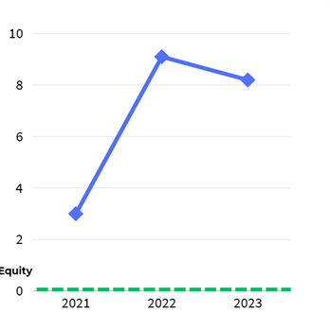
WRES Metric 5
2022 Priority
Percentage of BME staff experiencing harassment, bullying or abuse from patients, relatives or the public in last 12 months
 | 2021​ | 2022​ | 2023
BME​ | 30%​ | 35.9​% | 33%​
White​ | 33%​ | 26.8%​ | 24.8%​
Equity Gap | 3% | 9.1% | 8.2%

Slide 26
WORKFORCE RACE EQUALITY STANDARD (WRES) REPORT
National NHS Staff Survey: WRES Metric 5
Percentage of BME staff experiencing harassment, bullying or abuse from patients, relatives or the public in last 12 months
Black, Asian, and minority ethnic staff
White staff
* Estate and Ancillary data too low to compare

Slide 27
WORKFORCE RACE EQUALITY STANDARD (WRES) REPORT
National NHS Staff Survey: WRES Metric 5
Percentage of BME staff experiencing harassment, bullying or abuse from patients, relatives or the public in last 12 months
Other
Black, Asian, and minority ethnic staff
White staff

Slide 28
WORKFORCE RACE EQUALITY STANDARD (WRES) REPORT
National NHS Staff Survey: WRES Metric 5
Percentage of BME staff experiencing harassment, bullying or abuse from patients, relatives or the public in last 12 months
Black, Asian, and minority ethnic staff
White staff

Slide 29
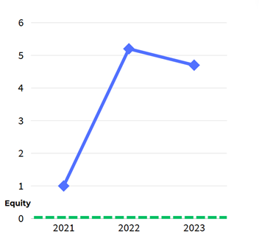
WRES Metric 6
Percentage of BME staff experiencing harassment, bullying or abuse from staff in last 12 months.
 | 2021​ | 2022​ | 2023
BME​ | 22%​ | 27.6%​ | 23.6%​
White​ | 21%​ | 22.4%​ | 18.9%​
Equity Gap | 1% | 5.2% | 4.7%

Slide 30
WORKFORCE RACE EQUALITY STANDARD (WRES) REPORT
National NHS Staff Survey: WRES Metric 6
Percentage of BME staff experiencing harassment, bullying or abuse from staff in last 12 months
Black, Asian, and minority ethnic staff
White staff
* Estate and Ancillary data too low to compare

Slide 31
WORKFORCE RACE EQUALITY STANDARD (WRES) REPORT
National NHS Staff Survey: WRES Metric 6
Percentage of BME staff experiencing harassment, bullying or abuse from staff in last 12 months
Other
Black, Asian, and minority ethnic staff
White staff

Slide 32
WORKFORCE RACE EQUALITY STANDARD (WRES) REPORT
National NHS Staff Survey: WRES Metric 6
Percentage of BME staff experiencing harassment, bullying or abuse from staff in last 12 months
Black, Asian, and minority ethnic staff
White staff

Slide 33
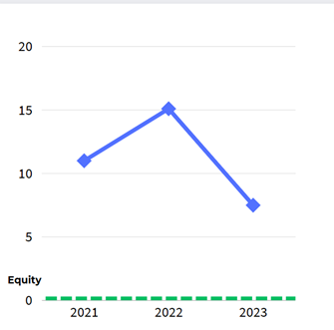
WRES Metric 7
Percentage believing that trust provides equal opportunities for career progression or promotion
 | 2021​ | 2022​ | 2023​
BME​ | 50%​ | 48.2%​ | 52.7%​
White​ | 61%​ | 63.3%​ | 60.2%​
Equity Gap | 11% | 15.1% | 7.5%

Slide 34
WORKFORCE RACE EQUALITY STANDARD (WRES) REPORT
National NHS Staff Survey: WRES Metric 7
Percentage of BME staff believing that trust provides equal opportunities for career progression or promotion
Black, Asian, and minority ethnic staff
White staff
* Estate and Ancillary data too low to compare

Slide 35
WORKFORCE RACE EQUALITY STANDARD (WRES) REPORT
National NHS Staff Survey: WRES Metric 7
Percentage of BME staff believing that trust provides equal opportunities for career progression or promotion
Other
Black, Asian, and minority ethnic staff
White staff

Slide 36
WORKFORCE RACE EQUALITY STANDARD (WRES) REPORT
National NHS Staff Survey: WRES Metric 7
Percentage believing that trust provides equal opportunities for career progression or promotion
Black, Asian, and minority ethnic staff
White staff

Slide 37
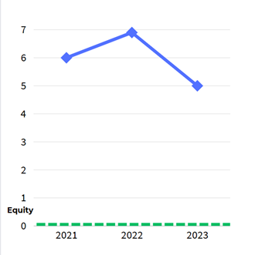
WRES Metric 8
In the last 12 months have you personally experienced discrimination at work from any of the following?
b) Manager/team leader or other colleagues
 | 2021​ | 2022​ | 2023​
BME​ | 15%​ | 17.2%​ | 12.6%​
White​ | 9%​ | 10.3%​ | 7.6%​
Equity Gap | 6% | 6.9% | 5%

Slide 38
WORKFORCE RACE EQUALITY STANDARD (WRES) REPORT
National NHS Staff Survey: WRES Metric 8
Percentage of BME staff experiencing discrimination from Manager/team leader or other colleagues in last 12 months
Black, Asian, and minority ethnic staff
White staff
* Estate and Ancillary data too low to compare

Slide 39
WORKFORCE RACE EQUALITY STANDARD (WRES) REPORT
National NHS Staff Survey: WRES Metric 8
Percentage of BME staff experiencing discrimination from Manager/team leader or other colleagues in last 12 months
Other
Black, Asian, and minority ethnic staff
White staff

Slide 40
WORKFORCE RACE EQUALITY STANDARD (WRES) REPORT
National NHS Staff Survey: WRES Metric 8
Percentage of BME staff experiencing discrimination from Manager/team leader or other colleagues in last 12 months
Black, Asian, and minority ethnic staff
White staff

Slide 41
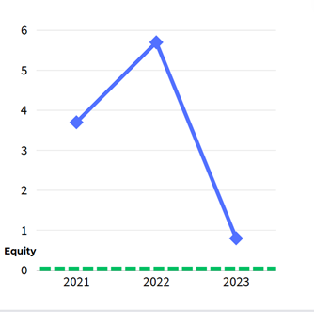
WDES Metric 4a
2022 Priority
Percentage of disabled staff compared to non-disabled staff experiencing harassment, bullying or abuse from patients, relatives or the public in the last 12 months
 | 2021​ | 2022​ | 2023​
Disabled | 34.1%​ | 34.8%​ | 27.8%​
Non Disabled​ | 30.4%​ | 29.5%​ | 28.6%​
Equity Gap | 3.7% | 5.3% | 0.8%

Slide 42
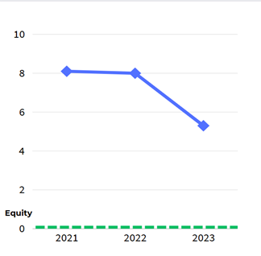
WDES Metric 4b
2022 Priority
Percentage of disabled staff compared to non-disabled staff experiencing harassment, bullying or abuse from line managers, in the last 12 months
 | 2021​ | 2022 | 2023​
Disabled | 17.5%​ | 19.6%​ | 14.2%​
Non Disabled​ | 9.4%​ | 11.6%​ | 8.9%​
Equity Gap | 8.1% | 8% | 5.3%

Slide 43
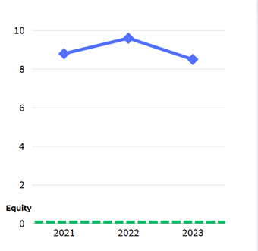
WDES Metric 4c
Percentage of disabled staff compared to non-disabled staff experiencing harassment, bullying or abuse from other colleagues, in the last 12 months
 | 2021​ | 2022​ | 2023​
Disabled | 23.2%​ | 25.9%​ | 23.1%​
Non Disabled​ | 14.4%​ | 16.3%​ | 14.6%​
Equity Gap | 8.8% | 9.6% | 8.5%

Slide 44
WDES Metrics 4a-c
Percentage of disabled staff compared to non-disabled staff experiencing harassment, bullying or abuse from patients, managers or colleagues
 | 2023​
Disabled | 43.6%​
Non Disabled​ | 38.3%​
Equity Gap | 8.5%

Slide 45
WORKFORCE Disability EQUALITY STANDARD (WDES) REPORT
National NHS Staff Survey: WDES Metric 4a, 4b & 4c combined
Percentage of disabled staff compared to non-disabled staff experiencing harassment, bullying or abuse from patients, managers or colleagues
Disabled
Non-disabled
* Estate and Ancillary data too low to compare

Slide 46
WORKFORCE Disability EQUALITY STANDARD (WDES) REPORT
National NHS Staff Survey: WDES Metric 4a, 4b & 4c combined
Percentage of disabled staff compared to non-disabled staff experiencing harassment, bullying or abuse from patients, managers or colleagues
Other
Disabled
Non-Disabled
*Data has not been included where less than 10 people responded

Slide 47
WORKFORCE Disability EQUALITY STANDARD (WDES) REPORT
National NHS Staff Survey: WDES Metric 4a, 4b & 4c combined
Percentage of disabled staff compared to non-disabled staff experiencing harassment, bullying or abuse from patients, managers or colleagues
Disabled
Non-disabled
*Data has not been included where less than 10 people responded

Slide 48
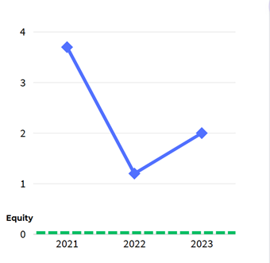
WDES Metric 4d
Percentage of disabled staff compared to non-disabled staff saying that the last time they experienced harassment, bullying or abuse at work, they or a colleague reported it
 | 2021​ | 2022​ | 2023​
Disabled | 60.1%​ | 55.9%​ | 59.9%​
Non Disabled​ | 63.8%​ | 57.1%​ | 61.9%​
Equity Gap | 3.7% | 1.2% | 2%

Slide 49
WORKFORCE Disability EQUALITY STANDARD (WDES) REPORT
National NHS Staff Survey: WDES Metric 4b
Percentage of disabled staff compared to non-disabled staff saying that the last time they experienced harassment, bullying or abuse at work, they or a colleague reported it
Disabled
Non-disabled
* Estate and Ancillary data too low to compare

Slide 50
WORKFORCE Disability EQUALITY STANDARD (WDES) REPORT
National NHS Staff Survey: WDES Metric 4b
Percentage of disabled staff compared to non-disabled staff saying that the last time they experienced harassment, bullying or abuse at work, they or a colleague reported it
Other
Disabled
Non-Disabled
*Data has not been included where less than 10 people responded

Slide 51
WORKFORCE Disability EQUALITY STANDARD (WDES) REPORT
National NHS Staff Survey: WDES Metric 4b
Percentage of disabled staff compared to non-disabled staff saying that the last time they experienced harassment, bullying or abuse at work, they or a colleague reported it
Disabled
Non-disabled
*Data has not been included where less than 10 people responded

Slide 52
WORKFORCE DISABILITY EQUALITY STANDARD (WDES) REPORT
National NHS Staff Survey Metric 5 & 6
The following Staff Survey Metrics, compare the responses for both Disabled and non-disabled staff
Metric 5 – Staff Survey Q.14 |  | 2022 | 2023 | 2024 |  | Comment
Percentage of Disabled staff compared to non-disabled staff believing that the Trust provides equal opportunities for career progression or promotion. | Disabled | 50% | 51% | 53.9% | ↑
 | Non- Disabled | 58% | 59% | 57.5% | ↓
Metric 6 – Staff Survey Q.11e |  | 2022 | 2023 | 2024 |  | Comment
Percentage of Disabled staff compared to non-disabled staff saying that they have felt pressure from their manager to come to work, despite not feeling well enough to perform their duties. | Disabled | 23% | 25% | 21.2% | ↑
 | Non- Disabled | 17% | 17% | 15.4% | —
↓ Needs Improvement ↑ Improved — No Change

Slide 53
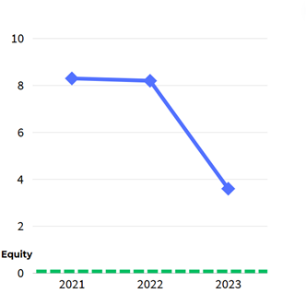
WDES Metric 5
The percentage of disabled staff compared to non-disabled staff believing that their trust provides equal opportunities for career progression or promotion
 | 2021​ | 2022​ | 2023​
Disabled | 49.7%​ | 50.9%​ | 53.9%​
Non Disabled​ | 58.0%​ | 59.1%​ | 57.5%​
Equity Gap | 8.3% | 8.2% | 3.6%

Slide 54
WORKFORCE Disability EQUALITY STANDARD (WDES) REPORT
National NHS Staff Survey: WDES Metric 5
Percentage of disabled staff compared to non-disabled staff believing that their trust provides equal opportunities for career progression or promotion
Disabled
Non-disabled
* Estate and Ancillary data too low to compare

Slide 55
WORKFORCE Disability EQUALITY STANDARD (WDES) REPORT
National NHS Staff Survey: WDES Metric 5
Percentage of disabled staff compared to non-disabled staff believing that their trust provides equal opportunities for career progression or promotion
Other
Disabled
Non-Disabled
*Data has not been included where less than 10 people responded

Slide 56
WORKFORCE Disability EQUALITY STANDARD (WDES) REPORT
National NHS Staff Survey: WDES Metric 5
Percentage of disabled staff compared to non-disabled staff believing that their trust provides equal opportunities for career progression or promotion
Disabled
Non-disabled
*Data has not been included where less than 10 people responded

Slide 57
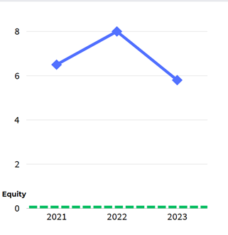
WDES Metric 6
Percentage of disabled staff compared to non-disabled staff saying that they have felt pressure from their manager to come to work, despite not feeling well enough to perform their duties
 | 2021​ | 2022​ | 2023​
Disabled | 23.8%​ | 25.1%​ | 21.2%​
Non Disabled​ | 17.3%​ | 17.1%​ | 15.4%​
Equity Gap | 6.5% | 8% | 5.8%

Slide 58
WORKFORCE Disability EQUALITY STANDARD (WDES) REPORT
National NHS Staff Survey: WDES Metric 6
Percentage of disabled staff compared to non-disabled staff saying that they have felt pressure from their manager to come to work, despite not feeling well enough to perform their duties
Disabled
Non-disabled
* Estate and Ancillary data too low to compare

Slide 59
WORKFORCE Disability EQUALITY STANDARD (WDES) REPORT
National NHS Staff Survey: WDES Metric 6
Percentage of disabled staff compared to non-disabled staff saying that they have felt pressure from their manager to come to work, despite not feeling well enough to perform their duties
Other
Disabled
Non-Disabled
*Data has not been included where less than 10 people responded

Slide 60
WORKFORCE Disability EQUALITY STANDARD (WDES) REPORT
National NHS Staff Survey: WDES Metric 6
Percentage of disabled staff compared to non-disabled staff saying that they have felt pressure from their manager to come to work, despite not feeling well enough to perform their duties
Disabled
Non-disabled
*Data has not been included where less than 10 people responded

Slide 61
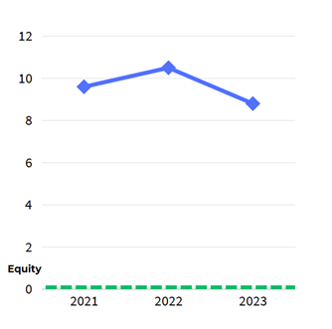
WDES Metric 7
Percentage of disabled staff compared to non-disabled staff saying that they are satisfied with the extent to which their organisation values their work
 | 2021​ | 2022 | 2023​
Disabled | 46.7%​ | 43.2%​ | 49.3%​
Non Disabled​ | 56.3%​ | 53.7%​ | 58.1%​
Equity Gap | 9.6% | 10.5% | 8.8%

Slide 62
WORKFORCE Disability EQUALITY STANDARD (WDES) REPORT
National NHS Staff Survey: WDES Metric 7
Percentage of disabled staff compared to non-disabled staff saying that they are satisfied with the extent to which their organisation values their work
Disabled
Non-disabled
* Estate and Ancillary data too low to compare

Slide 63
WORKFORCE Disability EQUALITY STANDARD (WDES) REPORT
National NHS Staff Survey: WDES Metric 7
Percentage of disabled staff compared to non-disabled staff saying that they are satisfied with the extent to which their organisation values their work
Other
Disabled
Non-Disabled
*Data has not been included where less than 10 people responded

Slide 64
WORKFORCE Disability EQUALITY STANDARD (WDES) REPORT
National NHS Staff Survey: WDES Metric 7
Percentage of disabled staff compared to non-disabled staff saying that they are satisfied with the extent to which their organisation values their work
Disabled
Non-disabled
*Data has not been included where less than 10 people responded

Slide 65
WDES Metric 8
2022 Priority
Percentage of disabled staff saying that their employer has made reasonable adjustment(s) to enable them to carry out their work
 | 2021 | 2022 | 2023​
Disabled​ | 76.3%​ | 70.6%​ | 76.4%​

Slide 66
WORKFORCE Disability EQUALITY STANDARD (WDES) REPORT
National NHS Staff Survey: WDES Metric 8
Percentage of disabled staff saying that their employer has made reasonable adjustment(s) to enable them to carry out their work
* Estate and Ancillary data too low to compare
Disabled
*Data has not been included where less than 10 people responded

Slide 67
WORKFORCE Disability EQUALITY STANDARD (WDES) REPORT
National NHS Staff Survey: WDES Metric 8
Percentage of disabled staff saying that their employer has made reasonable adjustment(s) to enable them to carry out their work
Other
Disabled
Non-Disabled
*Data has not been included where less than 10 people responded

Slide 68
WORKFORCE Disability EQUALITY STANDARD (WDES) REPORT
National NHS Staff Survey: WDES Metric 8
Percentage of disabled staff saying that their employer has made reasonable adjustment(s) to enable them to carry out their work
Disabled
Non-disabled
*Data has not been included where less than 10 people responded

Slide 69
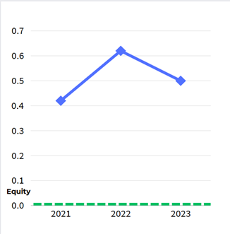
WDES Metric 9
2022 Priority
Staff Engagement Score
The NHS Staff Survey engagement score is a metric that measures the level of engagement among staff. It is calculated based on responses to survey questions related to staff engagement, satisfaction, and motivation. The score reflects the extent to which employees feel connected to their work, their organisation, and its mission. Higher engagement scores indicate that staff are more likely to be committed, motivated, and productive in their roles.
 | 2021​ | 2022​ | 2023​
Disabled | 6.96 | 6.7​0 | 6.96​
Non Disabled​ | 7.38​ | 7.32 | 7.46
Equity Gap | 0.42 | 0.62 | 0.5

Slide 70
WORKFORCE Disability EQUALITY STANDARD (WDES) REPORT
National NHS Staff Survey: WDES Metric 9
Staff Engagement Score
Disabled
Non-disabled
* Estate and Ancillary data too low to compare

Slide 71
WORKFORCE Disability EQUALITY STANDARD (WDES) REPORT
National NHS Staff Survey: WDES Metric 9
Staff Engagement Score
Other
Disabled
Non-Disabled
*Data has not been included where less than 10 people responded

Slide 72
WORKFORCE Disability EQUALITY STANDARD (WDES) REPORT
National NHS Staff Survey: WDES Metric 9
Staff Engagement Score
Disabled
Non-disabled
*Data has not been included where less than 10 people responded

