Slide 1


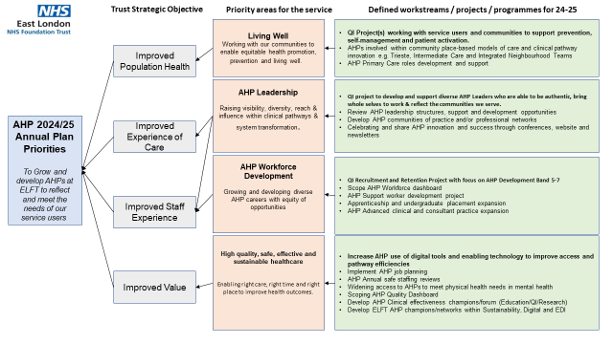
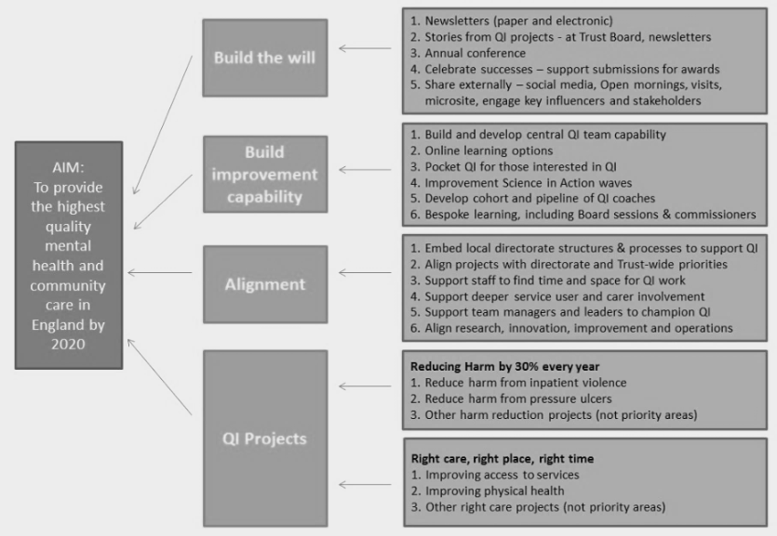
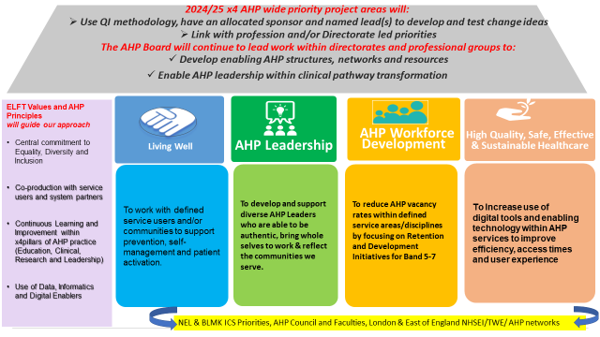
INSERT High quality Team photo
Allied Health Professionals Strategy & Quality Improvement Programme
Fiona Kelly, Katie Williams, Marion Levine, Alex Hadayah, Helen Glyn-Davies, Jo Raphael, Lorna Downing, Runa Park, Emma Stoneman, Graham Copnell, Emily Matthews, Julie Archer & AHP Senior Leadership Team
Life QI Code:
The ELFT AHP Senior Leadership Team has used QI Methodology to Co-produce our AHP Strategic Priorities and Quality Improvement Plan. This will raise the visibility and realise the potential of AHPs to deliver the ELFT Mission to improve the quality of life for all we serve.
Aim
How did you involve service users and carers in this work?
Tests of Change
To review our 5 year AHP plan & identify key strategic priorities and QI objectives to deliver our vision “To grow and develop AHPs at ELFT to reflect and meet the needs of our service users”
Our people participation team supported x2 AHP Senior Leadership co-production sessions to develop the AHP Strategy. We also gathered staff feedback via away day sessions. Staff and service users will be integral members within our x4 priority Quality Improvement Projects.
Each QI project will be allocated a sponsor and leads who will effectively test innovative change ideas – and report these tests into AHP Board.
AHP Strategy Driver diagram
Our x4 Quality Improvement Priorities
Share your data and stories
EXAMPLE
Learning and what next?
Bringing senior AHP leaders together, across professions, specialities and services enabled time to reflect, connect and identify shared challenges and priorities for collaboration. PDSA processes will be used for all testing and learning activities on the AHP QI projects to measure the impact of the intervention. Lessons learned across all projects will be reviewed at the AHP Board for the benefit of all projects.

Slide 2


Tell us your story in a nutshell
Over the past 10 months, the ELFT AHP Senior Leadership team has reviewed our 5 year AHP ELFT Plan. We have used an appreciative enquiry approach and QI Methodology, to reflect on progress and key challenges to co-produce our 2024/25 strategic priorities and a quality improvement plan. This will raise the visibility, and realise the potential of AHPs to deliver the ELFT Mission to improve the quality of life for all we serve.
We have engaged and co-produced with staff and our people participation team, using QI methodology including:
April 2023 sustainable healthcare improvement ideas jamboard (Greener AHPs week)
July 2023 world café session with senior AHP leadership team exploring what matters most, challenges and opportunities for AHPs to deliver the Trust Strategy.
Sharing the emerging strategy and staff feedback within professional and team away days, hearing what teams are proud of and their priorities for improvement.
Feb 2024 follow up session building on success and work in progress to agree our future priority areas using nominal group technique, affinity diagram and multi voting.
We will now be sharing and continuing to build on the strategy with the wider AHP workforce, working with our communications team and planning our ELFT AHP Conference in October 2024.

Slide 3
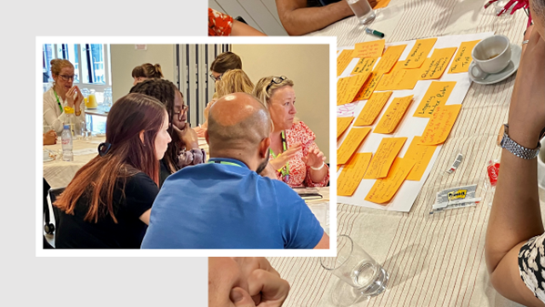
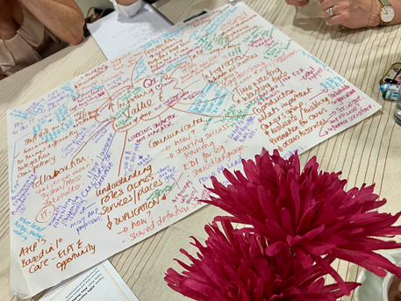
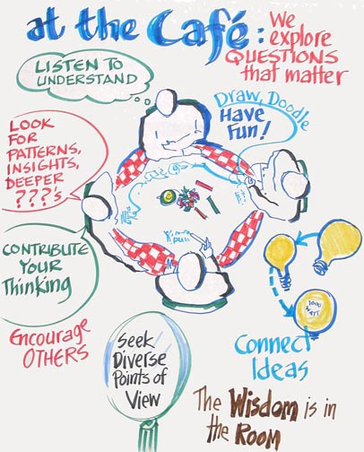
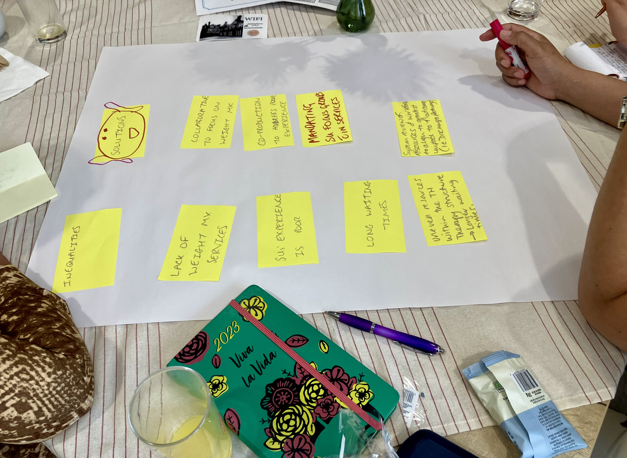
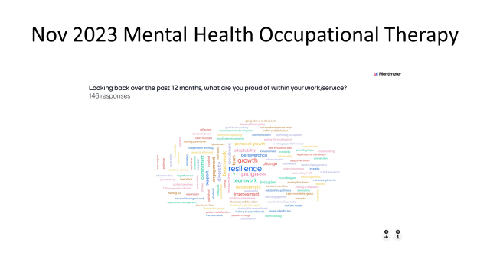
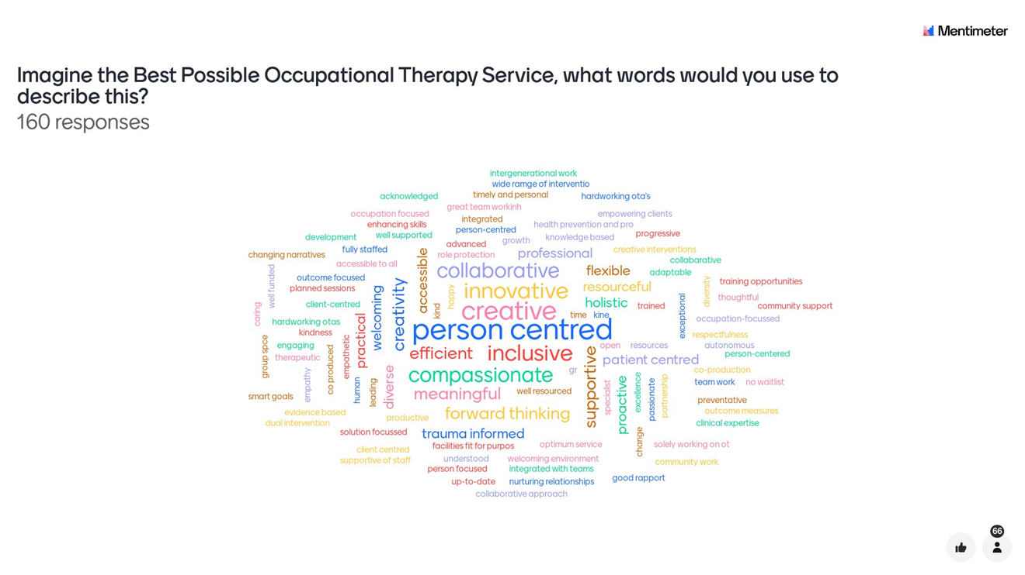
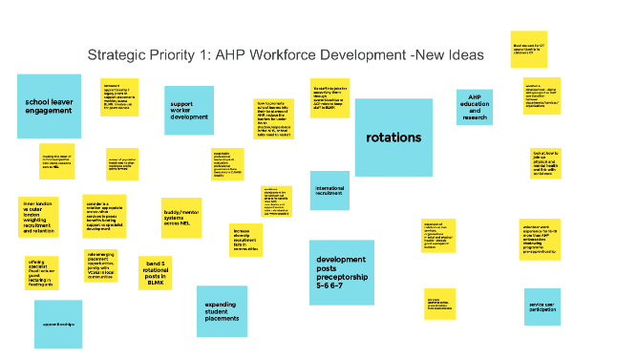
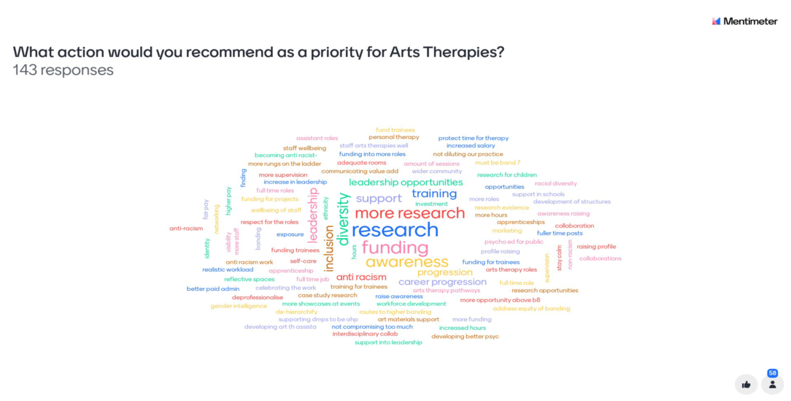
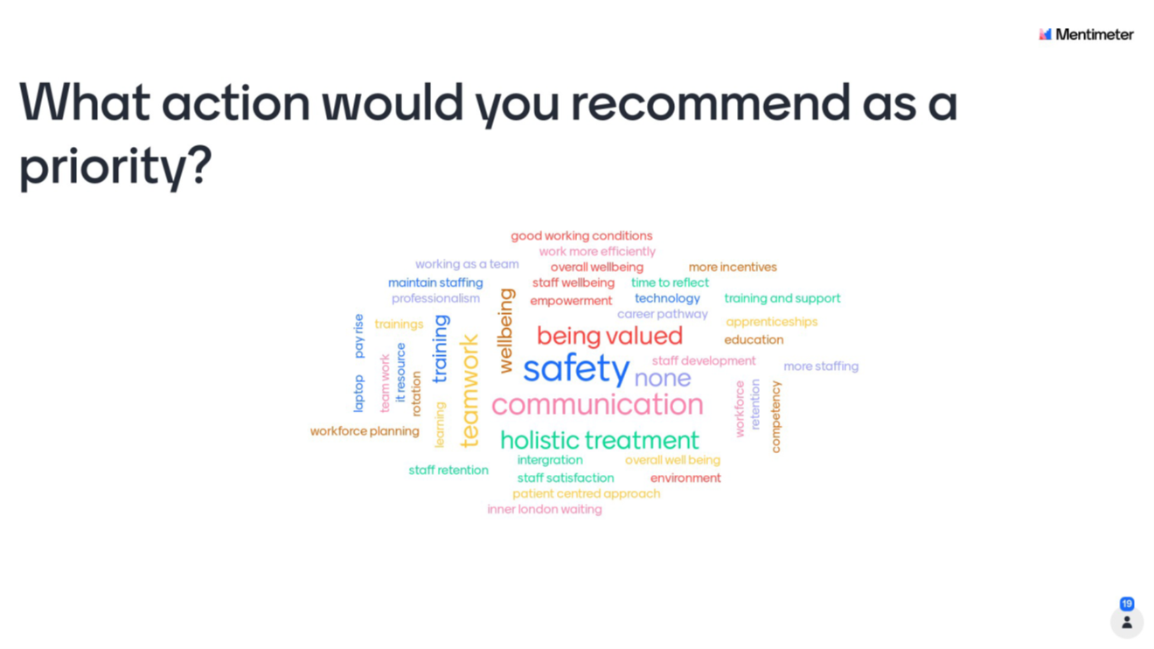
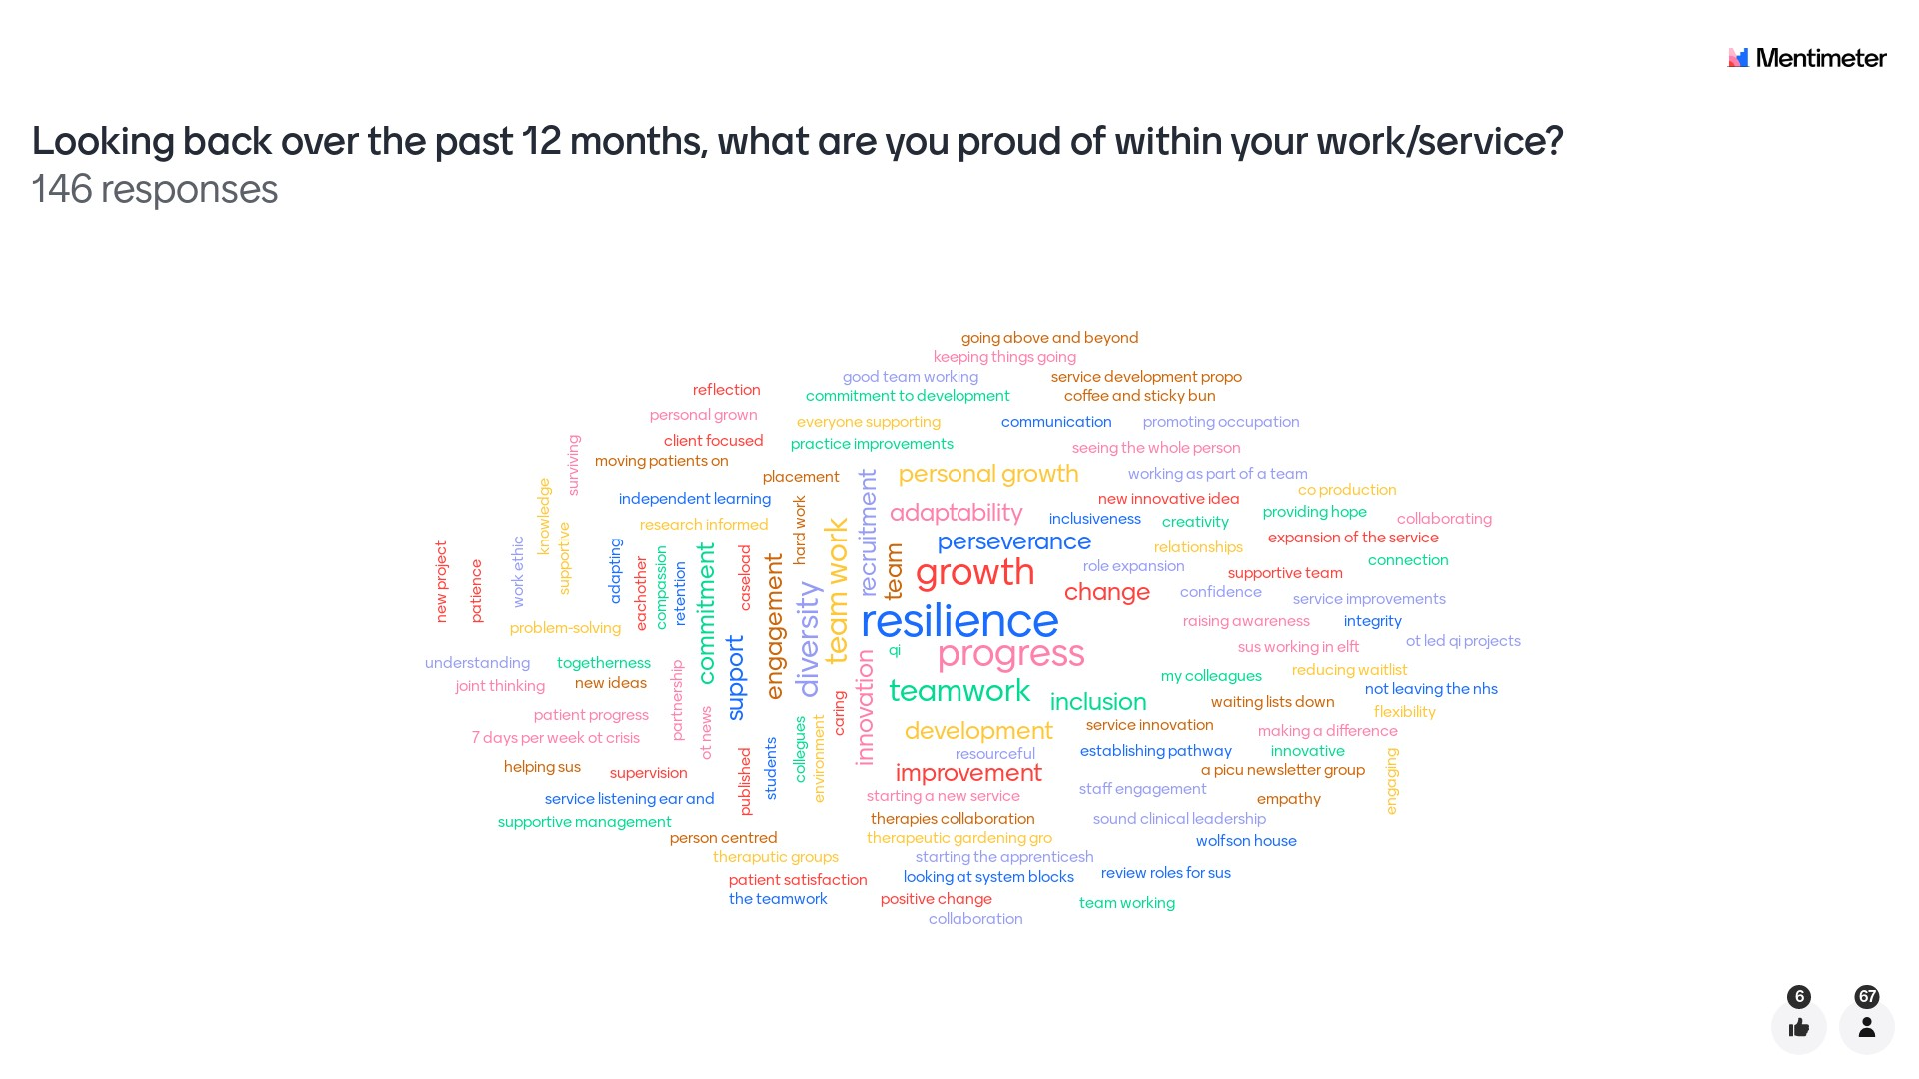
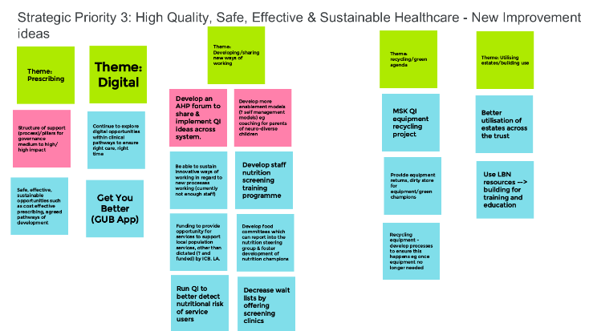
Co-producing our AHP Strategy and Priorities for Improvement

Slide 4
R
Raise awareness of AHPs within ELFT and our Integrated Care Systems
I
Inspire and identify opportunities for AHP innovation, improvement and development
S
Support our ELFT AHPs, AHP Support Workers, Students and Apprentices to develop within their careers
E
U
P
Engage and Celebrate and Connect AHPs working across ELFT care pathways and to ICS, Regional and Trust Strategic Priorities.
Understand and Learn from the experience of people accessing our AHP Services
Promote awareness of AHP Careers within our local communities

