Slide 1
Professional Development within the Podiatry Service in Bedfordshire
Rushmi Kanjee
Podiatry Professional Development Lead

Slide 2
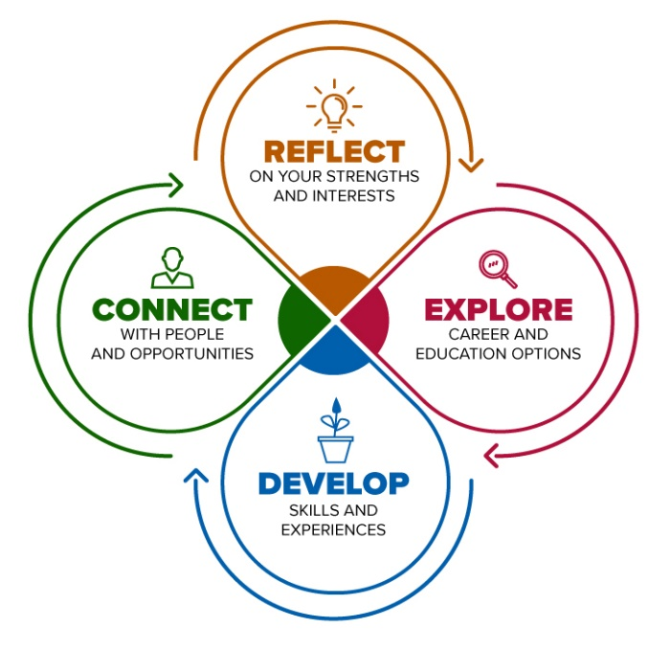
What is Professional Development?
In a changing world, we are constantly learning… as new standards and best practice become the benchmark against which we need to develop
Term person-centred focus on individual team members
Invest in yourself by committing to ongoing learning
This process is dynamic and informs career progression, it can be formal and informal, allows for upward and lateral progression
It is a process by which you can explore, apply, reflect and celebrate this investment in yourself
It leads to personal and professional growth of evidence-based knowledge
and skills, improves job satisfaction and performance
Benefits yourself, your team, service users and your employer
Allows for succession planning

Slide 3


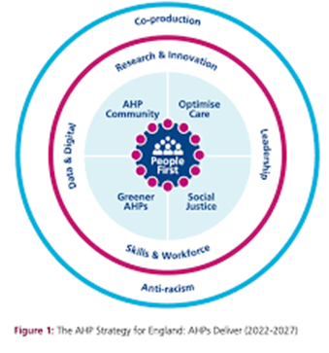
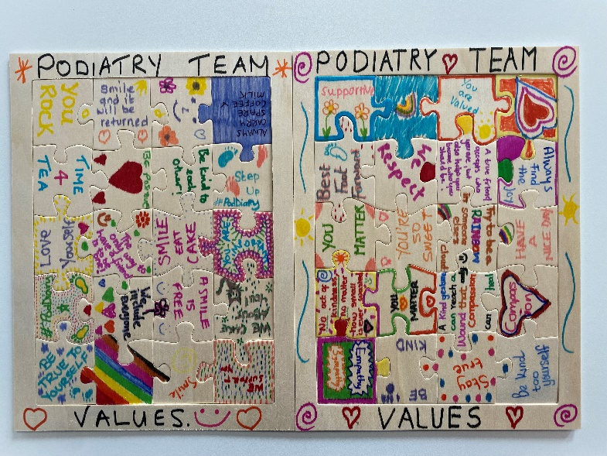



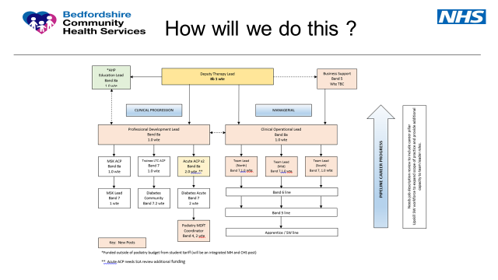




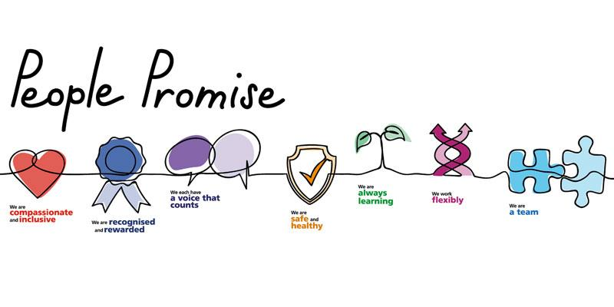

Why is it important?

Slide 4
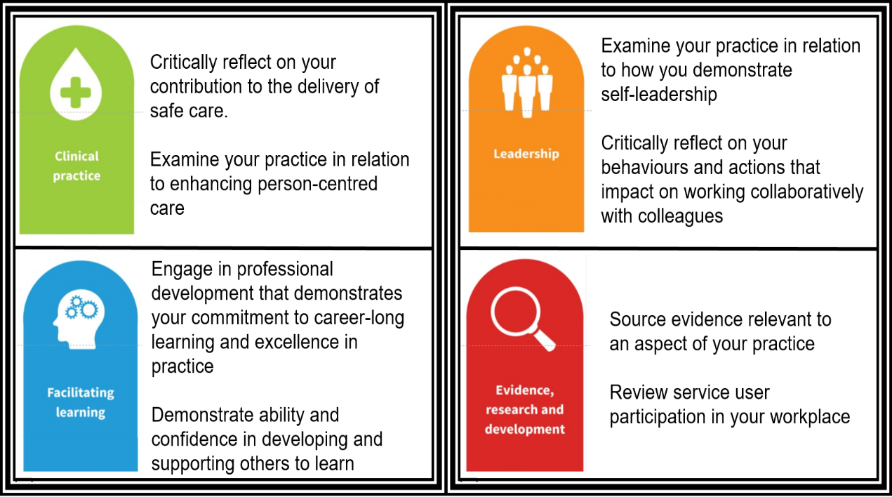
The 4 Pillars of Career Progression / Advancement

Slide 5
The story so far…
4 Pillars of Advancement
Workfoce Challenges & Recruitment
Induction. Preceptorship& Apprenticeship
System Partners & Collaboration
Health
Inequalities
Education
Retention & Staff Well-being
Succession Planning
PDP & Career conversations
Training needs analysis
TIM
Job plans
ACP
Competencies
PGD
Service user collaboration through PP
CQC
Raising profile of Podiatry
Training
Commu- nication

Slide 6
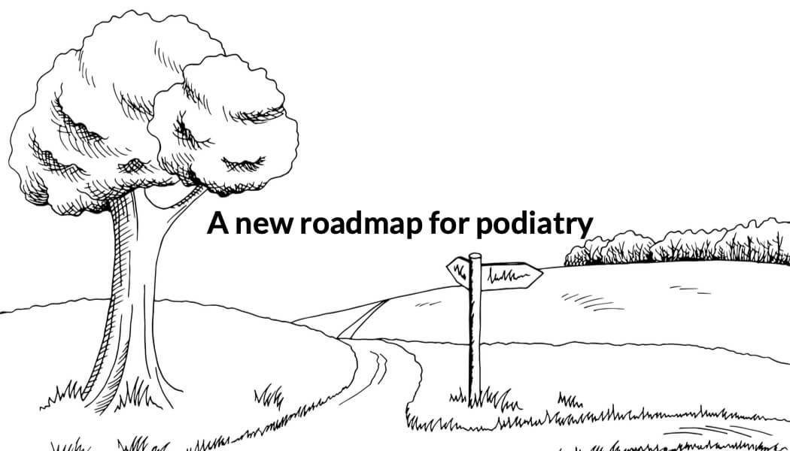
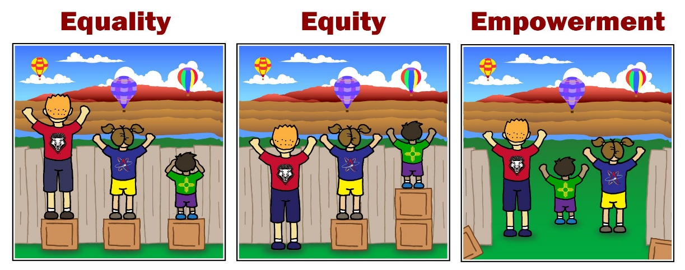

Slide 7
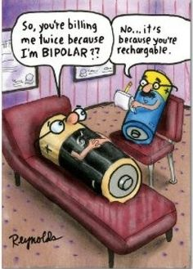
Don’t under estimate Resilience Nurture Potential = IMpossible

Slide 8
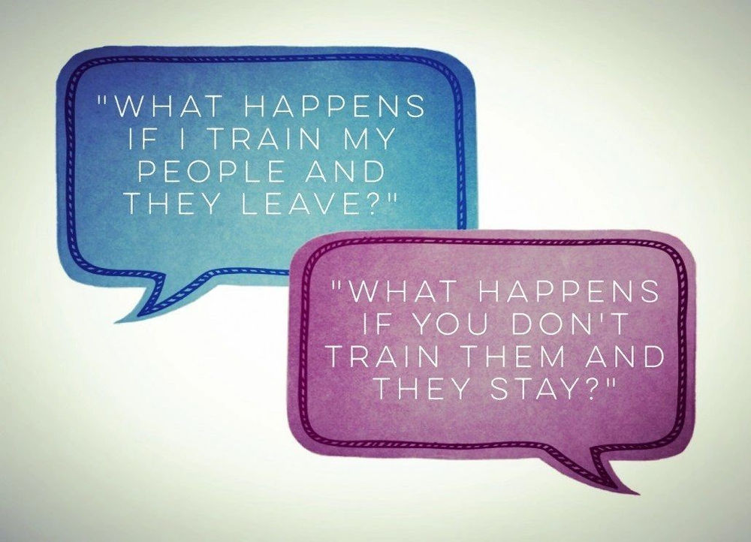
Thank you

