Slide 1
A new way of delivering some of our child and adolescent mental health services in North Central and North East London Our proposals for a temporary change to current arrangements
October 2024

Slide 2
About us

Slide 3





Who we are
North Central and East London Provider Collaborative (NCEL) is made up of:

Slide 4


What we do
Together, we plan and organise mental health services, and as individual NHS trusts we provide these services.
Inpatient
mental health services
for children and young people
Community
mental health services
for children and young people
Our teams include psychologists, family therapists, community mental health nurses, mental-health trained social workers, psychiatrists and psychotherapists trained to work with children, young people and their families.

Slide 5
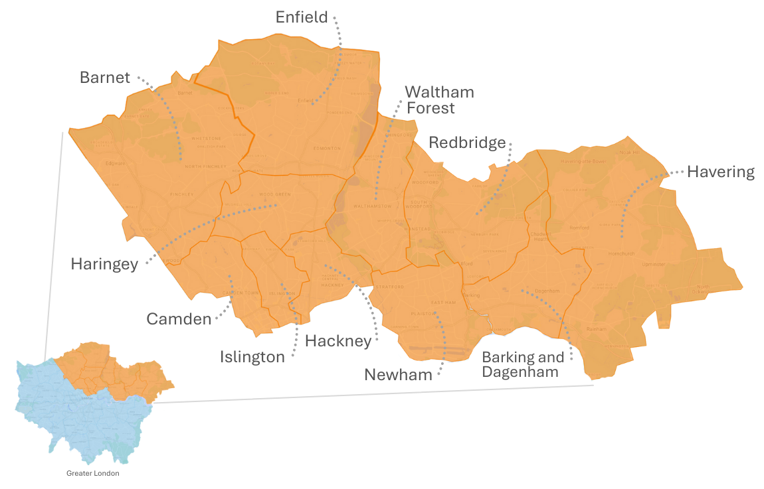
Where we do it

Slide 6
Temporary changes

Slide 7
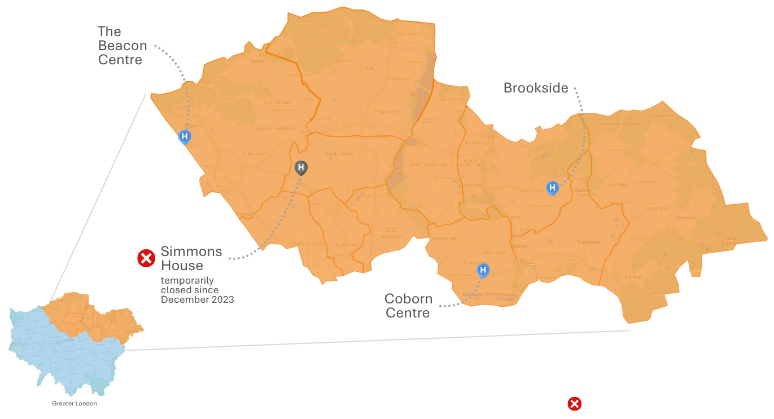
Temporary closure of 1 of our 4 inpatient units
We have 4 places in our area where children and young people can be cared for as an inpatient.
At the moment, one of those places is temporarily closed.
Unit closed

Slide 8
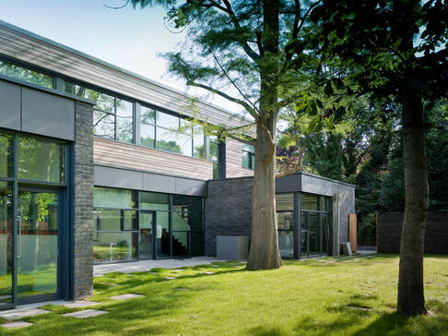
Why did Simmons House need to temporarily close?
Simmons House temporarily closed in December 2023 following safety concerns. An estates review identified the unit needed a significant building upgrade to continue to function as a children and young people’s inpatient mental health unit.

Slide 9

We temporarily admitted more people across the three other facilities
Admitted more patients
Unit closed

Slide 10
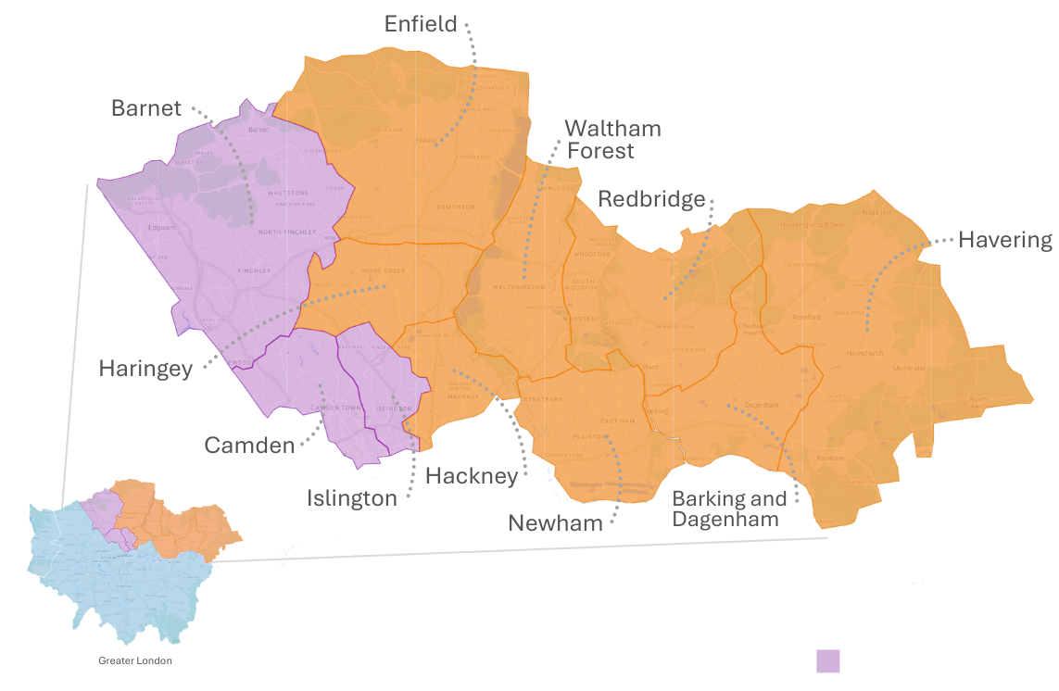
We also extended coverage of a new home treatment team
A newly established intensive home treatment team was extended to cover the whole of North Central London.
The development of this team means that young people are only admitted for inpatient mental health care when it is absolutely necessary.
Intensive home treatment team coverage area

Slide 11
Why do we need to change our approach?

Slide 12


We need to change our approach
While it is good news that we have not had to transfer any young patients out of our geographic area for care during this time, we need to adapt and improve upon the temporary arrangements currently in place. This is because:
Our other three inpatient units are seeing and treating more people
Some children and young people are having to travel further

Slide 13
Developing the proposed interim arrangements

Slide 14

Who developed the proposed interim arrangements?
A senior clinician from each of the NHS trusts providing mental health care in our area came together to consider what arrangements would be needed to cover the temporary closure of Simmons House. The clinical group looked at arrangements for the short-to-medium-term – for around the next 18 months.
Once new interim arrangements are in place, the clinical leaders will start the detailed work needed to develop a long-term solution for how children and young people’s mental health services are best organised and provided in North Central London. We are committed to doing this working alongside children and young people who use our services, their parents and carers, frontline staff, health and care partners in our area, and other stakeholders in our communities with an interest in mental health services.

Slide 15





What did the clinical group consider in developing the interim proposals?
In designing the interim proposals, the clinical group considered children and young people’s:
health needs
demographic changes
care as close to home as possible
previous and future demand for mental health services
experience of services (and their parents’ and carers’ experiences)

Slide 16
Our proposed interim arrangements

Slide 17


Proposed interim arrangements for care closer to home
Where possible and clinically appropriate, children and young people will receive specialist, tailored care at home from teams who work extensively with young people in the community who require mental health support.
As a result, in future, children and young people would only be admitted to an inpatient unit if it was absolutely clinically necessary.
Home treatment teams
We want to increase their capacity in North Central London by enhancing the care they are able to provide for young people with learning disabilities or autism
Outreach teams
We want to extend and invest in these teams. This service would be available into the evenings until 8pm and at the weekend for the first time. It would also have specialist support available for parents and carers

Slide 18
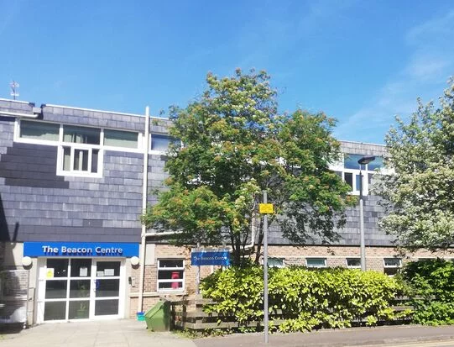
Proposed interim arrangements for inpatient care
The Beacon Centre in Edgware has additional space we can make use of.
Like Simmons House, it has an onsite school, meaning children and young people can get educational support during their stay.
We are proposing to buy three additional inpatient beds for children and young people at The Beacon Centre to help us meet people’s needs.

Slide 19
What happens next?

Slide 20


We want to hear your views
We want to understand how the proposals would impact people and are running a six-week period of engagement from 18 October to midnight on 29 November 2024.
You can find out more about these proposals including answers to some frequently asked questions at https://www.elft.nhs.uk/ncel
We’d like you to tell us:
What you think of these interim proposals
And, if appropriate, how they would impact you in getting the treatment you or the person you care for needs
You can give us your feedback by:
Emailing: elft.ncelengagement@nhs.net
Writing to: The Communications Team, NCEL Provider Collaborative, Robert Dolan House, 9 Alie Street, London E1 8DE.
If you would like to get this information or share your views in another format or language, please contact us.

Slide 21
What happens next?
29 November 2024
Engagement period ends at midnight
December 2024
Analyse, theme and summarise people’s responses to the proposals
December 2024 / January 2025
Consider people’s responses to the proposals and agree any adjustments or adaptations to the interim proposals
Early 2025
Implement interim proposals

Slide 22
Developing longer-term proposals for change

Slide 23
Developing longer-term proposals for change
The interim arrangements will make sure we are continuing to provide children and young people with the best possible care until more permanent arrangements are made.
We will be developing our thinking and planning about longer-term proposals for change over the next period.
And we are committed to continuing to work with children and young people, those who use our services and their families and carers, clinical leaders, our staff, our partners in health and care, and other stakeholders in our communities as we do this.
We will share information about how to get involved in this work once it gets started – likely in early 2025.

Slide 24
Thank you
You can give us your feedback by:
Emailing: elft.ncelengagement@nhs.net
Writing to: The Communications Team, NCEL Provider Collaborative, Robert Dolan House, 9 Alie Street, London E1 8DE.
If you would like to get this information or share your views in another format or language, please contact us.
Please do get in touch to share your views

