Slide 1

East London NHS Foundation Trust
AHP Conference 2024: Rise Up
Hannah Harniess | Director of AHPs | NHS North East London
10th October 2024

Slide 2


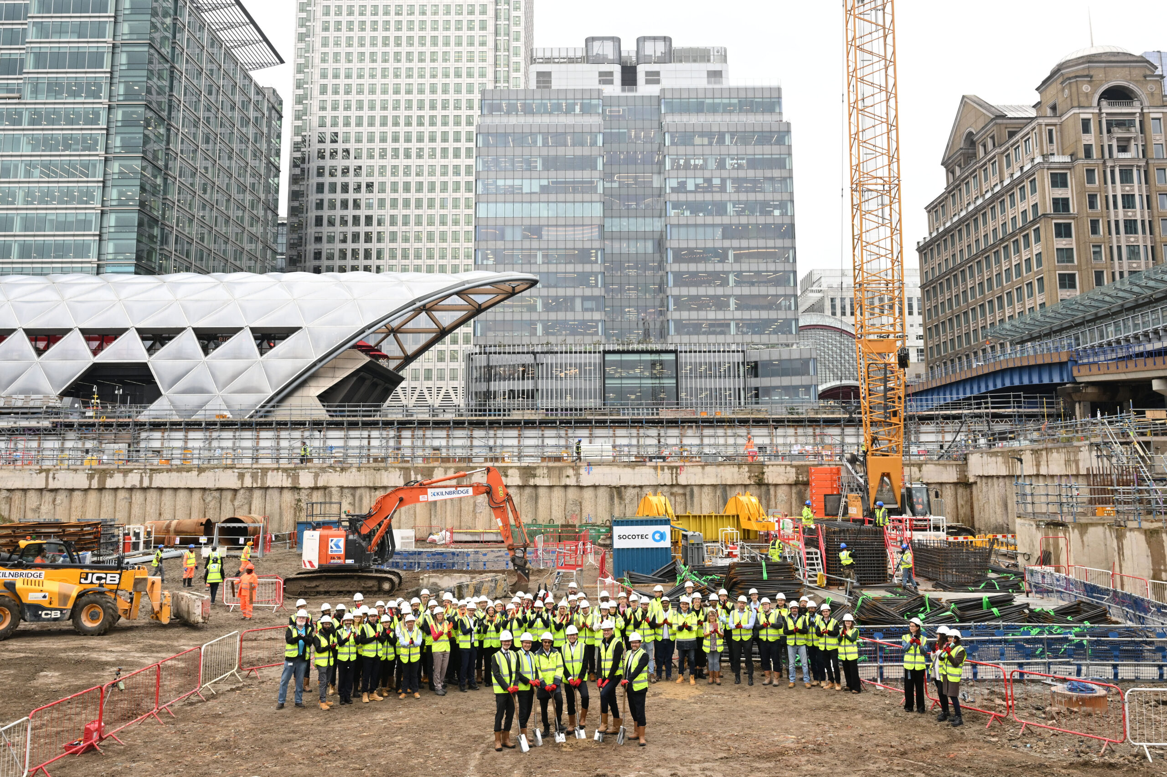
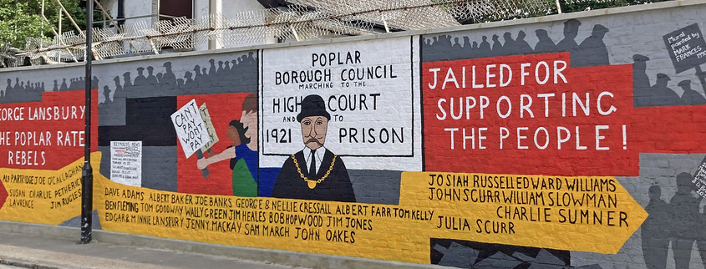
Looking Back…

Slide 3
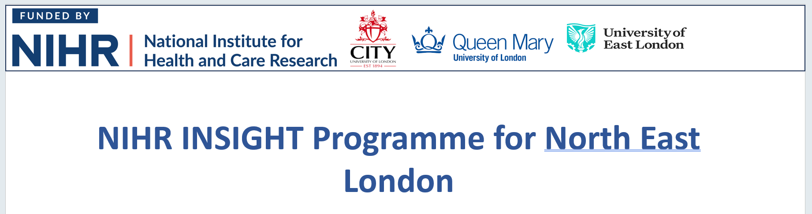
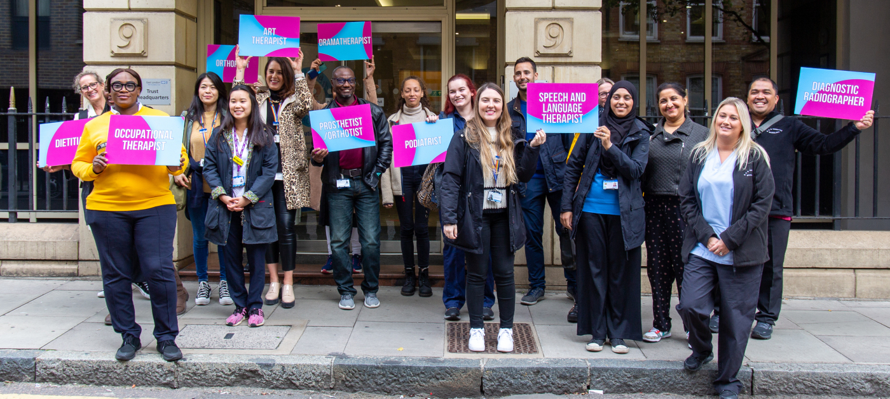
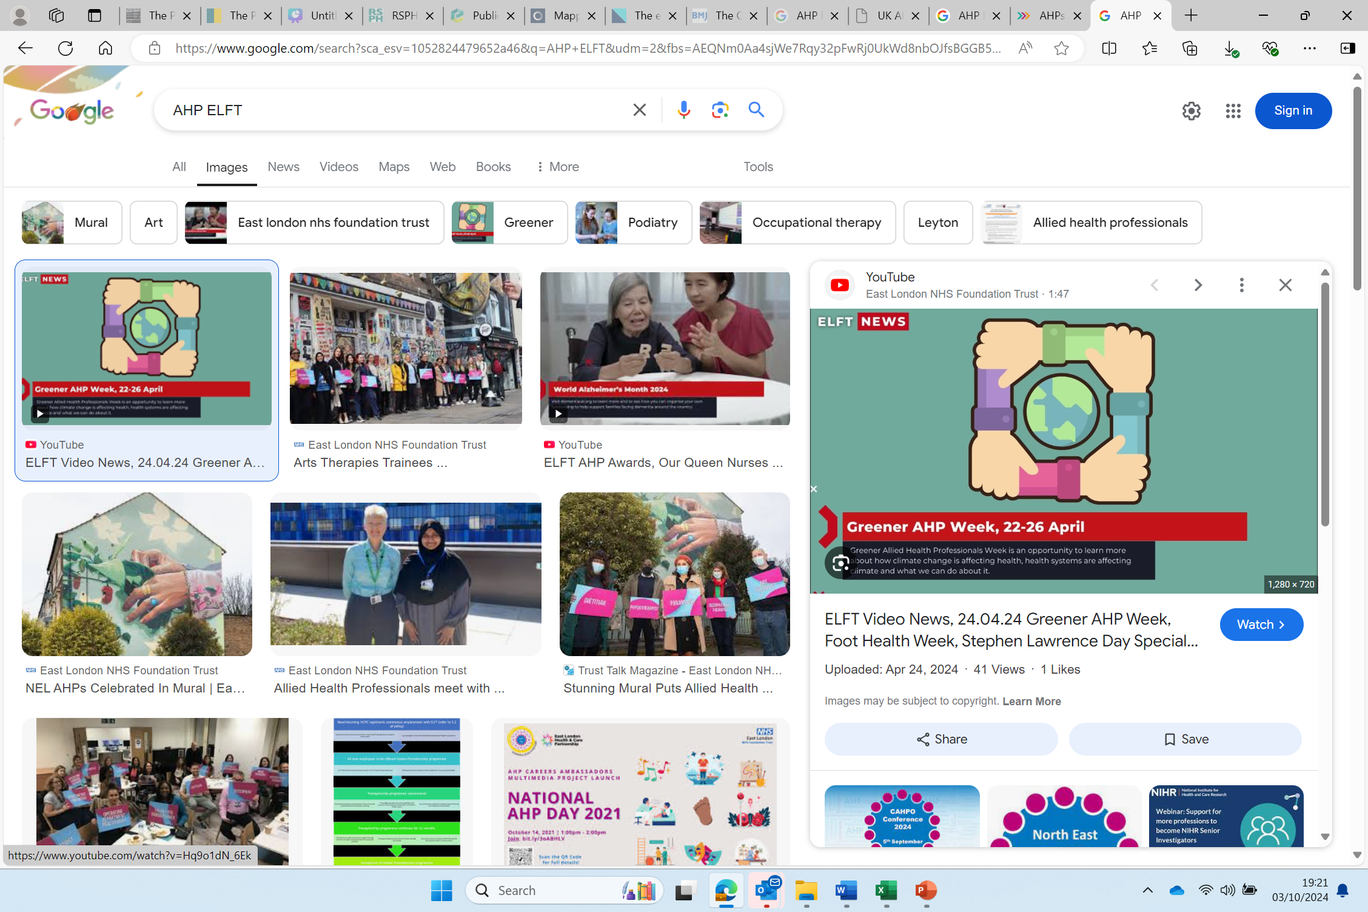
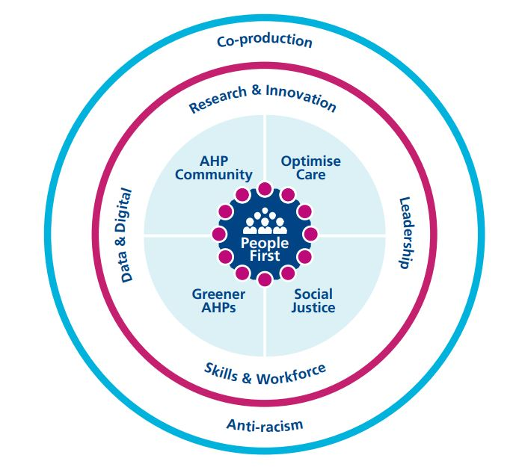
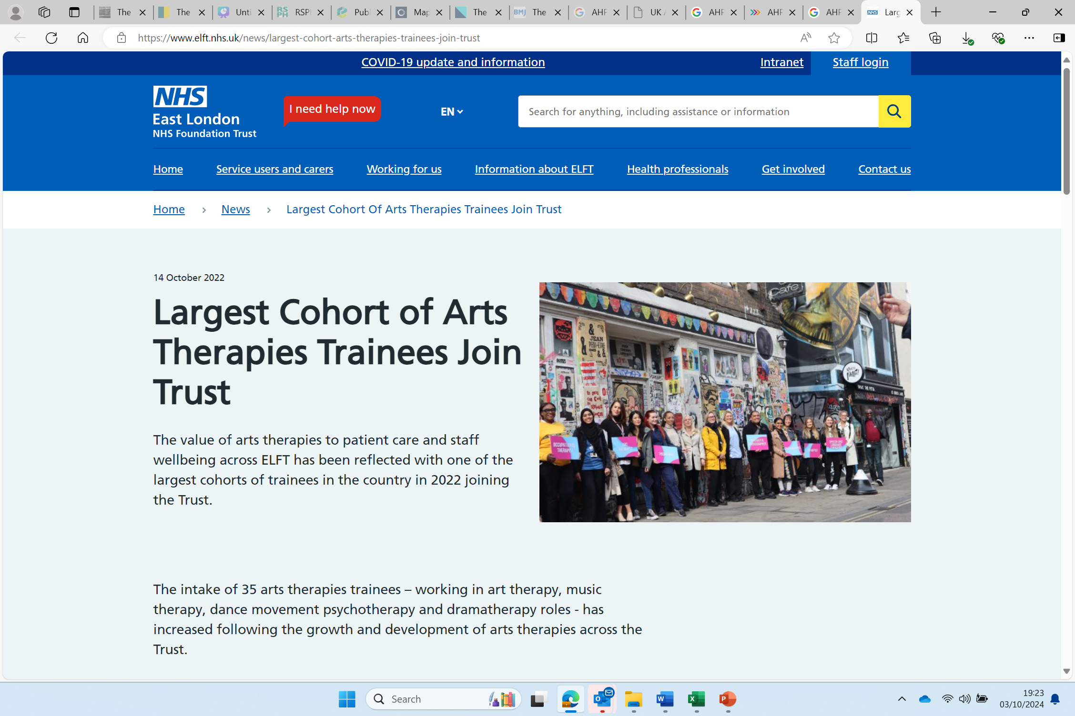


Reflecting on Now

Slide 4
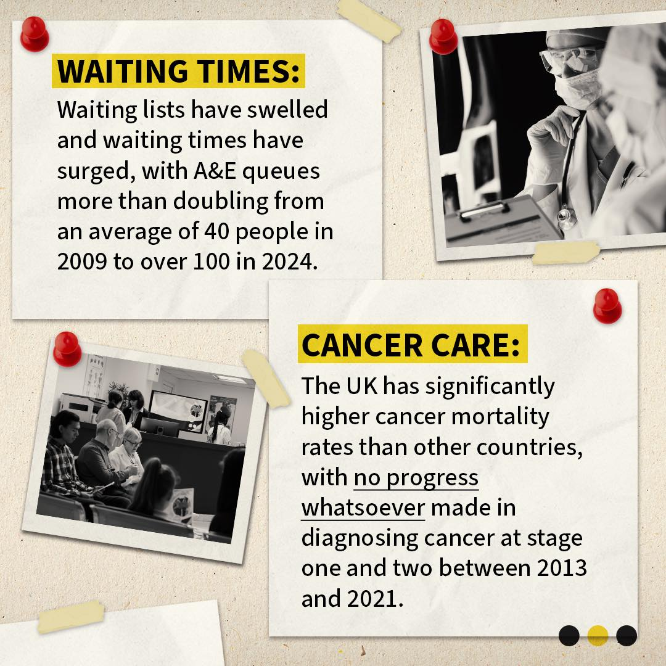
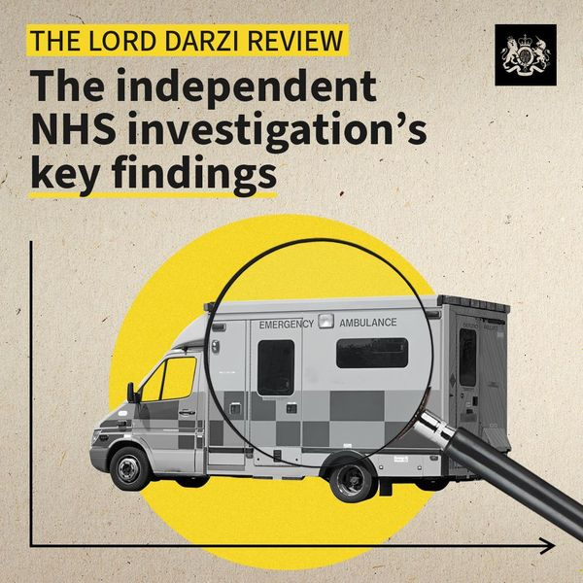

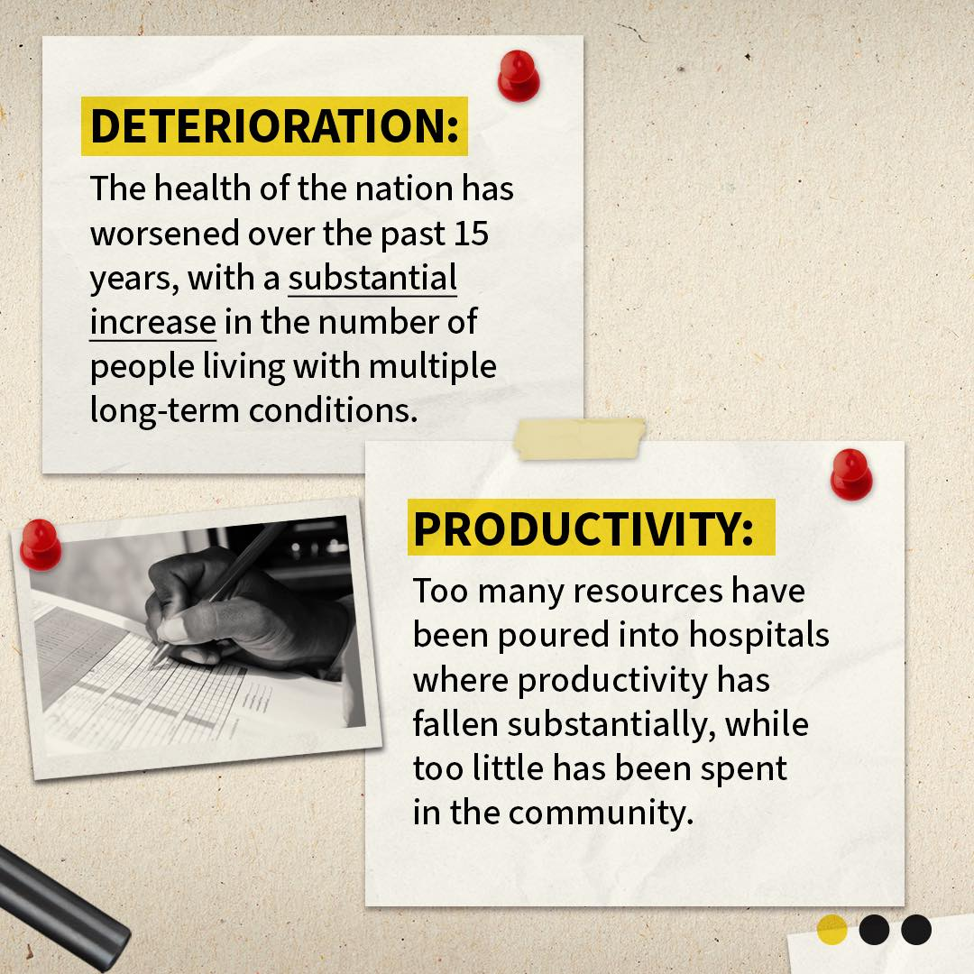

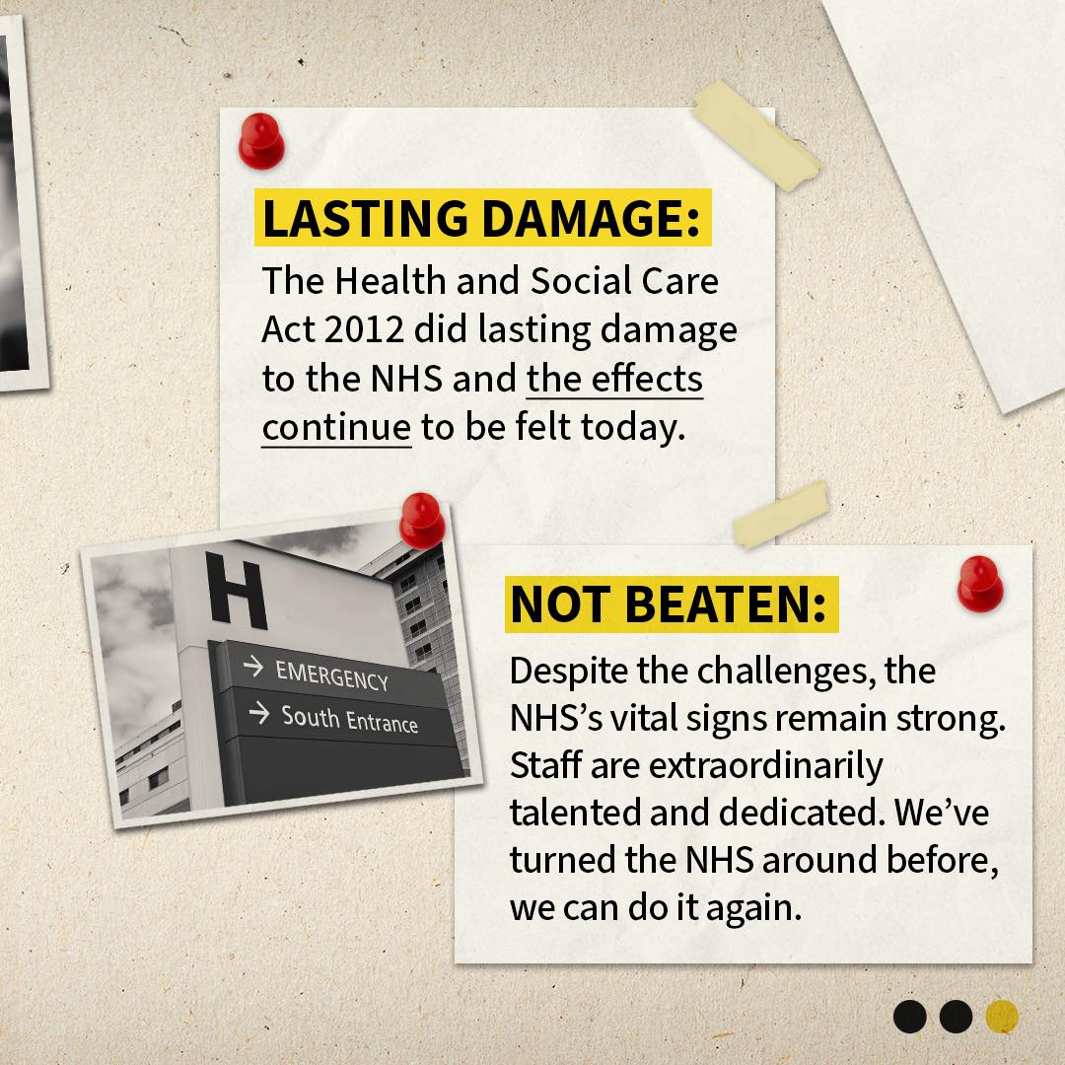

Slide 5
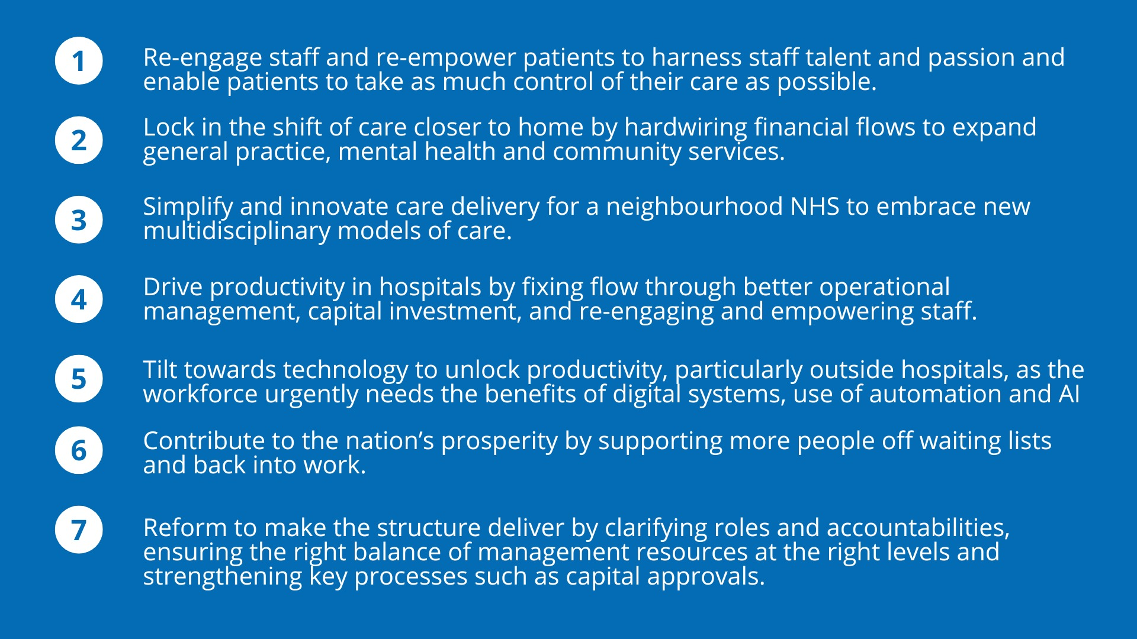

Themes shaping the 10-year Plan: Made for AHPs

Slide 6

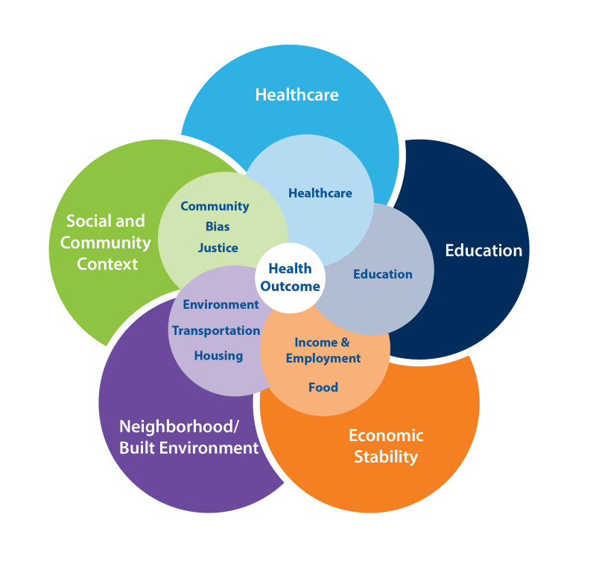
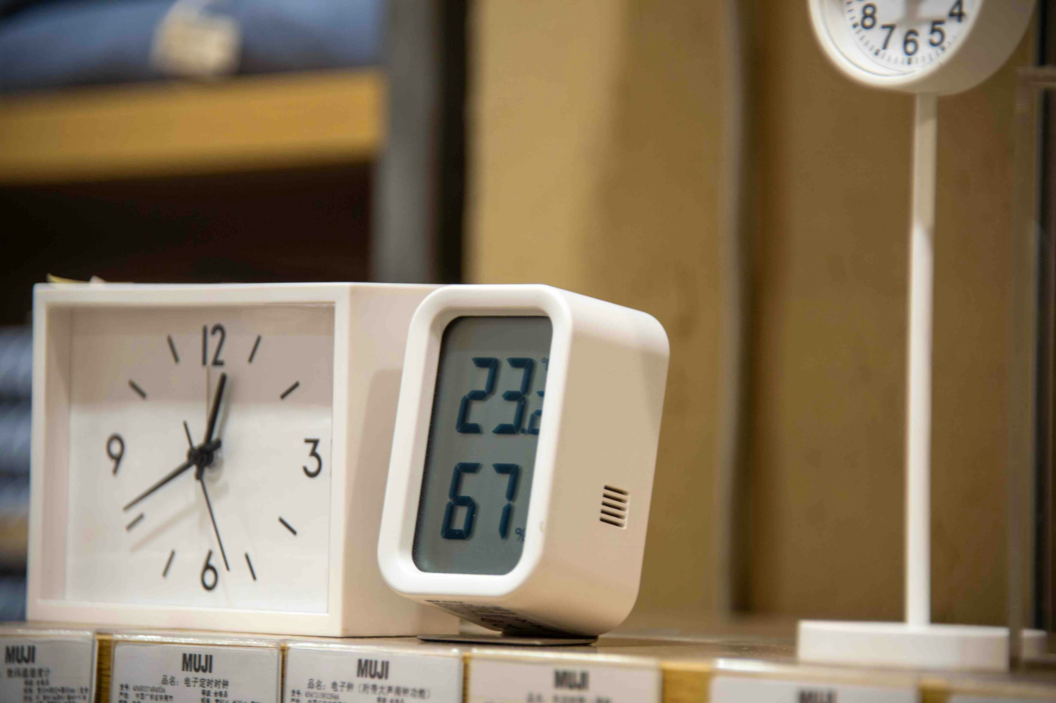
Looking Forward: AHPs Deliver, AHPs Lead
Sickness to Prevention
Hospital to Community
Analogue to Digital

Slide 7



NEL: AHPs Deliver, AHPs Lead
Clinical Leadership
Workforce Development, Education & Training
Research & Innovation
Anti-Racism, Equality & Diversity
Quality & Safety

Slide 8

Thank you
Hannah.harniess1@nhs.net

