Slide 1



ALLIED HEALTH PROFESSIONALS
OCTOBER 2024

Slide 2



Allied Health Professionals at ELFT
AHPs* identified
on ESR...
646
14%
of white AHPs
11%
*does not include AHP support workers
of Asian AHPs
Above Band 5...
received internal promotions since 2020
% of Black and Asian AHPs
9%
% of white AHPs
of Black AHPs
Notes:
Data in this report drawn from ESR data provided in March 2024.
Internal promotions data start from 2020.
% of white AHPs increased with pay band progression. % Black and Asian AHPs decreased or remained the same as AfC pay bands progressed above Band 5.

Slide 3

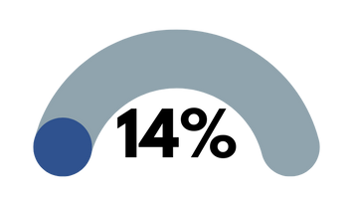
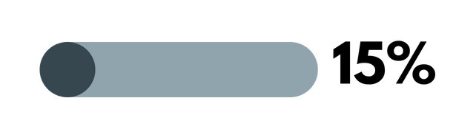
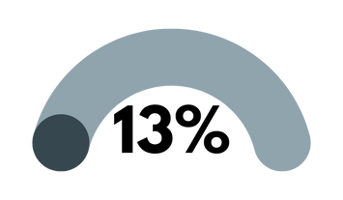

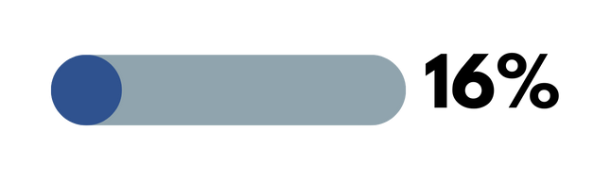
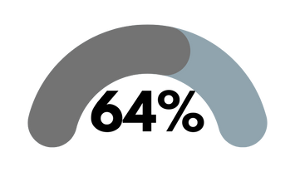
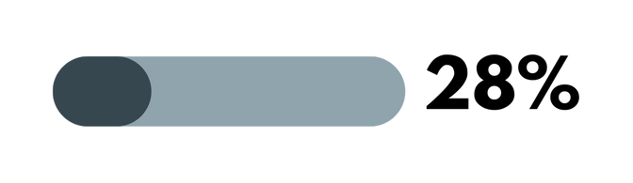
Allied Health Professionals at ELFT
Black
Arts Therapists
Black
Speech & Language Therapists
Asian
Asian
Podiatrists
Mixed
Occupational Therapists
Black
White
Physiotherapists
Asian
Mean average banding for AHPs by ethnicity:
White
Asian
Black
Band 7
Band 7
Band 6

Slide 4




Allied Health Professionals at ELFT Compared to HCPC
ELFT
HCPC
10%
2%
Arts Therapists are Mixed ethnicity
20%
5%
Physiotherapists are Black
10%
12%
Occupational Therapists are Asian
40%
76%
Podiatrists are white
With the exception of Asian OTs and arts therapists, ELFT’s AHP data is more diverse than HCPC data for Asian, Black, Mixed and Other ethnicities.
Notes:
Except for Asian OTs and Asian arts therapists, ELFT's AHP data is more diverse than HCPC for Speech and Language Therapists, Arts Therapists, Podiatrists, Physiotherapists and Occupational Therapists.

Slide 5
Workforce Race Equality Standards & Staff Survey AHP Data (2023)
Indicator Number | Metric | Equity Gap (AHPs) | Equity Gap (All Staff)
5 | Percentage of BME staff experiencing harassment, bullying or abuse from patients, relatives or the public in last 12 months | -0.5% | 8.2%
6 | Percentage of BME staff experiencing harassment, bullying or abuse from staff in last 12 months | 11.7% | 4.8%
7 | Percentage of BME staff believing that trust provides equal opportunities for career progression or promotion | 11.5% | 7.5%
8 | Percentage of staff experiencing discrimination from staff in last 12 months | 5.6% | 5%
The above metrics form some of the priority areas from the WRES and Staff Survey data for BME AHPs. The bullying and harassment metrics have improved for all BME staff compared to 2023 where they had deteriorated.
Notes:
Data taken from Staff Survey and WRES

Slide 6
What is the Trust doing to improve these?
Appraisal process refocused, ensuring BME staff have clarity of objectives and career progression
Trust approach takes into account intersectionality and intersecting characteristics in staff
Produced Ethnicity Pay Gap report for the first time
Supported RaCE Network to run effectively and deliver on Network strategy, in line with Trust Strategy and equity plans
Will expand and promote existing Mentorship Programmes, training more senior managers to take on BME staff mentees
Launched second ‘Race in the Workplace’ FLAIR survey
Promote use of formal and informal reporting mechanisms across the Trust, to facilitate reporting and recording of racialised incidents.​
Embed cultural competency in existing training offered by Quality Improvement and People Development training for all staff and managers.
Will host series of workshops organised by Chief People Officer on xenophobia, anti-racism, islamophobia and antisemitism
Notes:
Other actions currently in progress:
Embed cultural competency in existing training offered by Quality Improvement and People Development training for all staff and managers. (Belonging in the NHS)
Will integrate unconscious bias and anti-racism into onboarding process for new managers and HR staff (New Ways of Working)

