Slide 1
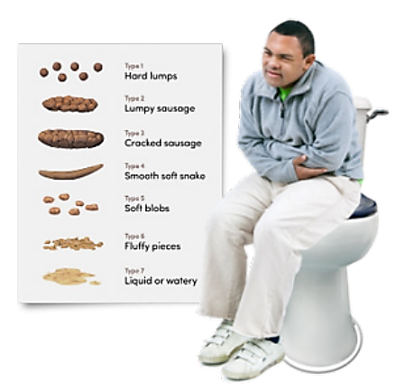
Holistic Bowel Management in Learning Disability
Working Group in Learning Disability
Antipsychotics Audit in CLDS
Training for Learning Disability Nurses at Barts
NEL Primary Care Data collection
Data Analysis
Share findings with stakeholders
Hannah Style Shiva Fouladi-Nashta
Professional Development Lead Dietitian Learning Disability Community Liaison Pharmacist
hannah.style@nhs.net shiva.fouladi-nashta@nhs.net

Slide 2



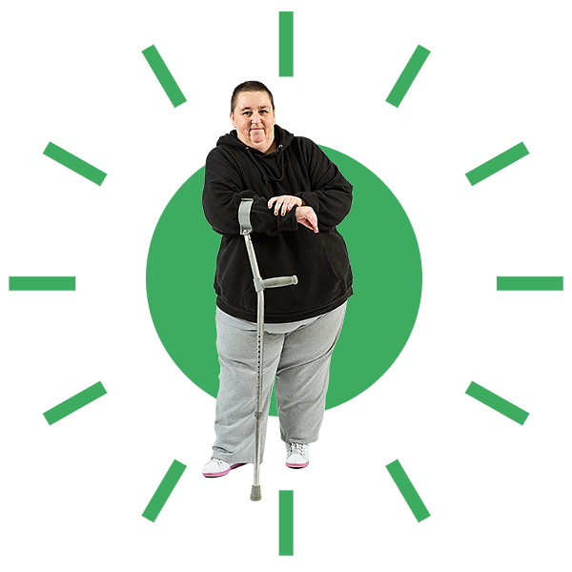








Why does a person with a learning disability have a higher risk of constipation?
Muscle wastage and progressive neurological conditions
Inadequate opportunities to go to the toilet
Reduced mobility and sedentary lifestyle
Dehydration risk with inadequate fluid intake
Anti-cholinergic medications
Inadequate dietary fibre intake
Notes:
23% people with LD who died prematurely had chronic constipation (LeDeR 2019)
33% people with LD who died prematurely had laxatives (LeDeR 2019)
Primary (lifestyle), secondary (medical condition), latrogenic (side effects of medications)
Poor mobility
Reduced range of activity
Abnormal muscle tone/spasticity
Cognitive/functional impairments
Lack of toileting opportunities
Toilet not meeting needs (e.g. too high, requires sides and so on…)
Fear of toileting (Autism)
Medications
Reduced fluid intake
Limited diet
Modified diet takes some fibre out of natural diet
Lower expectations from parents/carers for toileting

Slide 3

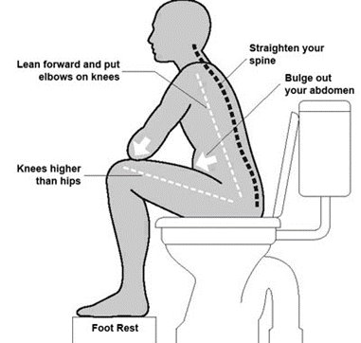





Detect Constipation
Rule out Red Flags
First-line Lifestyle Advice
Onward referrals
First-line Medication Advice
Total Bowel Management Protocol
Abdominal massage
Biofeedback
Behavioural therapies
Irrigation
Digital stimulation
Bowel cancer screening
Incontinence team
Reduce anti-cholingeric burden
Enhance laxatives
< 3 bowel motions / week
No bowel motion for 3 days
Hard, dry, lumpy stools
Difficult / painful to pass stool
Sensation of incomplete evacuation
Notes:
1) Detect Constipation
As defined by LeDeR (2019) & NICE 2019:
Bowels not opened for >3 days
Bowels not opened at least 3 times in a week
Stools which are hard to evacuate
Stools which are:
Larger than usual
Dry, hard e.g. pellets
After a long time between passing soft stool passing
Malodourous stool
2) Rule out Red Flags – mention screening test for Bowel Cancer
Blood and/or mucus in stool
Recent significant changes in bowel habits
Vomiting
Abdominal pain
Palpation: evidence of large bulky mass
Overflow diarrhoea
Pale pallor and sweating
Obviously unwell
Regular use of enemas
Smearing – “skid marks” or attempted self-evacuation
3A) First-line Lifestyle Advice
Dietary Advice (increase fibre, probiotics, and enhance fluid)
Toilet opportunities and routine
Optimise positioning
Increase activities/mobility opportunities (can do this in chair)
Monitor bowel output, food and fluid intake
3B) First-Line Medication Advice
Reduce anti-cholinergic laxatives
Antipsychotics
Benzodiazepines
TCAs
Antiepileptics
Enhance laxatives
If opioid or medication used - Osmotic or stimulant laxatives
Non-medication induced – start with bulk forming laxative
4) Onward referrals
Abdominal massage
Biofeedback
Behavioural therapies
Irrigation
Digital stimulation
Bowel cancer screening (offered to ages 50-74yrs)
Incontinence team

