Slide 1
Culture First - Developments in AHP Quality and Safety
Rachel Wakefield
Regional Chief Allied Health Professional & National CAHPO Portfolio Holder Mental Health, NHS England
Notes:
Standard title slide

Slide 2
Context:
Only 15-21% of people who need mental health services can access them compared to ‘virtually 100% in physical health’.
In February 2024, the Department of Health and Social Care published the first statement to define ‘parity of esteem’ between mental health and physical health as well as how this can be achieved.
Whilst this will take time, we now have more clarity as to how we will get to where we need to be.

Slide 3

Context:
The new government commissioned a rapid investigation of the state of the NHS.
Whilst broad in scope, the Darzi investigation:
Spotlights the state of mental health
services in England
Notes areas of improvement
Notes serious gaps and shortcomings and looks at why

Slide 4
Quality, Safety & Culture:
The NHS constitution describes the purpose of the NHS and was used as the foundation statement for the Darzi investigation. It illustrates that how we work is at the heart of the NHS.
The NHS “is there to improve our health and wellbeing, supporting us to keep mentally and physically well, to get better when we are ill and, when we cannot fully recover, to stay as well as we can to the end of our lives. It works at the limits of science – bringing the highest levels of human knowledge and skill to save lives and improve health. It touches our lives at times of basic human need, when care and compassion are what matter most.”

Slide 5


Quality, Safety & Culture:
And yet we have continued to see cases of
poor care and inhumane treatment,
sometimes at scale, of some of our most
vulnerable citizens.

Slide 6
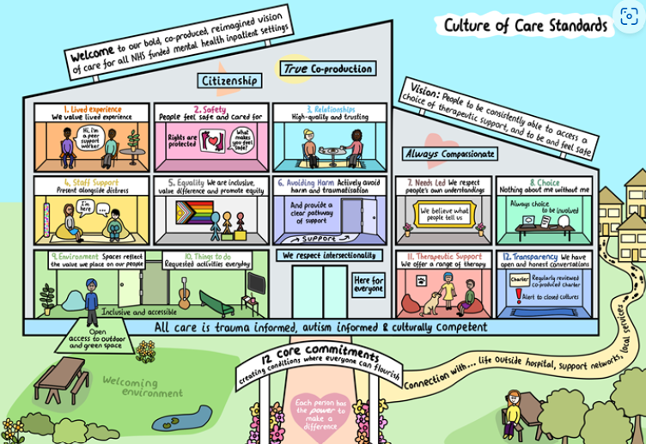

Quality, Safety & Culture:
NHSE Culture of Care Programme:
A culture which feels like care is at
the centre – patients and staff feel
cared for and can provide the care
they want to.

Slide 7
Quality, Safety & Culture:
The relationship between quality and safety and organisational culture is well established.
Roger Kline, BMJ Leader 2023:
How staff are treated (including whether they experience discrimination) directly impacts on patient care
Diversity - underpinned by inclusion – improves staff engagement, retention, innovation, productivity and quality and safety
Inclusive teams are more likely to be psychologically safe which means people can speak up

Slide 8
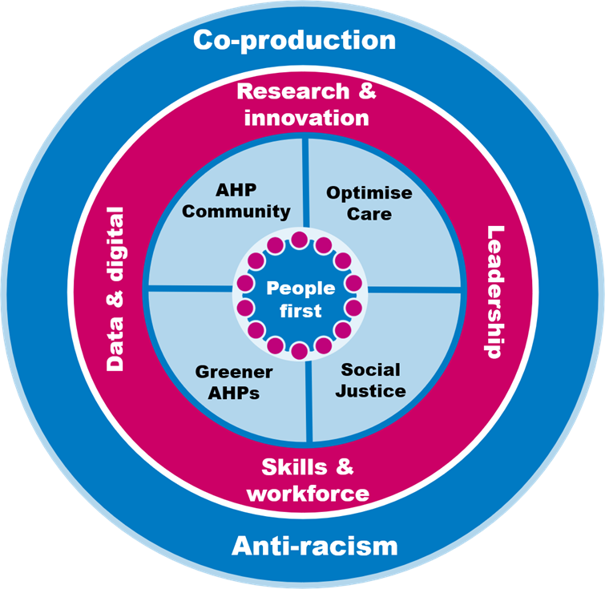
Quality, Safety & Anti-Racism:
Our shared commitment to anti-racism can
and must be seen through the lens of quality
and safety – for people using and working in
services.

Slide 9

Quality, Safety & Culture:
As AHPs we have been transparent about poor culture - and clear about expectations.
We all have a role to play in creating and maintaining the culture of the places we work.

Slide 10
Quality, Safety & Culture:
All staff should expect to be treated with respect, valued for their contribution and experience professional inclusion.
However, there is research evidence emerging that suggests this does not always happen for AHPs, in both terms of quality and safety governance and within mental health in-patient settings.
This adversely impacts on patient care; we need diverse, inclusive, nurturing and cohesive teams at every level and across our systems.
This research presents an opportunity to talk about culture through the lens of quality and safety, to listen and learn from each other and to build and sustain the cultures we need for safe, high-quality care.

Slide 11
Contact:
rachel.wakefield7@nhs.net

