Slide 1
NHS ELFT: Early Years Speech and Language Therapy (SLT) Staff wellbeing feedback
Zainab Issa (Highly Specialist SLT)

Slide 2




Why wellbeing?
Notes:
May 2022: Lots of staff leaving, staff sickness (3 on long leave), staff withdrawn, fatigue, post covid intensity in waiting times, “blitz”, career changes, burned out, staff sickness hike etc…
Quality service starts at the top and trickles down. We feel it internally.

Slide 3
—RCSLT Report: The Sustained Impact of COVID-19 on Speech and Language Therapy Services in the UK consequences of concern.
“Respondents were invited to leave any further comments in response to this question. The most predominant theme in these responses was the consequences of this increase in demand on SLTs themselves, particularly pertaining to their wellbeing. ‘Negative impact on staff wellbeing’, ‘staff burnout’, ‘staff leaving’ and an ‘increase in unpaid overtime’ “
Notes:
At the same time nationally:
Jan 2022 RCSLT Report: The Sustained Impact of COVID-19 on Speech and Language Therapy Services in the UK consequences of concern.
Big problem= staff leaving, high waiting times and even more pressure left for the staff left behind.
So RECRUITMENT WAS EVEN HARDER.

Slide 4
Team goals
Feel heard
Boost morale
Staff retention
Empowerment
Not just “lip service” or a “one off” tick box.
We want staff to love thier job and this transfers onto service users.
In line with ELFT’s strategy. More staff= shared load.
Staff to join forces in manifesting wellbeing.

Slide 5
Staff survey questions:
On a scale of 1-5 (1= Very unhappy and 5= Very happy) how you are currently feeling working within the Early Years SLT service?
Please give us 3 words or phrases to describe how you currently feel working in the Early Years service.
List at least 3 “hacks” or “top tips” which have helped you personally manage your work well-being.
List 3 ways in which you feel your staff experience could be enhanced in the short term (i.e. within the next few months). Please share practical ideas to achieve this.
List 3 ways in which you feel your staff experience could be enhanced in the long term (i.e. within the next year). Please share practical ideas to achieve this.
Please share any other thoughts or comments with us.

Slide 6
Feedback:
- Shortened clinic days (protected admin time)
- Flexible working
- Progression competencies
- Efficient processes
- Staff socials
- Supervision focusing on wellbeing too
- Anti-racism work (recent film session)
- Group therapy
- Increased SLTA workforce
- Shadowing and CPD
Notes:
The “golden thread”

Slide 7
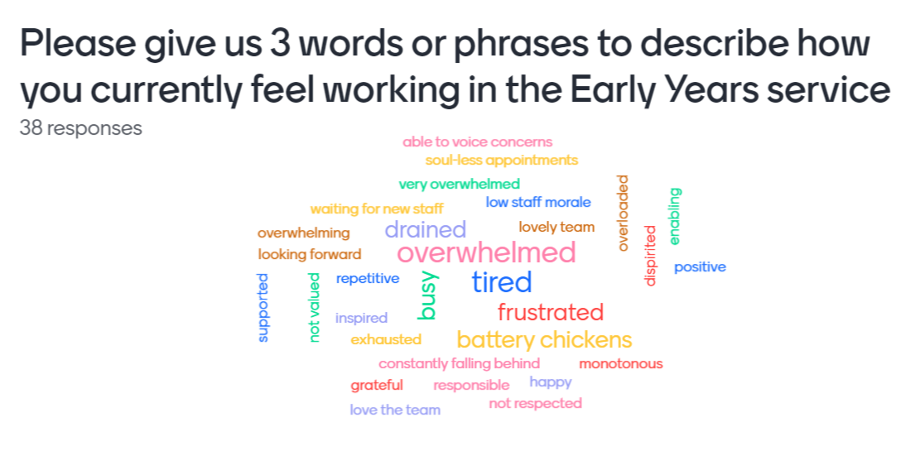
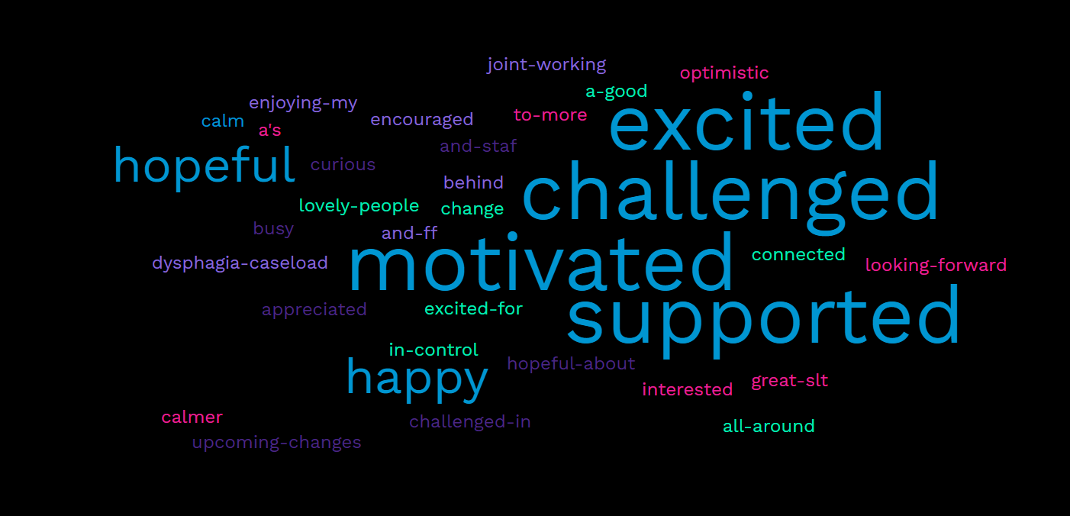
Findings so far…
Notes:
2.85, 4.3, 4.2
July 2022, May 2023
Soul-less appointments= affecting our service 100%

Slide 8
Staff comments…
This team is THE BEST....
Thank you for these follow ups- it feels like this topic is not just a tick box
I love this team so much!
Love the fact that there is a wellbeing survey :)
Our team makes going to work a pleasure!
I like working here :) Emma is a great manager and I look forward to spending time with the team. I've been struggling with my mental health and being at work helps because it is such a nice atmosphere.
Love the team and it feels very supportive and kind.
It feels great to be offering more to families! e.g. jet set / tuned in / extra blocks if needed. It makes a big difference to them and therefore our job satisfaction. Also great that school aged children are being prioritised meaning less overhang and 'PAC Blitzing'!
EY is quite stressful at times because the admin load is so heavy and the turnaround time is so fast, but it makes such a difference to have such a supportive lead! Thank you Emma :)
Notes:
https://www.menti.com/alqbbdcobb5y

Slide 9
Next steps
Wellbeing ambassadors across SLT and SCYPS
Survey
1
Analysis &
feedback
3
Repeat survey
Once a year
2
Currently ongoing with schools SLT team
4
“You said we did” document and face to face feedback
Continous monitoring
Notes:
Note:
Lots of work to still do as wellbeing is a VERB not a noun.
Refine data (split post vs all EY), audit the number being completed vs total staff number, repeated themes? Leavers survey
PREMS PRE + POST Wellbeing improvement on service provision!!!
Outcome measure progress in therapy for both staff satisfaction and service value.
Not JUST wellbeing.

Slide 10
Thank you!
(We really do):
- Care
- Respect
- Aim to be Inclusive
Notes:
Contact email.

