Slide 1

Welcome!
#ELFTAHPCONFERENCE2024 #AHPsDay
Notes:
Welcome!
Today is a wonderful opportunity for AHPS working across a wide breadth of roles, services, settings and locations to come together. I hope you will have the opportunity to connect and celebrate the fantastic work AHPS are leading across ELFT.
As you know it will be 7th National AHP Day on Monday 14th October. The theme is Quality and safety is the key theme for AHPs Day 2024. This aligns with the AHP strategy for England (2022-2027): AHPs Deliver, which emphasises the importance of providing exceptional care to the people and communities we work
Thank you to everyone that is presenting today and who has prepared posters, all work is available to view via QR code links and poster display.
Flags – QR code to main room presentations available to download and view during/after conference – there will also be Links to seminars and posters this pm.
Flags – Evaluation Form – complete as you go or at the end
Agenda/Breaks/Toilets/Coffee
This morning we will be based here in main room with a morning break and after lunch we will head upstairs to our seminar sessions before finishing with our awards presentations. You will have been advised at registration of the seminar allocation but there will also be lists on the seminar doors.
We have a great programme and I hope you will feel proud and inspired during the day.
Selfie board and social Media
Scribe capturing the key themes and actions from the days speakers and discussions and opportunity to share your reflections, thoughts and actions over breaks.
Welcome Lorraine

Slide 2
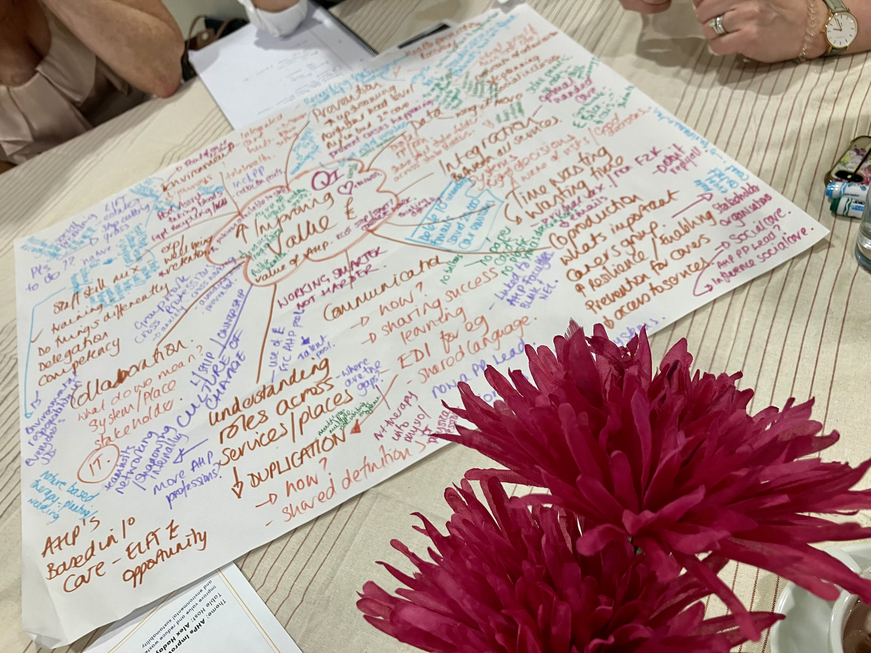
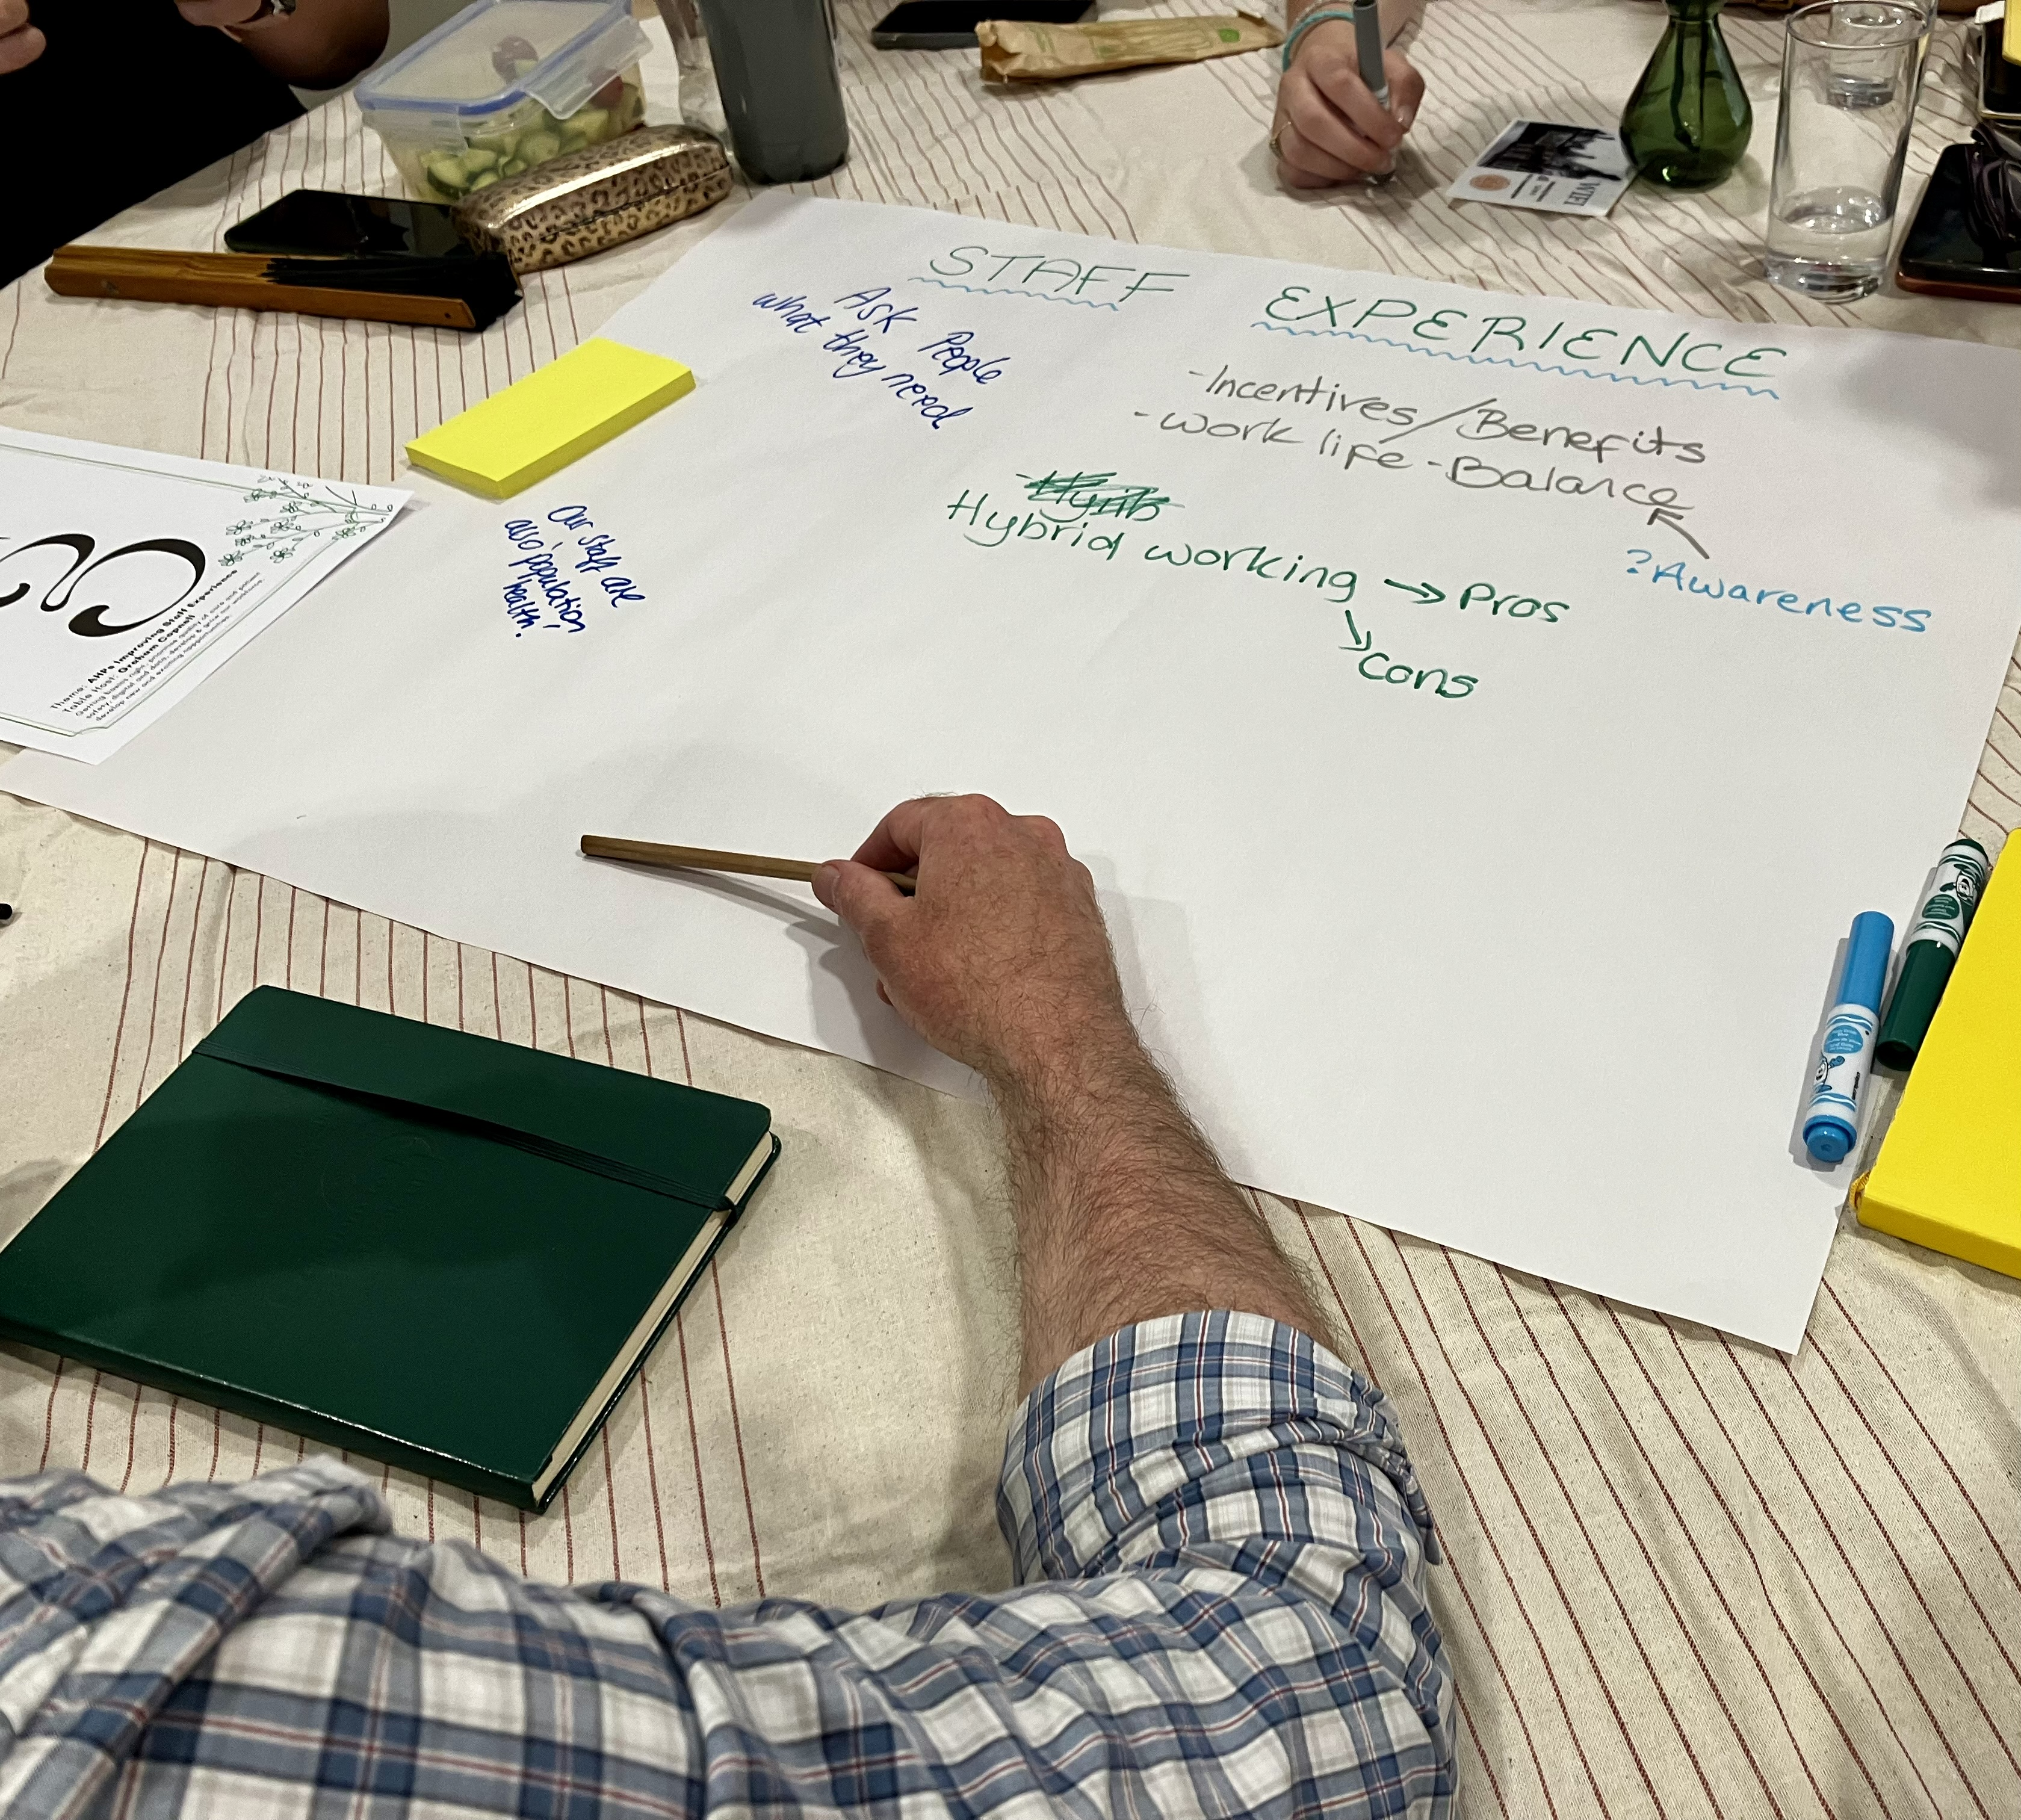
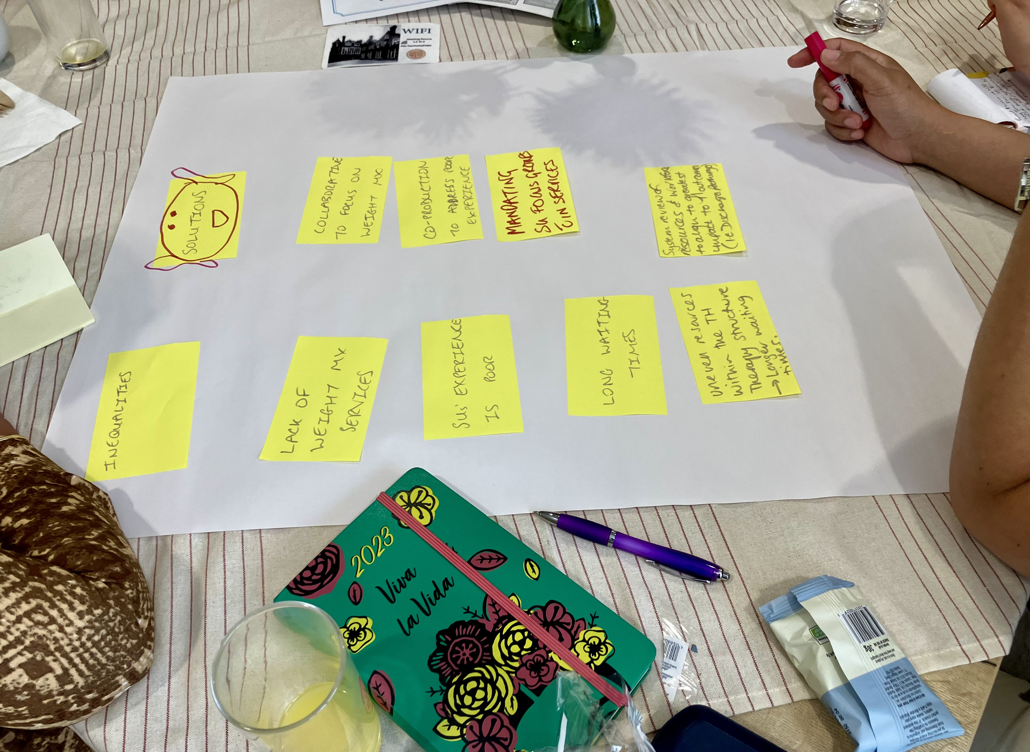
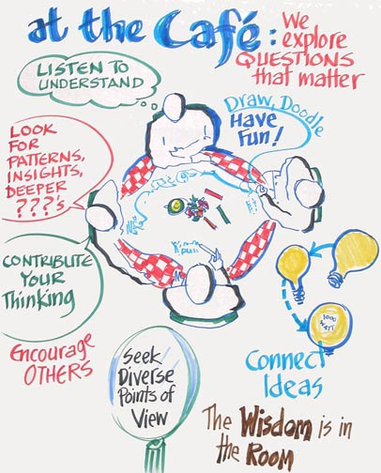

Our vision to “Grow and Develop AHPs at ELFT to Reflect and Meet the Needs of Our Service Users” Fiona Kelly ELFT Director of AHPs
Notes:
Our conference has been shaped around the ELFT AHP Annual Plan and Priorities to support delivery of the ELFT overall strategic mission to improve the quality of life for all we serve.
Our overall AHP mission is to Grow and Develop AHPs at ELFT to Reflect and Meet the Needs of Our Service Users. This includes a commitment to enable AHPs to develop across all x4 pillars of professional practice clinical, education, research and this leadership.
I wanted to share the journey and development of the AHP Priorities with you today.. Importantly this is as an evolving and iterating long term plan that needs to adapt and be agile to respond to challenges and opportunities.
Todays conference and discussions today will continue to inform the AHP Priorities as we connect and collaborate. During the conference you will have the opportunity to sign up to an area of interest so we can continue to update, network and connect beyond today.
Our AHP Hub on the Intranet will be a key point of information and communication.

Slide 3

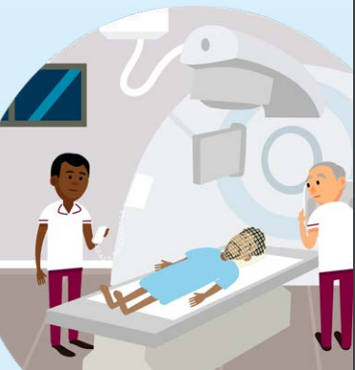
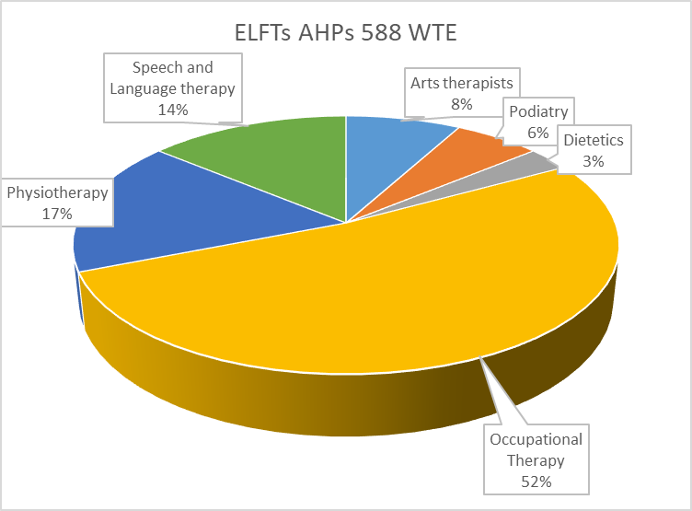


Thank you!
art therapists
dietitians
dramatherapists
music therapists
occupational therapists
operating department practitioners
orthoptists
osteopaths
paramedics
physiotherapists
podiatrists
prosthetists and orthotists
diagnostic and therapeutic radiographers
speech and language therapists
AHP support workers
Allied health professionals (AHPs) in ELFT:
work across the breadth of Trust services including inpatient, primary care, local authority and community settings.
hold a wide range of diverse roles and transferable skills encompassing Education, Leadership, Clinical and Research.
Lead within & beyond professional roles (Operational, QI, place based, ICS and pathway transformation).
Notes:
At ELFT we have a fantastic, diverse AHP Community (just under 600 WTE), 9/14 professions. As you are all aware AHPs deliver services (NEL, BLMK and specialist services) across the Trust, across the lifespan and all settings including health, social care, education and community.
Our AHP Community includes registered AHPs, AHP Support Workers, Apprentices, Students, AHPs in Advanced Roles, AHP Clinical Academics and Researchers. I am immensely proud and inspired as I continue to have the opportunity to visit and hear about the work you do everyday to improve the quality of life of our service users and local communities. I want to thank you all for your passion and commitment. We will hear today many examples of improvement and innovation within services and of compassionate leadership and support for each other.

Slide 4
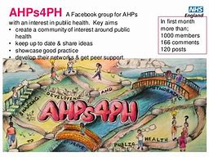
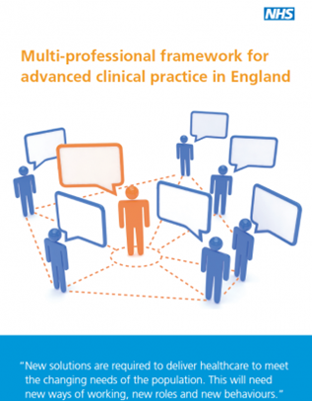

NHS staff are profoundly passionate and motivated to raise the quality of care for patients. Their talents must be harnessed to make positive change. The best change empowers patients to take as much control of their care as possible (Lord Darzi 2024)
AHP Opportunities: BCYPS, Adult, MH & CHS
AHPs Deliver care across life course, within health, Education, social care & wider community settings
Primary care & wider community roles
Public Health and MECC
How?
Integration: Focus on place based, integrated, person centred holistic pathways: prevention, rehabilitation, and community based care, closer to home.
Workforce: Optimising, supporting, growing and developing variety of AHP and AHP support worker careers.
Leadership: Develop and support
Digital & Data: Workforce planning, Quality & Impact
COVID Impact & System pressures
Rising Demand & Complexity: LTC, Ageing & growing population.
Impact of socioeconomic, climate, wider determinants of health and health inequalities
Climate Emergency
Staff experience and inequalities (WRES)
Workforce recruitment & Retention
Financial Viability Programme
Key Focus on:
1/ Prevention & admission avoidance
2/ Integrated Community Based Care & Supporting people with LTC
3/ Digital & Technology
Notes:
We are all aware of the wider context and challenges faced across the Health and Care System, which you will be experiencing every day within clinical practice and leadership. Reflected in recent NHS and Social Care reviews, national and system strategy and policy (Darzi 2024, NHS LTP and Workforce Plan).
There is clear recognition that doing more of the same is not the solution and a person centred approach that holds prevention and supports people to live and be supported within their communities needs to be embodied to optimise the use of the available resources. This requires thinking creatively and differently and this includes developing the pathways, workforce and enabling technology to deliver.
Our AHPs community are uniquely positioned to support and lead in this work. However, the level and combination of challenges can feel overwhelming.
Having key priorities and working in partnership, both as an AHP community and connected to wider Trust, place based, System, Regional and National initiatives will enable us to go Further Together; with improving quality and experience of care at heart of all we do.

Slide 5
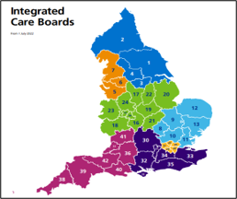


Chief AHP Officer NHSE
Suzanne Rastrick
NHSE Regional Chief AHP
Rachel Wakefield (EofE)
Phillipa Wright (London)
Regional AHP Boards
NHSE Regional AHP Workforce training and Education Lead (London & EofE)
BLMK/NEL AHP Councils
(Hannah Harniess Chief AHP NEL ICB) BLMK Chief AHP TBC)
BLMK & NEL AHP Faculty Leads
BLMK and NEL AHP Faculty Worksteams
Notes:
Our ELFT AHPs are also part of the wider AHP Community across our Regions and Integrated Care Systems.
The NEL and BLMK AHP Councils and Faculties bring together leadership across provider organisations, health and social care, VCS partners, HEIS, HEE (TWD) and ICB workforce leads. Identify AHP priorities and opportunities, connect to ICS and support delivery of the ICS Strategy and Priorities.
You may already be involved in workstreams led by the AHP Faculty – BLMK AHP Faculty are here today.
We will also be joined today by Rachel, Hannah and Steve.

Slide 6

Developing our ELFT AHP Vision and Priorities
Listening and Connecting
Time with AHPs, Directorates, PPL, place based and wider system partners
Refreshing:
AHP Board
AHP workforce and Education Committee
AHP Plan 2021-2025
Engaging and Celebrating:
Greener AHPs Jamboard April 2023
AHP Research and Innovation Webinars
AHP Senior Leadership away workshops July 2023 & Feb 2024
Visiting series and Team Away days
AHP Week October 2023
Building Our Future:
24/25 Delivering our AHP Priorities
1/ Data & Informatics
2/ AHP Wide Projects
3/ Connecting and Collaborating
Feb 2023 to March 2024
Notes:
Over the course of a year, using an appreciative enquiry approach, I have worked with AHP leaders, spent time with services and reviewed AHP data insights (e.g Staff survey, workforce reports) to explore successes, what matters most, challenges and priorities for improvement.
A design principle throughout has been seeking to support/align the AHP priorities with initiatives within services, directorates and professional groups -identifying where there are areas of commonality and opportunities for collaboration.
Working with senior leaders, we agreed the AHP Strategic priorities to include within our annual plan using nominal group technique, affinity diagram and multi voting.
Having key priorities and working in partnership, both as an AHP community and connected to wider Trust, place based, System, Regional and National initiatives will enable us to go Further Together; with improving quality and experience of care at heart of all we do.

Slide 7

Trust Strategic Objective
Priority areas for the service
Defined workstreams / projects / programmes for 24-25
Living Well
Working with our communities to enable equitable health promotion, prevention and living well.
Projects working with service users and communities to support prevention, self-management and patient activation.
AHPs involved within community place-based models of care and clinical pathway innovation e.g. Trieste, Intermediate Care and Integrated Neighborhood Teams
AHP Primary Care roles development and support
Improved Population Health
AHP Leadership
Raising visibility, diversity, reach & influence within clinical pathways & system transformation.
Project to develop and support diverse AHP Leaders who are able to be authentic, bring whole selves to work & reflect the communities we serve.
Review AHP leadership structures, support and development opportunities
Develop AHP communities of practice and/or professional networks
Celebrating and share AHP innovation and success through conferences, website and newsletters
AHP 2024/25
Annual Plan Priorities
To Grow and develop AHPs at ELFT to reflect and meet the needs of our service users
Improved Experience of Care
AHP Workforce Development
Growing and developing diverse AHP careers with equity of opportunities
Recruitment and Retention Project with focus on AHP Development Band 5-7
Scope AHP Workforce dashboard
AHP Support worker development project
Apprenticeship and undergraduate placement expansion
AHP Advanced clinical and consultant practice expansion
Improved Staff Experience
High quality, safe, effective and sustainable healthcare
Enabling right care, right time and right place to improve health outcomes.
Increase AHP use of digital tools and enabling technology to improve access and pathway efficiencies
Implement AHP job planning
AHP Annual safe staffing reviews
Widening access to AHPs to meet physical health needs in mental health
Scoping AHP Quality Dashboard
Develop AHP Clinical effectiveness champions/forum (Education/QI/Research)
Develop ELFT AHP champions/networks within Sustainability, Digital and EDI
Improved Value
Notes:
Our Annual Plan is available to view on the Intranet – link via the ELFT AHP Hub.
To achieve our mission of Growing and Developing AHPs at ELFT to meet and reflect the needs of our service users we identified x4 priority areas, each with a specific improvement project (red) and all with key requirements around 1/ AHP Data & Informatics and 2/ Connecting and Collaborating.
1/ Living Well
2/ AHP Leadership
3/ AHP Workforce Development
4/ High Quality, Safe Effective, Sustainable Healthcare
Work on the projects and priorities are primarily through bringing together work within this theme that is being led within service/directorate/professional groups. Creating the opportunity to identify areas for collaboration, share successes, opportunities to extend work or need for shared approach.
Will now share a brief update on key activities to date and planned in each area.
Todays conference and discussions today will continue to inform the AHP Priorities as we connect and collaborate. During the conference you will have the opportunity to sign up to an area of interest so we can continue to update, network and connect beyond today.

Slide 8

Living Well
We will work with our communities to enable equitable health promotion, prevention and living well.
Leads: Marion Levine
Sponsor: Fiona Kelly
Progress:
1st July AHP Living Well Workshop with Pop. Health Lead & Working Together Group | Aim: Support an ELFT AHP community of practice; working with people who are passionate about improvement work seeking to: Address health inequalities using a population health approach Develop early intervention and prevention pathways Enable access to the right care, right time, right person, right place Develop place based and partnership working to improve service user experience and health and well being Deliver sustainable healthcare
X11 projects
MHLDA, CHS & BCYP
Primary Care/Community/Vol Partnership
Future:
AHPs Making Every Contact Count Workshop Jan 2025 Continue to link AHPs to local & system integrated improvement/collaborative work streams
Notes:
Living Well - Create AHP Communities of Practice (system focused) to develop sustainable, integrated, upskilling models to optimize resources and support prevention/recovery/rehabilitation/LTC management within community.
Establish AHP Education/QI/Research/Knoweldge Forum to Share improvement/innovation/pathways across AHP roles/services
Support development of AHP roles (including advanced roles) within primary care, community, public & population Health
Further develop integration across primary care/health/social care and Phys/MH pathways

Slide 9
AHP Leadership
We will raise the visibility, diversity, reach and influence of AHPS within clinical pathways and system transformation
Leads: Graham Copnell, Rushmi Kanjee and Fiona Kelly
Sponsor: Fiona Kelly
Progress:
New! AHP Intranet page and AHP email circulation
✓ELFT AHP Conference ✓ELFT AHP Day and AHP Research and Innovation Webinars ✓Many examples of AHPs leading service and clinical pathway transformation ✓Review of AHP WRES and Career Progression Data
Future:
AHP Career Progression focus groups to: Explore the individual career pathway experiences of AHPs from Black, Asian and Minority Ethnic Backgrounds Co-design change ideas and improvement actions Connecting AHP Leaders to Trust/System/Regional and National workstreams Explore AHP Learning Forums/Professional Networks and Communities of Practice Explore AHP Leadership support and development opportunities
Notes:
AHP Leadership
Develop diverse opportunities e.g Clinical Academic and Clinical Research opportunities
Support people within roles – mentor/coaching/action learning/operational management/prof networks

Slide 10

AHP Workforce Development
We will Grow and Develop diverse AHP careers with equity of opportunities
Leads: Graham Copnell/Julie Archer/Nicola Larter
Sponsor: Fiona Kelly
AHP Support worker project Over 145 AHP support staff identified across ELFT Support Worker Survey (over 80 Reponses) MS Teams Channel developed AHP Workforce Information Dashboard under development Internationally recruited AHPs pastoral support and resources Apprentices x18 OT, x2 Physio, x3 podiatrists graduating 2024. ELFT AHP Preceptorship Programme recognition award. X7 Trainee AHP Advanced Clinical Practitioner and x2 Trainee Multi-professional Consultant pathway B7 Practice Education Facilitator Post under recruitment (FTC)
Progress:
Future:
Further work to develop Recruitment and Retention Project -focus on AHP Development Band 5-7 Connecting to CHS Workforce Steering group to support key areas
Notes:
Lots of great examples in the seminar this pm and keen for people to get involved in this work

Slide 11
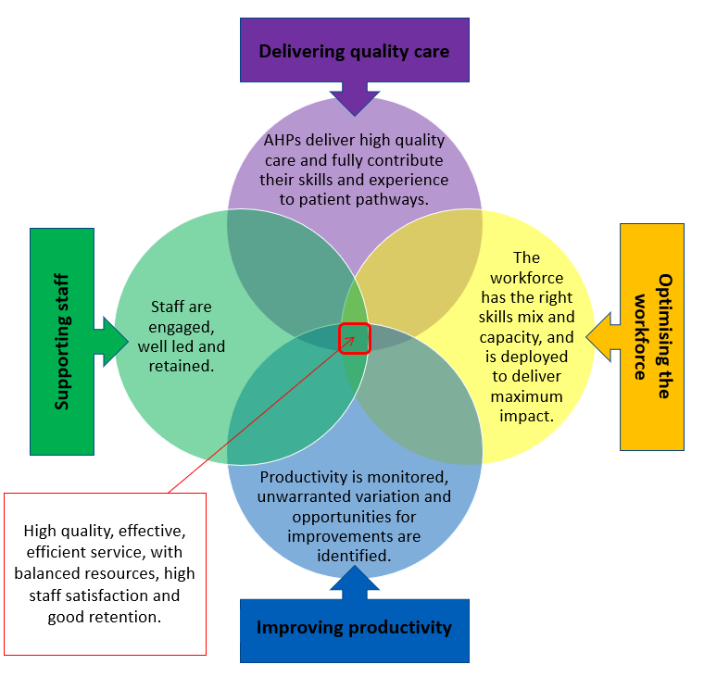
High Quality, Safe, Effective & Sustainable Healthcare
We will deliver High Quality, Safe, Effective and Sustainable Healthcare
Leads: Julie Archer, Graham Copnell and AHP Directorate Leads
Sponsor: Fiona Kelly
Progress:
✓AHP Job planning Project Business case developed for e-job planning software x8 early adopter pilot sites to co-design, test and trial methodology, using QI and other measures ✓AHPs supporting physical healthcare in mental health & Population Health groups ✓AHP Quality Dashboard Framework under development ✓Digital pathway innovations (MSK/CAHMS/Forensic) ✓AHPs linked to Trust Climate Network
X2 ELFT AHPs awarded the CAHPO Greener AHP Badge
CAHPO Digital Practice Award Runa Park (Arts PsychoTherapist) Shortlisted Nominee
Future:
Share learning from AHP Job Planning Pilots
Grow and establish AHP Digital and Greener Champions
NHSE AHP Quality Dashboard
Notes:
Job planning at ELFT is a strategic approach designed to align your unique roles and contributions with our collective goals, ensuring a balanced and fulfilling professional life

Slide 12
Invitation to get involved:
Who can get involved?
Any member of the ELFT AHP Community Registered and Support staff
What is the commitment?
You will receive invitations to get involved in related work
Time limited task and finish/QI groups over the next 6-12 months
Why get involved?
You are passionate about the area and keen to contribute existing work or new ideas
It aligns with work you are doing within your team/service/directorate/professional group
Development opportunity
This work provides potential opportunities to work with colleagues from across the organisation and be connected to wider work (AHP corporate, Trust, AHP Council/Faculty, system, regional and national initiatives)
QR Code to sign up

Slide 13
Thank you
Fionakelly2@nhs.net
X @fionakellyelft
Linkedin
AHP Hub:
https://www.elft.nhs.uk/intranet/things-support-me-do-my-job/allied-health-professionals-ahp-elft
AHP Corporate Team:
Graham Copnell AHP Professional Development Lead
Emily Matthews AHP Professional Development Lead (Beds and Luton)
Nicola Larter AHP Support Worker Project Lead

