Slide 1


Freedom to Speak Up
Anita Hynes
Freedom to Speak Up Guardian
ELFT Allied Health Professionals Conference 2024

Slide 2


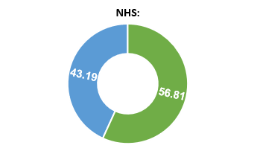
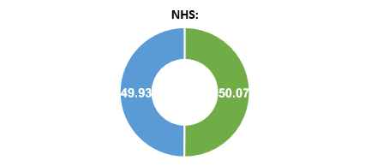
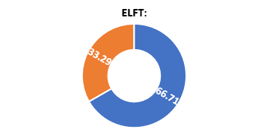
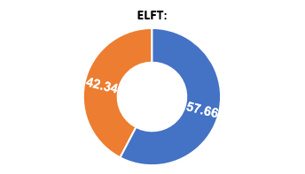
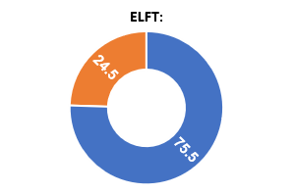
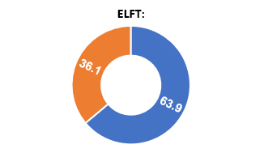
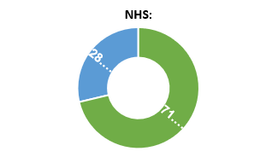
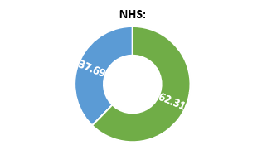
NHS Staff Survey 2023 – Speaking Up
I feel secure raising concerns about unsafe clinical practice.
I am confident that my organisation would address my concern.
71.3%
75.5%
56.8%
63.9%
I feel safe to speak up about anything that concerns me in this organisation.
If I spoke up about something that concerned me, I am confident my organisation would address my concern.
62.3%
66.7%
50.1%
57.7%

Slide 3
Freedom to Speak Up Guardian
Provide an additional channel for speaking up – when colleagues feel unable to do so by other routes
Explores issues about confidentiality and options to support colleagues decide on next steps
Can and may escalate a matter on someone’s behalf
Ensure that action is taken, and that feedback is given throughout and at the end of a process. Asks for feedback from those they supported.
Work in partnership throughout their organisation to ensure a positive speaking up culture exists in all areas of the Trust
Help identify and address barriers to speaking up to effect improvement in the speak up, listen up, follow up culture
Guardians record cases and report on data, themes and learning to senior leaders so that the information presented is used as opportunities for learning and improvement

Slide 4
Freedom to Speak Up Champions
work in partnership with their FTSU Guardian and their Team/Service.
advocate the power of Speaking Up in their Team/Service.
are a point of contact for their colleagues who want to seek advice on a work-related matter.
report the themes of discussions to the FTSU Guardian.
signpost colleagues to the support available to escalate their concern. If colleagues wish to raise a concern via FTSU, direct to the FTSU Guardian.
always maintain confidentiality.

Slide 5
FTSU Data

Slide 6
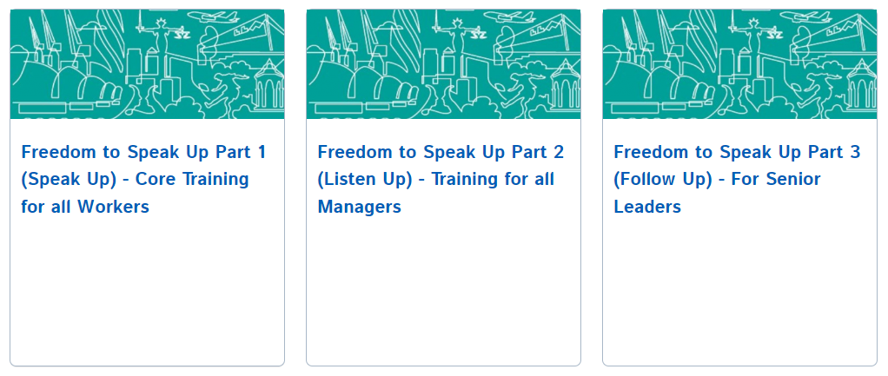
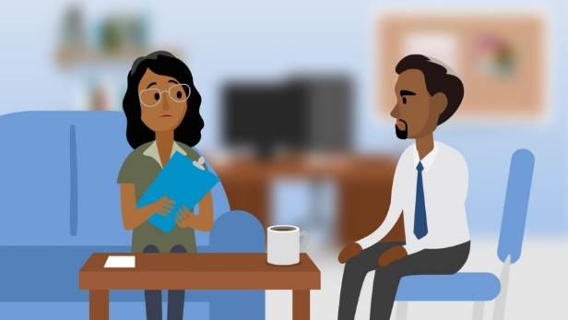
Speak Up - eLearning
Speak Up, Listen Up, Follow Up

Slide 7
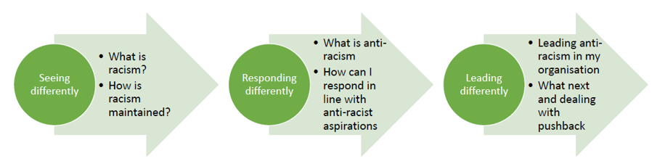
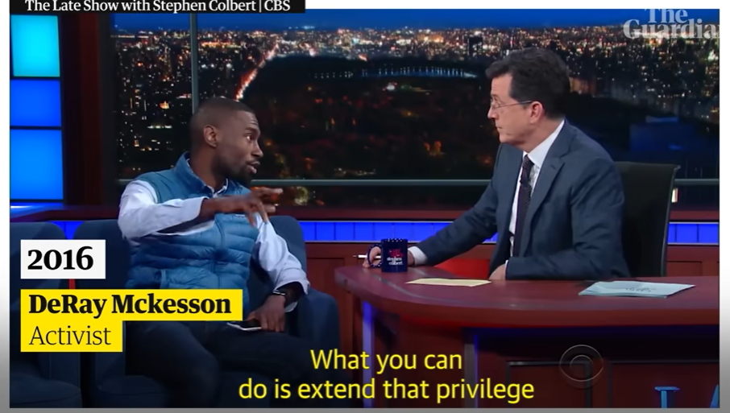
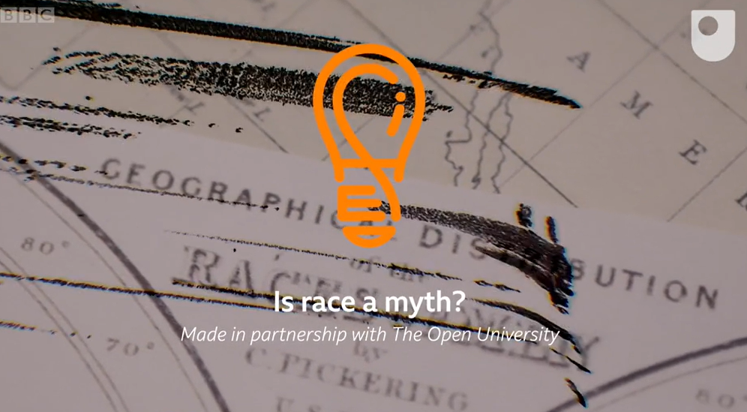

White Allies Programme
How 'white fragility' reinforces racism
The myth of race
Where have I come from and how has my whiteness shaped me?
“The beauty of anti-racism is that you don’t have to pretend to be free of racism to be an anti-racist.
Anti-racism is the commitment to fight racism wherever you find it, including in yourself. And it’s the only way forward.”
Ijeoma Oluo

Slide 8
White Allies Programme
1. How racism/inequality thrives … it’s about what you believe
Policies and laws are fair and when followed will ensure equity.
That when people who are racialised don’t succeed this is down to their poor attitude or lack of skills.
That disproportionate outcomes in favour of white people, means that Black people are less capable and need support.
Some BME people seem to be OK – so not sure what’s wrong with the others.
That I am a good person and well-intentioned, so can’t be racist.
That the people I work with have good values and therefore are not racist - they just make a few mistakes.
That if we increase the representation of BME people in positions of power, this will eradicate racism.
It is easy for people to speak up if they have an alleged race-related complaint.
That if white people get to know more about the experiences of ‘Black’ people, we will be able to change
It’s logical for Black people to be less likely to be in powerful roles, it’s to do with their lack of experience or education.
BME people know what to do about racism… we will let them do it.
We know that we haven’t always got things right - but overall, this is outweighed by what we do well.
3. Summary – beliefs that are being perpetuated…
That racism is not systemic - its about individual acts of discrimination
That some people are racially inferior
That racism is about individual likes and dislikes
That good people can’t be racist
That if people behave in accordance with our norms and values, then everything will be ok
That white people have no role in addressing racism
2. Exploring beliefs
Choose beliefs that you ‘agree’ with and that seem plausible and a couple that you totally disagree with
Explore the thinking that drives ‘the beliefs’

Slide 9
White Allies Programme
Anti-racism – What does the thinking/practice look like?
 | Thinking | Practice
Individual | Challenging the belief in different races Understanding racism as systemic Understanding ideology of racism and the role of whiteness | Nudging away from groupings/stereotypes based on racialised thinking See more than ‘colour’ Recognising the role of white presenting people in anti-racist movements and your role in maintaining the status quo
Organisational level | Not Believing that BME people are responsible for change Recognising racialised responses Supporting the active involvement of white people in anti-racist thinking | Understanding and challenging structural discrimination Supporting others to un-learn responses that maintain the status quo Replanning systems/services

