Slide 1
Loss, Learning disability and Arts Therapy: The Loss Pathway
April 2023 – April 2024
ELFT Bedfordshire and Luton

Slide 2
Background and Rationale
An increased demand for therapeutic support around loss and bereavement was noted anecdotally by the team, partially in relation to the coronavirus pandemic. This is evidenced in Graph A, which tracks the increase in the proportion of arts caseload and waiting list whose referral reasons relate to loss. Following the pandemic, approximately 1 in 3 of referrals to the arts therapies team relate to loss and bereavement.
National data supports this, recognising increased pressure on bereavement services because of an additional 750,000 deaths compared to the past 5 years (UK commission on bereavement, 2022). Increased pressure on services complexity of cases has led to poorer outcomes, with 70% of people not getting the bereavement support they need (Sue Ryder, 2022).
Locally, a Scoping and Gap Analysis Report was produced by the Bedfordshire, Luton and Milton Keynes Bereavement Alliance. It identified that one of the 6 gaps in local bereavement provision related to bereavement support for Adults with a Learning Disability.

Slide 3
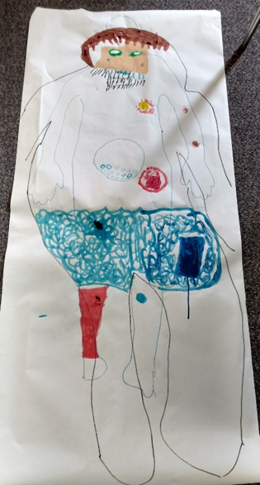
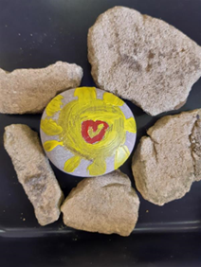
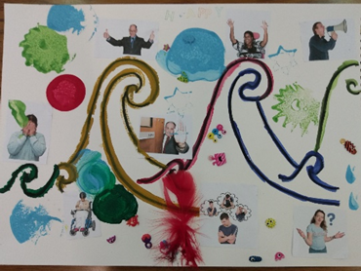
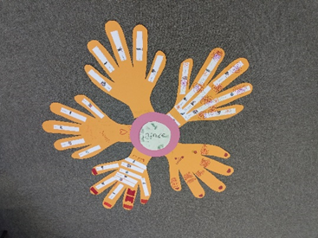
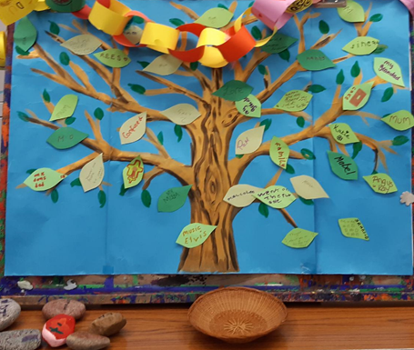
Approach and Method
From July 2022 onwards, research and planning began for a pilot Arts Therapies Loss Pathway with a dual focus:
A regular therapy group for adults with a learning disability who had experienced loss
Regular training sessions for parents and carers of adults with a learning disability who had experienced loss.
Both aspects were to be rooted in learning established through the existing research, evidence base and good practice.
Exclusion criteria included those with complex presentations, such as trauma and high risk behaviours. From this, possible service users were identified.
Easy-read information about the pathway was sent out follow-up phone calls were completed in which some service users declined the group for reasons such as preference for 1:1 or unavailability. Following this, the remaining service users were invited for 1:1 assessments.
Timeline:
Jan-Mar 2020 – Research, preparation and planning for Loss Peer Support Group
Mar 2020 – Loss Peer Support Group cancelled due to COVID-19
April – June 2020 – Development of ‘Exploring Loss’ Creative Workbook
July 2020 – November 2020 – Online Loss Support Group
Dec 2020 – June 2022 – Service focus on Covid recovery
July 2022 – Resumed research, planning and preparation for loss provision
April 2023 – Loss group assessments and therapy group began

Slide 4

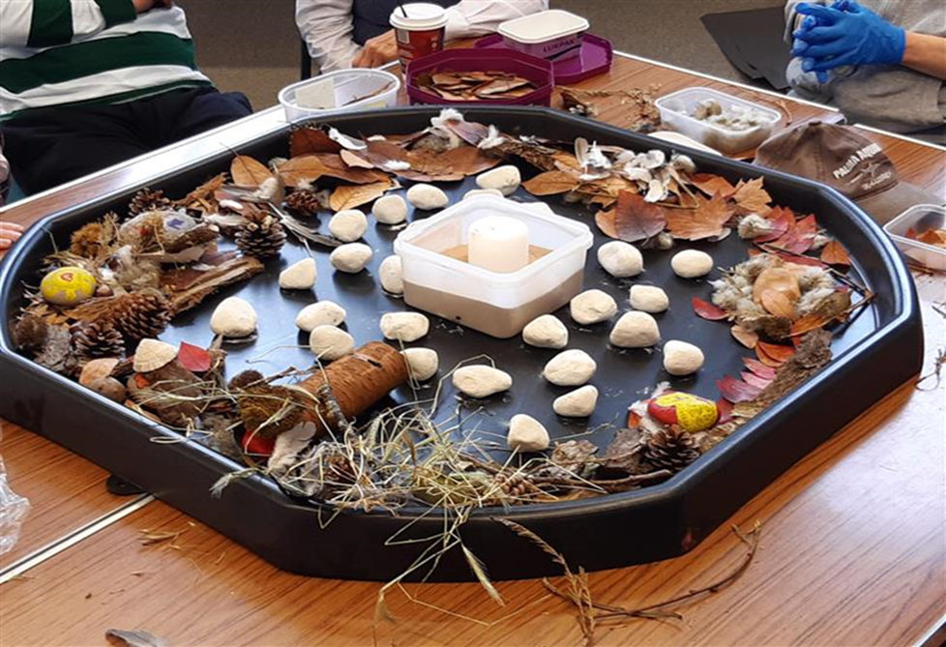

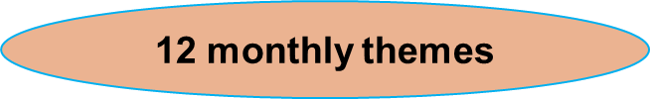
Loss Therapy Groups
The ‘Loss Pathway’ group ran one day each month for 12 months taking place at the Bunyan Museum in Bedford. Service users were offered additional shorter 1:1 sessions at Twinwoods CRC in between each group . At the end of the group sessions, therapists met with the SU and carer for an evaluation assessment. The therapy group was delivered by one Dramatherapist and one Art Therapist from the Arts Therapies Team.
The therapy group sessions created a space whereby service users could come together to share their experiences of loss and bereavement. The therapy sessions were designed to include an element of psychoeducation within each session exploring the experience of grief and means to develop tools and skills to self regulate. Peer support within this community was encouraged to explore the issues and gain insights from and with each other. The arts (drama and visual art) were integral as a means to explore and make sense of their historic losses and present bereavement. With support from the therapists, they had space in which to use directive and non-directive drama and art making alongside reflective space and time to share.
Initial Assessment | Group sessions 1-6 | Optional monthly 1-1 session | Group sessions 6 - 11 | Ending Session 12 | Post group evaluation assessment | Report and Discharge
Structure:
Understanding Life Stages Looking to the future
Exploring Thoughts and Feelings Loss and our bodies
Festive celebration Beliefs and rituals
Life Journeys Memories boxes
Support Networks Marking special days
Christmas Ending celebration

Slide 5
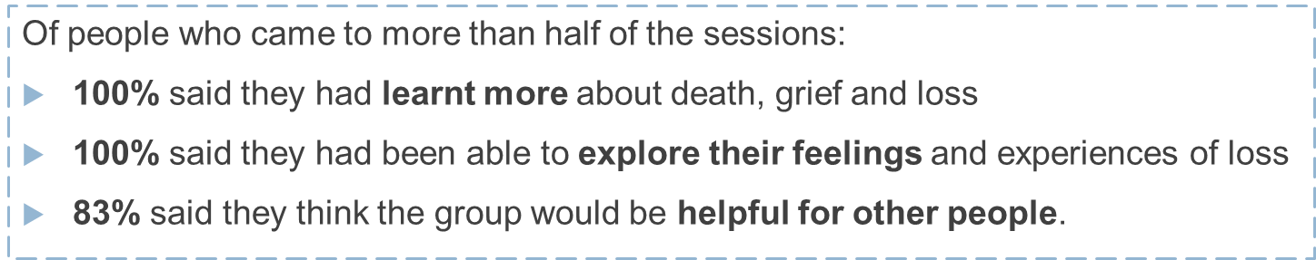
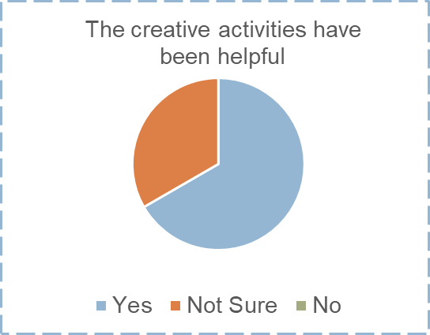
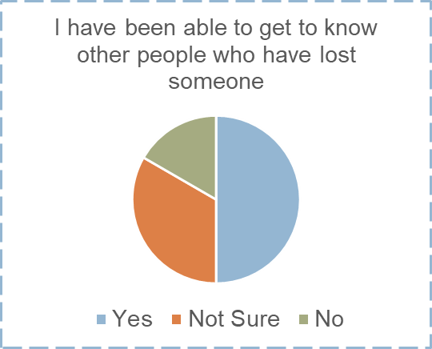
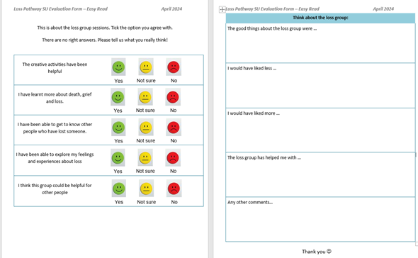
Outcome and evaluation of Loss Group – Service User Feedback
Summary:
The hopes were that by working jointly with parents and carers, the on-going grief and loss work could be established at home and be maintained.
The group aimed to develop mutual support between members and an understanding by SU’s and carers of tools and inner resources required for longer term management of grief. The group explored feelings and understanding of ‘grief now’ and juxtaposed long term ‘holding and memorialising’ incorporating this into moving to future life goals; a process lasting years.

Slide 6
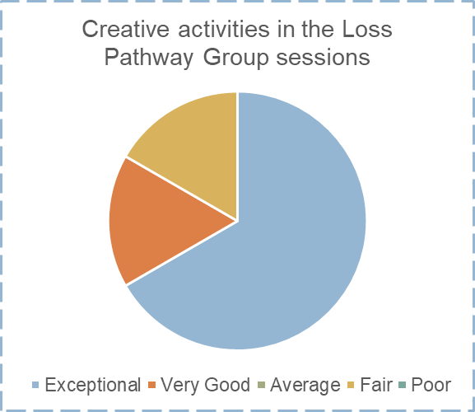
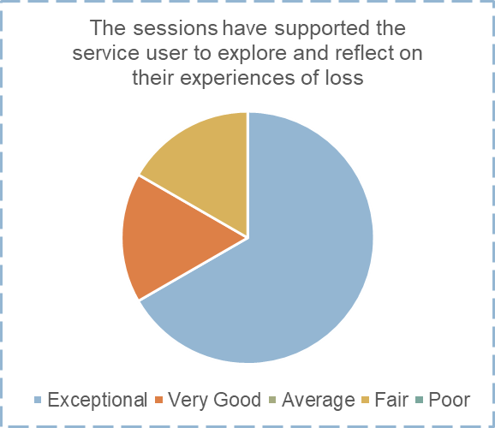
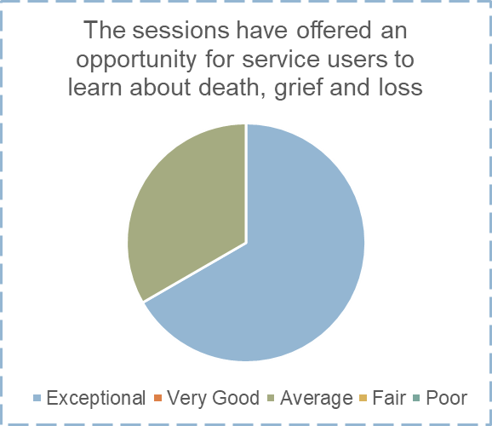
Outcome and evaluation of Loss Group – Parent/Carer Feedback
Learning points:
This pilot indicates positive outcomes for service users. Parent/carers; 83% said their overall experience of the loss sessions was ‘Exceptional’ or ‘Very Good’
All SU’s were able to be discharged from the arts therapies following the group. Feedback evidenced the majority of SU’s felt they understood more about death grief and loss and were able to reflect on their own personal journey in the bereavement process.
Recommendations for review/development:
Overall duration of group, and length of specific sessions
Adapting the group for SUs with varied communication styles
Increasing opportunity for building connections between SUs
Carer support in and between sessions
The arts therapies team continue to receive many referrals relating to loss. This pilot group was Bedford based and therefore a group based in Central or Luton area would capture those members of this community presenting in this catchment area.

Slide 7
References
A better route through grief: Support for people facing grief across the UK. (n.d.). Available at: https://media.sueryder.org/documents/A_better_route_through_grief_report_kL7fox1.pdf?_gl=1 [Accessed 28 Aug. 2024].
bereavementcommission.org.uk. (n.d.). UKCB findings - UK Commission on Bereavement. [online] Available at: https://bereavementcommission.org.uk/ukcb-findings/.
Beyond Words. (n.d.). Beyond Words. [online] Available at: https://booksbeyondwords.co.uk/.
Blackman, N. (2003). Loss and learning disability. London: Worth Pub.
Borsay, C., Halsey, M. and Critoph, A. (2012). Planning, facilitating and evaluating a bereavement group for adults with learning disabilities living in the community. British Journal of Learning Disabilities, 41(4), pp.266–272. doi:https://doi.org/10.1111/j.1468-3156.2012.00751.x.
Boyden, P., Freeman, A. and Offen, L. (2010). Setting up and running a loss and bereavement support group for adults with learning disabilities. British Journal of Learning Disabilities, 38(1), pp.35–40. doi:https://doi.org/10.1111/j.1468-3156.2009.00560.x.
Change (2016). CHANGE - Free Easy Read Resources - Blog. [online] Changepeople.org. Available at: https://www.changepeople.org/blog/december-2016/free-easy-read-resources.
Humphrey, G.M. and Zimpfer, D.G. (2007). Counselling for Grief and Bereavement (Counselling in practice). Sage Publications.
‌Mappin, R. and Hanlon, D. (2005). Description and evaluation of a bereavement group for people with learning disabilities. British Journal of Learning Disabilities, 33(3), pp.106–112. doi:https://doi.org/10.1111/j.1468-3156.2005.00339.x.
Marie Curie. (2024). Easy read. [online] Available at: https://www.mariecurie.org.uk/help/support/publications/easy-reads#:~:text=Easy%20read%20%2D%20Feelings%20you%20might [Accessed 22 Aug. 2024].
‌McEvoy, J., Reid, Y. and Guerin, S. (2002). Emotion Recognition and Concept of Death in People with Learning Disabilities. The British Journal of Development Disabilities, 48(95), pp.83–89. doi:https://doi.org/10.1179/096979502799104247.
McRitchie, R., McKenzie, K., Quayle, E., Harlin, M. and Neumann, K. (2013). How Adults With an Intellectual Disability Experience Bereavement and Grief: A Qualitative Exploration. Death Studies, 38(3), pp.179–185. doi:https://doi.org/10.1080/07481187.2012.738772.
O’Keeffe, L., Guerin, S., McEvoy, J., Lockhart, K. and Dodd, P. (2019). The process of developing self‐report measures in intellectual disability: A case study of a complicated grief scale. British Journal of Learning Disabilities, 47(2), pp.134–144. doi:https://doi.org/10.1111/bld.12261.
Scope. (2023). Explaining death and bereavement | Disability charity Scope UK. [online] Available at: https://www.scope.org.uk/advice-and-support/explaining-death-and-bereavement [Accessed 28 Aug. 2024].
Stoddart, K.P., Burke, L. and Temple, V. (2002). Outcome Evaluation of Bereavement Groups for Adults with Intellectual Disabilities. Journal of Applied Research in Intellectual Disabilities, 15(1), pp.28–35. doi:https://doi.org/10.1046/j.1468-3148.2002.00084.x.
‌‌Stroebe, M., Schut, H. and Boerner, K. (2017). Cautioning health-care professionals: Bereaved persons are misguided through the stages of grief. OMEGA - Journal of Death and Dying, [online] 74(4), pp.455–473. doi:https://doi.org/10.1177/0030222817691870.
Summers, S.J. and Witts, P. (2003). Psychological intervention for people with learning disabilities who have experienced bereavement: a case study illustration. British Journal of Learning Disabilities, 31(1), pp.37–41. doi:https://doi.org/10.1046/j.1468-3156.2003.00196.x.
‌Winston’s Wish. (n.d.). Winston’s Wish Homepage. [online] Available at: https://winstonswish.org/

