Slide 1
Podiatry Innovation:
MSK initiatives to address backlogs
Hardeep Mehmi
Podiatry MSK Clinical Lead - Bedfordshire
East London Foundation Trust

Slide 2
Musculoskeletal
(MSK) Podiatry
….is an area of podiatry focusing on the diagnosis and treatment of patients of all ages presenting with joint, muscle, ligament, tendon and structural issues affecting the lower limb.
MSK disorders negatively impact on people’s quality of life and ability to work due to experiencing pain as well as a reduction in mobility.
Notes:
20% of the population reports Foot pain
10% of people report foot pain as disabling, with reduced quality of life.
These include patients with Chronic disease processes incl. Diabetes and Rheumatology. Some of these pts, if not managed can result in major amputations.
Good management enables them to become active members of the community with an improved QOL and a reduced burden on the NHS in the future, preventing unnecessary surgical interventions, by managing foot pain conservatively in a local setting.

Slide 3
The Backlog
service suspension during the COVID Pandemic lead to the backlog of patients.
drop in actual staffing levels (national shortage of podiatrists)
redirecting resource to the acute sector podiatry teams, resulting from staff shortages.
The net effect is a rising caseload and relative lack of resources to achieve full recovery.

Slide 4

Driver Diagram
AIM
PRIMARY DRIVERS
SECONDARY DRIVERS
CHANGE IDEAS
Waiting List
Process
Identify the percentage of patients triaged (how many are adult and children). Offer follow up clinic appointments to Children as they are usually classified as P1 which is high priority
Criteria
Telephone triage clinics
Reduce the average waiting time for first podiatry consultation to less than 18 weeks by January 2022
Capacity
Virtual
Video consultations (e.g ACCURX)
Staffing
Reinstate redeployed staff back to MSK clinics
Recruitment of podiatrists into MSK
Feedback
Upskill existing practitioners
Referral System
Monitor PREMS and Compliments and Complaints to highlight any unknown themes
Referrals
Improve referral form?

Slide 5
MSK Initiatives
Communication
  Letters to all patients informing delays
Data cleansing
  S1 inactive patients (pre-covid) discharged
  Support workers calling with telephone questionnaires to help stratify caseload
  Separating Paediatrics from general caseload to prioritise treatment

Slide 6
MSK Initiatives
Recruitment
  Locum x2 transitioned to substantive posts
  Skill mixing – use of support workers and apprentices to assist in MSK tasks
Training
  3x pods trained in specialist MSK skills using competency framework
  Upskill all podiatry staff with basic MSK skills in staff meetings

Slide 7
MSK Initiatives
Group Education / Triage
  Education sessions for parents of paediatric patients, and adult patients
  Fast track Triage clinics
Policy changes
  New discharge policy to prevent building inactive caseloads, in line with National PIFU guidelines

Slide 8
The Future
Increased capacity to see MSK pts with whole department approach
MSK rotations for all new staff to avoid de-skilling
New referral form to enable prioritisation of pts at triage
Use of technology to help educate and inform pts re: training / exercise videos

Slide 9
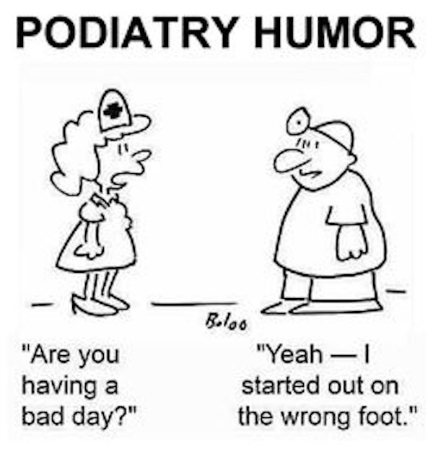
Thank you for listening!
Any Questions?

