Slide 1
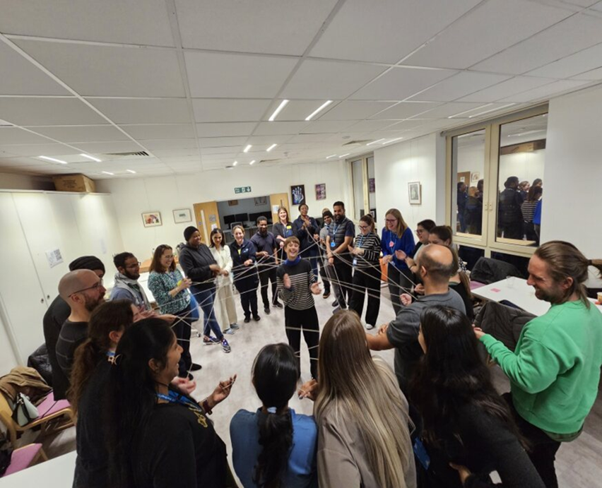


Effective management of Community Therapy waiting lists in Tower Hamlets
Our Story In a Nutshell
Challenge: Post-Coronavirus Pandemic, the Tower Hamlet Community Therapy Team experienced significant delays in providing initial therapy assessments, with waiting times reaching up to 16 weeks. The goal is to reduce this waiting time to 6 weeks from referral acceptance.
Initial Efforts: The team developed a recovery plan to manage the backlog, identifying causative factors and agreeing on action plans and measures. Despite initial efforts, progress was slow, and improvements were not sustained. The team realized that additional, 'hidden' factors were likely contributing to the delays and explored these further.
Quality Improvement Initiative: In August 2022, the Community Therapy Team launched a Quality Improvement Project with the specific aim of offering an initial therapy assessment within 6 weeks of referral.
​
What we changed
Successful Integration of Community Therapy Team
Implemented Standardised approach to caseload and waiting list monitoring across teams
New appointment booking process
New Triage Process including Integrated Triage with AADS and Reablement

Slide 2
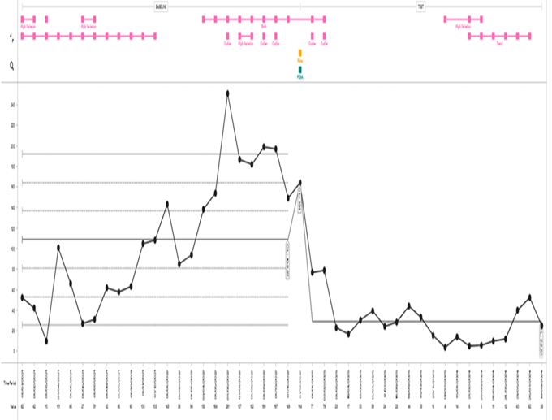
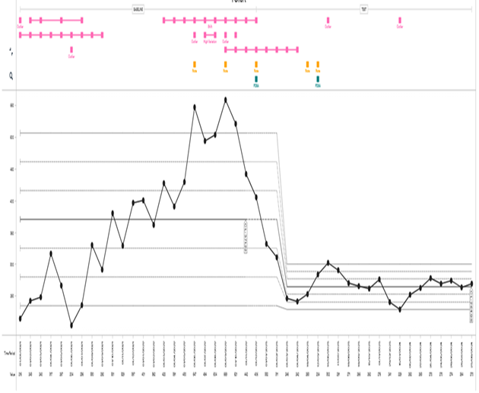
What we achieved
Therapy waiting list number reduced by 50%
6+ weeks referral waiting times reduced by 98%
Therapist clinical capacity increased by approx. 70%
Admin time reduced for therapists
Better service user outcomes from timely therapy intervention
Graph 1: Total No. of patients waiting >6 weeks for initial therapy assessment
What we learnt
Acknowledge change is needed
Process of QI and how data matters
Small and quick gains maintains project continuity and team motivation
Critical and analytical thinking skills
Stay the course, even when progress is slow or not positive
Graph 2: Total No. of patients on therapy waiting list

Slide 3
What this means
Positive service user outcomes
Staff satisfaction and wellbeing
Improved recruitment and staff retention
Provides reassurance to our referring services and partner providers
Shared learning with wider service (Newham EPCT Therapy team)
Feedback
Staff Feedback:
Better clinical oversight
Stronger together – easier decisions engagement
More impact – data story
Find a Therapist now so much easier
More clinical time for Band 6
Better communication with admin team
Patient feedback:
“I would like thank you for being so responsive in looking after me.”
“The Therapist made me feel I could get back in control of my life again. I can't praise the support I have been given highly enough
Our Reflections
Increase in demand and complexity
Staffing (Capacity) fluctuates due to hard to fill posts, sickness & supporting apprentices/students/developmental posts
Acknowledging/ recognising failure when change ideas are not working – PDSA (Rigid diary slots did not work for all staff due to flexible working)
Data is important to manage waiting list i.e. demand and capacity. However, time in motion identified other areas for clinicians which are overlooked therefore we need to focus on Job planning.
Cultural change: new ways of working/team structure/data
Future Plans
Implement positive changes (Triage process and appointment booking system)
AHP Job planning
Improving access to Therapy service (Weekend/evening plans)
Celebrate achievement

