Slide 1


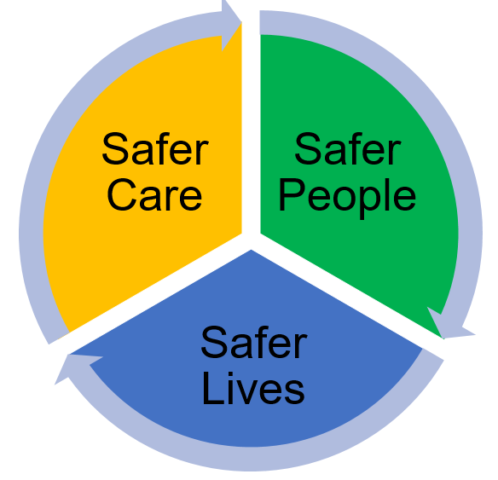
Human factors deductive thematic analysis of therapeutic and physical health observations Dr Jane Carthey, Human Factors and Patient Safety Consultant. Jane Carthey Consulting

Slide 2
Overview
ELFT: Focus on improving therapeutic and physical health observations
Human factors-based analysis of observations practice
Deductive thematic analysis of twenty-six serious incident investigation reports
Six workshops to explore everyday work with staff working in adult in-patient acute and PICUs

Slide 3
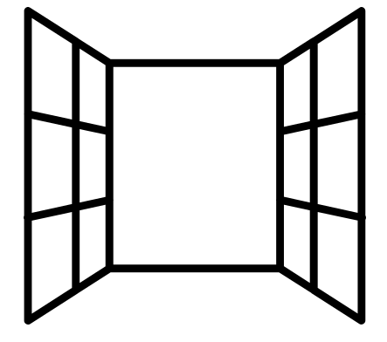
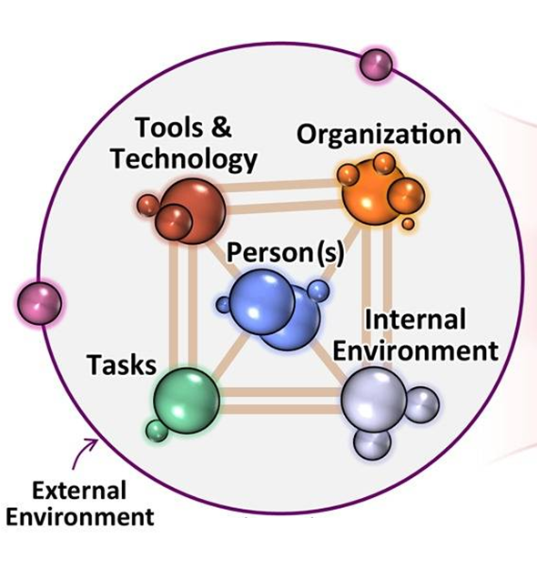
PSIRF: System based approach
What’s changed?
Uses incidents as a ‘window on the system,’ not a search for root causes
Looks to the future by exploring what a patient safety incident reveals about gaps in the healthcare system.
Emphasis on exploring everyday work shifts the focus from developing quick fixes to understanding wider system influences
SEIPS 2.0: A human factors framework for studying and improving the work of healthcare professionals and patients: Ergonomics: Vol 56 , No 11 - Get Access (tandfonline.com)

Slide 4
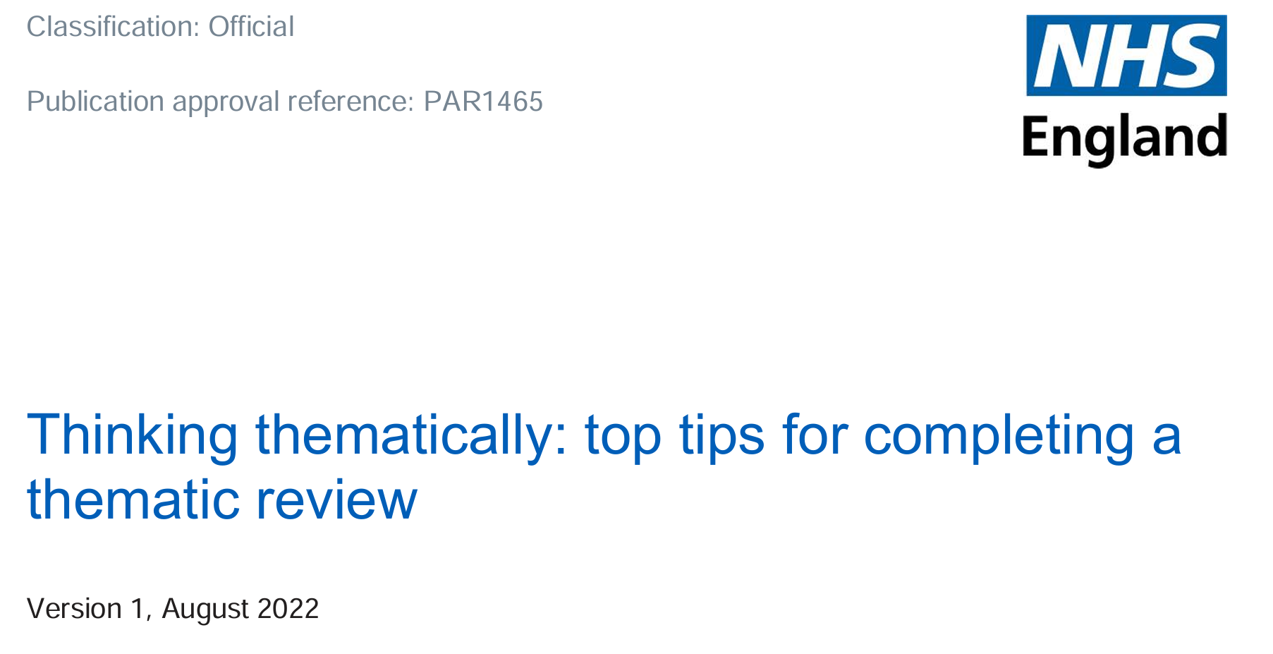
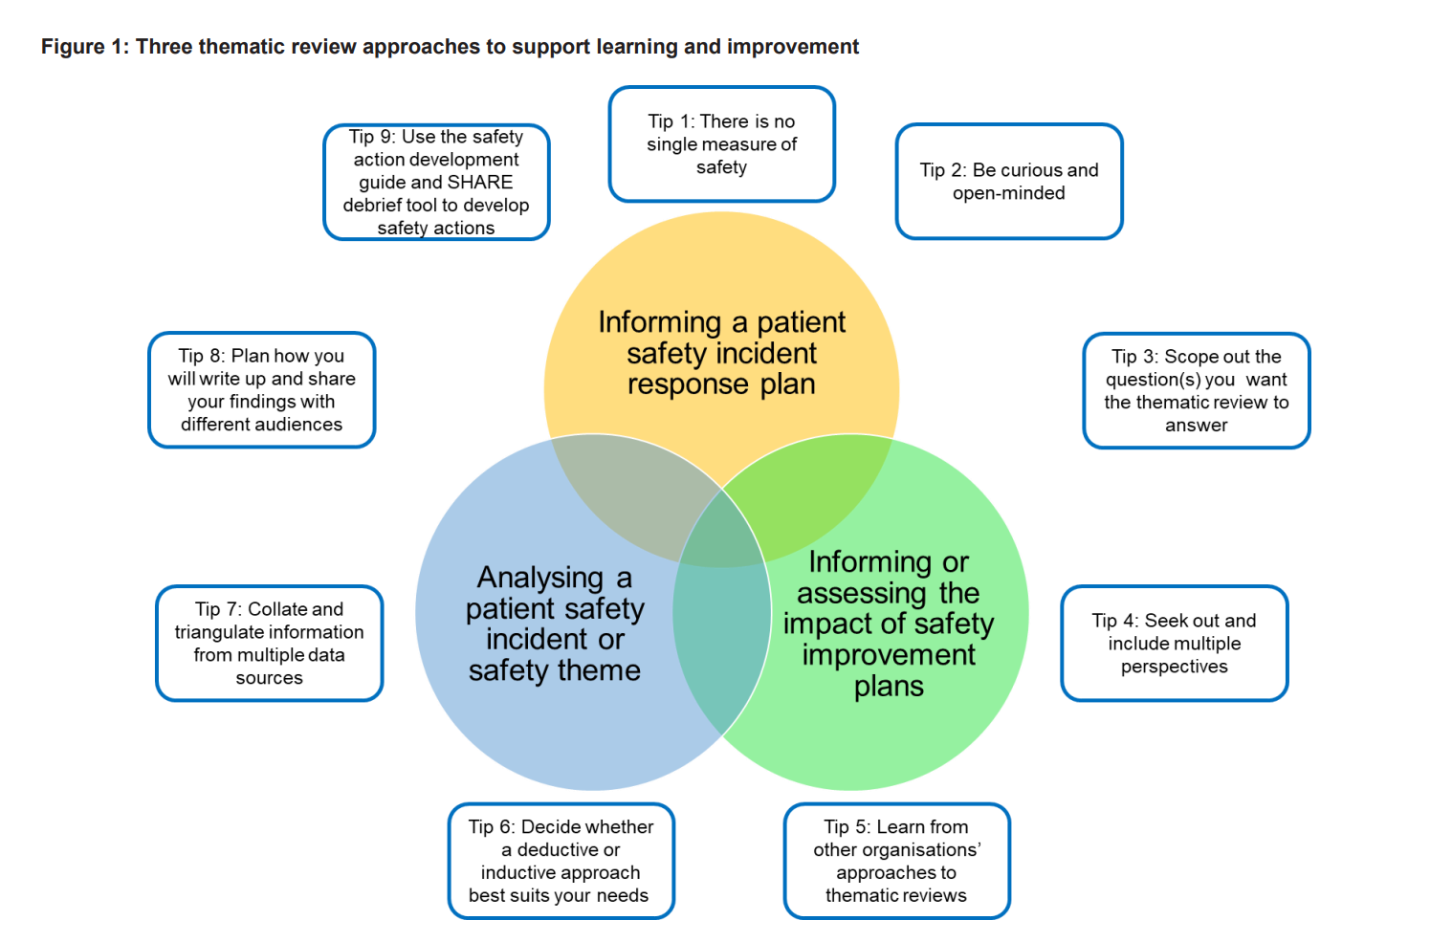
Thinking Thematically: Top tips for completing a thematic review

Slide 5
Classified contributory factors into elements of the SEIPS work system

Slide 6
Technology & Tools
IT functionality and reliability including connectivity, IT outages, design of NEWS 2 template on Rio (155136, 162980;124655) (links to organisation and task).
IT accessibility: No handheld devices or mobile computers to record observations as they are carried out (207916) (links to person, task, organisation)’
IT accessibility: Different electronic record system used by the AMHP service (176426) (links to external environment) or acute hospital (e.g. HEI system for RLH hospital (157482), (links to person, task, external environment)
Duplicate IT and paper documentation: Examples include Rio and the paper NEWS chart (113911; 116848; 207916), BM chart (159260), the on-call manager log and Rio electronic patient record (176426) (links to task and person)
Presentation of information on IT systems: Design of Rio electronic system for calculating NEWs 2 scores: Rio function which automatically calculates the NEWS 2 score potentially impacts staff interpretation of the significance of the score (207916) (links to task and person).
Presentation of information on IT systems: Doctor documented stepping up the of level of observations on Rio without communicating this directly to the nurses. (141835; 207916) (links to task, organisation and person).
Lack of standardisation in the design of an IT system: On Rio, risk of self-harm can be documented in progress notes, on risk assessment forms and in safety plans (141835; 207916)(links to person, task, organisation)
No system to document who is responsible for carrying out observations (207916)(links to person, task, organisation)
The design of the observations sheet: Observation sheet comprises many codes to denote a patient’s whereabouts: The observation task has been designed to focus on a patient’s whereabouts (186699) (links to task, and person)
Power supply outage, e.g. affecting medication dispensing (167593), (links to task and person)
Batteries not charged, e.g. laptops (167593) (links to person, organisation and task)
Access to equipment used to self-harm, e.g. needles, (159260) (links to external environment, person)
Tool design: Design and use of NEWS 2 chart in context of patients taking psychotropic medications which increase heart rate, or who have diagnoses of high blood pressure and diabetes (2071916)(links to person, task, external environment)
Tool design: The Food & Fluid template is based on the inpatient acute model (170863)(links to external environment and task)
Alarms: Staff response to an emergency: Emergency alarm or pinpoint alarm not activated (141835, 199283;107366) or alarms cancelled (204370), or delay in calling 999 (207916;199283;107366)(links to task, person, and organisation)
Equipment no longer in use: Tabards to increase visibility of staff carrying out observations (171073) (links to person and task)
Equipment not used: PPE not donned when responding to an emergency (141835; 132260); back up laptop not used (167593) (links to task, person); radio to communicate information across the team when responding to an emergency (107366) (links to person, task and organisation)
Equipment not used: Food and fluid charts not used to monitor patient’s dietary intake (159260)

Slide 7
Organisation
Staffing/skill mix: Member of staff phoned in sick: The staff member called in at short notice had not completed ILS training (116848) (links to person and task)
Staffing/skill mix: There was no senior Band 6 nurse on the night-shift (204370) (links to person)
Staffing/skill mix: There is only one doctor on call covering all the wards at hospital X – the workload would become unmanageable if every NEWS score of 2 or above is escalated (207916) (links to person, task, internal environment and technology & tools)
Staffing/skill mix: Staff shortages & a busy ward linked to gaps in observations (170863) (links to person, task, internal environment)
Staffing/skill mix: Additional staff not requested for nightshift (167593)(links to person and task);
Staffing/skill mix: Bank members of staff, working nights only, who are not being regularly supervised in line with Trust policy (where gaps in training would have been identified; (specifically, BLS training for 141835, 199283 and ILS training for 116848) (links to person and task)
Staffing: Staffing issues within the IPC team when the ward sought advice on treatment of a patient with scabies (209864) (links to person and task)
Staffing: Staff member allocated emergency response had to go and work on another ward when another staff member did not turn up for the shift (107366) (links to task, person, internal environment)
Staffing: There is no dedicated junior doctor on ward due to sickness and annual leave (159260) (links to task, person, internal environment)
Supervision arrangements: Gaps in supervision of staff (141835) (links to person and task)
Work schedules/staffing/skill mix: No consultant psychiatrist review because consultant on annual leave and consultant covering not asked to review patient (159260) (links to person, internal environment and task):
Work schedules: Medical reviews of patient not carried out (159260) or patient was new to the ward and consultant review not yet carried out (155136) (links to person and task)
Work schedules: Ward round scheduled at short notice and then overran; staff member attending the ward round was also responsible for carrying out observations and omitted the observation (134929)(links to task, person, internal environment)
Work scheduling: Member of staff named as responsible for overseeing falls risk assessment was completed was on jury service. No other staff member was assigned responsibility for the task in their absence (204370) (links to task, person, external environment)
Work schedules/staffing: Bank staff members, working nights only: No process to assess their competences (e.g. BLS training)(141835) (links to task & person)
Workload allocation: It was not clear who in team who was responsible for patients with physical health conditions (113911) (links to person, task)
Management system to oversee competencies: Local observation register (which records which staff are up-to-date with observation competencies) is held for substantive staff only and not temporary staff (bank and agency staff). (141835) (links to task and person)

Slide 8
Analysis of the strength of recommendations

Slide 9
Person-focused Recommendations: The Serious Incident Framework
Ward manager to remind staff to comply with the Therapeutic Observations Policy and Procedure
Additional training to be provided to the HCA who did not carry out the intermittent observations at the set time
Re-write the Trust Preventing Adult Deterioration Policy to state medical staff MUST review a patient (not should) when NEWS scores of 2 or more are escalated

Slide 10
Strong, moderately strong and weak recommendations summary table Cafazzo JA and St-Cyr O. From Discovery to Design. Healthcare Quarterly (2012): 24-29. Hibbert, Thomas et al., 2018. Are root cause analyses recommendations effective and sustainable? An observational study. International Journal for Quality in Health Care, Volume 30, Issue 2, March 2018, Pages 124–131, https://doi.org/10.1093/intqhc/mzx181
Notes:
Facilitator notes: Explain that the table on the slide has been developed based which shows that some types of recommendations are weaker than others. When recommendations from incident investigation reports are ‘person-focused’ they are weak because the underlying design flaws and systems weaknesses are not resolved.
Relevant research papers on which the table is based are: i. Hibbert, Thomas, Deakin et al (2018). Are recommendations from root cause analysis effective and sustainable. An observational study. International Journal of Quality in Health Care, 30; 124-131 and ii. Cafazzo and St Cyr (2012), From discovery to design: the evolution of human factors in healthcare. Healthcare Quality, 2012:15 Spec No:24-9.
doi: 10.12927/hcq.2012.22845.

Slide 11
ELFT Strength of recommendations analysis

Slide 12

Exploring everyday work relating to observations on in-patient mental health wards

Slide 13
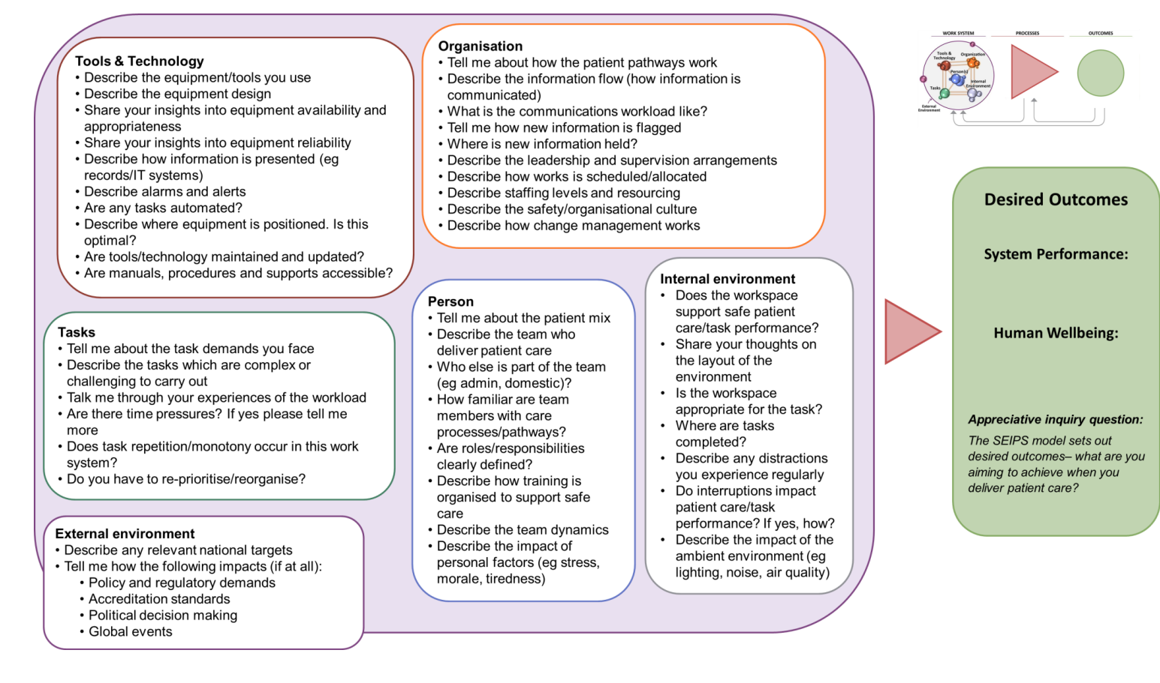
SEIPS work system explorer

Slide 14

Share with me what happens on a shift when everything goes well?

Slide 15

Insights into everyday work
‘Too many tasks to do at the same time, getting interrupted so you lose your mental focus on which intermittent obs., you have to do next..’
‘Work as imagined is that we should invite family members and carers to ward rounds. But this is difficult when we don’t know the time the ward round is going to be carried out… this impacts on observations is -physical and mental health -because family members know the patient best -they know what works and does not work, they know how the patient will self-harm, they know the physical health problems. And they have lives and jobs; it is just not possible for them to come at short notice to a ward round…’
‘When we are short of staff it becomes very difficult to manage the workload when equipment we need is broken, and we waste time searching for kit that is working…it’s an added pressure on a pressured shift.’

Slide 16
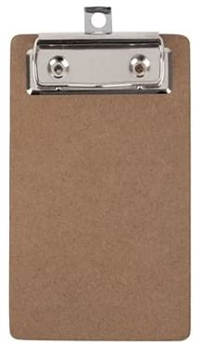
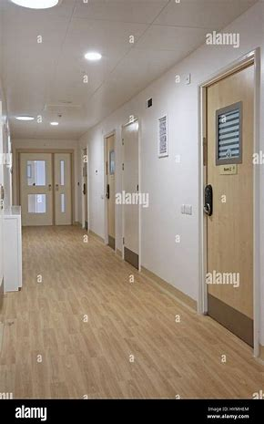
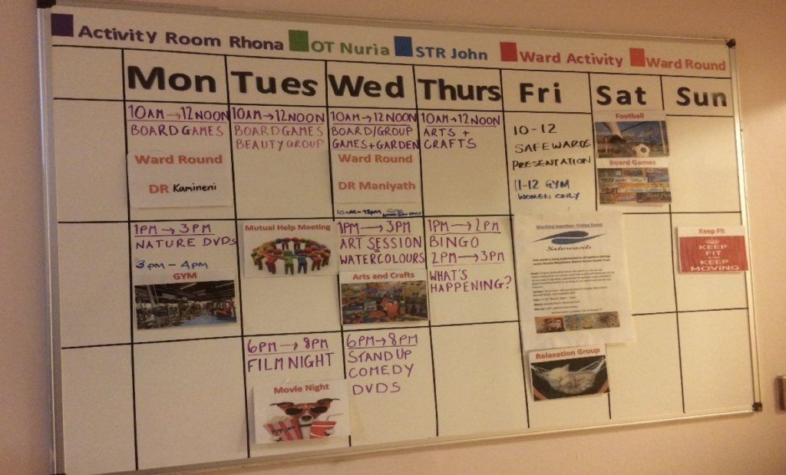
Insights into QI initiatives
Board rounding supports handover and accountability of observations
Zonal observations can improve the interaction between the staff member allocated to carry out observations and patients
Twilight shifts to improve activities on wards

Slide 17
The task of completing observations is linked to and influenced by other microsystems and processes
Carrying out therapeutic and physical health observations
Rostering of staff on shift
Morning huddle
Transfers and external demands
Shift handovers
Admissions
Ward rounds
Escorted leave
Discharges
Emergency response

Slide 18
Conclusions
ELFT has done a lot of work to improve therapeutic and physical health observations
‘Turbulence’ in the work system is an everyday reality on wards and PICUs
Need to reduce the turbulence (where possible)
Consider how we might redesign the task of therapeutic observations
Evolve the current measurement and monitoring approach

Slide 19
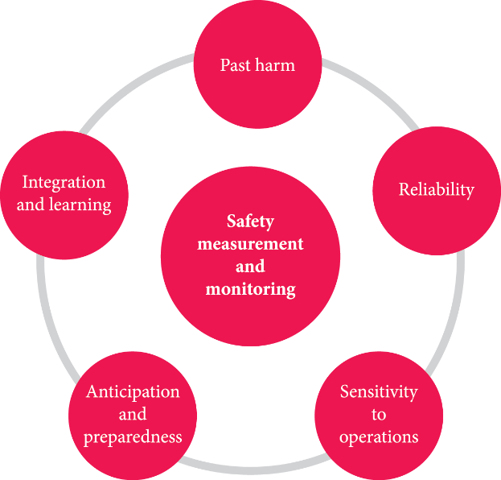
Measurement and Monitoring of Safety Framework (Vincent, Burnett and Carthey J, 2013)
How is learning fed back to frontline teams?
What evidence is there that learning translates into improvement?
What does not fit on a dashboard but is important soft safety intelligence (i.e. avoiding ‘dash-board-it is’)
Incident data, complaints, claims, learning responses including PSIIs (national and local), coroners’ feedback etc..
Near misses, good catches
? Safety II learning
Audits of documentation of observations (i.e. number of missed observations shown on an SPSS chart over time).
? Reliability of admissions arrival times, scheduled time of ward rounds etc..
Operational data: Admissions rates, discharges
PICU capacity – impact on wards
Staff rostering alignment with patient mix
New builds – designing a therapeutic environment
Workload assessment on wards
Observing, listening and perceiving ‘observations as done.’
Tuning into patient, staff, family & carer insights, including bank staff, STs etc.
Tuning into staff experiences, e.g. some days of the week are ‘busier’ and more challenging?

