Slide 1
Therapeutic Engagement and Observation…our journey so far
Sasha Singh
Director of Nursing- London MH

Slide 2
Staffing/ resource availability | Staff establishment reviews undertaken 22/23 and 23/24. Correct and agreed investments have gone into teams increasing staff on each shift by 1 unregistered Band 3. Additional investment for a Life Skills Recovery Worker Band 4 Monday to Friday 9-5 to increase delivery of activities and opportunities for meaningful engagement Proactive recruitment campaign has been ongoing with services moving to zero registered vacancies and review of unregistered workforce (correct band and skill) Healthrosters have been reviewed and updated to reflect safer staffing requirements; senior approval of rotas required 6 weeks in advance of current period and quarterly rota monitoring meetings in place Escalation protocols developed for use to guide staff when there are not insufficient resources in place to meet care needs
Notes:
What does nursing have to offer?
Didn’t choose this career – I was heading into business after completing a BA in Strategic Management

Slide 3
Caring
Positive observed practice
Staff competency | Inpatient Safety Suite (previous local and manual records) now ‘live’ and classed as essential for all inpatient nursing staff. This gives the ability to have oversight of compliance via Trust wide training reporting. This suite includes training on observations and honesty in documentation Honesty in Documentation training developed in Dec 23 and rolled out face to face across all inpatient services over period of December 2023 – April 2024 Pilot of Trust-wide clinical induction started in August 2024. Prior to these comprehensive clinical inductions were being done in directorates. This supports consistency of material and ensuring core learning on commencement of clinical role. Non substantive staff (bank staff) are booked to attend and have access to protected study time to achieve same competencies as substantive staff. Trust-wide learning lessons seminars focus on areas of learning and improvement from incidents or identified areas of good practice. Safety discussions sessions are facilitated weekly in Directorates for all Inpatient staff to review observation data, reflect on gaps in practice and disseminate learning Time to Think forums in directorates are well established (Time to Think forums are held monthly in directorates, led by lead nurses and open to all staff within the Inpatient service. They are a protected resource for teams to reflect on their practice, understand work as it happens using data and clinical examples and generate discussions to inform learning and next steps). Inpatient safety suite developed and mapped on staff training requirements as essential for all inpatient nursing staff

Slide 4
Quality improvement | Trust-wide QI undertaken from September 2022 with agreed 3 interventions, details of which are found in Appendix 2. This project engaged all 54 wards, their staff teams and service users across the Trust and ran over a period of 18 months. The aim was to improve consistency of completed observations and shift the culture of observation practice. There were 3 change ideas agreed to move into standard practice Board relay Twilight shifts Zonal observations Review of Policy and practice standards (investment in additional staff resource to increase opportunities for engagement) E-obs power app being developed and in testing phase. Proposed pilot from October 2024
Notes:
What does nursing have to offer?
Didn’t choose this career – I was heading into business after completing a BA in Strategic Management

Slide 5
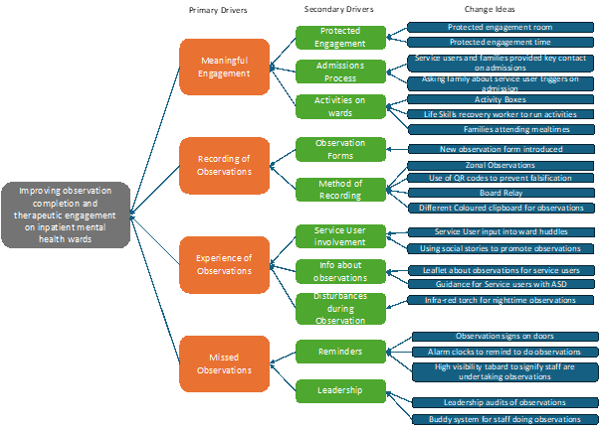
Trustwide Quality Improvement Work

Slide 6
Service driven change ideas
Location | Change Ideas tested
Bedford and Luton | Board Relay, Life Skills recovery workers on twilight shift, Revised observation templates, Infrared torches for night-time observations
CAMHS (Coborn and Evergreen) | Board Relay, high visibility jackets, Buddy system, using social stories to promote observations, guidance for service users with ASD
City and Hackney Centre for Mental Health | Board relay, protected engagement time, using tablets to collect FFT
East Ham Care Centre | Activity boxes, Spot checks on 1-1, this is me life story, loved ones attending mealtimes
Forensics | Zonal Observations, revised observation template, infrared torches for night-time observations
Newham Centre for Mental Health | Alarm reminders for observations, protected engagement time, QR Codes to record observations, Zonal observations, Spot checks on observations
Tower Hamlets Centre for Mental Health | Leaflet explaining observations, go to person on admissions, Board relay, Asking family about triggers
Notes:
What does nursing have to offer?
Didn’t choose this career – I was heading into business after completing a BA in Strategic Management

Slide 7
Standards of professional practice | Communication and outlined standards of practice communicated to staff with frequent updates on improvement work since 2021 to date. In 2023, this has specifically addressed accountability and responsibility for documented observation. honesty in documentation and guidelines for staff to follow where observations were missed. Trust-wide QI has introduced the observation relay board to reduce incidents of observations being left or not handed over Local directorates have addressed learning from their own incidents
Audit and monitoring | Standard Observation Measurement (SOM) Tool developed for oversight of rates of completion of all observations. Individual ward teams and Directorates can access and use their data to drive continued improvement. Local governance systems to ensure changes to practices are embedded Night visits undertaken by senior staff in Directorates to monitor practice through spot check audits and observing work as it happens.

Slide 8
In-Patient Ward Safety Culture Improvement Work | Since 2023 a new safety culture self-assessment process has been incorporated into the Quality Assurance annual review process for each in-patient team across ELFT. On an annual basis, staff complete an anonymous survey based on each component safety culture element. A bespoke team report on the safety culture results is then shared back to directorates and teams (where enough responses are received) with advice/signposting to where steps can be taken to strengthen safety culture. The survey tool results are then discussed in team awaydays and meetings with teams, enabling local leaders to focus on areas where improvements need to be made. All our mental health in-patient wards have been participating in this process, with good engagement and over 800 responses from across all directorates and wards, to date. Next steps are to seek service user perspectives to triangulate and strengthen the safety culture intelligence available to the teams. The Trust is involved in the Cavendish Square community of practice attended by Chief Nurses and are applying to enrol in a new NHS England 90-day collaborative around Enhanced Therapeutic observations)
Notes:
What does nursing have to offer?
Didn’t choose this career – I was heading into business after completing a BA in Strategic Management

Slide 9
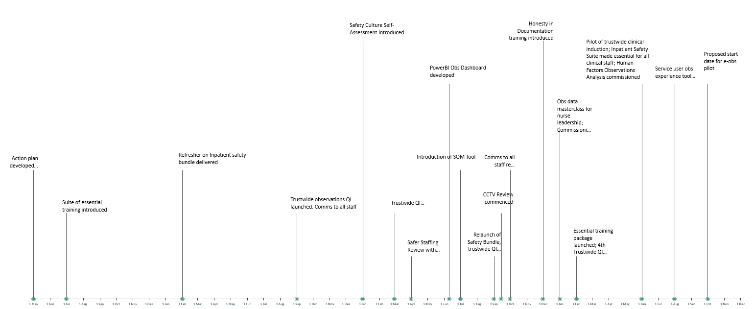
Notes:
What does nursing have to offer?
Didn’t choose this career – I was heading into business after completing a BA in Strategic Management

Slide 10
Still in the oven!
Power App sign off and testing
Analysis and application of Human Factors review
Re-launch of Inpatient Safety Suite with refreshed material that is co-produced
Trustwide campaign to maintain awareness and importance of these principles
Improved systems for oversight of this work- improved reporting and governance structures
Stayin connected to purpose- developing a qualitative audit tool to understand people’s experience of observation and what we do well and have room for improvement

