Slide 1


Trust-wide Learning Lessons: Clinical Observations
Power Apps/Automation
Contents
Power Apps
Power Apps and Automation
Power Apps is a Microsoft automation tool already in use and available across the NHS.
It contains artificial intelligence features to allow users to access templates and build applications without specialist technical knowledge.
You can connect the tool to your existing SharePoint documents, your email and teams’ channels for example.
!
IMPORTANT INFORMATION: When an app is developed for use within a patient care pathway, the following measures must be taken:
A Clinical Safety Officer (CSO) must be appointed.
A comprehensive clinical risk assessment must be conducted.
Observations App
Progress
Contact us
Automation
To perform routine and repetitive tasks with reduced or minimal human assistance. These tasks are often time-consuming.
While automation aims to reduce human effort, it can still involve human interaction (e.g. for approvals).
In healthcare it should support clinical decision-making and reduce the administrative burden.
Useful links
Clinical safety step by step guidance
© Data & Analytics, East London NHS Foundation Trust
V 1.2

Slide 2
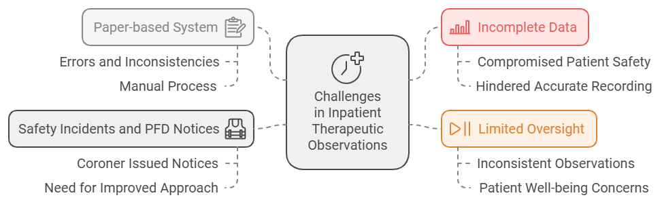
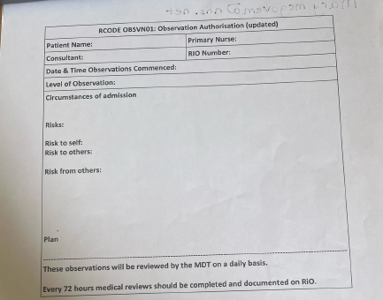
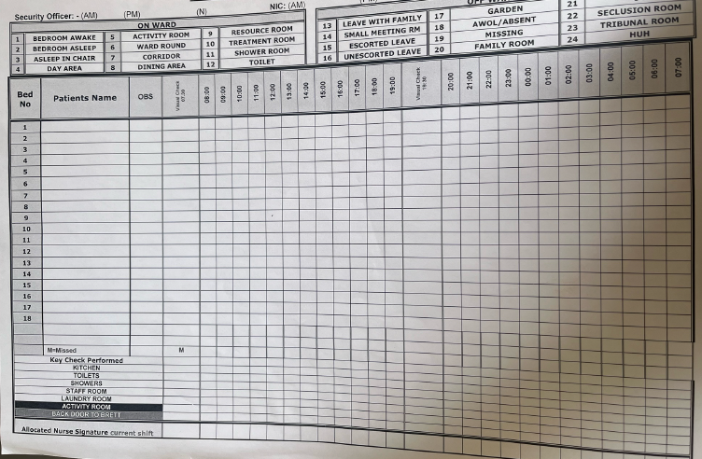
Trust-wide Learning Lessons: Clinical Observations
Observations App
Power App to record Therapeutic Observations
Contents
Power Apps and Automation
Safety Incidents and PFD Notices.
Observations App
QI project: “Improving Observational Practice and Therapeutic Engagement Across Inpatient Wards”.
Progress
Contact us
Power App-based solution to ensure comprehensive and reliable recording of observations.
Enhanced Observation Sheet
Observation Care Plan
General Observation Sheet
Review Template
V 1.2
© Data & Analytics, East London NHS Foundation Trust

Slide 3
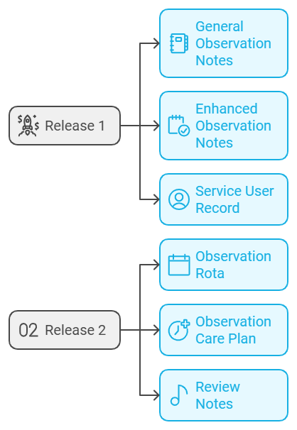
Trust-wide Learning Lessons: Clinical Observations
Progress
Timeline: Therapeutic Observations App
Contents
Design
Discovery sessions with a diverse range of inpatient teams across all directorates informed the development of a bespoke design tailored to the Trust's practices and policies.
Power Apps and Automation
Observations App
Development
A minimum viable product (MVP) was developed, incorporating the essential features defined during the design phase.
Progress
Contact us
Testing
Alpha testing was conducted in six wards across Newham, Tower Hamlets, City & Hackney, and Luton to assess the app's functionality, usability, and real-time integration with reporting systems.
Refinements
Insights from the testing phase are being integrated into the app's design, and the app is being prepared to meet regulatory requirements.
Regulatory Approvals
In addition to the existing DPIA and Cyber approvals, the app must undergo DCB0160 and DCB0129 Clinical Risk Management standards. ELFT has confirmed that the app is not classified as a medical device
Go live preparations
Ensure device and secure Wi-Fi readiness, provide comprehensive training, and offer ongoing support both during and post-implementation.
V 1.2
© Data & Analytics, East London NHS Foundation Trust

Slide 4

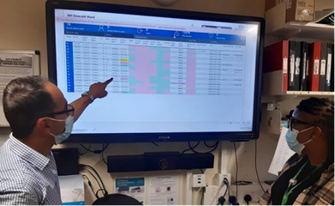
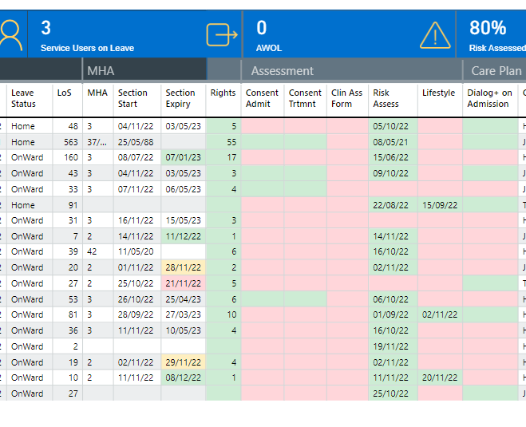




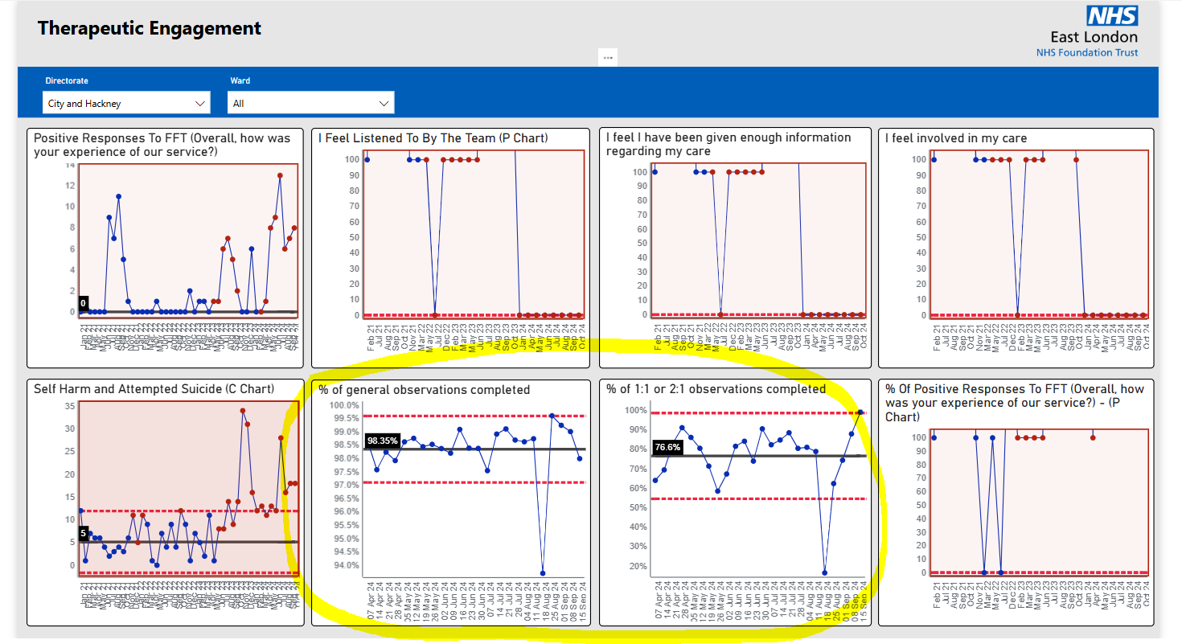




Trust-wide Learning Lessons: Clinical Observations
Progress
How will the Therapeutic Observations App Improve Existing Process?
Contents
Power Apps and Automation
Observations App
Due Service User Location Actual Time of Obs Performed By
Progress
Contact us
Upload to RiO
Visibility of the timeliness and completion of therapeutic observations will be able to be displayed on ward screens and safety pages in Power BI
V 1.2
© Data & Analytics, East London NHS Foundation Trust

Slide 5
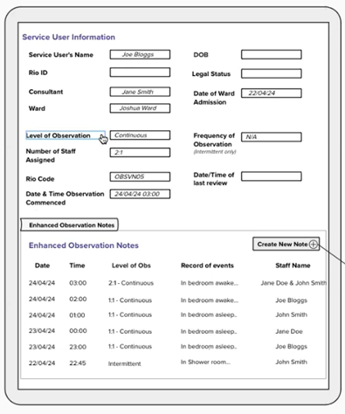
Trust-wide Learning Lessons: Clinical Observations
Contact us
Contents
How to get support for Power Apps?
Power Apps and Automation
Data and Analytics has established a dedicated Power Apps Centre of Excellence (CoE) team to champion and share best practices in Power app development and ensure security measures are in place.
If you have an idea for a new PowerApps, please contact us at elft.analytics@nhs.net. A CoE team member will get in touch with you to review your idea and assist in writing a short business case. The business case will evaluate the opportunity, benefit, development model and resources needed. We will ensure that the process meets the trust's Information Governance and Cyber Security standards and has the appropriate licencing model.
We are also introducing a new App for submitting requests. This app will allow you to provide details on the costs and benefits of your idea or project, helping us prioritise effectively.
Observations App
Progress
Contact us
V 1.2
© Data & Analytics, East London NHS Foundation Trust

