Slide 1



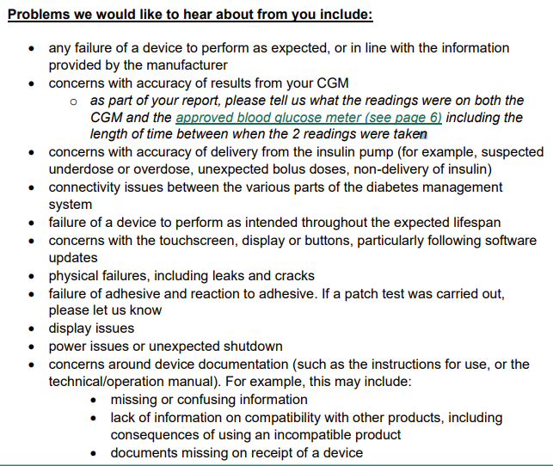

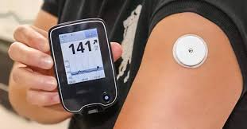

MEDICINE MATTERS (November 2024) – Medicines Safety information at your fingertips
Learning from incidents at ELFT
MHRA– Insulin Pumps and continuous glucose monitoring
Guidance is now available nationally to support users on reporting suspected adverse incidents and safety concerns with diabetes equipment to the yellow card scheme. Any concerns should also be reported locally via INPHASE
Incident report 00017115- Patient x routinely on clozapine. Admitted to A&E and then transferred to MEH. Not prescribed clozapine for the day in A&E, then prescribed olanzapine on admission to MEH. Allergies stated to olanzapine and haloperidol noting NMS as reaction. Patient received one dose of olanzapine on 28/07/24 and developed Neuromalignant syndrome (NMS). Olanzapine discontinued on Monday 29/07/24 and clozapine re-commenced as was up to the 48 hour mark of clozapine administration
Learning:
Olanzapine was recorded as a sensitivity and not an allergy on JAC hence the doctor was able to prescribe the Olanzapine.
Olanzapine was prescribed despite the documented history of NMS with olanzapine, albeit in combination with haloperidol. The prescriber rationalised the decision by assuming a lower risk if only one of the medications was prescribed.
Work will be undertaken to reflect documentation of severe reactions such as NMS in the allergy section within EPMA, Medicines Policy and standards for physical health monitoring of patients on antipsychotic treatment
This example will be used as part of EPMA training for new doctors
Incident report 00020578 - During a routine medication review, patient mentioned she was running out of medication. On further questioning, there had been a misunderstanding during a GP appointment, where the patient thought she was advised to double her dose of amlodipine. Patient X has been taking amlodipine 10mg twice a day since 30/08/2024. Max BNF dose is 10mg daily.
Learning:
Possibly overloaded patient with information by making multiple medication changes in one appointment
Multiple new diagnoses made together (Diabetes and high cholesterol)
Areas of good practice
Toxbase was contacted and relevant signposting to A+E, appropriate escalation once identified patients misunderstanding
Appropriate treatment for each indication was initiated according to clinical guidelines,
Good identification of long-term conditions and appropriate nurse follow up, with further blood tests requests
As antimicrobial awareness week approaches we are encouraging all healthcare professionals to participate in promoting best practice for antimicrobial management. This is an opportunity to raise awareness by educating patients and staff about responsible use of antimicrobials. The theme for this year is “Educate, advocate and act now” .
Bulletin produced by Medication Safety Officers and collaborative work of Trustwide Medicines Safety Group

Slide 2



MEDICINE MATTERS (February 2023) – Medicines Safety information at your fingertips
MHRA Drug Safety Update Valproate use in men: as a precaution, men and their partners should use effective contraception.
Male patient must be counselled on the following
Advice for Healthcare Professionals:
Male patients must be counselled on the following.
Risks when initiating or reviewing treatment.
Effective contraception, such as condoms, during treatment and for three months after stopping before trying to conceive.
Sperm donation must be avoided during treatment and for three months after stopping.
Continue taking valproate unless advised otherwise and report any side effects via the Yellow Card Scheme.
More information available below. Also stay tuned to latest version of trust valproate policy due to be published in the new year
https://assets.publishing.service.gov.uk/media/66f55d6ee84ae1fd8592e976/Sept_2024_DSU.pdf
2. GLP – 1 receptor agonists: reminder of the potential side effects and the potential for misuse
3. Bromocriptine: monitor blood pressure when prescribing
More detailed information on the above alerts can be found below and will be discussed at December’s Trust Medicines safety group
https://assets.publishing.service.gov.uk/media/671a1dd6b31c669e899c13e2/October_2024_DSU.pdf
Key medicine shortages
Kay-cee-l syrup. Discontinued from Late November 24
Olanzapine (Zypadhera) (210,300 and 405mg depot). Limited supply until end of 2024
Patient Safety Spotlight:
The under recognised risk of toxicity of propranolol in overdose
Summary: In 2022-23 the national poisons information service, who maintain toxbase received 358 enquiries involving intentional propranolol overdoses (321 exposures in 318 patients). In 12 cases the overdoses resulted in death
Specific groups of patients may be at increased risk (i.e those with migraine, depression or anxiety)
Pharmacology
Peak plasma concentrations of propranolol occur 1-2 hours after ingestion, so symptoms of overdose will not be seen instantly. Rapid detoriation can occur which can include; confusion, loss of consciousness as well as cardiovascular complications. Propranolol crosses the blood brain barrier (BBB) and so risk of convulsions is significantly higher.
Please read on below link 2x Prevention of future death (PFD) reports.
https://www.pharmacyregulation.org/about-us/news-and-updates/regulate/patient-safety-spotlight-under-recognised-risk-toxicity-propranolol-overdose
KEY POINTS
Prescribe small quantities
Weekly dispensing for at risk patients
Refer patient to specialist where appropriate
Knowing who to contact when raising concerns.
This year’s campaign focuses on the safe use of medicines to prevent side effects and the importance of reporting them when they occur.
TWO exciting Blogs will be featured to raise awareness of medicines safety week this year across the trust. We will be promoting this message on the intranet and encouraging all staff to get involved via social media #Medsafetyweek #MHRAyellowcard
A Personal Perspective on the Importance of Correct Medicine Use and Side Effect Reporting.
Using Medicines correctly is crucial to minimise side effects and ensure their effectiveness.

