Slide 1
A new way of delivering some of our child and adolescent mental health services in North Central and North East London
Approved Interim plans for a temporary change to current arrangements
March 2025

Slide 2
About us

Slide 3





Who we are
North Central and East London Provider Collaborative (NCEL) is made up of:

Slide 4


What we do
Together, we plan and organise mental health services, and as individual NHS trusts we provide these services.
Inpatient
mental health services
for children and young people
Community
mental health services
for children and young people
Our teams include psychologists, family therapists, community mental health nurses, mental-health trained social workers, psychiatrists and psychotherapists trained to work with children, young people and their families.

Slide 5
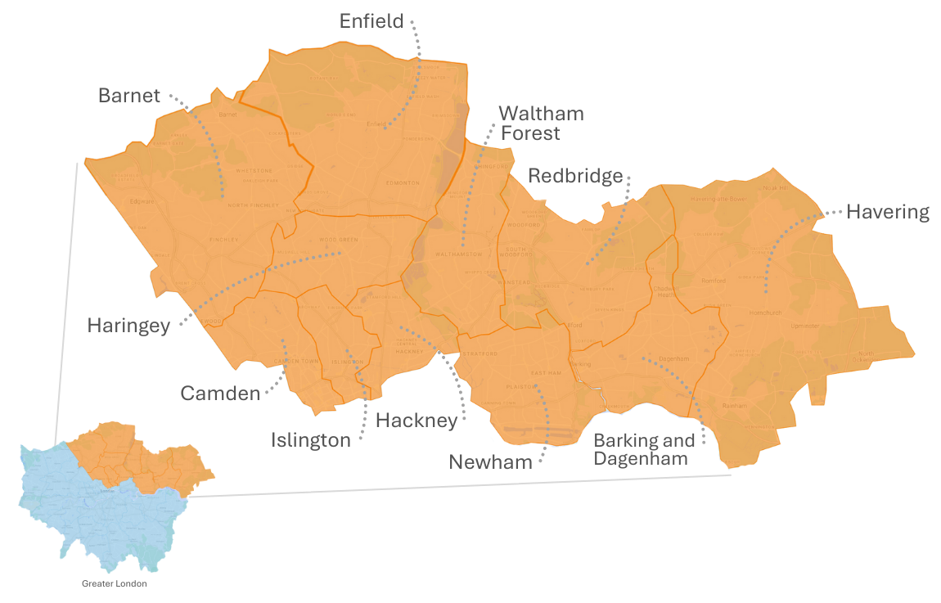
Where we do it

Slide 6
Temporary changes

Slide 7
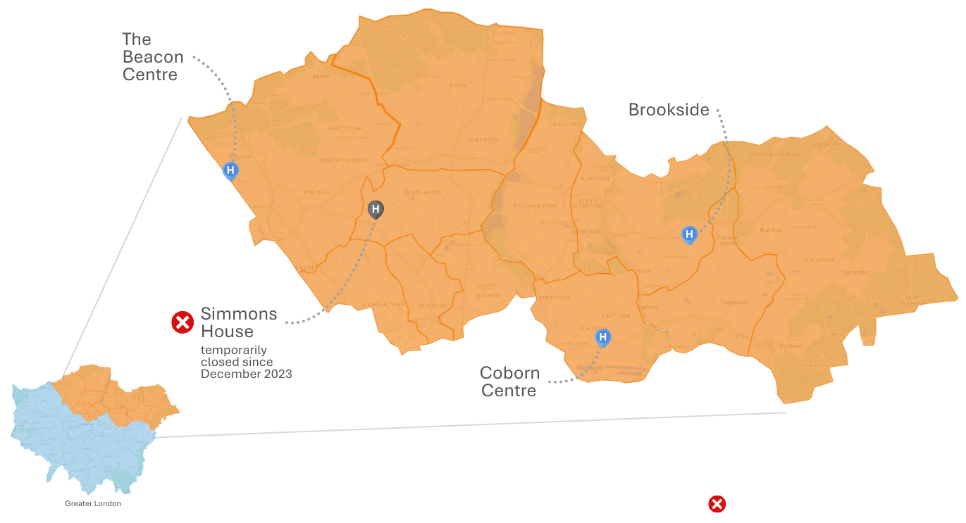
Temporary closure of 1 of our 4 inpatient units
We have 4 places in our area where children and young people can be cared for as an inpatient.
At the moment, one of those places is temporarily closed.
Unit closed

Slide 8
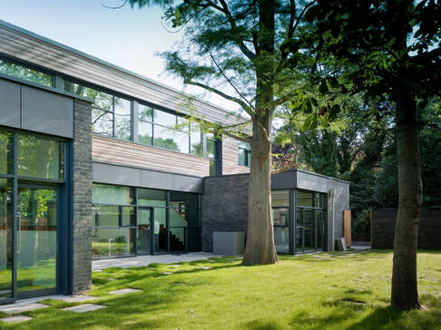
Why did Simmons House need to temporarily close?
Simmons House temporarily closed in December 2023 following safety concerns.
An estates review identified the unit needed a significant building upgrade to continue to function as a children and young people’s inpatient mental health unit.

Slide 9

We temporarily admitted more people across the three other facilities
Admitted more patients
Unit closed

Slide 10
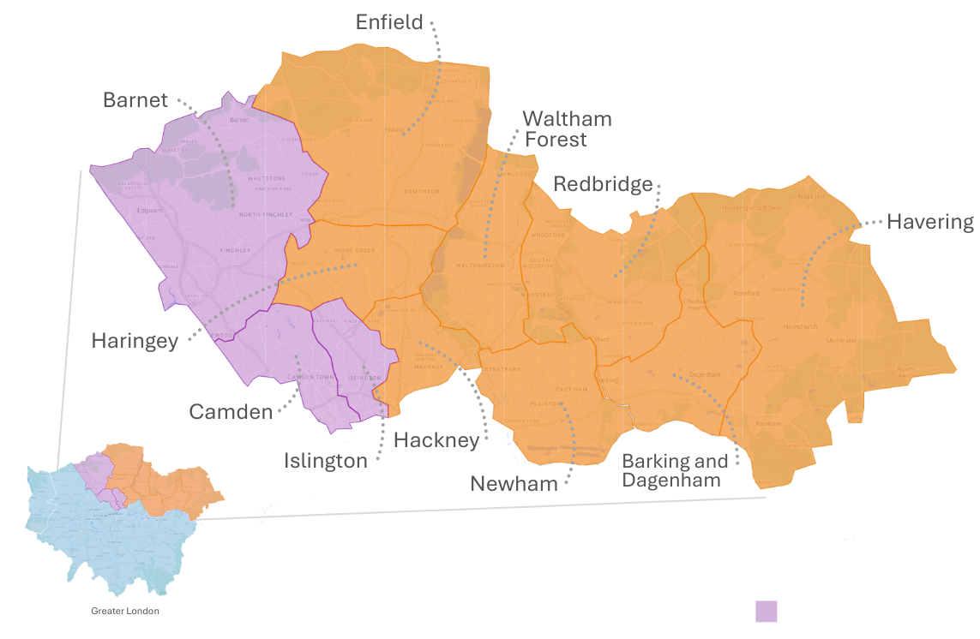
We also extended coverage of a new home treatment team
A newly established intensive home treatment team was extended to cover the whole of North Central London.
The development of this team means that young people are only admitted for inpatient mental health care when it is absolutely necessary.
Intensive home treatment team coverage area

Slide 11
Why do we need to change our approach?

Slide 12


We need to change our approach
While it is good news that we have not had to transfer any young patients out of our geographic area for care during this time, we need to adapt and improve upon the temporary arrangements currently in place.
This is because:
Our other three inpatient units are seeing and treating more people
Some children and young people are having to travel further

Slide 13
Developing the interim arrangements

Slide 14

Who developed the proposed interim arrangements?
A senior clinician from each of the NHS trusts providing mental health care in our area came together to consider what arrangements would be needed to cover the temporary closure of Simmons House. The clinical group looked at arrangements for the short-to-medium-term – for around the next 18 months.
Once new interim arrangements are in place, the clinical leaders will start the detailed work needed to develop a long-term solution for how children and young people’s mental health services are best organised and provided in North Central London. We are committed to doing this working alongside children and young people who use our services, their parents and carers, frontline staff, health and care partners in our area, and other stakeholders in our communities with an interest in mental health services.

Slide 15




What did the clinical group consider in developing the interim proposals?
In designing the interim proposals, the clinical group considered children and young people’s:
health needs
demographic changes
care as close to home as possible
previous and future demand for mental health services
experience of services (and their parents’ and carers’ experiences)

Slide 16
Our planned interim arrangements

Slide 17


Planned interim arrangements for care delivered in North Central London
Increase bed capacity at The Beacon
We will increase bed capacity in North Central London by opening an additional 3 beds at The Beacon.
Increase capacity to support young people with a learning disability and autistic young people
We will increase the capacity in North Central London with dedicated LDA posts based in intensive community services.
Expand the NCL Home Treatment Team
We will expand the Home Treatment Team to provide additional capacity and specific evidenced based therapeutic interventions such as Family Therapy and DBT and extend its hours of operation. We will also develop a Family Support Offer for parents and carers and siblings within the Home Treatment Team.

Slide 18
What happens next?

Slide 19
What happens next?
26 March 2025
Plans approved at NCEL Strategy Board
April 2025
Additional LDA Capacity extended
Increased beds at Beacon commissioned from 1st April 2025
Commence recruitment for HTT expansion with clear implementation timetable
April 2025
Establish parent led steering committee to co produce family support offer
July 2025
Full implementation in place

Slide 20
Developing longer-term proposals for change

Slide 21
Developing longer-term proposals for change
The approved interim arrangements will make sure we are continuing to provide children and young people with the best possible care until more permanent arrangements are made.
We will evaluate the impact of the investment over the course of the year which will inform our thinking and planning about longer-term proposals for change.
We are committed to continuing to work with children and young people, those who use our services and their families and carers, clinical leaders, our staff, our partners in health and care, and other stakeholders in our communities as we do this.
We will share information about how to get involved in this work once it gets started.
Contact us

