Slide 1



ELFT Estates Annual Report 24/25
May 2025

Slide 2
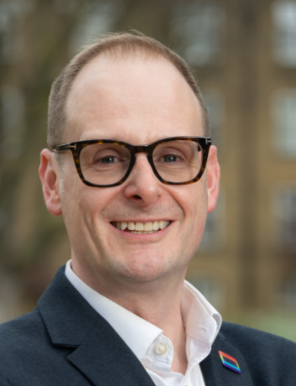
Executive Summary
This report reviews the work of the Estates, Facilities and Capital Development Directorate during 2024/25 and outlines priorities for the year ahead. It reflects a period of sustained activity across capital delivery, facilities management, sustainability, compliance and property strategy, with a clear focus on supporting the Trust’s wider objectives.
Significant progress has been made in improving the condition and use of the estate. This includes exiting unsuitable properties, delivering capital projects, and improving space utilisation to support better service delivery. Capital investment has been targeted through a more structured approach to prioritisation, enabling high-impact improvements and sourcing additional funding for energy efficiency schemes.
The green team has driven forward sustainability goals through staff engagement, investment in renewables, and reductions in energy use and waste – which supports efficiency targets by reducing spend. At the same time, key risks such as backlog maintenance and contractor performance have been managed through strengthened planning, procurement and contracts oversight.
We are grateful to all those who have supported our work over the past year. The progress made would not have been possible without the commitment and collaboration of our clinical colleagues, service leads, corporate teams, service users and system partners. Their insight, engagement and practical support have been central to shaping and delivering improvements across our environment and services.
Looking ahead to 2025/26, the focus will include completing the Trust-wide space survey, enhancing accessibility, refreshing the Green Plan, supporting efficiency targets and finalising a long-term capital pipeline to ensure the estate continues to meet the needs of service users, staff and services.
David Stevens Director of Estates, Facilities & Capital Development May 2025
,
2

Slide 3
Contents
Area | Slide
Key Estate Metrics | 4
ELFT Environmental Strategy | 5
ELFT Estates Environmental Strategy – Updates | 6 - 11
Impact on Staff and Service Users | 12
Risks and mitigations | 13
Awards, Nominations and Appointments | 14
Capital Team - Annual Update | 15 - 18
Sustainability Team - Annual Update | 19 - 22
Facilities Management - Annual Update (inc. PLACE) | 23 - 26
Property Team - Annual Update | 27 - 31
Infrastructure and Engineering - Annual Update | 32 - 37
Fire Team - Annual Update | 38 - 41
3

Slide 4









Key Estate Metrics
East London NHS Foundation Trust (ELFT) property estates currently consists of 139 properties with geographical coverage encompassing London, Bedfordshire and Luton. The London estate is situated across the Boroughs of City and Hackney, Tower Hamlets and Newham in East London. The Bedford and Luton estate is situated across the towns of Dunstable, Leighton Buzzard and Bedford.
London
Luton & Beds
75
Properties
102,821sqm
Total size of estate
64
Properties
37,827 sqm
Total size of estate
22 leasehold properties can be exited on the next 5 years
32% Leasehold
Based on sqm
39 leasehold properties can be exited on the next 5 years
35% Leasehold
Based on sqm
75% of estate footprint
is clinical
60% of estate in East London is over 40 years old
85% of estate footprint
is clinical
40% of estate in Bedfordshire and Luton is
Older than 40 years old
60% in partner buildings
Based on sqm
638 beds in East London estate
50% in partner buildings
Based on sqm
204 beds in Bedfordshire and Luton estate
£357 m2 average cost of leasehold occupation in East London (rent, S.C. & rates)
£190m Value of Freehold assets
*based 24/25 asset valuation
£228 m2 average cost of leasehold occupation in Bedfordshire & Luton (rent, S.C. & rates)
£41m Value of Freehold assets
*based on 24/25 asset valuation
4

Slide 5
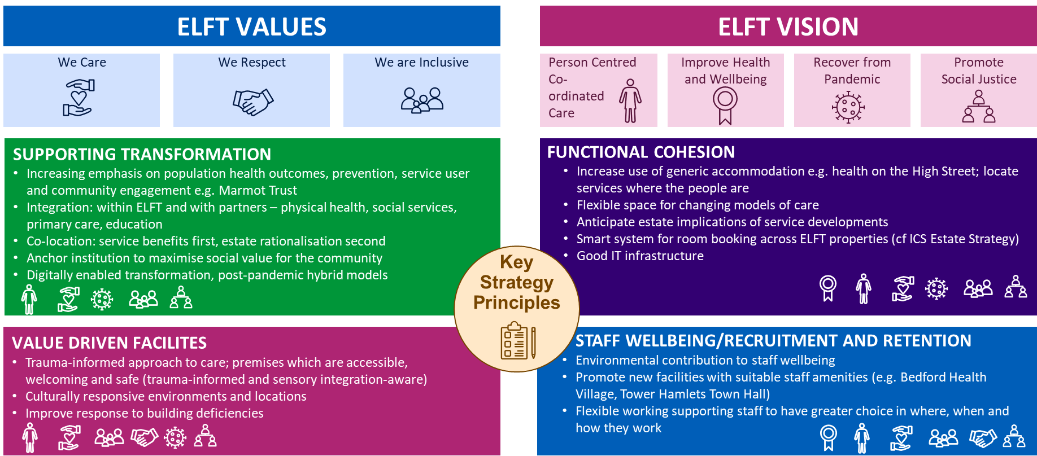
ELFT Environmental Strategy
ELFT’s vision is to make a positive difference in people's lives by delivering high-quality mental health, community and primary care services. The Estates team supports this by working closely with service users, carers and partners to create and maintain safe, sustainable and effective environments. The team drives continuous improvement and supports innovation in care delivery, sharing learning across the organisation. The environmental strategy was shaped in 2023 through engagement with stakeholders and senior colleagues inside ELFT and our communities.
The Estates values and visions can be attributed to the four key strategic principles to ensure there is alignment between the key principles and the overarching values and visions.
Increasing emphasis on population health outcomes, prevention, service user and community engagement e.g. Marmot Trust
Integration: within ELFT and with partners – physical health, social services, primary care, education
Co-location: service benefits first, estate rationalisation second
Anchor institution to maximise social value for the community
Digitally enabled transformation, post-pandemic hybrid models
Increase use of generic accommodation... locate services where the people are
Flexible space for changing models of care
Anticipate estate implications of service developments
Smart system for room booking across ELFT properties (ICS Estate Strategy)
Good IT infrastructure
Trauma-informed approach to care; premises which are accessible, welcoming and safe (trauma-informed and sensory integration-aware)
Culturally responsive environments and locations
Improve response to building deficiencies
Environmental contribution to staff wellbeing
Promote new facilities with suitable staff amenities (e.g. Bedford Health Village, Tower Hamlets Town Hall)
Flexible working supporting staff to have greater choice in where, when and how they work
5

Slide 6
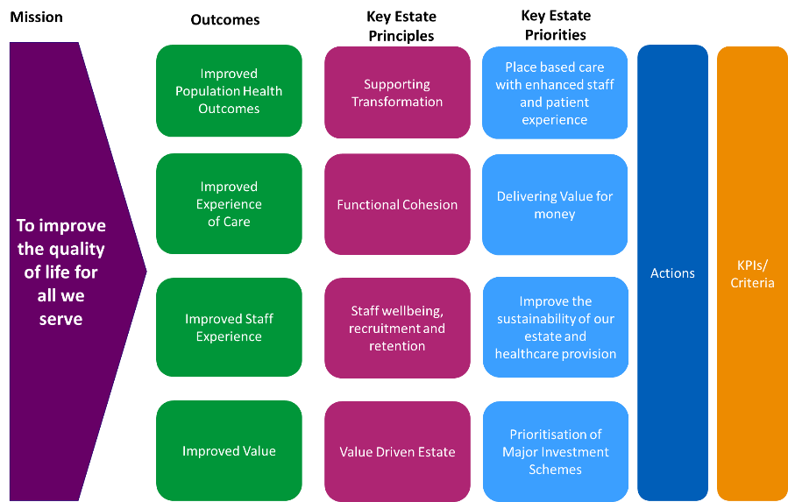
ELFT Estate Environmental Strategy – Key Priorities
6

Slide 7
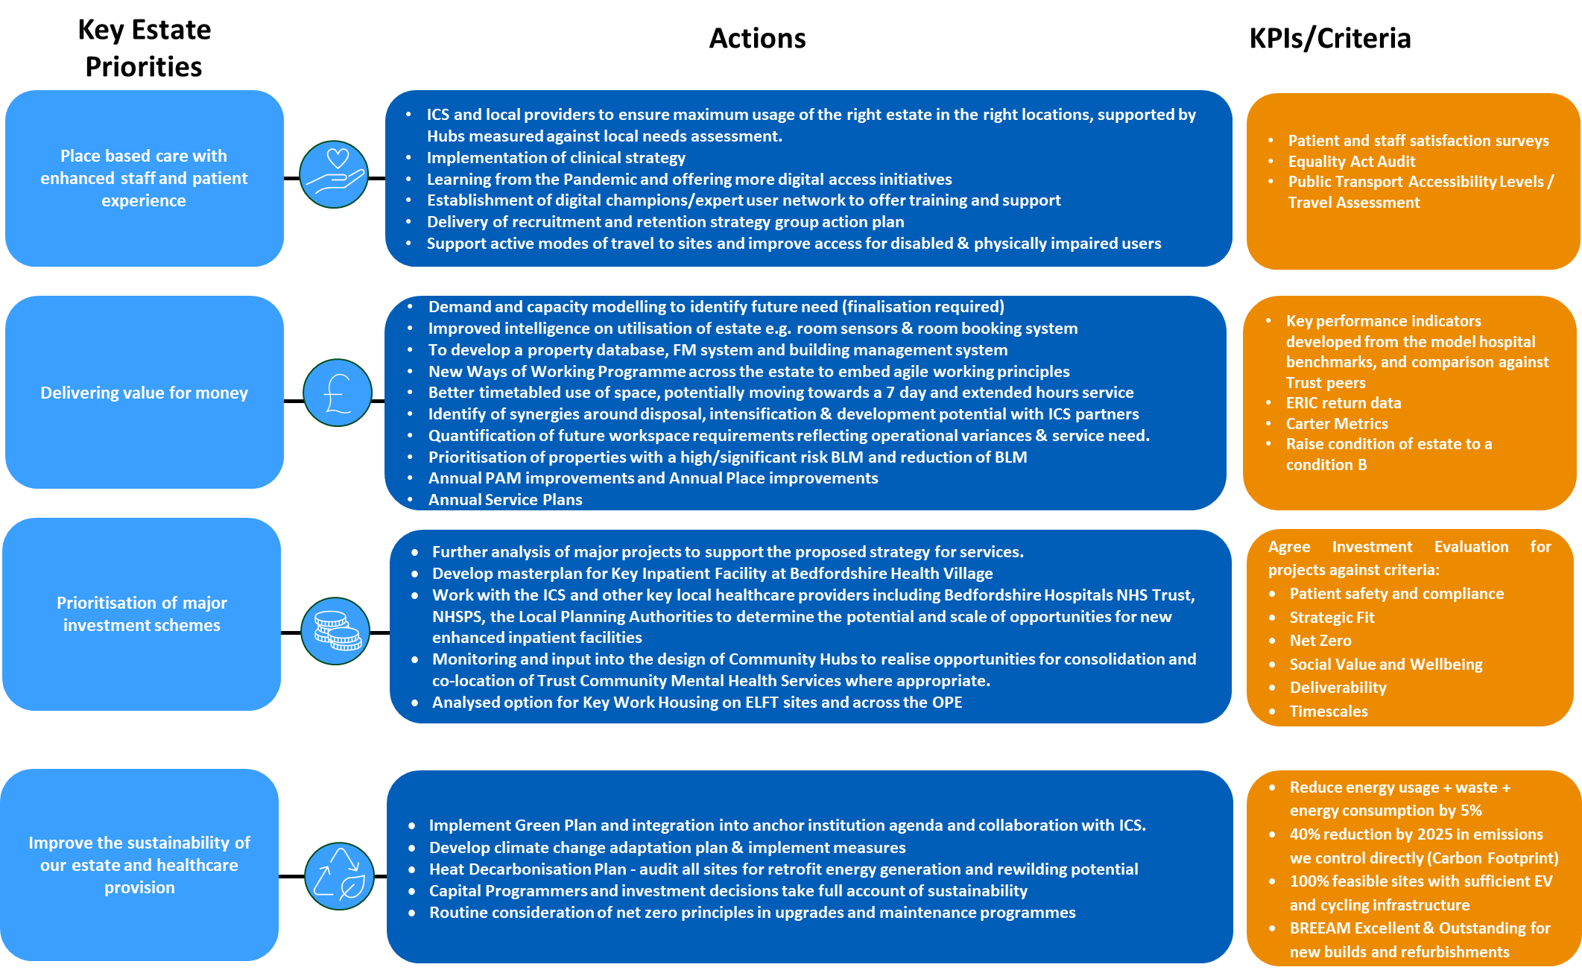
ELFT Estate Environmental Strategy – Action Plan
ICS and local providers to ensure maximum usage of the right estate in the right locations, supported by Hubs measured against local needs assessment.
Implementation of clinical strategy
Learning from the Pandemic and offering more digital access initiatives
Establishment of digital champions/expert user network to offer training and support
Delivery of recruitment and retention strategy group action plan
Support active modes of travel to sites and improve access for disabled & physically impaired user
Patient and staff satisfaction surveys
Equality Act Audit
Public Transport Accessibility Levels / Travel Assessment
Complete implementation of space survey program by Q3/Q4 2025
Demand and capacity modelling to identify future need
Improved intelligence on utilization of estate e.g. room sensors & room booking system
Reduce backlog maintenance by 2.5% by March 2026
Annual PAM Improvements and Annual Place improvements
Complete Hard FM Tender Project for appointment of new supplier(s) by December 2025
Implement Compliance Improvement Program to reach 80% compliance assurance by April 2026
Reduce
Compliance database (in Power BI)
6 Facet Survey Data
ERIC return data
PLACE Data
Base condition of estate to a condition B
Regular Estates Liaison meetings with Service Directors, Digital and Finance
Further analysis of major projects to support the proposed strategy for services
Work with the ICS and other key local healthcare providers to determine potential opportunities for new enhanced inpatient facilities
Finalise the estates input to the Trust business case for the NHSE 25/26 Capital Funding
Continue implementation of standardized capital procedures
Continue strategic partnerships with ICBs to maximize external funding opportunities
Agree Investment Evaluation for projects against criteria:
Patient safety and compliance
Strategic Fit
Net Zero
Social Value and Wellbeing
Deliverability
Timescales
Complete the Green Plan refresh for 2025-2028 following engagement with stakeholders and ICB
Develop a long-term climate change adaptation plan separate from business continuity plan
Appoint a nominated lead accountable for adaptation planning and management
Develop climate change adaptation plan & implement measures
Heat Decarbonisation Plan - audit all sites for retrofit energy generation and rewilding potential
Capital Programmers and investment decisions take full account of sustainability
Routine consideration of net zero principles in upgrades and maintenance programmes
Reduce energy usage + waste + energy consumption by 5%
40% reduction in emissions we control directly (Carbon Footprint)
100% feasible sites with sufficient EV and cycling infrastructure
BREEAM Excellent & Outstanding for new builds and refurbishments
7

Slide 8
Place Based Care & User Experience Update
Action
Progress 24-25
Next Steps 25-26
INTEGRATED CARE DELIVERY
ICS and local providers to ensure maximum usage of the right estate in the right locations
Implementation of clinical strategy
Reviewing void/vacant space in freehold estate to increase clinical/corporate capacity or lease to third sector
Property data review programme established to assess freehold/leasehold information, team occupation and accommodation requests
Created annual service plans and Service/Borough estate dashboards highlighting key estate areas
Continued alignment with ICS estates strategies (NEL & BLMK strategies now completed)
Ongoing discussions at ICS board regarding providers estates plan and potential options to leverage estates
Complete space survey program by Q3/Q4 2025 to optimise service delivery locations
Implement standardised approach to data gathering, storing, analysing, and reporting for informed decision making
DIGITAL INTEGRATION
Working with Digitail- offering more digital access initiatives
Establishment of digital champions/expert user network to offer training and support
Created boardroom conference facility on 2nd floor of Alie Street with enhanced digital capabilities
Developed Power BI dashboards for Compliance data
Migration of property data from Master Site Spreadsheet to dedicated ERIC Portal initiated
Digital champions network established and supporting staff and service users
Develop and publish Power BI dashboard to ensure all in Estates can access and manipulate the data.
List of Requirements being drawn up to move Master Site Spreadsheet to ERIC portal
Set up a new ways of working group to discuss technology enablers
Continue to develop and expand digital support networks across the estate
Development of Estates Document Repository (SharePoint)
STAFF SUPPORT AND ACTIVE TRAVEL
Delivery of recruitment and retention strategy group action plan
Support active modes of travel to sites and improve access for disabled & physically impaired users
Established a parking service at Calnwood Road and Alma Street, improving site accessibility
Commenced access and signage audit creation sessions to improve accessibility
Improved service user experience by providing modern fit-for-purpose hub facilities
Promotion of new facilities with suitable staff amenities (Tower Hamlets Town Hall and Grove View)
Providing flexible working supporting staff to have greater choice in where, when and how they work
Complete accessibility and signage audits by August 2025
Implement "Put Yourself In My Shoes" accessibility assessment in 2025 looking at the service user experience from the local gateway point to the building entrance and beyond.
Continue improving accommodation for staff and service users through the priority of works programme
Review and enhance active travel support at key sites
Expand service user and staff involvement in estate improvement initiatives
8

Slide 9
Delivering Value for Money / GFGT Updates
Action
Progress 24-25
Next Steps 25-26
SPACE OPTIMISATION AND UTILISATION
Demand and capacity modelling to identify future need
Improved intelligence on utilization of estate e.g. room sensors & room booking system
Better timetabled use of space, potentially moving towards a 7 day and extended hours service
New Ways of Working Programme across the estate
Quantification of future workspace requirements reflecting operational variances & service need
In conjunction with clinical teams, met 50% of space reduction target (1,000sqm) through GFGT initiative
Total savings of £78k from space reduction efforts, with additional £1.5M business rates savings.
Additional rental income of approximately £50k from lease renewals (Happy Computers increased by £26k, Kent Dental by £23k)
Reviewed void/vacant space in freehold estate to increase clinical/corporate capacity or lease to third sector
Created boardroom conference facility on 2nd floor of Alie Street to reduce reliance on external conferencing
Complete implementation of space survey program by Q3/Q4 2025
Improve space management through dedicated space resource (subject to approval)
Implement standardized approach to data gathering and reporting on space utilization
Move forward with service-led and risk-assessed approach to planning
Migration of property data from Master Site Spreadsheet to dedicated Estates Portal initiated.
Property data review program established to assess freehold/leasehold information, team occupation and accommodation requests
Created annual service plans and Service/Borough estate dashboards highlighting key estate areas
Instructed Lexica to review Property Data and update Dashboards (initially focusing on Primary Care and BCHT directorates)
Complete three-phase migration process to Estates PortaL
Develop comprehensive digital dashboards for all directorates/boroughs
Continue to participate in system-wide strategic property initiatives with ICS partners
Establish quarterly property reviews with service directors
ESTATE DATA MANAGEMENT AND SYSTEMS
To develop a property database, FM system and building management system
Identify of synergies around disposal, intensification & development potential with ICS partners
ESTATE CONDITION AND COMPLIANCE
Prioritisation of properties with a high/significant risk BLM and reduction of BLM
Annual PAM Improvements and Annual Place improvements
Annual Service Plan
Six facet surveys completed for all properties under ELFT maintenance and responsibility
Working with contractors to carry reduce backlog works
PAM for FY 23/24 successfully submitted on September 13th, 2024
RAAC assessment completed - confirmed RAAC not present in ELFT freehold estate and 83 leasehold properties
93% of PLACE 2023 actions completed/closed, with remaining actions integrated into PLACE 2024
Implemented annual PAM and PLACE improvements
Creation of Trust Asset Register for Hard FM Tender
Implement Compliance Improvement Program to reach 80% compliance assurance by April 2026
Complete Hard FM Tender Project for appointment of new supplier(s) by November 2025
Reduce backlog maintenance by 2.5% by March 2026
Complete remaining PLACE 2024 actions and prepare for PLACE 2025 assessments
Establish a program to bring estate up to Condition B and develop mid / long term strategy
9

Slide 10
Capital and Investment Update
Action
Progress 24-25
Next Steps 25-26
CAPITAL PROJECT PLANNING AND PRIORITISATION
Further analysis of major projects to support the proposed strategy for services
Develop masterplan for Key Inpatient Facility at Bedfordshire Health Village
Work with the ICS and other key local healthcare providers to determine potential opportunities for new enhanced inpatient facilities
Monitoring and input into the design of Community Hubs for consolidation/co-location of Trust services
Capital Department Expenditure Limit (CDEL) for 25/26 was established at with a core ELFT allocation of £12.224m i.e. 7.049m for Estates (58%), £4.575m for Digital (37%), and £600k (5%) for estates staff capitalization. This was prior to the allocation of an additional £5.016m NHSE estates funding .
In 24/25 the Trust successfully secured £550k NHS Energy Efficiency Fund (NEEF) for LED lighting installation at Newham Centre for Mental Health and John Howard Centre .
Established a draft prioritized capital pipeline for 2025/26 following a robust service-led and risk-assessed approach to planning
Received and processed Initial Capital Requests (ICRs) throughout the year to maintain an updated capital pipeline
Regular Estates Liaison meetings with Service Directors, Digital and Finance to improve coordination and allow redistribution of funds based on capacity and priority
Review the 10 year Capital Projects Pipeline & Prioritization plan.
Finalise the estates input to the Trust business case for the NHSE 25/26 Capital Funding to reduce Mental Health Out of Area Placements (OAP) with submission to NHSE in May 2025.
Ensure that the momentum of the early agreement of the Capital Plan is maintained in order to allow delivery of the core capital programme by Dec 2025.
CAPITAL PROJECT DELIVERY AND MANAGEMENT
Analyse options for Key Worker Housing on ELFT sites and across the OPE
Monitoring and input into design of Community Hubs
Focus on major project opportunities
Completed construction of Alie Street 2nd Floor AV Facility in December 2024, creating an in-house conferencing facility reducing reliance on external venues
Completed HBPoS Luton suite renovation providing enhanced patient experience, staff monitoring station, and escape route
Upgraded Wolfson House lifts, addressing recurring failures and reducing repair costs
Anti-ligature improvements across multiple sites including window replacements at Tower Hamlets Centre for Mental Health
Patient bathroom and shower room renovations at Bevan Ward
Implemented LED lighting upgrades across multiple sites, improving sustainability and reducing costs
Continue implementation of standardized capital procedures and ensure Capital Team is sufficiently resourced to manage the workload
Create a common record storage approach for project documentation across the Capital team
Develop a nimble capital project approach to respond quickly to national funding opportunities with ready-to-submit projects
Recruit sufficient internal client representative project manager resource to successfully deliver the 25/26 capital programme i.e. more than double the value of the 24/25 capital programme.
In January 24, estates will review PLACE action plans and prioritise works so contactors can complete works by end of March 24.
FINANCIAL MANAGEMENT AND VFM
Future planning horizon for capital requirements
Develop system capital partnership approach
Implemented "purchase now, install later" approach for long lead items to maximize available funding in 24/25
Asset Property Management (APM) funding was fully committed with 57 budget codes created and significant maintenance projects delivered
Successfully managed disposal of unlawful occupiers at 54 Lewsey Road (Luton), preparing for potential capital receipt of £350k
Enhanced Services Centre in Bedford – negotiated a 10% footprint reduction resulting in £200k lease cost savings
Continue with Post Project review Boards (including Lessons leartn capturing process) to ensure consistent approach to project governance
Develop response to significant underfunding of backlog maintenance (currently ~£75M) through prioritized approach
Re-evaluating job descriptions and team structure to adapt to GFGT constraints while maintaining delivery capability
Continue strategic partnerships with ICBs to maximize external funding opportunities
10

Slide 11
Improve the Sustainability of our Estate and Healthcare Provision
Action
Progress 24-25
Next Steps 25-26
STRATEGIC PLANNING AND ORGANISATIONAL ENGAGEMENT
Implement Green Plan and integration into anchor institution agenda and collaboration with ICS
Develop climate change adaptation plan & implement measures
Green Champions program launched with a climate network of over 300 people
Over 30 service users actively engaged in the Green Plan
Sustainability threaded through annual planning
Appointed Net Zero Project Manager (January 2025) to deliver Green Plan projects
Green Plan measures successfully linked with GFGT program with approximately £200k savings achieved
Streamlined comms drive
Co-design Green Plan with staff, service users and ICB leads
Complete the Green Plan refresh for 2025-2028 following engagement with stakeholders and ICB
Develop a long-term climate change adaptation plan separate from business continuity plan
Appoint a nominated lead accountable for adaptation planning and management
Expand service user and staff involvement in green initiatives across all directorates
Implement early warning system for extreme weather events and their impact on services
TECHNICAL IMPLEMENTATION AND INFRASTRUCTURE
Heat Decarbonisation Plan - audit all sites for retrofit energy generation and rewilding potential
Capital Programs and investment decisions take full account of sustainability
Funding for onsite solar renewables obtained
LED lighting program on track. Four sites in 24/25
Full external BMS audit completed with actions identified
Net Zero Project Manager now shadowing capital team on large LED projects
Developed decarbonisation plan to support drive towards Net Zero by 2040
Linked Green Plan goals with capital investments for 2024/25 totaling about £243.5k
Planned for 5% reduction in carbon emissions on scope 1 & 2 by end of FY 2025/26
Create minimum three robust energy efficiency projects aligned with potential funding opportunities
Implement comprehensive BMS improvements with new M&E contractor
Further integrate sustainability criteria into project scoring matrix for capital investments
Continue LED lighting rollout across the estate
OPERATIONAL SUSTAINABILITY
Routine consideration of net zero principles in upgrades and maintenance programmes
Gas usage showing an 8.8% reduction compared to same period in previous year
Recycling rates increased from average of 25% to 32% by February 2025
Initiated rollout of food waste provision across all Trust-managed sites
Leak detection system in place
Set 0% domestic waste to landfill target
Continue progress toward 5% reduction in utilities and 40% recycling rate across the Trust
Implement food waste collection across all remaining sites
Complete green space improvements identified in site survey
Ensure inclusion of net zero principles in new Hard FM contract specifications
Develop assurance methodology for monitoring supplier and contractor carbon reduction plan
11

Slide 12







Estates – Impact on Staff and Service Users
Improving service user experience by providing a modern fit for purpose hub facility (Grove View)
01
05
Providing flexible working supporting staff to have greater choice in where, when and how they work
Promotion of new facilities with suitable staff amenities
02
06
Improving accommodation for staff and service users through the priority programmes
Improving the environmental contribution to staff wellbeing
03
Review into void / vacant space to support increased clinical capacity
07
Improving service users' quality and provision of care through the dedicated People Participation Lead
04
08
PAM and PLACE demonstrates to service users that robust systems are in place to assure premises are safe
12

Slide 13






Estates – Risks & Mitigations
Key risks
Mitigation
Prioritise critical works through structured capital planning process; implementing phased approach targeting critical statutory compliance items first (£5.28M allocated to Estates in current capital program)
Significant backlog maintenance liability
Hard FM Suppliers performance issues
Hard FM reprocurement process underway with tender complete Autmn 25. interim governance and assurance processes implemented
Collaborative discussions with neighbouring providers on joint approach to PFI/PPP contract expiries; engaging with Government's Infrastructure Project Authority for potential support during 2025/26
PFI contract expiry planning at Newham Centre
Comprehensive remediation program underway with £180K allocated for fire door rectification at multiple sites; established regular Safety Group meetings for each engineering discipline; close liaison with Fire Services
Fire safety compliance issues
Insufficient engineering and compliance resources
Training program for existing staff in Authorised Person roles; imbedding of resources into new Hard FM; implementation of new compliance reporting process by Mid 2025
Space utilisation inefficiencies and high leasehold costs
Trust-wide space utilisation review underway with pilot commenced; strategic program to reduce footprint by an additional 1% in 2025/26; targeted micro-review of key leases to identify renegotiation opportunities. Working with NEL on void costs
Environmental quality and patient experience challenges
Implementing detailed PLACE action plan with 70% of 2023/24 actions completed; establishing food committees across all inpatient areas; Dietician appointment implementing access and signage audit program by July 2025
13

Slide 14
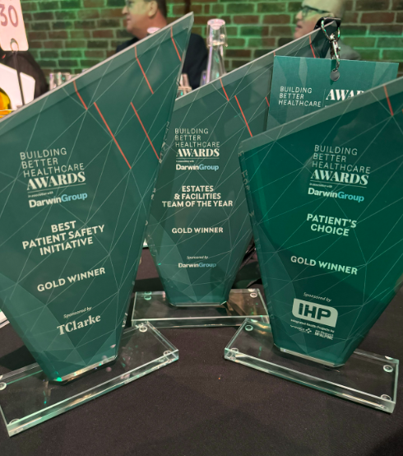
Awards, Nominations and Appointments
Award / Appointment / Nomination | Awarding Body | Link to details
Estates and Facilities Team of the Year | Better Healthcare Awards 2024 | National Awards for Trust Estates Team | East London NHS Foundation Trust
Estates Team of the Year | Design in mental health awards 2024 | https://www.designinmentalhealth.com/awards-2024-winners/#1736776890680-ae507adf-2735
Patient's Choice Award | Better Healthcare Awards 2024 | BBH Awards 2024 - The Winners
Best Patient Safety Initiative | Better Healthcare Awards 2024 | BBH Awards 2024 - The Winners
Support Services Award – Vivian Korankye – Estates PM | ELFT Staff Award 2024 | Winners Announced for Distinguished Staff Awards | East London NHS Foundation Trust
Working in Collaboration Award Nomination | ELFT Staff Award 2024 | Staff Awards Celebration 2024
Team of the Year Award (Finalist) | Patient Experience Network
David Stevens appointed as vice president for CIBSE | Chartered Institute of Building Services Engineers (CIBSE) | https://www.elft.nhs.uk/news/david-stevens-appointed-vice-president-cibse
14

Slide 15
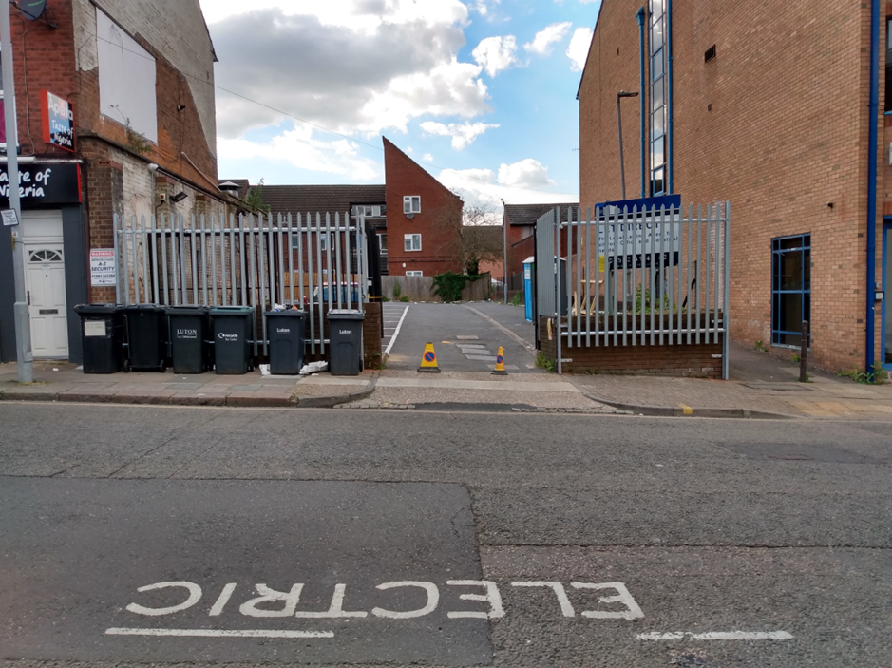
ELFT Capital Development - Annual Update
In 2024/25, the Estates, Facilities and Capital Development team delivered over £5.8 million in capital investment, excluding staffing costs. Projects delivered this year have strengthened critical infrastructure, improved patient and staff environments, and supported sustainability across multiple sites.
The directorate has continued to meet high delivery standards despite pressures on internal resources. Key improvements include greater standardisation across processes and stronger clinical engagement in project planning – a significant improvement on previous years. National recognition through professional appointments and nominations for awards has reflected the continued impact and professionalism of the team.
The delivery of major projects requires detailed planning and can sometimes be a testing time for those involved e.g. when delivering works amidst a busy operational environment or involving a decant. We are always grateful for the input and forbearance of our Trust colleagues in all disciplines and at all levels.
Alma Street, Car Park front fence on completion
16

Slide 16
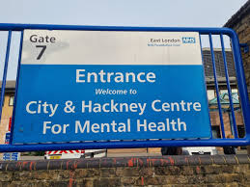
Capital Financial Overview & Achievements
The capital allocation for Estates in 2024/25 totalled £5.834 million, representing just over half of the Trust’s total Capital Departmental Expenditure Limit (CDEL). Digital projects accounted for a further £4.983 million, with the remaining allocation linked to capitalised staffing costs.
In January 2025, the Trust secured £550,000 from the NHS Energy Efficiency Fund to deliver LED lighting upgrades at the John Howard Centre. Equipment was procured during the year, with installation scheduled for 2025/26. This investment supports the Trust’s wider Net Zero ambitions, with an expected 18-month payback period.
Looking ahead, the Estates capital budget for 2025/26 has more than doubled to £12.665 million, which includes significant central funding in addition to CDEL. The capital plan was finalised ahead of schedule and shows stronger project definition and prioritisation compared to previous years
16

Slide 17

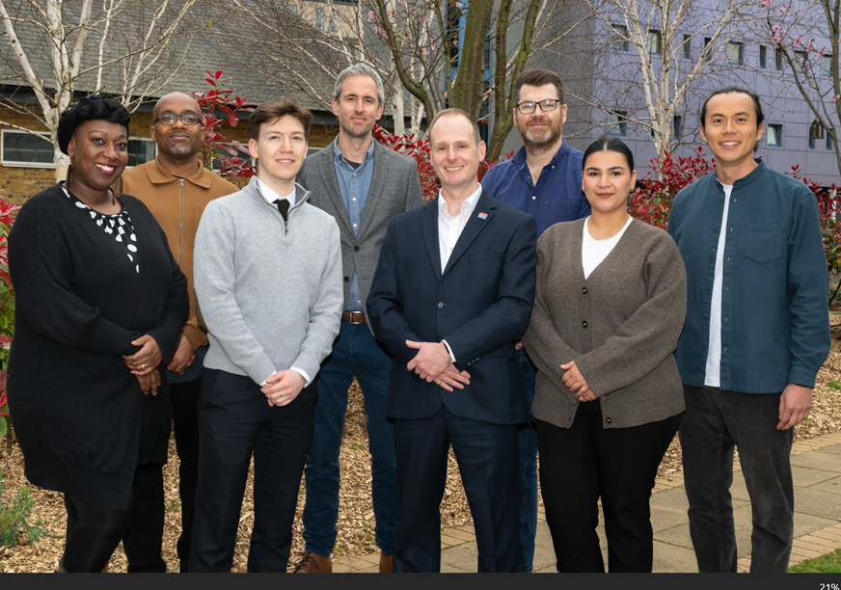



Capital Key Projects Delivered
Building Renovations
Luton Health-Based Place of Safety remodeling
Alie Street 2nd Floor AV Suite construction
Charter House external repairs (multiple elevations)
Accessibility & Safety
Fountains Court accessibility improvements
Wolfson House lift refurbishment (both lifts)
Anti-ligature window installations at Tower Hamlets
Environmental Improvements
Millfield Unit garden improvements at John Howard Centre
LED lighting upgrades across multiple sites e.g. Twinwoods and the Vivienne Cohen Centre
Conolly Ward Kitchen upgrade
Security & Safety
JHC Seclusion Rooms improvements
Pinpoint alarm system installation at Rush Court
24/25 saw the successful completion of numerous high-impact projects across our estate. From major renovations like the Luton Health-Based Place of Safety to critical safety improvements such as anti-ligature window and door installations.
Fire door upgrades at Newham Centre for Mental Health
17

Slide 18
Capital Process Improvements & Future Plans
Process Improvements
Team Development
Looking Forward
A new Capital Projects Procedures Manual was introduced this year, providing a consistent framework for project delivery across the Trust. All actions identified in the RSM Internal Audit Report 7.23/24 have been completed
The team also implemented Trust-wide standards for key building components, ensuring greater consistency and quality. Improvements to the capital prioritisation process for 2025/26 have increased clinical and operational engagement, supporting more informed investment decisions.
Despite staffing resource challenges, including the departure of one permanent and two interim team members, the team have maintained high standards of project delivery. The hard work of Vivian Korankye was recognised at the Staff Awards in 2024 and in September 2024 Temi Ohwovoriole joined the team as Senior Project Manager.
The team reorganised its delivery approach to ensure comprehensive coverage across all Trust regions and are optimising the capital delivery team structure to meet the demands of an expanding project portfolio.
Focus for 2025/26 includes an increased emphasis on energy efficiency and Net Zero carbon initiatives – including the installation of LED lighting hardware purchased in 2024/25, representing a total investment of £889k, and a £1.1m investment in solar panels at John Howard Centre and Newham Centre for Mental Health.
The team will continue to prioritise quality standards and improved patient environments, building on the successful approaches developed this year to advance strategic infrastructure goals.
18

Slide 19
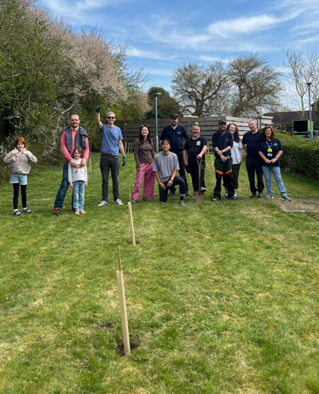
Sustainability Progress: Our Green Journey
In October 2020, the Greener NHS National Programme published its strategy, Delivering a net zero National Health Service, outlining the impact of climate change on human health and on the delivery of healthcare and committing the NHS to becoming the world’s first net zero healthcare systems.
The report set actions for the entire NHS to reach net zero carbon emissions by 2040 on direct emissions (80% by 2028-32) and 2045 on those we can influence (80% by 2036-2039). These actions include for NHS Trusts to develop local Green Plans detailing our approach to emissions reductions in line with national targets
ELFT's first Green Plan covered the three-year period from 2022 to 2025 and as the Team embarks on the Green Plan update for the next three years it is helpful to look back at the last year of progress for this report and acknowledge those who have helped to make this plan a success.
19

Slide 20
Sustainability Major Achievements
6.2%
32%
Gas Reduction
Recycling Rate
Decrease in gas usage compared to previous year
Up from 25%, on track for 35% target
£240k
300+
Cost Savings
Members of Climate Network
Delivered across utilities and waste budget
35 active climate champions
The ELFT energy efficiency initiatives have yielded impressive results, with a 6.2% reduction in gas usage. However, electricity consumption increased by 2.3% due to the strategic transition away from gas-powered systems. Funding was secured for LED lighting upgrades and solar PV installations at the John Howard Centre and NCfMH. Once complete, these initiatives will significantly reduce energy consumption and carbon emissions.
The Green Champions network now includes more than 300 staff members, with over 30 active participants. Service users are also playing a key role in shaping the next Green Plan, supported by a dedicated People Participation Lead for sustainability. Thanks for the progress of this initiative and many others must go to our dedicated clinical leads for sustainability as well as all stakeholders that have had a hand in helping to move this forward.
20

Slide 21




Sustainability - Current Initiatives & Targets
Green Plan Refresh
Co-design process underway for 2025-2028 Plan with stakeholders, clinical leads, service users and ICB leads
QI Integration
21 active QI projects linked to Green Plan initiatives across the Trust.
This needs to improve going forward with better engagement and analysis of projects
Green Spaces
Developing therapeutic green environments through horticultural group and site surveys
Infrastructure
BMS audit completed with new systems installed where required, rolling out food waste provision
The Trust has committed to a set of ambitious environmental targets. These include achieving a 5% reduction in energy consumption year-on-year and ensuring that all sites are equipped with Automated Meter Reading (AMR) for both gas and electricity. The rollout of LED lighting is set to increase by at least 10% annually, with full coverage targeted by 2028. In addition, recycling rates are expected to reach 40% by the end of the 2025/26 financial year.
21

Slide 22
Sustainability Challenges & Next Steps
Key Challenges
Next Steps
Staffing constraints associated with triple lock
Complete implementation of LED and solar PV projects
Operational waste management issues at John Howard Centre
Continue Green Plan refresh with broader stakeholder engagement
Balancing increased electricity usage whilst reducing gas consumption
Develop robust climate change adaptation planning
Securing investment for energy efficiency measures
Expand green space improvements and outdoor projects
Underdeveloped climate adaptation planning
Prioritise carbon reduction through GFGT workstream
While progress has been made, several challenges remain. Reducing reliance on gas while managing an increase in electricity demand continues to be a difficult balance, particularly in the context of overall energy reduction targets. Work on climate adaptation planning also needs to be strengthened to better prepare for future risks. The focus over the coming year will be on completing planned infrastructure upgrades and continuing the development of green spaces across Trust sites. The Green Plan is currently being refreshed, with wider input from stakeholders to ensure the 2025–2028 strategy is both practical and inclusive. The Trust remains committed to meeting its environmental targets through steady and sustained action.
22

Slide 23
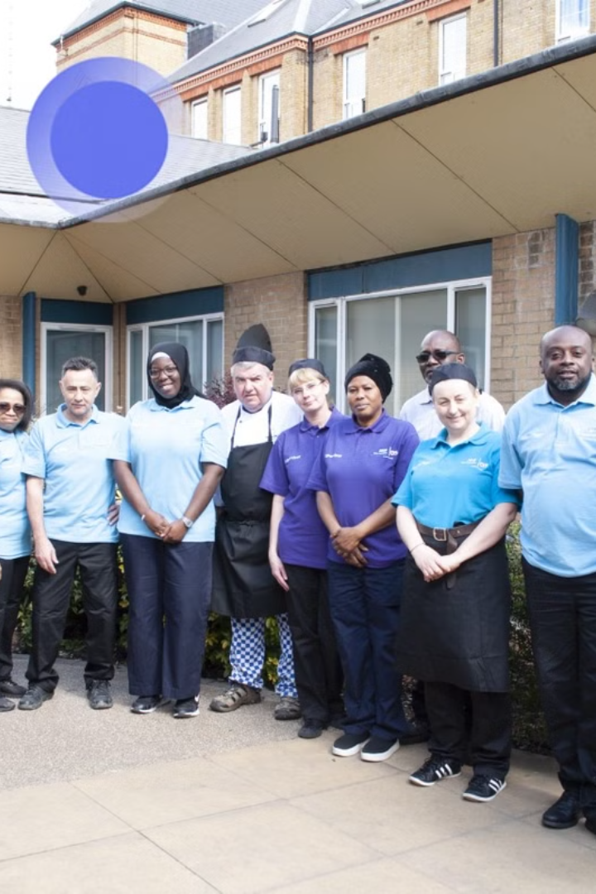
Facilities Management
This section outlines the performance of the Facilities Management team in 2024/25. Despite some challenges at partner-run sites, the team has worked collaboratively to improve service delivery, increase cost efficiency, and enhance the care environment.
The focus remains on delivering well-managed, safe and compliant spaces that support high standards of patient care, while making best use of available resources.
This involves working collaboratively with our service partners and fellow NHS Trusts.
23

Slide 24




FM - Team Development & Key Achievements
Team Growth
A new Facilities Officer joined the Bedfordshire team (June 2024) and an Estates H&S Manager (January 2025), strengthening capabilities in key areas.
Training Excellence
Maintained 93-100% training compliance with quarterly team events focused on Patient Environment Standards, PLACE, and personal safety awareness.
Service Optimisation
Implemented portion size optimization from 1.5 to 1.0 portions per (standard) meal, reducing waste & projecting annual savings of over £600,000.
Contract Management
Identified and delivered cost savings of approximately £800,000 across soft FM services whilst successfully navigating supplier senior management changes.
24

Slide 25
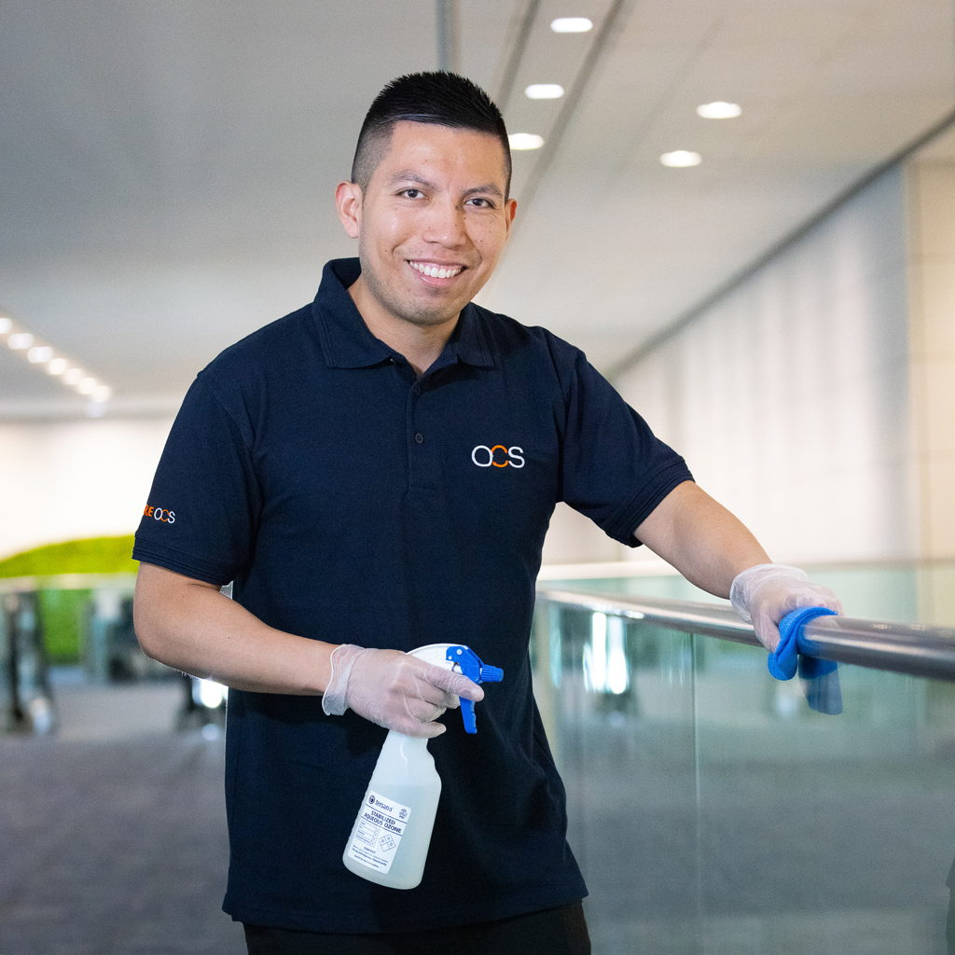
FM - Financial Performance & Cost Savings
Service | Average Monthly Spend (£) | Trend
Catering | 181,165 | Decreasing
Linen | 13,311 | Stable
Consumables | 31,576 | Stable
Escorting | 10,526 | Decreasing
Ad-hocs | 17,970 | Decreasing
The Going Forward, Going Together (GFGT) programme delivered substantial savings this year, particularly through catering efficiencies where ELFT’s contractor OCS provides the service. ELFT was providing food previously working to 1.5 portions of main course per person which was an anomaly in the provider peer group. It gave additional choices above and beyond the desired level but also led to substantial waste. Portion sizes were reduced to the nutritionally balanced and recommended standard, generating a monthly saving of nearly £50,000.
These savings have been achieved whilst maintaining service quality and addressing operational challenges. Estates worked with dieticians, the cook-freeze provider Apetito, and Food Committee attendees before the changes, and received positive feedback from the EAGs (Environment Assurance Groups) for Bedfordshire and Forensics afterwards.
The comprehensive cost control measures reflect our commitment to effective resource management within the constantly evolving healthcare environment.
25

Slide 26
PLACE Success & Future Priorities
PLACE Programme Achievements
2025-26 Strategic Priorities
The Patient-Led Assessments of the Care Environment (PLACE) programme has made strong progress during the year and we are grateful to clinical colleagues for supporting the Facilities Team with updates. The full assessment cycle was completed using enhanced monitoring protocols, with over 70% of action points closed by February 2025 and the programme on track to reach 80% completion by March.
The Trust has worked closely with NHS England to improve the assessment methodology for mental health settings, helping to ensure that environments are appropriate for the people using them. Environmental Action Groups have now been established at all sites, increasing service user involvement in reviewing and shaping the care environment
Standardised ward kitchen design implementation
Three-year rolling programme for kitchen upgrades
New audit tracker for facilities officers
Expansion of service assurance meetings
Comprehensive accessibility audit tools
Further progress on PLACE action items
Implementation of National Standards for Healthcare Food and Drink
26

Slide 27
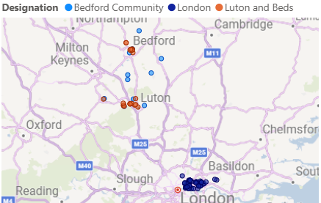
Property Portfolio Performance & Strategy
Our diverse portfolio spans 139 properties across the London Boroughs of City and Hackney, Tower Hamlets and Newham in East London and also Luton and Bedfordshire. The Trust manages 842 beds across52 wards.
The next slides show our property distribution, financial highlights, upcoming estate activities, and safety priorities.
27

Slide 28
Portfolio Overview
London
Luton & Beds
75
Properties
102,821 sqm
Total size of estate
64
Properties
37,827 sqm
Total size of estate
22 leasehold properties can be exited on the next 5 years
32% Leasehold
Based on sqm
39 leasehold properties can be exited on the next 5 years
35% Leasehold
Based on sqm
75% of estate footprint
is clinical
60% of estate in East London is over 40 years old
85% of estate footprint
is clinical
40% of estate in Bedfordshire and Luton is
Older than 40 years old
60% in partner buildings
Based on sqm
638 beds in East London estate
50% in partner buildings
Based on sqm
204 beds in Bedfordshire and Luton estate
£357 m2 average cost of leasehold occupation in East London (rent, S.C. & rates)
£190m Value of Freehold assets
*based 24/25 asset valuation
£228 m2 average cost of leasehold occupation in Bedfordshire & Luton (rent, S.C. & rates)
£41m Value of Freehold assets
*based on 24/25 asset valuation
28

Slide 29

Property Financial Performance
£1M
£1.5M
Annual Rental Income
Business Rates Savings
From leased properties
Additional £200K expected
£78K
£178K
Space Reduction Savings
Highest New Rental Income
From strategic initiatives
For Robin Pinto Unit
In 2024/25, the Trust generated £1 million in rental income from leased properties, supported by commercial tenancies including
Happy Computers (£155K), Essex Partnership University (£178K), and Kent Community Health (£71K).
29

Slide 30




Property Activity 2024/25
New Leases
7 properties with combined annual rental of £400K
4 Primary Care APMS contract properties: £361K p.a.
1 CHP/LIFT property for Pharmacy Service: £43K p.a.
1 Private Landlord property for CAHMS service: £23K p.a.
Key Rent Reviews
15 Homerton Row: £83K p.a. to £165K p.a.
409 Stratford High Street: Peppercorn to £74K
West Ham Lane: £160K to £267K
Disposals in Progress
54 Lewsey Road: Transfer at Book Value to Beds Hospital NHS Trust
Beacon House: Market value £350K
King Street Surgery: Expected sale date June 2025
30

Slide 31
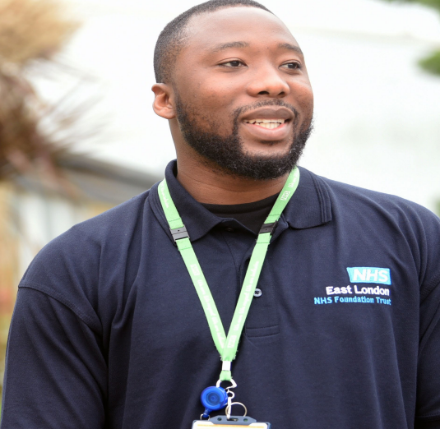
Property Safety & Future Plans
Safety Compliance
RAAC assessments completed with no issues found. Estate reviewed against new Building Safety Act 2022 requirements. 3 higher-risk buildings have full compliance measures in place.
Space Optimisation
In conjunction with clinical teams, 50% of target achieved with 1,000 sqm reduction. £1.5M additional business rates savings with additional rebates pending.
Lease Review Programme
Initial workshop style meeting held with Property Management Consultants.
Review of leases in progress to identify opportunities to reduce costs,
achieve value for money, renegotiate lease terms and mitigate risks.
System Improvements
Property data migration to dedicated Estates Portal.
Structured governance with SLAs and KPIs established.
Resource needs identified: PFI/LIFT Manager, Space Planner, and Property Assistant.
31

Slide 32
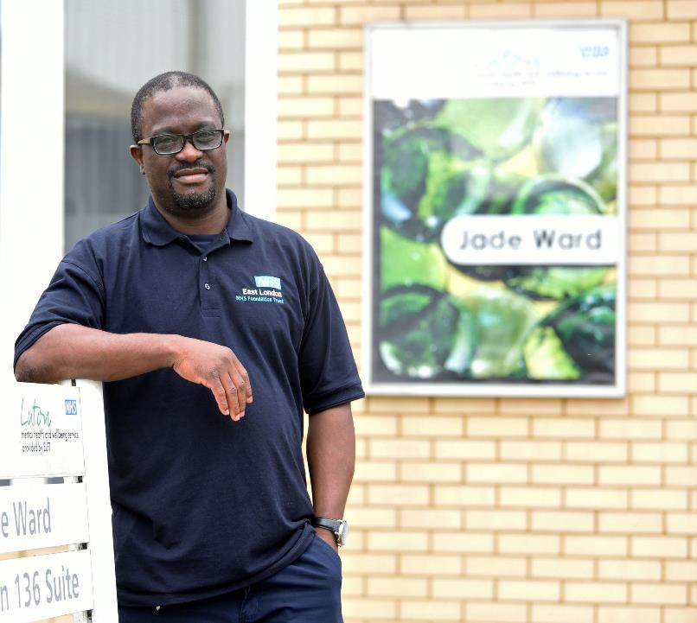
Infrastructure and Engineering
The Infrastructure and Engineering department is responsible for maintaining the technical foundation that supports the trusts operations.
The Backlog Maintenance Programme aims to achieve a 2.5% reduction in backlog maintenance by 31st March 2026. Alongside this, the Hard FM Transformation Project is focused on appointing a Trust wide Strategic Hard FM Contractor, with the target date set for completion by the 31st October 2025.
Additionally, a Compliance Programme of Improvement is underway, with the objective of reaching 80% Compliance Assurance by the 31st March 2026. These initiatives form part of a broader strategy to enhance operational efficiency, ensure regulatory compliance, and improve the overall quality and reliability of facilities management services.
The Infrastructure and Engineering team would like to thank those that have collaborated, supported and engaged with our team this year including but not limited to.
Clinical colleagues who have supported our infrastructure and engineering improvements works and have supported the Trust’s Hard FM Tender.
Service Users who are a key stakeholder at ELFT’s Safety Groups and have supported the Trust’s Hard FM Tender.
Digital colleagues who work with the Estates team to ensure that we’re able to provide the best service possible to our Service Users, Visitors and Colleagues.
32

Slide 33
Infrastructure and Engineering - APM
Asset Property Management (APM)
APM had an allocated budget of £2,832k in the last financial year.
Primary Objectives of APM
Improve the environment for service users and colleagues.
Significant Projects funded by APM
Charter House – Landlord Works
Risks
Lack of Estate resource.
Financial Reporting / Budget Code changes
Reduce Back Log Maintenance
Replace ageing Assets and Infrastructure
Reduce the Trust’s Compliance Risks
Wolfson House –Lifts Refurbishment
Fire Door improvement works
LED lighting upgrades
Capacity / competency of the current Hard FM supply chain
Capital to Revenue transfers
21

Slide 34
Infrastructure and Engineering – Estates Management
Secondment
Technical Standards
Supported by additional resource in latter part of 2024 with this resource extended to October 2025.
Building Operatives
Reviewed Building Operative roles and improvements implemented.
Engineering and Infrastructure Audits
Estates Management audits which are reviewing standards of work and highlighting risks and opportunities.
Incident Management
Improvements to Incident Management process.
Inconsistent specifications, lack of and inconsistent data.
Contractor Performance
Poor contractor performance including response times, maintenance, standards of work and competence. PPM.
Estate Workload
High workload due to poor performing contractors, lack of Estate Management resource and Engineering Competence within the Estates Team.
Asset Register
Initial Asset Register created.
22

Slide 35
Programme Management Office
PMO Programme developed showing projects which the PMO track across the Estates function.
Governance structure developed with Capital colleague inc. Post Project Review Board.
Reports development, including Annual Report, Insightful Leadership Report, Environmental Strategy, and Digital Estates Transformation Board report.
Programme Management
Reporting
Technology
Data Management
Utilising AI technology to analyse their existing data and draw out themes and summaries.
Development of Power BI dashboards.
Document Repository in development which will support the ‘One version of the Truth’ for Estates data.
35

Slide 36
Infrastructure and Engineering Compliance
Gap Analysis
Safety Groups
Authorising Engineers
Additional Compliance Elements added to Compliance Tracking
Quarterly Safety Group Meetings with Terms of Reference, Minutes and Agendas
Development of Online Asbestos Register
Policy
Authorising Engineers appointed for all engineering disciplines.
Regular audits by Authorising Engineers.
Policies are being developed with Ventilation, Electrical and Lifts being launched this year.
Key Risks
Documentation
Poor quality documentation provided by Suppliers.
Attendance
Poor attendance at some of the Safety Groups.
Professional Structure
Estates do not have the resource for all Authorised / Responsible Person roles as detailed with the relevant HTMs.
Gaps
Gaps in Compliance activities.
36

Slide 37
Infrastructure and Engineering - Key Priorities & Future Plans
Compliance
Improvements to Compliance Tracking process including remedial works.
Estates Management
PMO/Performance
Development of further reporting mechanisms
Hard FM Tender
Appointment of Hard FM Contractor by 1st of November 2025.
Business Centre
Review of Business Centre function so that it aligns with new Hard FM Contract.
Supporting improvements to Capital Programme and Governance Structure.
Further development of Technical Specifications.
Continuing to identify and address Engineering and Infrastructure issues.
Document Management System development.
Communication plan implemented to inform colleagues of changes.
Further Policy development and implementation.
Reduction in Back Log Maintenance (based on Six Facet Surveys)
37

Slide 38
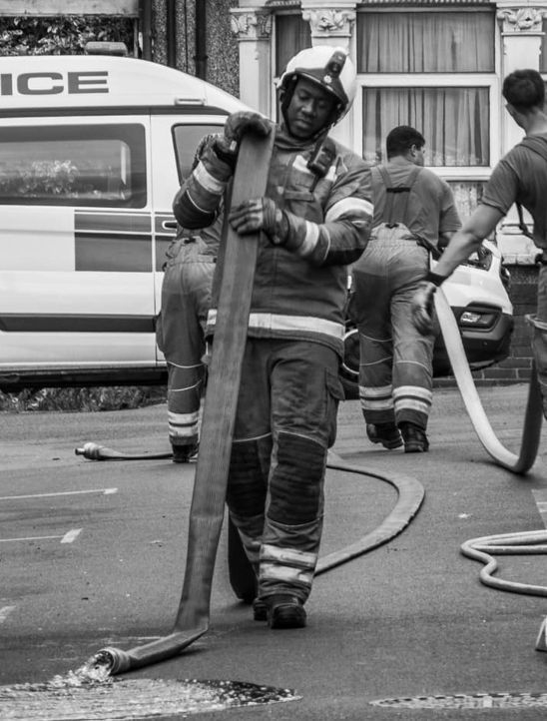
Fire Safety
This section provides an overview of the Trust’s fire safety performance and developments during 2024/25. It outlines key achievements, current initiatives, ongoing challenges, and future priorities in maintaining high standards across all ELFT sites.
Over the past year, notable progress has been made in strengthening fire safety infrastructure, improving training compliance, and building team capacity. At the same time, several complex challenges remain and will require sustained focus and investment.
Effective fire safety management continues to play a vital role in protecting patients, staff and buildings, and remains central to the delivery of safe, high-quality care. Integral to this is the outstanding assistance and cooperation of staff across the organisation in their commitment and support to the Fire Team.
Duane Davis, ELFT Senior Fire Safety Adviser
38

Slide 39




Fire Safety - Achievements and Team Development
Infrastructure Improvements
Completed critical compartmentation works at Felstead Street and Three Colts Lane, with surveys completed at Wolfson House and Elizabeth Fry Building identifying remedial works required. Upgraded fire doors across City & Hackney, Tower Hamlets, and Newham facilities.
Equipment Modernisation
Implemented P50 multi-purpose fire extinguishers at Tower Hamlets Centre, delivering projected cost savings through reduced maintenance requirements. Units already installed across Forensics, Bedfordshire and Luton in-patient sites.
Training Compliance
Increased Trust-wide fire safety training compliance from 86% to 87.67% as of February 2025, reflecting our commitment to ensuring all staff have current fire safety knowledge. Supplemented with mandatory site-specific training courses for all nurses across the organisation.
Team Strengthening
Appointed Duane Davis as Senior Fire Safety Advisor and Dalver Singh Basi as Health & Safety Manager (with fire safety responsibilities), enhancing ELFT’s expertise and capacity.
These achievements demonstrate the Trusts continuing commitment to enhancing fire safety infrastructure and capabilities. The successful Fire Audits (by an external Auditor) at Tower Hamlets Centre and Calnwood Road, further highlight the robust approach to fire safety management.
39

Slide 40








Fire - Current Challenges and Risk Assessment
Fire Door Issues
Substantial cost implications at Newham Centre
False Alarms
Numerous unwanted fire alarm activations at in-patient sites
Evacuation Concerns
Lift problems at East Ham Care Centre and Wolfson House
Regulatory Compliance
Building Safety Act 2022 requirements
The Newham Centre fire door replacement presents significant financial challenges, with costs ranging from £800K for like-for-like replacement to £1.4M for Kingsway alternatives. This represents our most substantial single fire safety expenditure / risk.
Patient vaping continues to trigger an unacceptable number of false alarms, disrupting services and straining relationships with landlords. Additionally, the new Fire Service response protocols requiring confirmation of 'fire' before attendance at non-residential NHS buildings has necessitated urgent adaptation of our evacuation procedures in many ELFT buildings.
40

Slide 41




Fire Safety - Current Initiatives and Future Plans
Infrastructure Projects
Fire alarm system replacement at Homerton Hospital Trust East Wing (landlord responsibility)
Wireless fire alarm upgrades at Homerton Row, Primrose Centre, and Shore Road
Priority compartmentation remediation at Wolfson House and Elizabeth Fry Building (JHC)
Training Enhancements
New fire safety awareness training for community staff (initially in C&H with planned future roll out across all Directorates)
Updated evacuation procedures reflecting new Fire Service protocols
Ongoing assessment of in-patient site evacuation protocols to ensure best practice and response
Partnership Development
London Fire Brigade Home Fire Safety Visits for discharged service users
Resolution of fire door issues with SPV and GFM (Newham)
The continual development of working relationships with external partners / stakeholders (NHSPS, CHP, HHT, Barts)
Documentation and Compliance
Finalizing Fire Strategy documentation for high-risk buildings
Improvement in compliance recording
Implementing measures to control and reduce false alarms
This comprehensive approach addresses immediate concerns while preparing for future regulatory changes. The team are prioritising the most critical safety issues while working to enhance fire safety culture across all ELFT facilities.
41

