Slide 1



ELFT Allied Health Professionals Awards 2025

Slide 2

ELFT Allied Health Professionals Awards Categories 2025
1: AHP Innovation and Service Improvement Award
2. AHP Support Worker Award
3. AHP Living Well –Working Together Award
4. Climate Champion Award
5: Supporting AHP Learners
6: AHP Digital Practice Award
7: AHP of the Year –Leadership Award

Slide 3

AHP Innovation and Service Improvement Award
Name | Team
Winner: Emma Stoneman and Harriet Ensor-Clinch Complex In-reach Pilot Project ​ The pilot demonstrated a significant reduction between people being declared medically fit for discharge from 20 days to 8 days. Fantastic AHP leadership at system level. | Beds CHS
Hannah McDonald​ -pioneering a unique tracheostomy home service that improves patient safety, reduces hospital stays, eliminates waste, and influences national standards | Tower Hamlets CHS
Aida Mumtaz – Therapeutic Engagement QI project …..She has shown leadership, dedication and passion… consistently prioritizing improvement | Newham Mental Health OT Team

Slide 4

ELFT AHP Support Worker Award
Name | Team
Winner: Elzbieta (Ela) Lach Runs groups including accessible gym sessions, hydrotherapy sessions and a new accessible dance group for adults with learning disabilities. She is a superstar &without her these groups could not be run. | Newham Adult Mental Health & Learning Disabilities
Deborah Charman consistently strives to gain the best outcomes and supports people with complex needs. Clients report feeling heard and supported. | Primary Care at Home South Team Beds CHS
Chafinaz Ramjan supports therapy assessments for non-complex patients, reducing waiting times. Her work significantly improved patient flow, maximised rehabilitation opportunities, and strengthened the overall quality of service. | Community Therapy Team, THCHS

Slide 5

Supporting AHP Learners Award
Winner:
Moji Ojomo (OT Student University of Northampton)

Slide 6

AHP Digital Practice Award
Winner: Amy Simpson Beds CHS
Pioneering remote OT and PT consultations. Through a collaborative “digital experimentation group,” she co-produced tools including a therapy intervention table, digital competency frameworks, and patient resources—ensuring safe, effective, and inclusive digital
care.

Slide 7
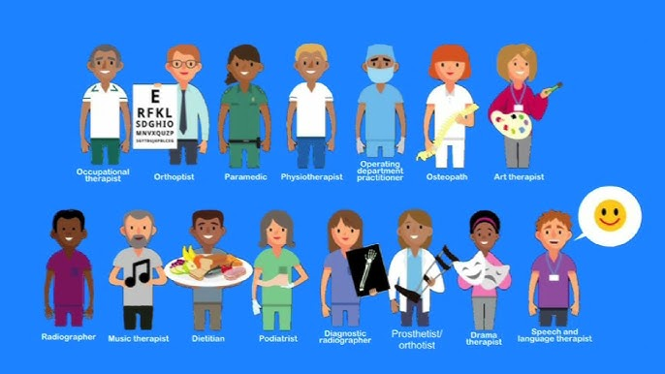
AHP of the Year –Leadership Award
Name | Team
Emma Stoneman | Bedfordshire Community Health services
Neusha Khyabani | OT Coburn Unit CAMHS
Marisa Bouman | Borough Lead OT TH Directorate
Amanda Wildgoose | Operational Lead Podiatry Beds CHS
Inthuja Kesavanathan | Head of OT Forensic Services
Winner: Ellie Gillet | BLMK AHP Faculty Lead
Nicola Power | Strategic Lead for Arts Therapies (Learning Disability)
Olawale Oladimeji | Admission Avoidance and Discharge Service Tower Hamlets CHS
Peter Smith | Head OT Crisis Service C&H

Slide 8
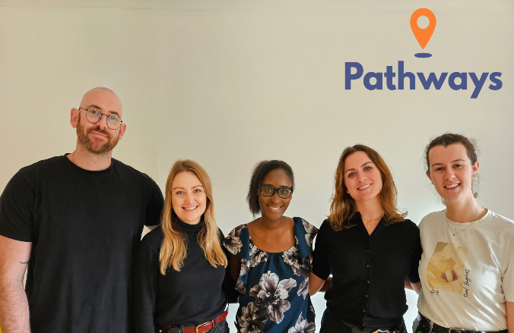

2025 Trust, Place, National Awards &
Nominations so far…
Our ELFT Trust AHP Award Winners
Star of the Future Award – Kate Manning, Luton Mental Health
Improving Value Award – Community Integrated Mental Health Team (North), Newham Mental Health
HSJ Shortlisted:
  Pathways App MH Innovation of the Year Award.
  Community Integrated Mental Health Service (CIMHS) North Team Performance Recovery Award.

Slide 9

Closing Reflections

