Slide 1

Pathways from childhood maltreatment to brain structure alterations in later life
Sofia Orellana
NHS Safeguarding Conference
November 2025
Notes:
- Hi everyone, it’s a pleasure to be here.
- I want to thank the NHS east London Foundation Trust for inviting me to this conference. I hope I can provide a meaningful contribution.
- So, I am Sofia Orellana – I am a neuroscientist, and today I will talk a little bit about how one might research the long-term effects of childhood maltreatment - as a neuroscientist.

Slide 2
Why childhood maltreatment?
CM can encompass multiple things
Abuse: physical, sexual, emotional
Neglect: physical, emotional
Notes:
Why childhood maltreatment?
- We can define this to encompass a few different experiences.
These are any experiences before adulthood

Slide 3
Why childhood maltreatment?
CM can encompass multiple things
Abuse: physical, sexual, emotional
Neglect: physical, emotional
Relevant across the lifetime
Notes:
These experiences are relevant in a safeguarding context because we believe their influence can be observed across the lifetime.

Slide 4

Notes:
Imagine an integrated care team where 3 interdisciplinary professionals come together every week to support individuals with complex needs in the community.
- A social worker
- A doctor or GP
- A psychologist or mental health practitioner of some kind.

Slide 5
Case 1
Female, Age 37
Intimate partner violence
Pre-diabetes
Depression
High blood pressure
PTSD
Financially constrained
Inflammatory bowel
Psychosis symptoms (?)
Female, Age 40
Notes:
You also collect information about their life & they report abuse at home.

Slide 6
Case 2
Male, Age 45
High cholesterol
Unstable relationships
Chronic back pain
Depression
No long-term employment
Alcohol & drug misuse
Arthritis
Notes:
Again this person also reports some sort of childhood adversity

Slide 7
Many cases later …
Notes:
Whilst not all individuals display the same characteristics.
SOME display ALL
Some only one

Slide 8
Many cases later …
Notes:
You observe that for the most part - many issues co-occurr together.
Most people tend to present with complication of at least a few kinds.

Slide 9
Average pattern
At least one psychiatric diagnosis
Psychosocial issues
Physiological / physical illness
Notes:
3….

Slide 10
You emerge with the sense that all these things are connected
Notes:
MANY MEETINGS LATER: You develop a sense that all of these things are connected. Stressful life circumstances, affect mental health, worsening physical health is also linked.

Slide 11
You emerge with the sense that all these things are connected
You have also been reading the news
Notes:
After working with these people you can sense ok, they are in a stressful situation, this makes mental health worse. You’ve done this work. You have likely learned about it in your own profession. You probably learned about this in your work.

Slide 12
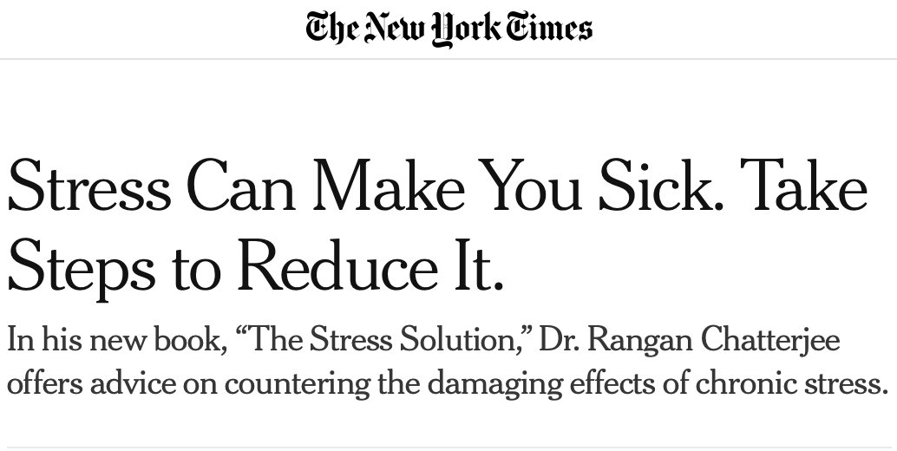
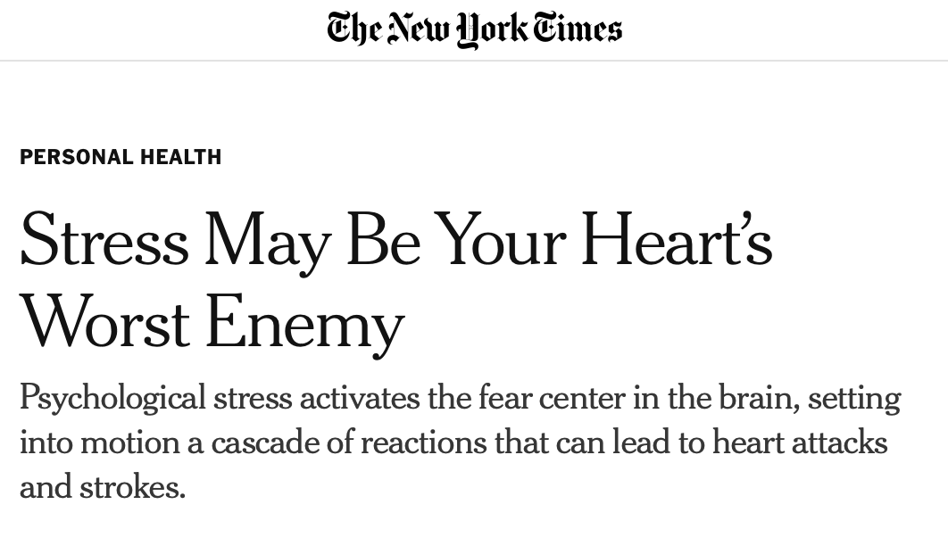
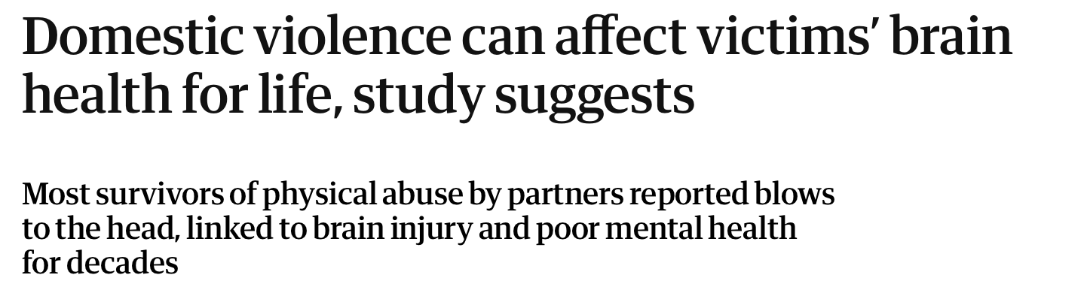
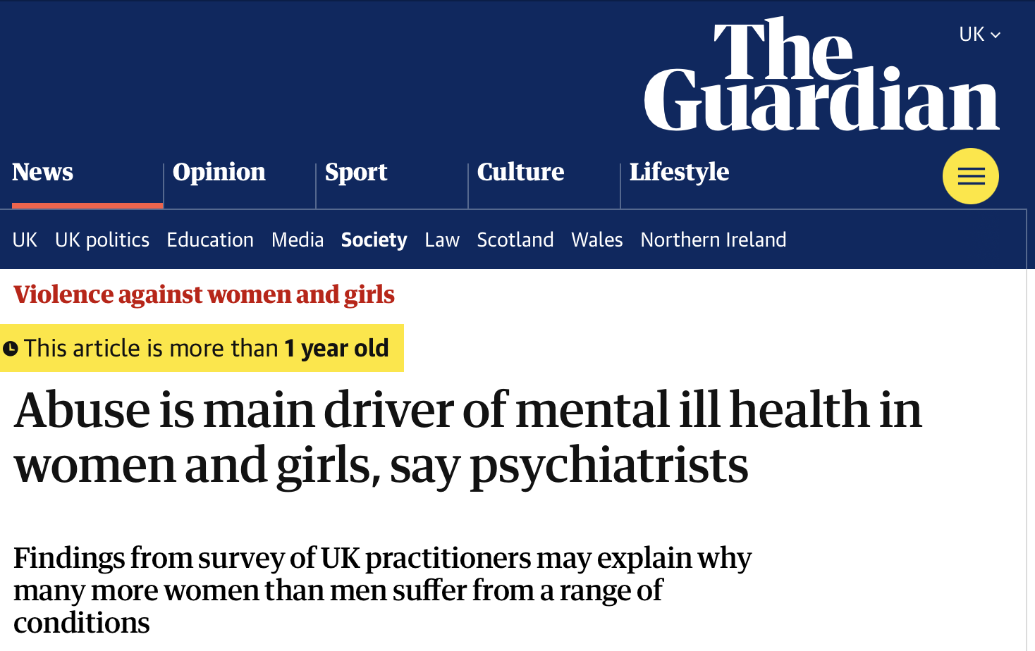
You emerge with the sense that all these things are connected
You have also been reading the news
Notes:
After working with these people you can sense ok, they are in a stressful situation, this makes mental health worse. You’ve done this work. You have likely learned about it in your own profession. You probably learned about this in your work.

Slide 13
How do we understand the way these things are connected?
Notes:
Well, if we look at the literature …. And you will find that several of your hunches are confirmed.

Slide 14
This is hopefully where I come in
Notes:
And as a scientist I sort of try to look at what you have stablished and what I have stablished.

Slide 15
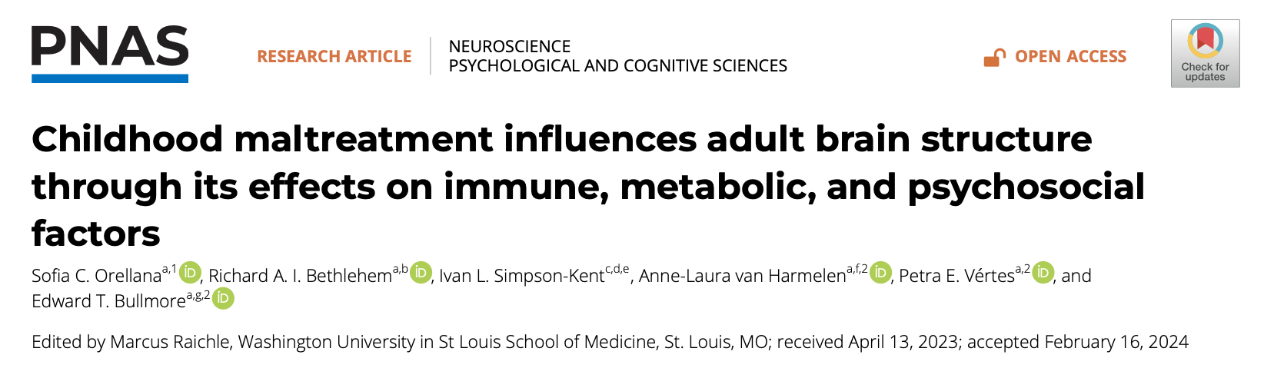
Notes:
What comes first, next and afterwards.

Slide 16
Let’s look at the literature
Notes:
Well, if we look at the literature …. And you will find that several of your hunches are confirmed.

Slide 17
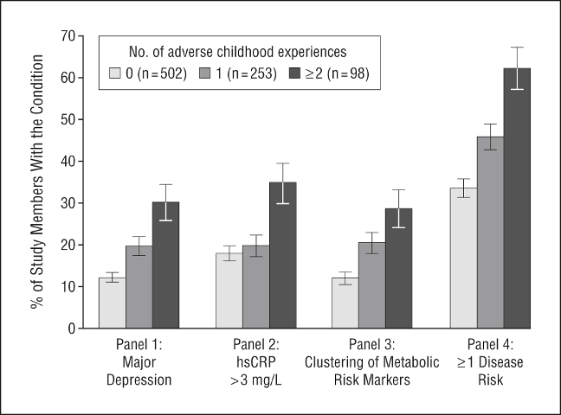
CM is associated with several risks across life
Danese et al., 2009, Arch Pediatr Adolesc Med
Notes:
Much work has been published since then to corroborate this.

Slide 18
CM is associated with several risks across life
~30% of psychiatric patients report exposure to CM.
**Not everyone who experiences CM develops an illness - but there is a small causal risk.
CM is associated with revictimization risk
Kessler et al., 2010, Br J Psychiatry; Grummitt et al., 2024, JAMA Psychiatry; Widom et al., 2008, Child Abuse Negl
Notes:
Risk of revictimization “adult trauma”
Psychiatric disorder risk:
For people who report CM these tend to be more severe, have earlier onset, display chronicity and treatment resistance.

Slide 19
Building & testing a model
Notes:
We can build a model based on the literature and test these hypotheses about how these “things” are related.

Slide 20
Building & testing a model
Metabolic
Immune
CM
Psychosocial
Notes:
Psychiatric risk will be facilitated by changes to the brain

Slide 21
Building & testing a model
Metabolic
Immune
CM
Psychosocial
Notes:
We can build a model based on the literature and test these hypotheses.
For this we need to specify each of the variables

Slide 22
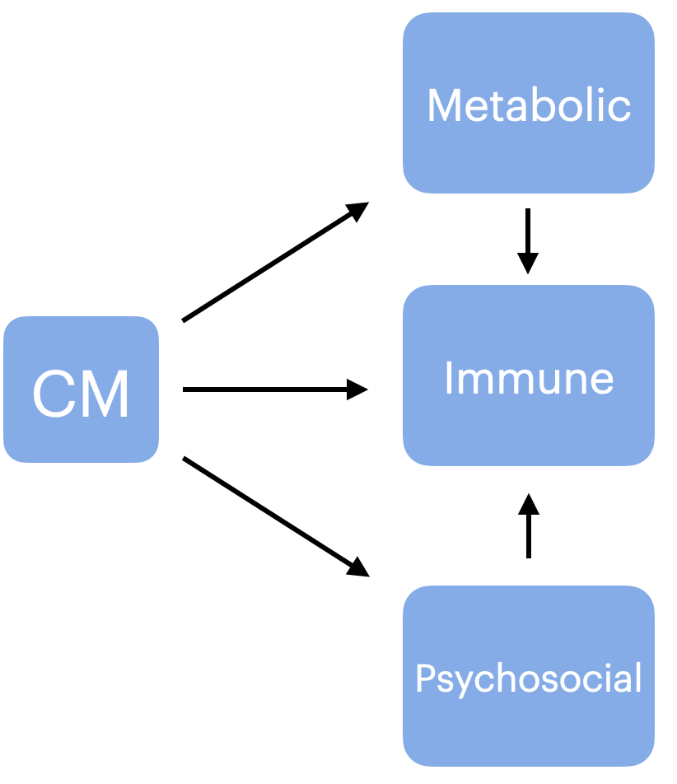
First: we must understand each part individually
H1

Slide 23
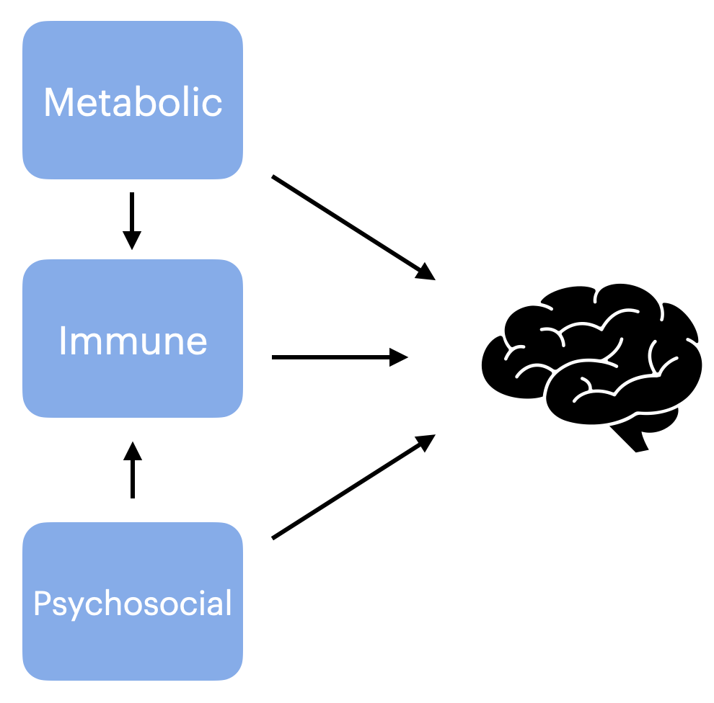
First: we must understand each part individually
H1
H2

Slide 24
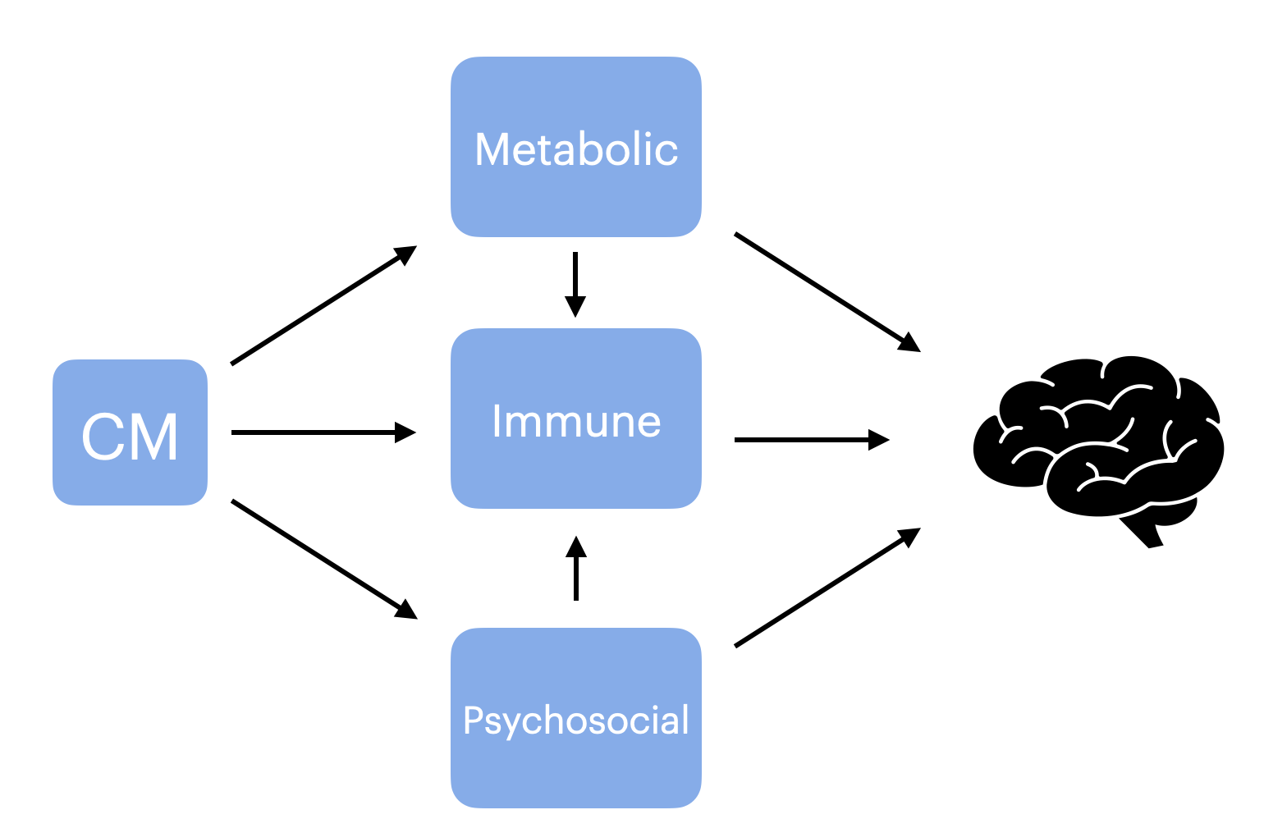
First: we must understand each part individually
H1
H3
H2

Slide 25

Sample & methods
Sample:
~ 20k subjects
Ages ~ 40-70

Slide 26
Sample & methods
Variables
Childhood maltreatment = CM
CM

Slide 27
Sample & methods
Example CM questionnaire
1
2
3
4
5
When I was growing up:
I felt loved
Someone molested me
I felt someone in my family hated me
There was someone to take me to the doctor if I needed it
I was hit and left with bruises and marks
*(inverted)
*(inverted)

Slide 28
Sample & methods
Variables
Childhood maltreatment = CM
Immune = CRP
Metabolic = BMI
Psychosocial = AT
BMI
CRP
CM
AT
Notes:
Questionnaire item

Slide 29
Sample & methods
Variables
Childhood maltreatment = CM
Immune = CRP
Metabolic = BMI
Psychosocial = AT
BMI
CRP
CM
AT
Notes:
Questionnaire item

Slide 30
Notes and caveats
These are imperfect measures
Hopefully — a population-level signal emerges
All measurements are corrected for socio-economic status.
Notes:
SES will invariably drive a lot of what you observe in this study! It correlates aggressively with many of the things we will show. And I am sure many of you here are aware of this.

Slide 31
H1: CM effects on psycho-physiology
BMI
Hypothesis 1:
Has direct/indirect effects on BMI, CRP, AT
CRP
CM
AT

Slide 32
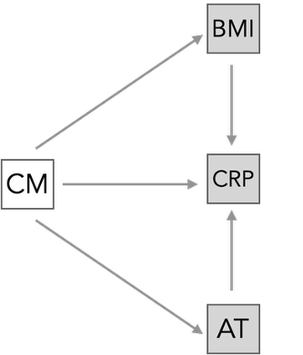
H1: CM effects on psycho-physiology
Method:
Path model
Are these variables related?
How strong are these relationships?
Notes:
DIRECTIONALITY: We believe it is CM affecting BMI and not the other way around.

Slide 33
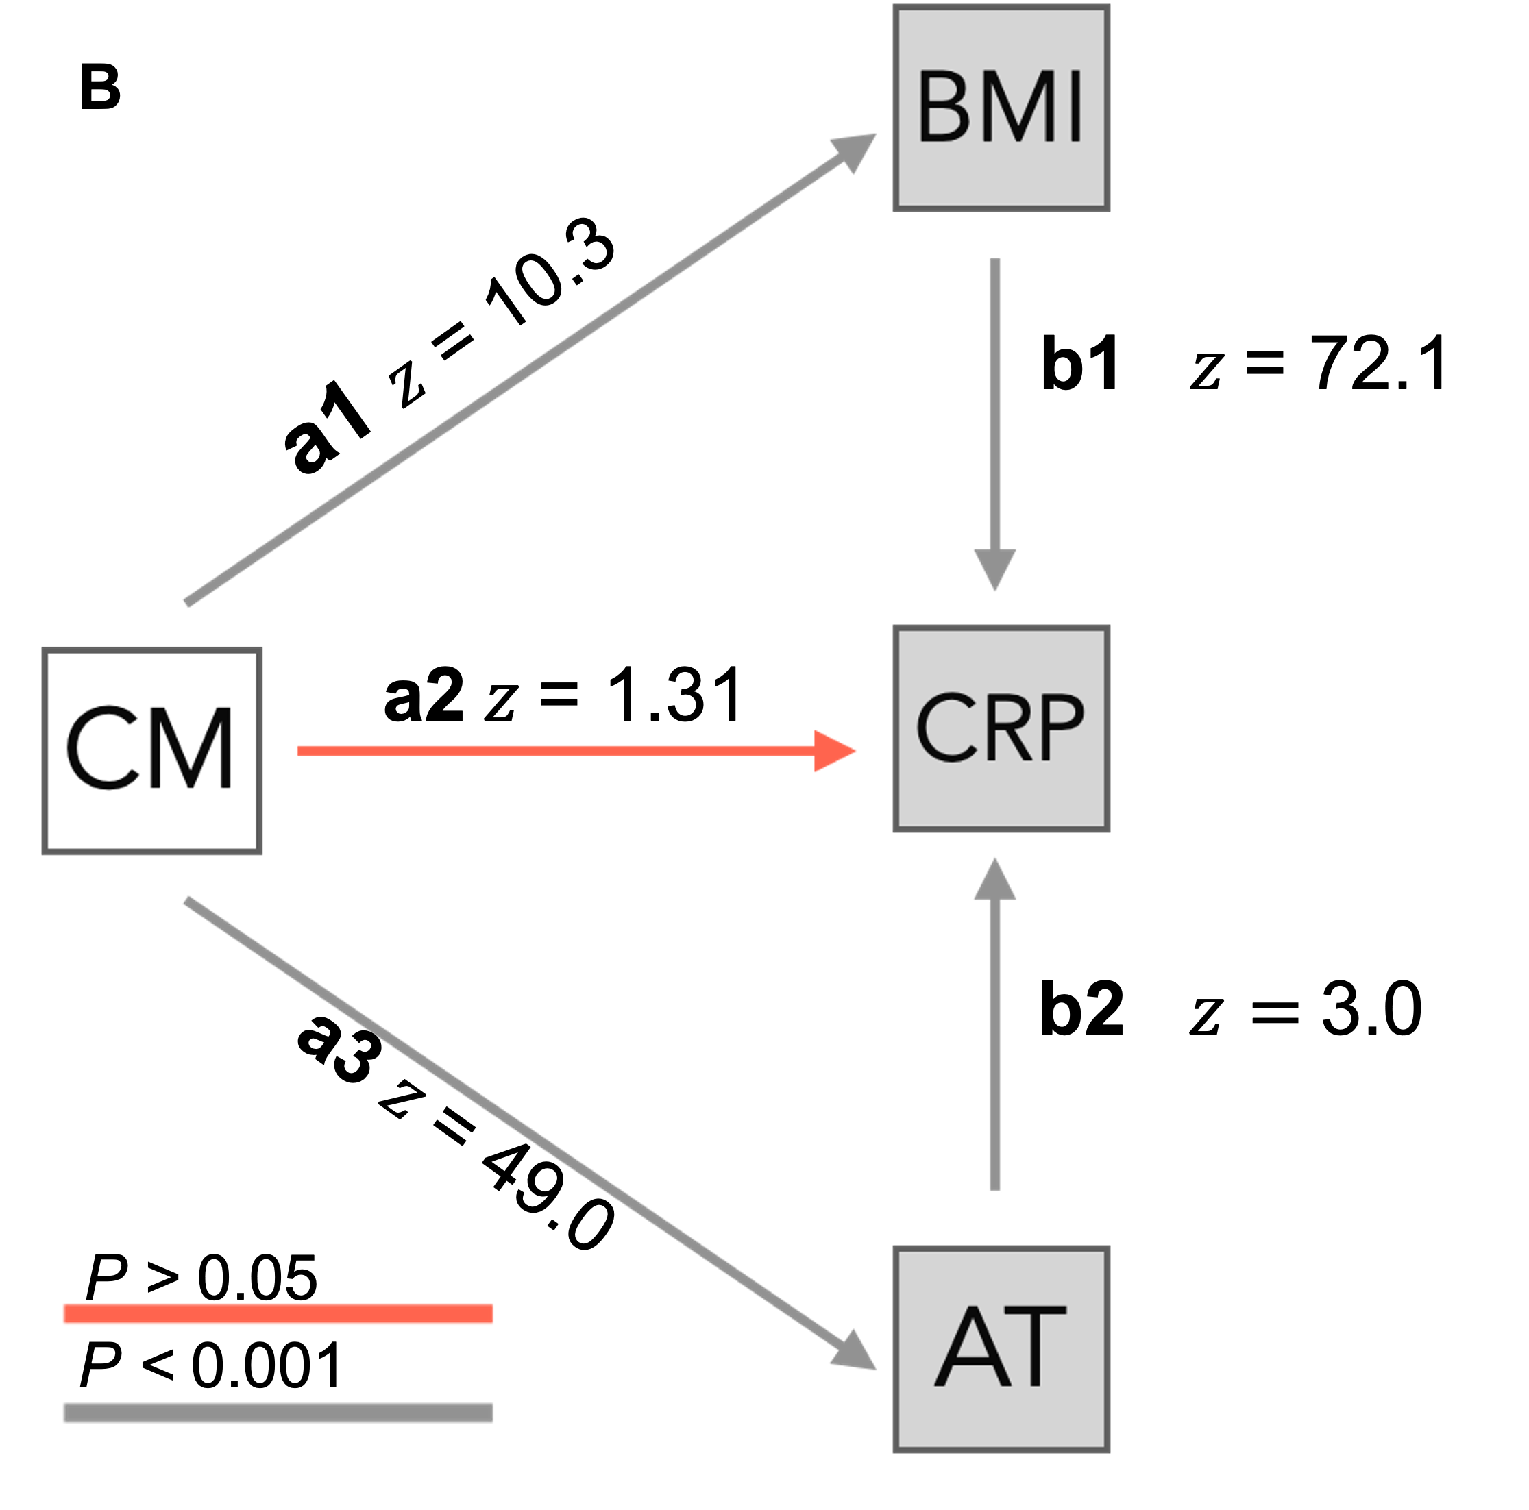
H1: CM effects on psycho-physiology
Results:
CM predicts greater BMI and AT
Notes:
SQUARE: These numbers - you can ignore them but they say something about how strong these relationships are

Slide 34
H1: CM effects on psycho-physiology
Results:
CM predicts greater BMI and AT
Does not predict inflammation

Slide 35
H1: CM effects on psycho-physiology
Results:
CM predicts greater BMI and AT
Does not predict inflammation
Inflammation - predicted by greater trauma and metabolic disfunction.

Slide 36
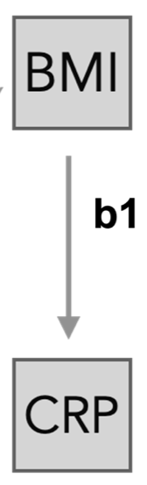
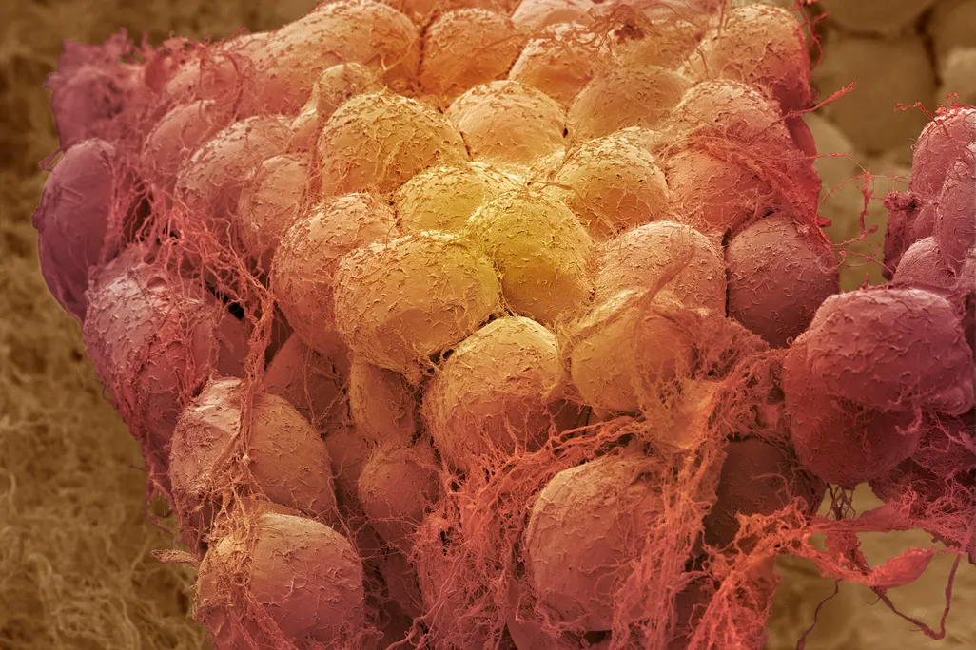
Makki et al., 2013, ISNR Inflammation
Notes:
And this makes sense, because we know that obesity is a pro-inflammatory factor—> (EFFECT) adipose tissue (FAT CELLS) also contains immune cells that can estimulate further immune activation.

Slide 37
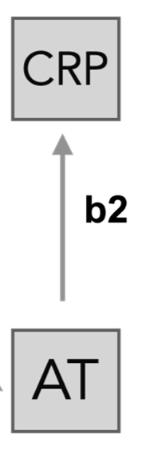
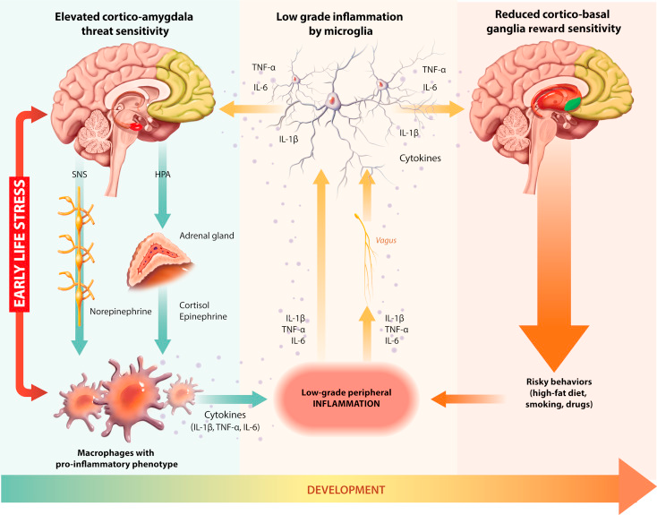
Nusslock & Miller, 2016, Biol Psychiatry (adapted figure)
Notes:
There is a lot to this figure: But - in normal circumstances: the body releases cortisol due to threat and this tends to dampen the immune response. Under CHRONIC release - Childhood stress that continues into adulthood - cortisol can not longer STOP inflammation - becomes chronic.

Slide 38
H2: Direct brain effects
BMI
Hypothesis 2:
BMI, CRP, AT have direct effects on brain structure.
CRP
AT
Notes:
Can we measure the independent effects of these variables on the brain?

Slide 39
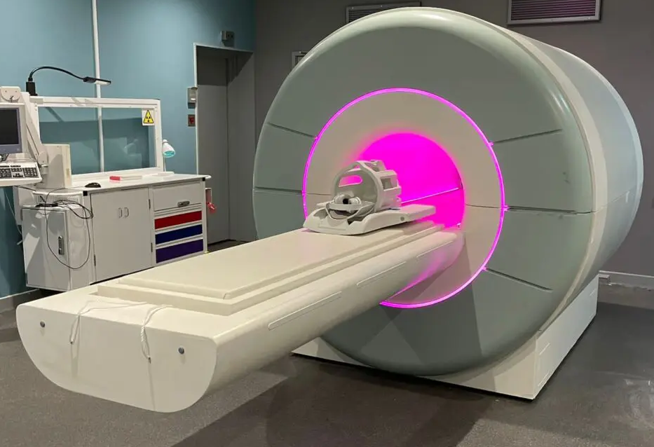
Sample & methods
How do we measure the brain?
Sample: 20k subjects
Grey matter morphology (macroscopic)
Cortical thickness
Subcortical volume

Slide 40
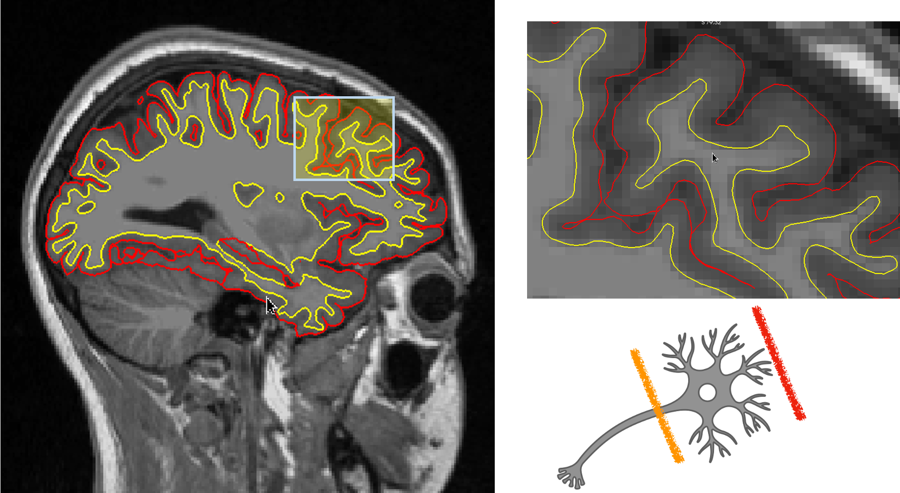
Sample & methods
Meaning of MRI measurements
Notes:
Cortical thickness: is the thickness of the outer grey matter layer for the brain.
Red: surface of the brain
Yellow: white mater - or the fat that connects sort of the cables neurons (brains cells) use to connect to each other.

Slide 41
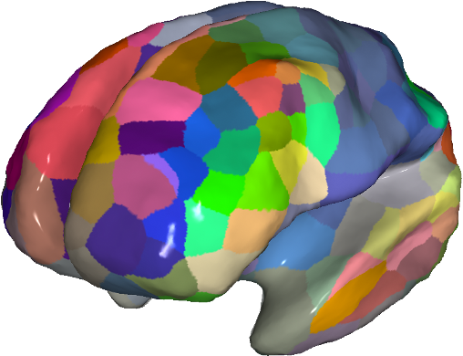
Sample & methods
How do we measure the brain?
Sample: 20k subjects
Adults: ages ~ 40-70
Grey matter morphology (macroscopic)
Cortical thickness
Subcortical volume
Number of brain regions
180 cortex
7 subcortex

Slide 42
Sample & methods
How do we relate variables to the brain?
CT ($Y_{RegionA}$)
BMI ($X_{1}$)
…
…
`
1.5
24
1.3
$$β_{0}X_{0}$$
+
$$β_{1}$$
30
+
Noise & confounds
=
1.9
27
1.5
38
1.7
25
…
…
Notes:
If BMI goes up? How does CT behave?

Slide 43
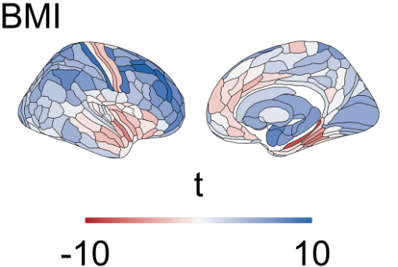
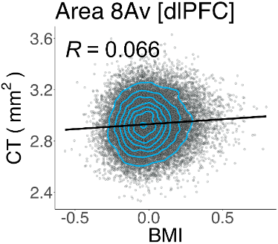
H2: Direct brain effects
`
Single subject’s data
`
Cortical thickness (CT)
Increase
Decrease

Slide 44
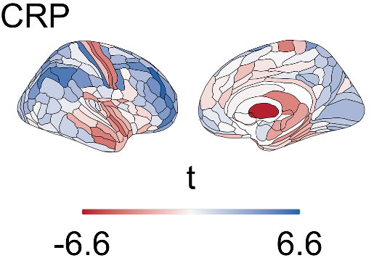
Immune and metabolic variables have surprisingly similar effects
Notes:
These look surprisingly similar & we can test!

Slide 45
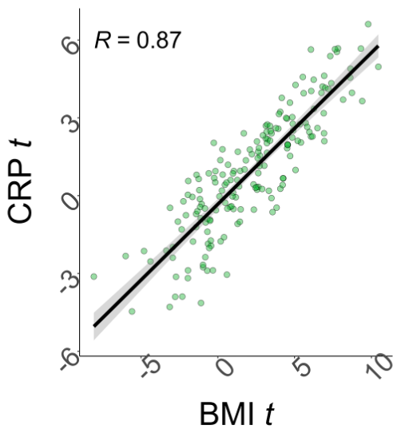
Immune and metabolic variables have surprisingly similar effects
Notes:
Mind you they are independent tests.

Slide 46
Immune and metabolic variables have surprisingly similar effects
Results:
BMI and CRP have similar cortical patterns
Implication
Peripheral Immune and metabolic effects are not entirely independent on the brain

Slide 47
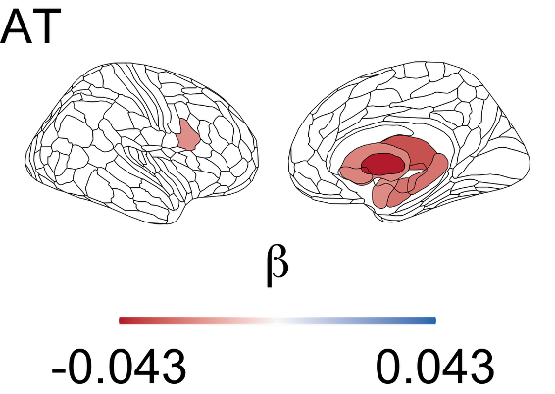
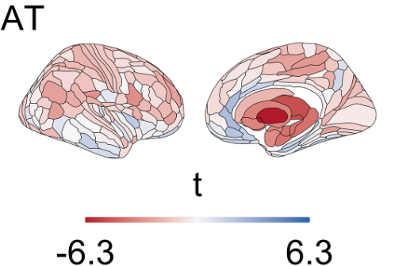
H2: Direct brain effects
Effects exclusive to sub-cortex
Notes:
Now, we can see that self-reported adult trauma rates have a different pattern. This pattern however only affects the sub cortex of the brain. - i.e. less brain regions, rich in stress hormone (cortisol) receptors

Slide 48
Makki et al., 2013, ISNR Inflammation
Notes:
As mentioned earlier we know that inflammation and adiposity in the periphery are related to each other!

Slide 49
H2: Direct brain effects
Regions rich in stress receptors
Luppien et al., 2018, Nat Rev Neurosci
Notes:
- i.e. less brain regions, rich in stress hormone (cortisol) receptors

Slide 50
H2: Direct brain effects
Regions rich in stress receptors
Luppien et al., 2018, Nat Rev Neurosci
Notes:
POSSIBLE MECHANISM: Potential for dysregulation of the local neuronal environment through excessive exposure.

Slide 51
H2: Direct brain effects
Immuno-metabolic
Neuroendocrine
(Putatively)
Notes:
We identify two pathways relating physiology to the brain: Stress-sytem vs inmuno-metabolic system.

Slide 52
H2: Direct brain effects
Results:
Even when examined independently, 2 pathways:
Immuno-metabolic
2. Neuroendocrine (putatively)
Notes:
These look surprisingly similar & we can test!

Slide 53
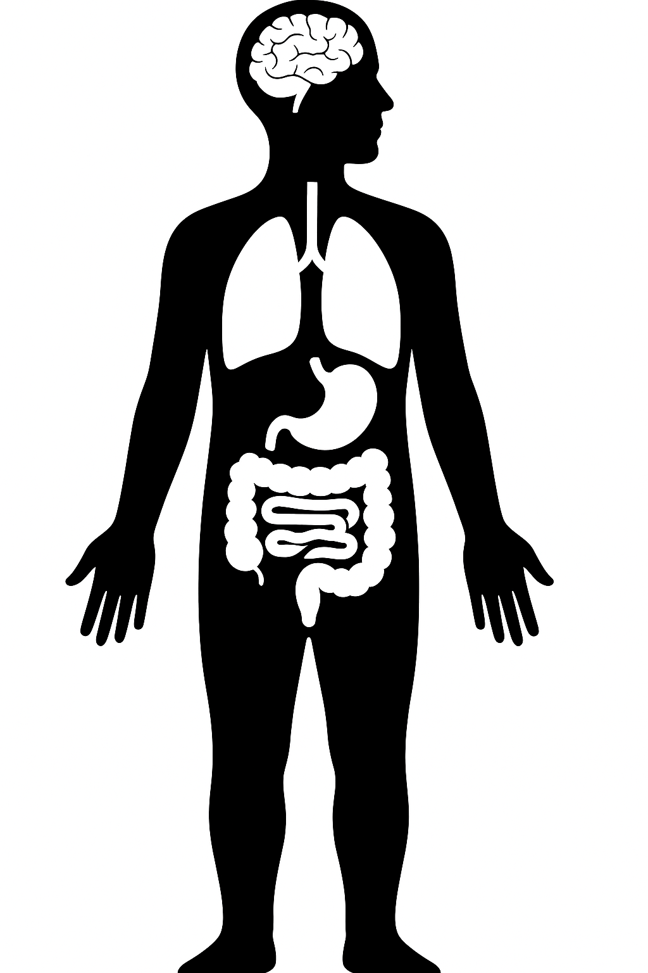
H2: Direct brain effects
Notes:
The brain —> IS NOT independent of physical health AND stress exposure. We can observe a relationship.

Slide 54
H3: Mediated brain effects
BMI
Metabolic
CM
CRP
Immune
AT
Psychosocial
Notes:
Can exposure to CM account for the effects of psychosocial and physiological risks on the brain?

Slide 55
H3: Mediated brain effects
Hypothesis 3:
CM affects the brain through its effects in psychology and physiology
BMI
Metabolic
CM
CRP
Immune
AT
Psychosocial
Notes:
To test this we can do so with a hypothesis.

Slide 56
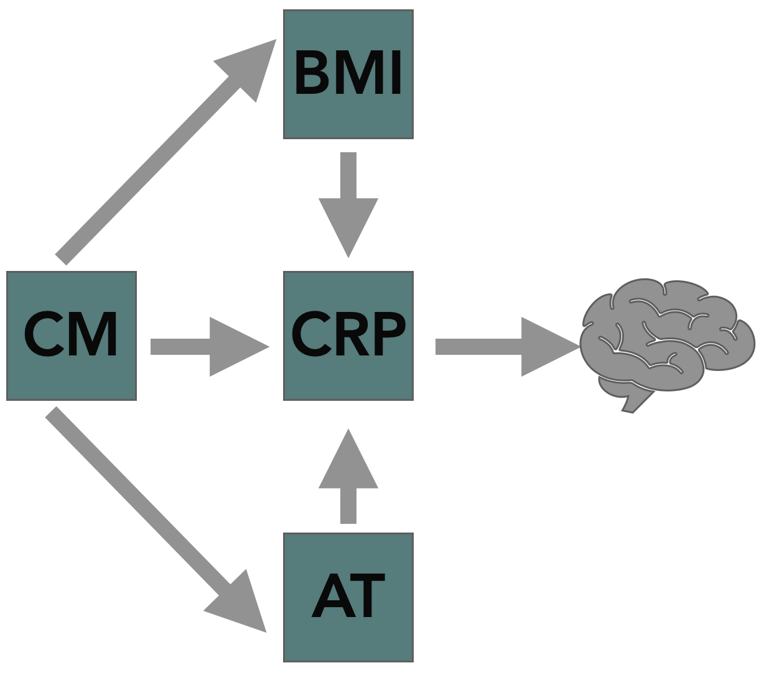
H3: Mediated brain effects
Sparse model
Inflammation is the main variable affecting the brain
Notes:
One of two possible.

Slide 57
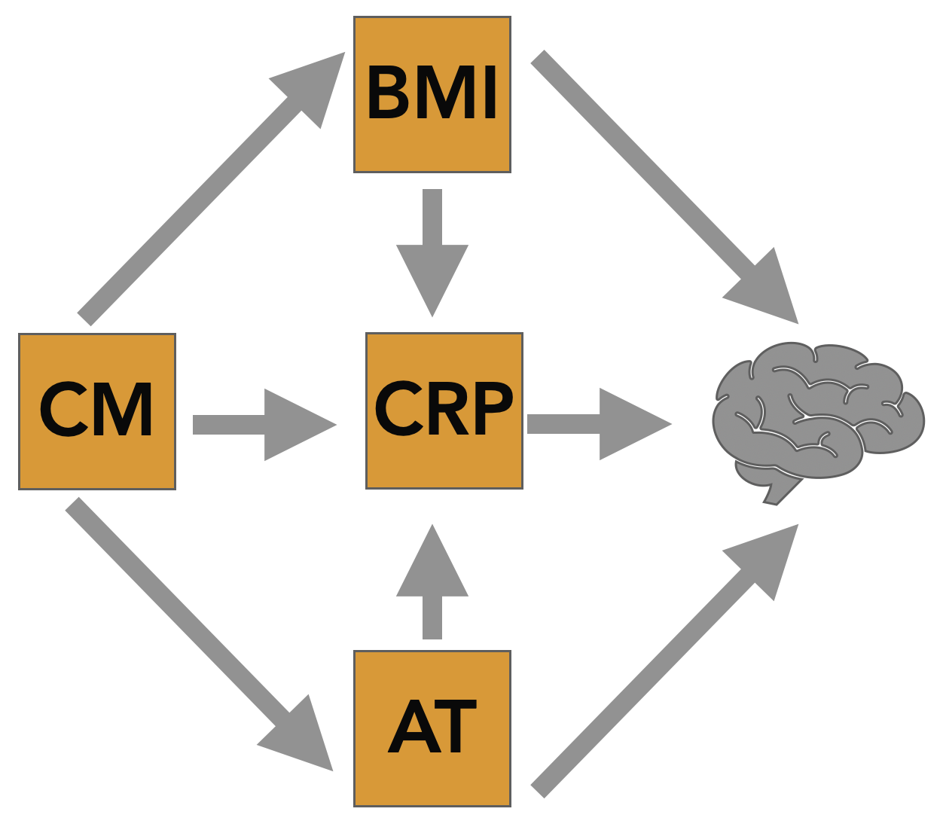
H3: Mediated brain effects
Sparse model
Full model
Inflammation is the main variable affecting the brain
All variables affect the brain
Notes:
One of two possible.

Slide 58
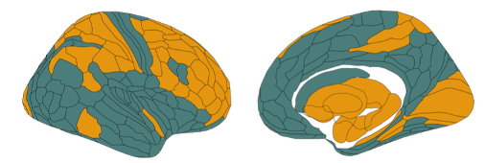
H3: Mediated brain effects
“Stats magic” to find:
1. Where does each model work best?
(Which regions?)
2. We examine results only in those regions.

Slide 59
Is anything explainable?
BMI
CM
Notes:
How much of it? How many regions? - what we will see is one

Slide 60
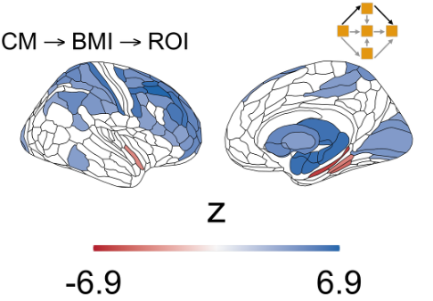
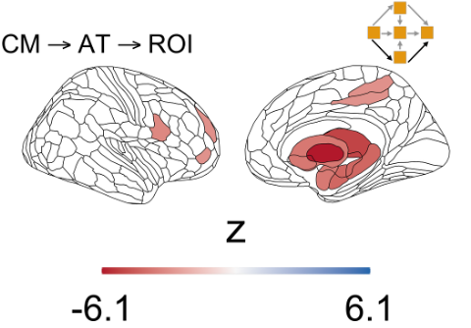
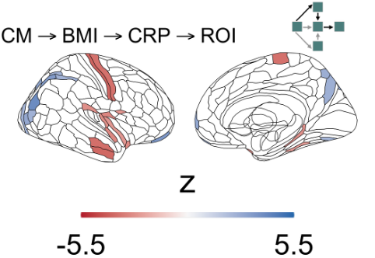
Yes!

Slide 61
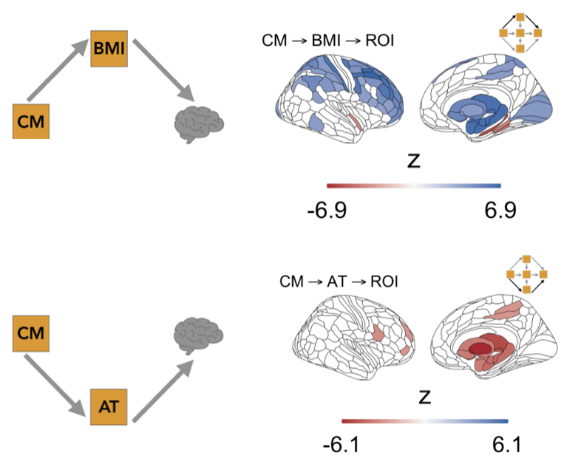
Yes!
*and! Inflammation effects are primarily driven by metabolism

Slide 62
Conclusion
Early life stress (CM) is strongly associated with later physiological and psychosocial alterations.
These alterations appear to drive differences in brain structure.
There is reason to believe these alterations in brain structure help sustain psychiatric risks in CM-exposed individuals

Slide 63
Conclusion II
The diversity of risks points to multiple possible points of intervention.
Repeated stressors and poor physical health should be addressed at the same time in affected individuals.
Highlights the need for multidisciplinary intervention

Slide 64
Notes:
Hopefully there is a small tidbit of something useful that can

Slide 65



Thank you!
Collaborators:
Prof. Ed Bullmore
Prof. Petra Vértes
Dr. Ivan Sympson-Kent
Dr. Richard Bethlehem
Prof. Anne-Laura van Harmelen
Funders:
How to find me:
sdco2@cam.ac.uk
linkedin.com/in/sofia-c-orellana
Notes:
Thanks to my collaborators at both Cambridge and Leiden

