Slide 2
Section 17 & Section 47 Children’s Act
Section 17 of the Children Act 1989 Enquiry – Child in Need, single agency enquiry by Social Care.
Example – Minor neglect or emotional abuse. If a criminal offence has been committed Social Care must inform the Police for crime recording purposes, but not warrant a police investigation.
Section 47 of the Children Act 1989 Enquiry – Child is likely to be at risk of Significant Harm. Joint enquiry by Police and Social Care.
Example – referral comes into the MASH from a school where a child has an injury and disclosed the parents caused that injury. Police lead on Criminal side Social Services on Safeguarding

Slide 3

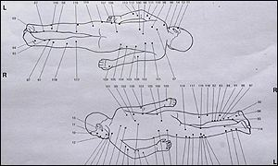
1- Victoria Climbe - On 24 February 2000, Victoria was taken semi-conscious and suffering from hypothermia, multiple organ failure and malnutrition, to the local Universal Church of the Kingdom of God church. Victoria died the following day at 3:15pm local time. The Home Office pathologist who examined her body noted 128 separate injuries and scars on her body, and described it as "the worst case of child abuse I've encountered". She had been burnt with cigarettes, tied up for periods of longer than 24 hours, and hit with bike chains, hammers and wires. This resulted in the Laming Enquiry which in turn led to the ‘Every Child matters’ report.
Lord Laming said “A gross failure of the system” by Police, Social Services, and Health Service – 108 Recommendations were made.
‘The HO pathologist found the cause of death to be hypothermia, which had arisen in the context of malnourishment, a damp environment and restricted movement.
He also found 128 separate injuries on Victoria's body, showing she had been beaten with a range of sharp and blunt instruments. No part of her body had been spared. Marks on her wrists and ankles indicated that her arms and legs had been tied together.
It was the worst case of deliberate harm to a child he had ever seen’.
Notes:
Quote by Neil Garnham QC, Counsel to the Inquiry:-
“The food would be cold and would be given to her on a piece of plastic while she was tied up in the bath. She would eat like a dog, pushing her face to the plate. Except of course that a dog is not usually tied up in a plastic bag full of its excrement. To say that Kouao and Manning treated Victoria like a dog would be unfair; she was treated worse than a dog

Slide 4
Space of a few months Victoria transformed from a healthy, lively and happy little girl, into a wretched wreck of a human being.
Would strike Victoria on a daily basis with a shoe, coat hanger, wooden cooking spoon and strike her on her toes with a hammer
Food given to her on a piece of plastic whilst she was tied up in the bath. She would eat it like a dog…..except a dog is not usually tied up in a plastic bag full of excrement.
Social workers attended the address on numerous occasions, unable to gain entry.
Damning of all professionals involved – poor or non-existent inter agency working. Lack of focus on Victoria.
Known to two housing authorities, four social service departments, two child protection teams, admitted to two hospitals for suspected deliberate harm. Haringey Social Care closed Victoria’s case on the day she died.
Notes:
Majority of live jobs come in this way, as many as 11-12 referrals in a day.
Social Care responsible for Safeguarding – usually parents will consent to child staying somewhere else until a core assessment can be done by SC. In extreme cases where parents don’t consent or have no where else to go – PPO is an option
Go through MASH process

Slide 5
Section 1 of the Children & Young Persons Act 1933
Any person aged 16 or over who has responsibility for a child under that age commits an offence if he wilfully assaults, ill-treats, neglects, abandons or exposes that child (or causes or procures him to be so treated) in a manner likely to cause him un-necessary suffering or injury to health.

Slide 6
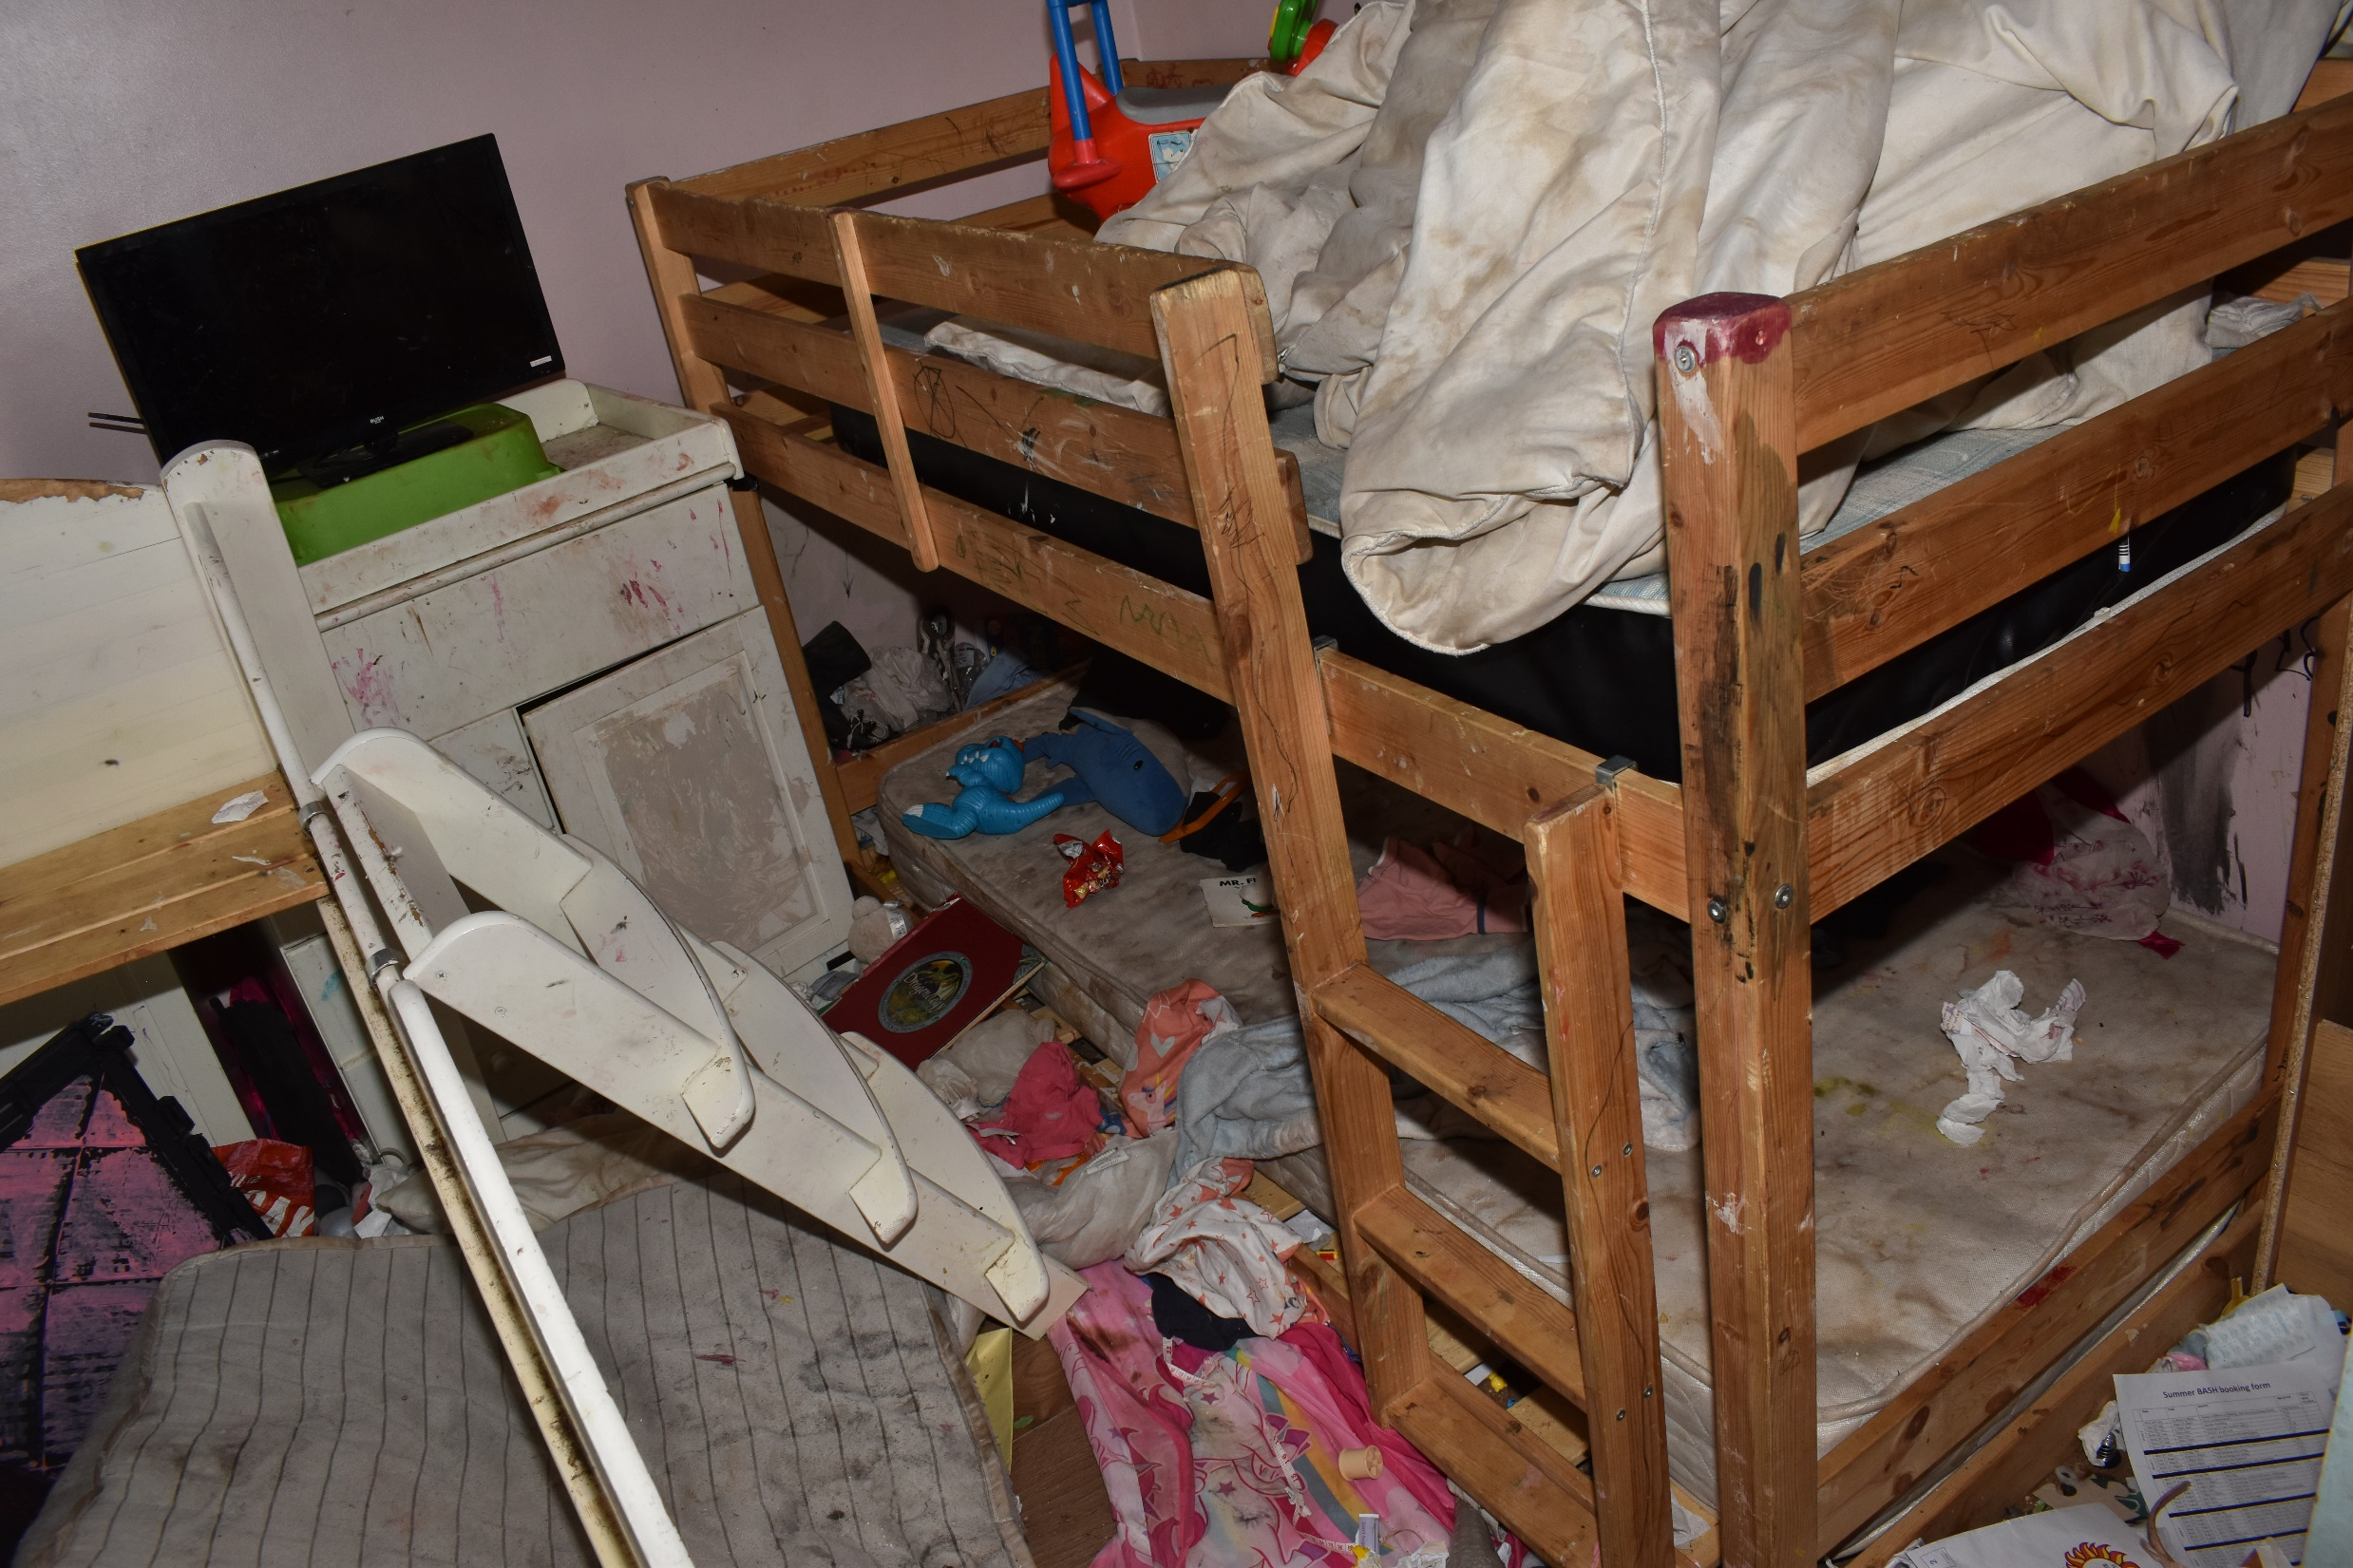

Slide 7
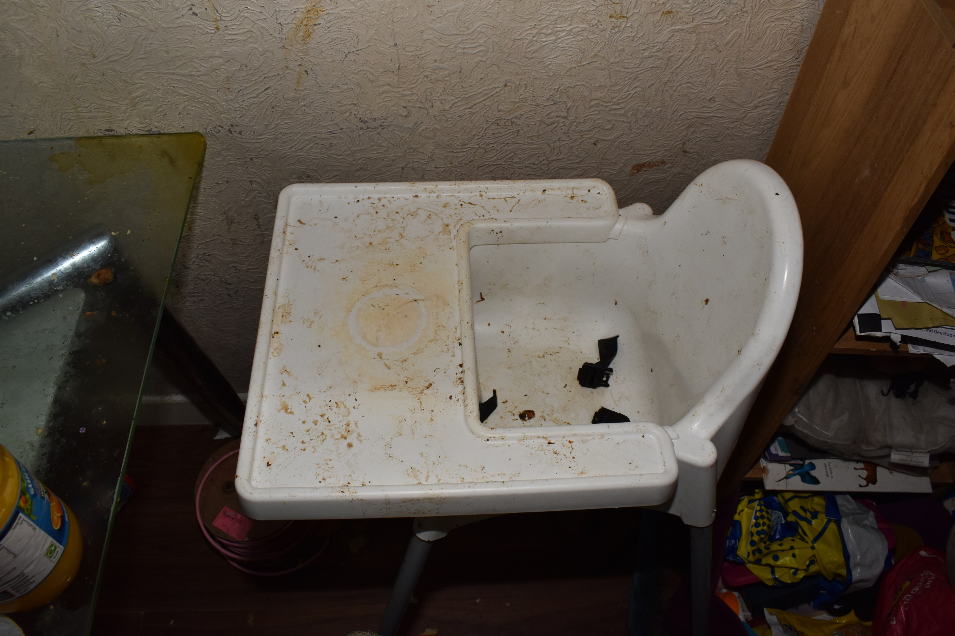

Slide 8
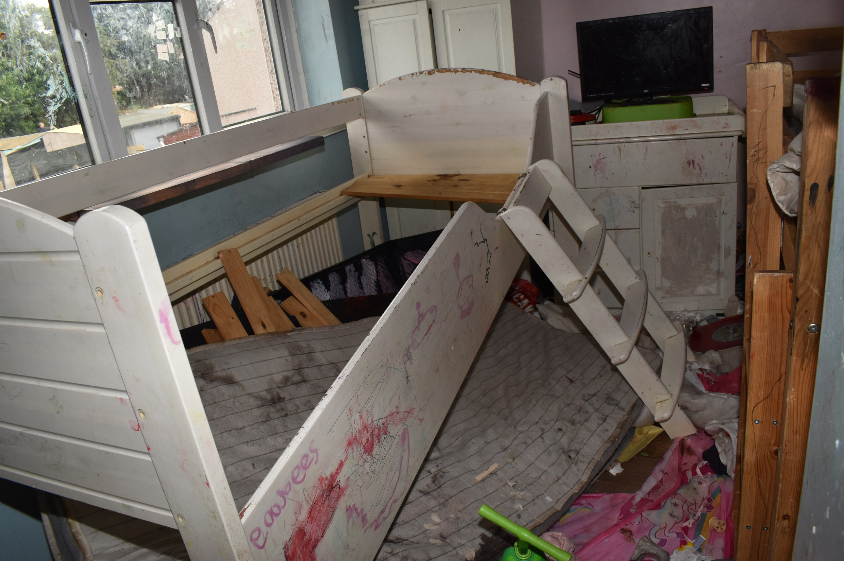

Slide 9
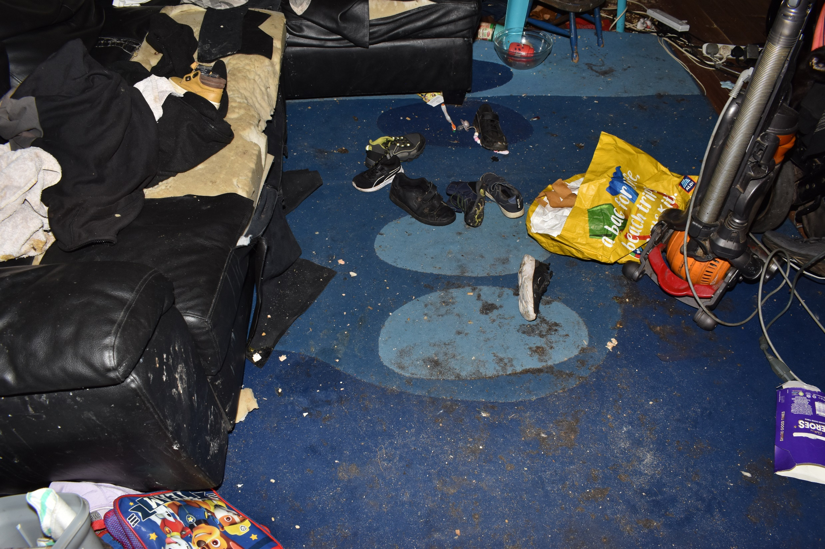

Slide 10
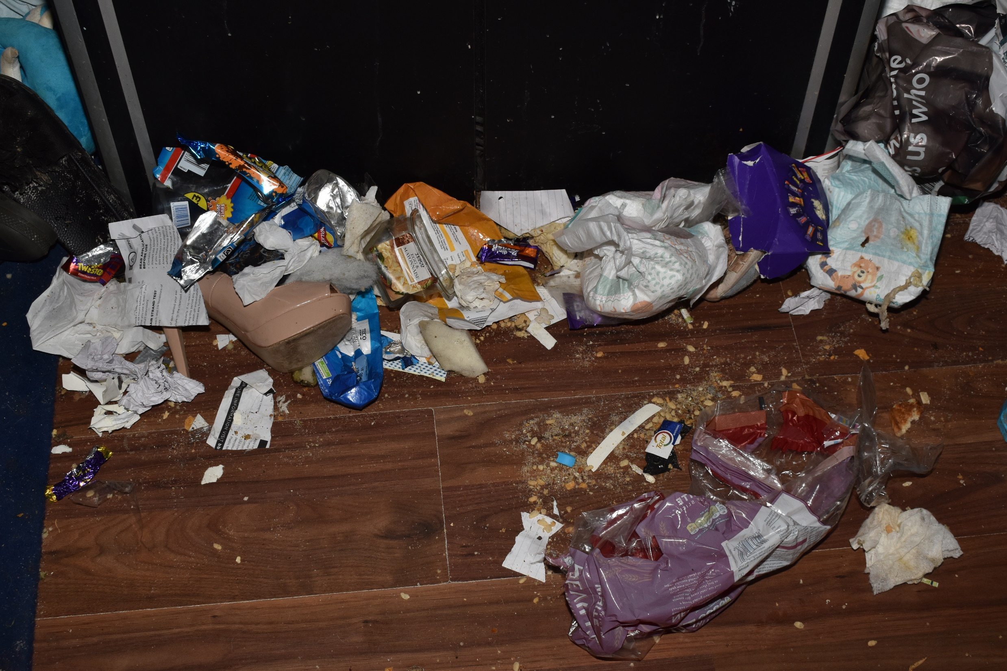

Slide 11
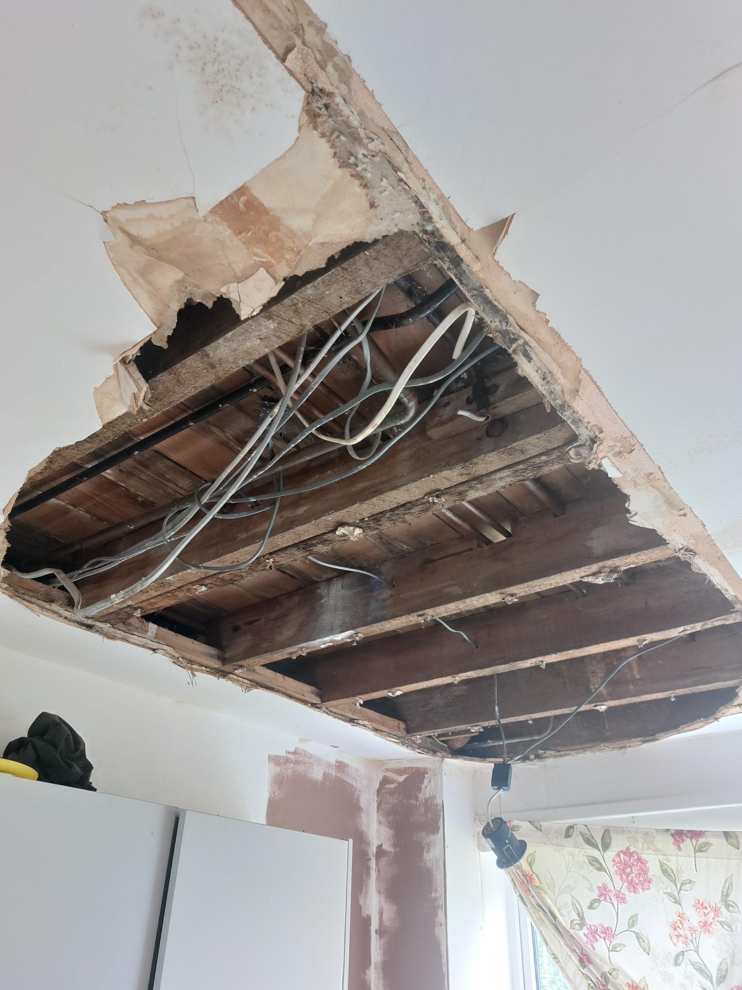

Slide 12
Voice of the child
Children’s experiences, feelings, thoughts and comments – more than just what children say – refers to many other aspects of their presentation, behaviour and home environment.
Includes children who are too young to speak or less able to communicate effectively.
Police and other services with safeguarding responsibilities should consider the voice of the child before making any decisions that affect them.
Share with Social Care partners and use when assessing the signs of safety. Enhances the multi-agency child safeguarding response

Slide 13
Issues in criminal investigations - neglect
Evidence – quality and availability of evidence. Neglect often lacks clear physical evidence. Signs of neglect, such as malnutrition or poor hygiene, less obvious and more subjective.
Documentation – reliable documentation including medical records, school reports and social worker notes are crucial – but can be incomplete or inconsistent.
Witness testimonies – children as primary witnesses may struggle to articulate their experiences due to age, fear and trauma. Reluctance of others to get involved.
Proving neglect – intentional or recklessness can be difficult – threshold for what constitutes significant harm and parent’s culpability can be hard to establish.
Long-term impact – demonstrating the long-term impact of neglect on a child’s well-being requires expert testimony and longitudinal evidence, which can be complex and resource-intensive.
Legal framework – the Children Act 1989 is the cornerstone for child welfare in the UK, defining neglect and the local authority’s role in intervention. However, its application can vary between local authorities

Slide 14
Issues in criminal investigations
Cross-border issues – cases where families move across borders within the UK or internationally can cause complexities.
Resources and policies – local authorities differ in resources, policies and thresholds for intervention, leading to inconsistent application of the law and varied levels of protection for children.
Fair trial – ensuring a fair trial for parents or guardians accused of neglect while protecting the child’s interests is a delicate balance. This includes the right to legal representation and the presumption of innocence.
Publicity and confidentiality – child neglect cases often involve sensitive information. Maintaining the confidentiality of the child while ensuring transparency in the legal process is challenging.
Child’s rights and welfare – legal proceedings must prioritise the child’s best interests, which can sometimes conflict with the due process rights of the parents.
Participation in proceedings – ensuring that children’s voices are heard in legal proceedings, appropriate to their age and maturity, without causing additional trauma
Child’s rights and welfare – legal proceedings must prioritise the child’s best interests, which can sometimes conflict with the due process rights of the parents.
Participation in proceedings – ensuring that children’s voices are heard in legal proceedings, appropriate to their age and maturity, without causing additional trauma

Slide 15
Issues in criminal investigations
Systemic challenges – effective prosecution requires robust inter-agency cooperation, including children’s services, healthcare professionals, education and police, which can be hampered by bureaucratic hurdles and communication issues.
Resource limitations – overstretched social services and legal systems may struggle to provide the necessary support and intervention for neglected children.
Training and awareness – judges, lawyers, social workers and police officers require specialised training in order to handle neglect cases sensitively and effectively.
Public awareness – greater public awareness and understanding of neglect can aid in early detection and reporting, but different attitudes towards parenting can influence perceptions of what constitutes neglect.

Slide 16
Issues in criminal investigations
Legal framework – comprehensive protections against child neglect, balancing need for safeguarding children with the rights of parents and guardians.
Children Act 1989 – outlines responsibilities of local authority and other professionals in preventing and addressing neglect.
The role of children’s services, healthcare providers and educational institutions is critical in early detection and intervention, supported by mandatory reporting requirements and multi-agency cooperation

Slide 17
Murders of Athur Labinjo Hughes and Star Hobson
Core issues
• Weaknesses in information sharing and seeking within and between agencies.
• A lack of robust critical thinking and challenge within and between agencies, compounded by a failure to trigger statutory multi-agency child protection processes at key moments.
• A need for sharper specialist child protection skills and expertise, especially in relation to complex risk assessment and decision making, engaging reluctant parents, understanding the daily life of children and domestic abuse.
• Underpinning these issues is the need for leaders to have a powerful enabling impact on child protection practice, creating and protecting the organisational conditions needed to undertake this complex work.

Slide 18
Information sharing – Working Together 2023
NO single practitioner can have a full picture of a child’s needs and circumstances – need effective information sharing between agencies.
Rapid reviews and safeguarding practice reviews have highlighted missed opportunities to record, understand the significance of, and share information in a timely manner can have severe consequences for children.
Practitioners need to be proactive in sharing information as early as possible to help identify, assess and respond to concerns about the safety of children.
The Data Protection Act 2018 and UK General Data Protection Regulation (UK GDPR) supports the sharing of relevant information for the purposes of keeping children safe.
Fears about sharing information must not be allowed to stand in the way of safeguarding and promoting the welfare of children.

Slide 19
Parental Contact – change in Law
The government will repeal the legal presumption of parental involvement in the family courts, a move that survivors of domestic abuse, children’s advocates, and frontline organisations have long called for.
This change comes after a thorough review found that the “no stone unturned” approach to promoting a child’s relationship with both parents has, in too many cases, resulted in unsafe decisions that risk the wellbeing and safety of both children and adult survivors.
Why This Change Matters
The presumption, introduced in 2014 through the Children and Families Act, instructed family courts to assume that a child’s welfare is best served by being involved with both parents, whether directly or indirectly, unless there was evidence that this would put the child at risk of harm.

Slide 20
Parental Contact – change in Law
But for years, survivors and professionals have warned that this presumption has often tipped the balance away from safety, reinforcing a “pro-contact” culture that overlooks or minimises the impact of domestic abuse. It has also made it harder for survivors to protect their children from harmful contact arrangements, often requiring them to prove a risk, even in the face of ongoing abuse.
What Happens Next?
The Ministry of Justice has confirmed it will legislate to remove the presumption as soon as parliamentary time allows. This marks a critical step in shifting the culture of the family courts towards one where the child’s welfare and safety are truly paramount, not assumed, but assessed carefully and on a case-by-case basis.
Justice Minister Baroness Levitt rightly stated:
“Being a parent is a privilege, not a right. The only right that matters is a child’s right to safety.”

Slide 21
Domestic Abuse Act 2021
Recognises children as victims of domestic abuse in their own right, rather than just witnesses.
Significant step ensuring they receive the necessary support and protection.
Legal recognition empathises the need for tailored interventions and support to address the unique needs of children affected by domestic abuse.
The effects of domestic abuse on children are profound and multifaceted, impacting their emotional, psychological, and physical health
By the time they start school, at least one child in every class will have been living with domestic abuse since they were born. 78% of these will experience direct abuse in the home.

Slide 22

ELP
EVIDENCE LED PROSECUTIONS

Slide 23
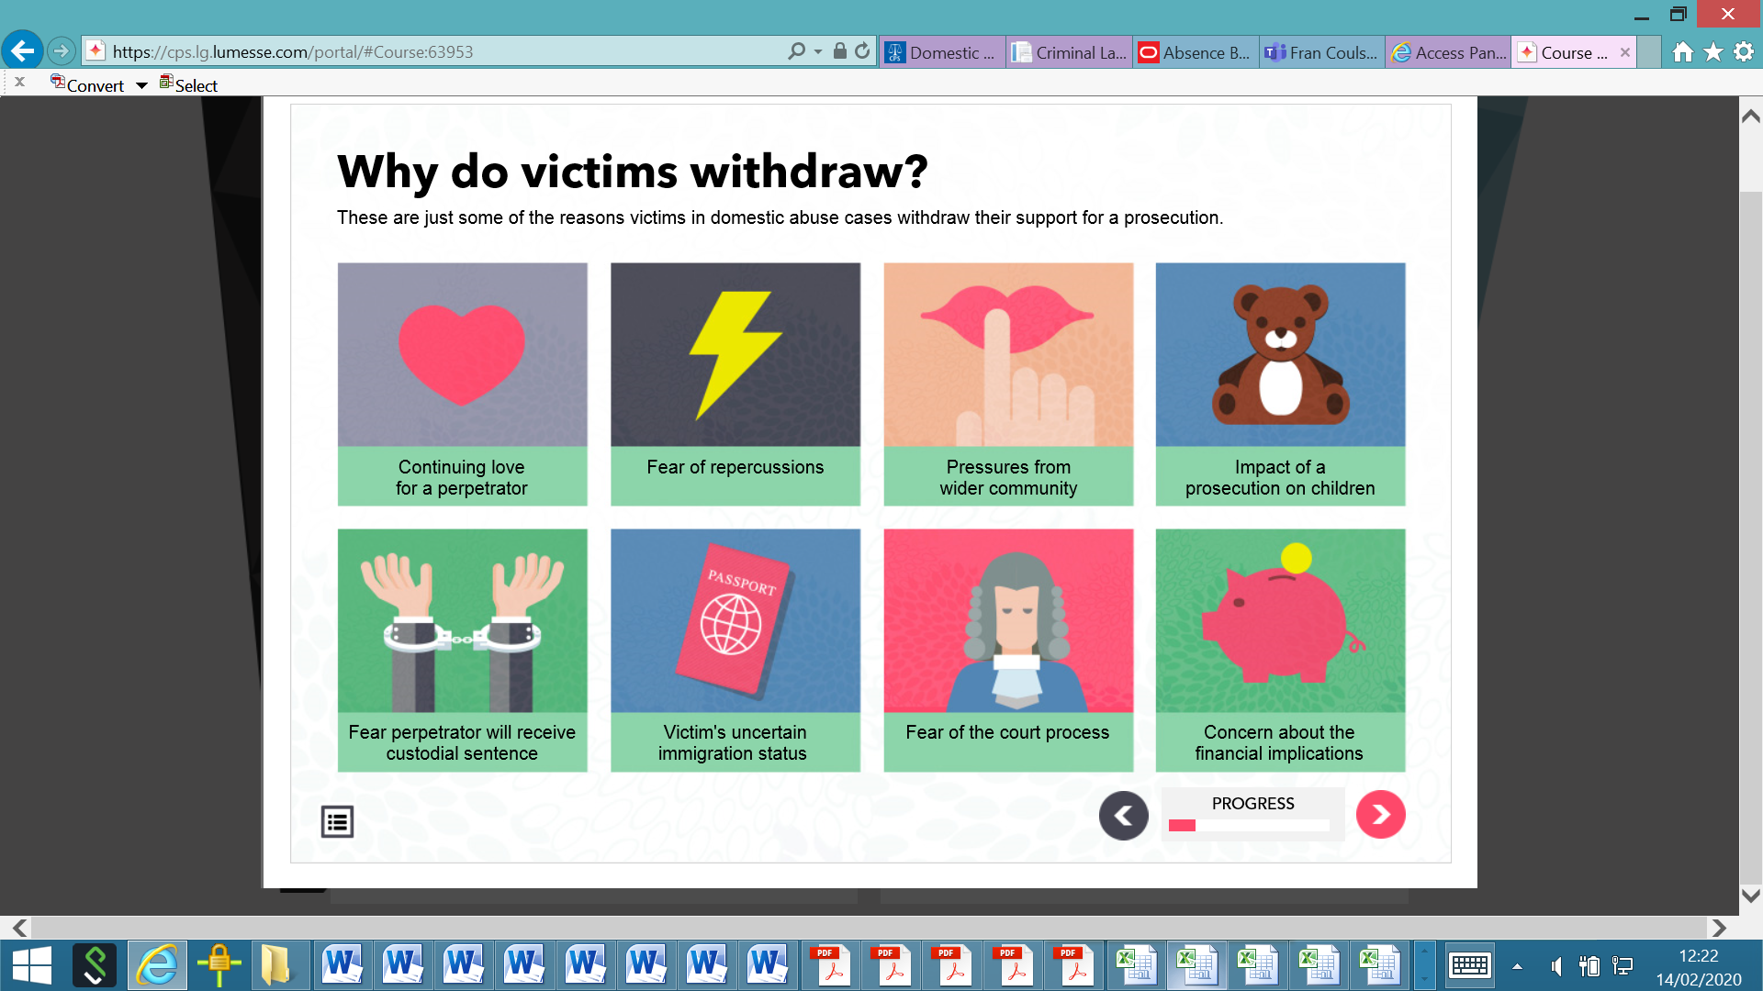
- Threats of removal from country
- Concern around victim/suspect VISA status
Why our victims unsupportive or withdraw support
- Reconciliation
- Remain in relationship
- Family
- Friends
- Gang Members
- Further harm from suspect – in person/social media
- Community leaders/elders – shame and public humiliation
- Family and friends
- Pressure from suspect

Slide 24
- Victim will blame themselves
- Impact/Break up family
Why are victims unsupportive or withdraw support
- Removed/placed in care
- Difficulty in child contact
- Social services involvement
- Lose children – custody applications
- Not being believed
- Being treated as suspect
- Lack of engagement
- CJ don’t understand issues (special measures)
- Personal information being revealed/sexual orientation disclosed
- No longer in relationship/does not wish to relive experience
Loss of finances
Refusal to pay
Benefits paid into suspect account

Slide 25
An evidence led prosecution relies on evidence other than that provided by the victim to a secure a conviction. This prosecution is likely to take place where the victim is unwilling to give evidence, and it is in the public interest to proceed.
Res Gestae (things done)
- Statements made by the victim or a witness to a third party around the time the offence was allegedly committed and is so directly linked to the event that it’s unlikely it was distorted or concocted
- Evidence from 999 calls and/or comments made to Police Officers immediately after the event
- Such evidence is widely used in domestic violence prosecutions where a victim is unwilling to give evidence through fear or another reason, but it is in the public interest to prosecute
Direct Evidence | Hearsay Evidence
Body Worn Account | Medical records
999 calls | 3rd Party Records (social services/medical)
Mobile phone data/CCTV | Bank Records
Other Witnesses/Expert witness | Bad Character
Photos of Damage or Injury | Victim can be shown to be in fear
Officer Statements

Slide 26
Op Pasteur case study
21st February 2023 – mother reported Sarah missing, she had not seen or heard from her since November/December 2022;
At the time of her disappearance she was living with her boyfriend, Matt Waddell – History of domestic abuse incidents and coercive and controlling behaviour between them. Both Sarah and Matt had been noted to be perpetrators on various occasions.
Sarah had her own health issues, both physical and mental including PTSD and multiple sclerosis.
21st February 2023 – Police attended the home address looking for Sarah, they were told by Matt she had been admitted to a neurological hospital in London and had been there for some weeks, but didn’t know the name. This information was accepted on face value by attending officers and no follow up investigation (professional curiosity)
24th February 2024 – missing person investigation graded as a high risk.
25th February 2024 – joint investigation MCU/CID/Missing Persons – Matt arrested on suspicion of murder.

Slide 27
CASE STUDY EVIDENCE – Op Pasteur
Sarah had been placed inside a suitcase in a wheelie bin with gaffer tape over bin lid. She was badly decomposed due to length of time she had been in the suitcase.
27th February 2023 – CPS authorised charge of murder
2nd March 2023 – FPM cause of death “sharp and blunt force trauma to the head”. Formal identification by way of dental records.
Family were of the view police had “failed” Sarah by not protecting her and were hugely critical of the previous policing handlings of the DA investigations.
14th September 2023 – Waddell sentenced to life imprisonment to serve minimum term of 32 years. HHJ Simon critical of Beds Police handling of the previous DV incidents.
Evidence led prosecutions – need to consider this - need to consider coercive and controlling behaviour overall.
How are we mitigating risk – balancing act between people’s right to a private life v’s risk of harm – difficult decisions to make.

