Slide 1
Lived Experience of Domestic Abuse
Beverley McConnell
Luton Safeguarding Children Partnership
Domestic Abuse Survivor

Slide 2
About me
Strategic Business Manager LSCP
Registered Social Worker with 25 years plus experience
Independent Safeguarding Consultant
Independent Reviewer for Statutory Reviews
Trustee for a Domestic Abuse Charity

Slide 3

What you might not know
Mum to two adult sons, Nana to four grandchildren
Dog mum to Maggie
Domestic abuse survivor of 31 years living with domestic abuse
Lived experience advocate
Safe now and have been for 14 years
My story is not unusual…
Notes:
Given national statistics on domestic abuse there is likely to be someone with lived experience present today either as a survivor or in a current situation. It is improtoant that we look after ourselves and seek support from someone you trust if anything we say today is difficult or triggering

Slide 4
Prevalence in the past year (England and Wales, year ending March 2024)
Overall: 4.8% of people aged 16 and over experienced domestic abuse, a figure also described as approximately one in 20.
Non-sexual domestic abuse: 4.4% of people aged 16 and over experienced this type of abuse.
Domestic stalking: 0.9% of people aged 16 and over experienced domestic stalking.
Police-recorded crimes: The police recorded over 1.35 million domestic abuse-related crimes and incidents.
https://www.ncdv.org.uk/domestic-abuse-statistics-uk
Notes:
This is a figure for a one-year period, while lifetime prevalence estimates suggest that one in four women and one in seven men have experienced domestic abuse in their lives. Women are more likely to be victims, and a significant portion of domestic abuse is not reported to the police.

Slide 5
Lifetime prevalence
Women: Approximately one in four women in England and Wales have experienced domestic abuse in their lifetime.
Men: Around one in seven men have experienced domestic abuse in their lifetime.
Total: The National Crime Victimisation Survey estimates that 2.3 million people experienced domestic abuse in the year ending March 2024 (1.6 million women and 712,000 men).
https://www.ncdv.org.uk/domestic-abuse-statistics-uk/

Slide 6
What happened?
The detail of what happened to me is not important
What is important?
signs, indicators, disclosures and response by practitioners
the perpetrator profile
learning from DARDRs etc mirror some of my experiences
trauma informed approaches
role of guilt and shame in ‘not telling’
Notes:
Sufficient to say it was serious enough to result in a significant number of charges and conviction - was a respected professional in a criminal justice organisation

Slide 7

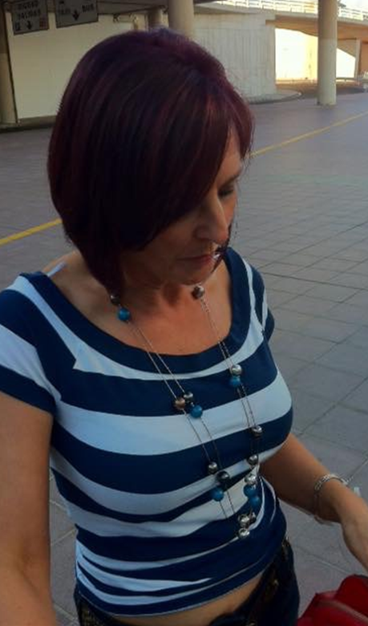
What happened?
From start of relationship aged 16
To 5 months after its traumatic end aged 47
Notes:
Sufficient to say it was serious enough to result in a significant number of charges and conviction - was a respected professional in a criminal justice organisation

Slide 8
What people who might have known said at time?
“we all knew you as just brilliant at your job and really personable – I never suspected as people don’t cope with things like that”
“many of us were shocked because of what you were achieving, it didn’t seem possible you were being abused – especially with what we then found out you went through”
“sometimes it was like you were a robot, things that would have floored me, you kept going, now it makes sense – you needed one aspect you could control.”

Slide 9
What they could have seen and asked me about:
Regular minor injuries, cuts and bruises – elaborate explanations
Changes to usual dress style, e.g. long sleeves, covering up
Repeated phone calls – where was I – who was I with – etc?
Jumping at sudden / unexpected noises
Rushing off at the end of the day
Rapid weight loss
Notes:
Example of the GP and him taking me to a GP appointment – when I went back for the results..

Slide 10
What happened when professionals noticed?
I am sorry that you are bruising more easily now you are thinner, but I’ll do the blood test
That’s a nasty bruise, just stand here so I can do the x-ray
Why don’t you just tell him to stop calling or stop picking up the phone
No one sleeps 45 minutes per night – how about some sleeping tablets
Why would you let him do this?
You need to leave him, he won’t stop, it's going to end in tragedy
He’s not well, he can't help himself
Your ‘arm/leg/eye’ looks painful is there anything I can do, is there anything you want to tell me?
I know you know this but if you need us to do something just say
I can see what’s happening, what can I do to help?
I am not sure you can keep yourself safe because..
Bev, that is not what you are for…

Slide 11
What happened when I told?
What did you do to make him do that?
Are you working from home or taking unpaid leave?
What about the report that’s due in on Friday?
Do you know there are things called hotels with nice comfy beds?
Nothing….
Do you need me to call someone?
You do not sound as if you are safe, and I need to ensure you are.
Let's make a safety plan and decide who we need to tell
Notes:
I can’t come in today as there has been an incident.. he’s taken all my clothes and locked me in the house..
Attendance at relate – disclosed non-fatal strangulation – but what did you do to make him do that – I never went back or spoke to a professional again.

Slide 12
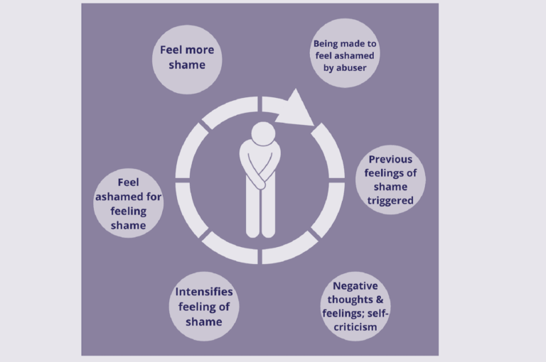
Why didn’t I tell for so long?
Guilt and shame play a significant and complex role in preventing victims from disclosing domestic abuse, often acting as powerful psychological barriers that help abusers maintain power and control.
“It is my fault; I can put it right”
“He’s his mental health”
“I am a professional I should be able to deal with this myself”
“Everyone told me I would fail”
Cycle of Shame - Christiane Sanderson 2020
Notes:
Domestic violence victims are in frequent contact with the healthcare service yet rarely disclose. Therefore, it is critical to understand victims' experiences and perceptions regarding disclosure in healthcare settings.
If a survivor of abuse experiences shame and guilt, it can also benefit the abuser as it makes the survivor feel less helpless and vulnerable, as self-blame and feeling guilty can give the survivor the illusion of control in which they can imagine that in the future if the abuse were to happen again. This also may make the survivor less likely to seek help.
https://pmc.ncbi.nlm.nih.gov/articles/PMC8248429/

Slide 13
Things that went well
Call to the Police was transferred to an Inspector and the investigation was managed by Major Crime, out of area Forensics and Courts
Evidence led prosecution – restraining order on conviction
Work gave me a week off after the major incident
MARAC was convened as a closed meeting
Perpetrator’s psychiatrist checked in with my mental health
Work colleagues kept in close contact to check in
My current line manager who uses trauma informed approaches when I am struggling

Slide 14
Things that didn’t work so well
My return-to-work plan after being off a week
What happened being an ‘open secret’
Managers commenting on my appearance
Being made to go off sick
Lack of liaison between the courts and victim support
Notes:
as ‘acting like a little ghost’

Slide 15
Why didn’t colleagues ask?
“ I still wonder about a colleague who I noticed had bruises, pulled their sleeves down and wasn’t often seen on camera.. Next time I saw them they had lost a lot of weight suddenly …”
“I wish I had asked them. I just didn’t want to offend them or know what to say, as they were a colleague, it would be different if they were a service user…”
“as your GP I knew you were a professional so assumed you knew what you needed to do to get help – after all you deal with people like that every day – I even wrote it down for you”
Notes:
What’s the harm in asking, so what if they get offended – you might be able to sign post them support them – example of in the DARR panel member left and staff member had disclosed DA when asked – if someone had asked me, I might have defected the first few times but I became deperate.

Slide 16
How do I speak to a colleague about it?
Follow your gut if you feel like talking to them about what might be taking place. After all, the worst that could happen is that they don’t want to talk; but they’ll know you care enough to raise the issue.
Approach them confidentially, and at a time and place away from interruptions. First thing to remember is to be non-judgmental when talking to your coworkers about domestic violence. They may be embarrassed by the situation, and you might be the first person to ask them about it.
Start with observations about their recent stress or distraction and ask if they want to talk about it. Even so, give them space to share what they want but don’t pressure them.
Listen to what they have to say. Your role is not to fix the problem for them and all they want is someone who listens. Above all, if your coworker opens up to you about the abuse they’re experiencing, consider passing along appropriate information or resources, including how to contact The Hotline. By identifying local service providers ahead of time, you can provide them with actionable options.
Ask if they’d like to create a safety plan for their work environment. Include what they want you to do if their partner calls or stops by the office. Remember, advocates from The Hotline are available 24/7 to help you create a create a safety plan.
https://www.thehotline.org/resources/talking-to-your-coworker/
Notes:
It can be very difficult to know a coworker in an abusive relationship. It is possible that you fear for their safety – and perhaps for the right reasons. Although you may want to rescue your coworker or insist they leave, it is their decision to make. It is important to remember that each situation is unique, as are the people involved. Talking with your coworker might help. The following tips may be helpful.

Slide 17
Questions and Observations
Are we ok? If not, do we have a plan or someone to talk to?
Remember that not everyone’s experience of domestic abuse is as obvious – some will be experiencing coercive control or emotional abuse which can be harder to spot
Anything else you want to ask or know?
Notes:
Abusive home situations carry over into the workplace. Employees who live in an abusive home atmosphere bring these troubles to work – by effects on their health, and by phone, email or physical harassment at the workplace. This can lead to changes in behaviour at work. These changes can include declines in productivity, excessive lateness or absences, unexplained injuries or bruising, sensitivity to discussing home life, or changes in appearance. Talking to your coworker can help. Here are some ways to identify abuse signs if you suspect your coworker is in an abusive relationship.

