Slide 1















Domestic Abuse
Safety Planning
Jenny Bull, Public Health Officer, Luton
Notes:
Don’t forget your broken heart….

Slide 2
What is this session about?
We will be taking a quick look at some of the tools to help safeguarding professionals respond appropriately to individuals (adults and children) affected by domestic abuse and coercive control.
The session highlights the importance of Safety Planning.
We will be sharing advice and resources to help increase your confidence in your everyday practice.
This includes the DA Referral Pathway, MARAC/IDVA and signposting to national and local resources.

Slide 3


You will all know someone close to you that is or has been affected.
There are likely to be victims, survivors and perpetrators at this event.
If you need a moment at any stage, then please feel free to absent yourself.
If any of you are experiencing DA, please consider telling someone and getting help if you haven’t already done so.
Please try to give yourself a break following this event. Self-care is important!
Self care & health warning
Notes:
Before we start it is important to take a breath and check in with yourself.
We are going to be talking about a subject which is highly likely to have impacted on all of you in one way or another.
If you find any of the content difficult for whatever reason, please do take a break.
If you think you may currently be in an abusive relationship, just remember there is help out there and all the details for local and nations support services are included in this session or you can search on-line for ‘help with domestic abuse’.
Who should delegates talk to if they are experiencing abuse? DA Policy available on intranet, being updated currently, EAP, employee wellness

Slide 4
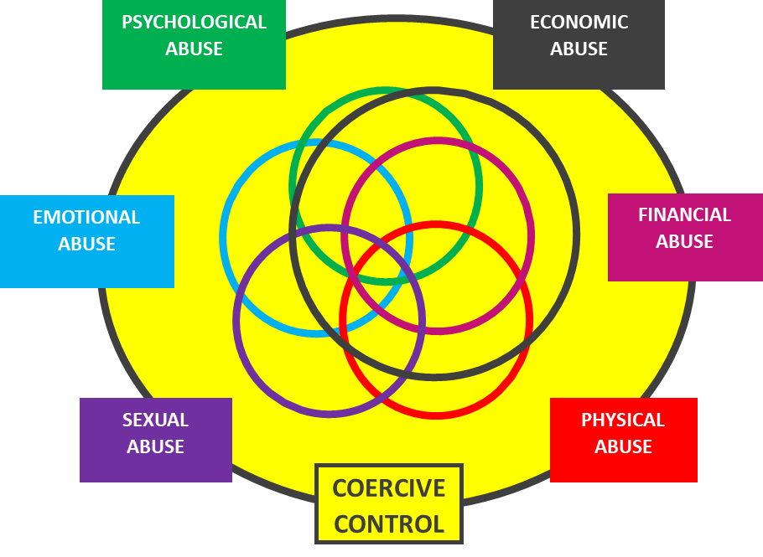
Domestic abuse in real life.
Domestic abuse is still considered a gendered crime with women more likely to experience repeat victimisation, be physically injured or killed, and experience sexual violence.
Latest ONS figures suggest that around 30% of women and 22% of men will be affected by DA at some stage in their lifetime.
Estimates suggest that 1 in 5 children & young people experience domestic abuse.
In the last year, an estimated 9.5% of women (2.3 million) and 6.5% of men (1.5 million) have experienced domestic abuse.
Only around 1 in 5 incidents are reported to Police.
On average in the UK, 1 woman is killed by their partner or ex every 5 days, 1 man is killed by their partner or ex every 3 weeks.
88% of victims of domestic homicide are known to services. 78% to Health, 21% Housing,16% to DA services, 14% to Social Care and 10% Children Services.
In 2023-24, the number of recorded alleged abuse types for domestic abuse by Adult Safeguarding was only 436 (10%) of all alleged abuse types recorded at the concern stage.
If left unchallenged it will increase in severity & frequency.
Notes:
The failure of criminal justice agencies to respond appropriately to domestic abuse is a key factor in the significant underreporting of domestic abuse. Source: Police failure to use protective measures in cases involving women and girls (March 2019) Centre for Women’s Justice.
Remarks…
In addition to how many male/females are killed by their partner/ex partner, how many men/women may be added to this if we considered all those that die by suicide due to DA? Domestic abuse plays a role in as many as a third of all female suicides - Last year data from National Council of Police Chiefs revealed that more people killed themselves (93) than were murdered (80) due to DA so the number could easily be doubled – Kiena Dawes case in news recently. Also 6-year old Hope Gordon -murdered by Dad who then killed himself. Perpetrators kill themselves too ‘ultimate act of coercive control’
Only about 10% of DA reported is considered high risk
The majority is at medium risk – it is what we will be dealing with tomorrow if we don’t do something today.
A head’s up for everyone – research suggests that only about 20% of DA is ever reported to Police. The majority of abuse is not being reported to the police.
DA is a gendered crime – meaning it is committed against a person because of their sex or socially constructed gender roles
Highlight figures for women murdered by men 75%
Mention numbers of male victims still high, under reported, lack of safe spaces etc.
During the same period, Police reported a 24% increase in domestic abuse related incidents on the previous year.
https://www.femicidecensus.org/wp-content/uploads/2022/02/010998-2020-Femicide-Report_V2.pdf
436 adult safeguarding concerns raised that allege domestic abuse in 2023-24. This equates to 10% of all alleged abuse types recorded at the concern stage. Alleged abuse types with higher proportions than domestic abuse were neglect and acts of omission (23%), self-neglect (20%), physical abuse (16%), psychological abuse (13%) and financial or material abuse (10%). More than one type of abuse can be recorded per concern.
Number of adult safeguarding concerns mentioning domestic abuse: Luton Council Adult Safeguarding, April 2023 – March 2024

Slide 5
Local Authority DA responsibilities
The Domestic Abuse Act 2021 says that each local authority:
  Has a duty to safeguard all victims of domestic abuse, regardless of age or gender.
  Must meet the support needs of all victims of domestic abuse and their children, in refuge and safe accommodation, including those presenting from outside the area.
  Must ensure that eligible homeless victims of domestic abuse are given ‘priority need’ for homelessness assistance.
  Recognises that a ‘related’ child who, sees, hears or experiences the effects of, domestic abuse is regarded as a victim.
To see the full list of measures, including the full definition go to https://www.gov.uk/government/publications/domestic-abuse-bill-2020-factsheets/domestic-abuse-bill-2020-overarching-factsheet
Notes:
Act introduces (amongst other things..)
A new Domestic Abuse Protection Notice and Domestic Abuse Protection Order (DAPO)
A duty on local authorities to provide accommodation-based support to victims of domestic abuse and their children in safe accommodation
Prohibits perpetrators of abuse from cross-examining their victims in court
Victims of domestic abuse are eligible for special measures in the criminal, civil and family courts
Extend the controlling or coercive behaviour offence to cover post-separation abuse.
“revenge porn” offence is extended to cover threats to disclose material
Created a new offence of non-fatal strangulation or suffocation of another person.
Clarified the law that a person may not consent to the infliction of serious harm and, by extension, is unable to consent to their own death (‘rough sex’ defence)
Places “Clare’s law” (Domestic Violence Disclosure Scheme) including the ‘right to be informed’ and the ‘right to ask’ about a partner’s history of violence. on a statutory footing.

Slide 6



What’s in our DA Toolkit?
Safe routine enquiry means routinely asking service users about domestic abuse. This must be done in a safe way/safe place, where a victim can’t be overheard and in a way that shows they will be believed and supported. Everyone, every time.
Identify Risk (DASH) allows for assessment of current risk & safety planning.
Refer or signpost for support.
Go to www.bedsdv.org.uk for guidance and details of local & national support services, advice and information about all forms of domestic abuse.
If in doubt, contact a DA professional.
Enhanced Tools now include the Homicide Timeline.
Notes:
There are still too many missed opportunities to get help for individuals & families experiencing domestic abuse
SafeLives data shows that 85% of victims sought help five times on average from professionals in the year before they got effective help to stop the abuse.
The data also shows that victims might have experienced abuse for between 2 and 5 years before seeking help.

Slide 7




Why do we need to safety plan?
It’s part of our safeguarding responsibility.
Planning is the process of thinking ahead to achieve a goal; our goal is always to reduce risk and improve safety of survivors of DA.
Safety planning is a key activity to help protect an individual and their children.
Provides relevant safety advice & ensures a survivor has basic safety knowledge as well as information about services available.
Helps us prepare to respond to what we know and prepare for what we don’t.
Level of risk can change in a moment. Why?
Can increase a survivor’s confidence, empowerment and feelings of hope.
Even most basic advice could prevent serious harm/death – including suicides related to domestic abuse.
Around 1 in 3 adults in England report having experienced at least one traumatic event.
Despite safety planning or advice, a survivor might involuntarily react to a trigger as if the trauma is happening right now. They might still open the door…
It’s never too early to safety plan…but it can be too late.
Notes:
Safety planning is a key activity to help protect an individual and their children
Allows us to identify what steps to take to avoid repetition/escalation/severity.
Prepares individual (and us) to consider the possibility of future abuse and violence.
Offering service users relevant safety advice and is written to ensure that the client understands basic safety knowledge and well as information about services available. Tailored to an individual.
How confident to delegates feel about their abilities to safety plan?

Slide 8
What to consider when Safety Planning
Home & Away
Post Separation
Legal
Housing
Children
Financials
It’s never too early to safety plan!
Notes:
Why is safety planning so important?
Whether we have completed a DASH or not – whether we know where someone’s risk level is we need to always make sure they know how to get help and know that there is support for them no matter what they want to do.
Respond to what we know and prepare for what we don’t.
Increases confidence & empowerment.
Even most basic advice could prevent serious harm/death.
It’s never too early to safety plan…but it can be too late.
The level of risk can change in a moment. Why?

Slide 9




Home & Away
Post Separation
Legal
+ Who are they going home to?
+ Vary routes from and to home, work, school…
+ Practice escape routes.
+ Ways to increase thinking time in a crisis? Such as lock & block the door?…
+ Agree a code word NOW
+ Access to ‘safe’ phone?
+ Silent Solution (55)
+ Emergency SMS service
+ Know your key contacts.
+ Teach CYP how to call 999, for help/code word.
+ Inform school/work.
+ Identify safe spaces.
+ Pack an emergency bag.
+ Pets!
+ Privacy settings: delivery, gaming, shopping & streaming apps etc.
+ Be alert to stalking – F.O.U.R
+ Mute not block perpetrator.
+ Keep a diary of incidents
+ Personal safety tech.
+ AirGuard, AirTag device tracker app.
+ Safety apps (Hollie Guard, People Safe )
+ Unwanted Prisoner Contact.
+ Homicide Timeline
+ Encourage police reporting (101) or can report online, at Beds Police
+ Aware of court/witness support
+ Victim rights - Victim Code
+ Clare’s Law
+ Responding to and reporting breaches bail, child contact etc.
+ Explore protection orders.
+ Immigration Status, No Recourse, Migrant Victims DA Concession.
+ Legal Aid
+ Probation – victim contact scheme.
+ Family Court/Child contact – weaponized!!
9
Notes:
5 mins – some points to remember /things to consider?
More detail can be found via Women’s Aid or various other on-line resources. Most support services have a version of a safety and support plan.
These are the elements to consider – some info included as prompts.
When panic takes over at the moment when you see the AP (at the door or out and about) how can we increase our thinking time so that panic doesn’t take over. Think about the human fear response. i.e. don’t just lock the door, block the door too….?
What’s app – you can access on your computer you only need your phone number and ID once….
https://walksafe.io/ - WalkSafe+ is the UK’s leading personal safety app which combines journey-sharing features and a national Safe Space map. The map plots safety-trained venues across the UK in partnership with Local Authorities and Businesses that offer safety facilities such as phone charging stations and free period products, enabling our users to find help in real-time while on their commute home. WalkSafe+ has a suite of tracking and non-tracking features available, which enables trusted friends to follow your live journey should you need it.
Prisoners’ families helpline:
The new national Unwanted Prisoner Contact service (formerly Victims Helpline) helps protect all victims from receiving unwanted contact from prisoners. The service is there to help if you are suffering from a prisoner’s attempts to control, use, bully, harass or intimidate you.
Website: https://www.prisonersfamilies.org/unwanted-prisoner-contact-service
Unwanted contact form: https://unwanted-prisoner-contact.form.service.justice.gov.uk/
Email: unwantedprisonercontact@justice.gov.uk

Slide 10

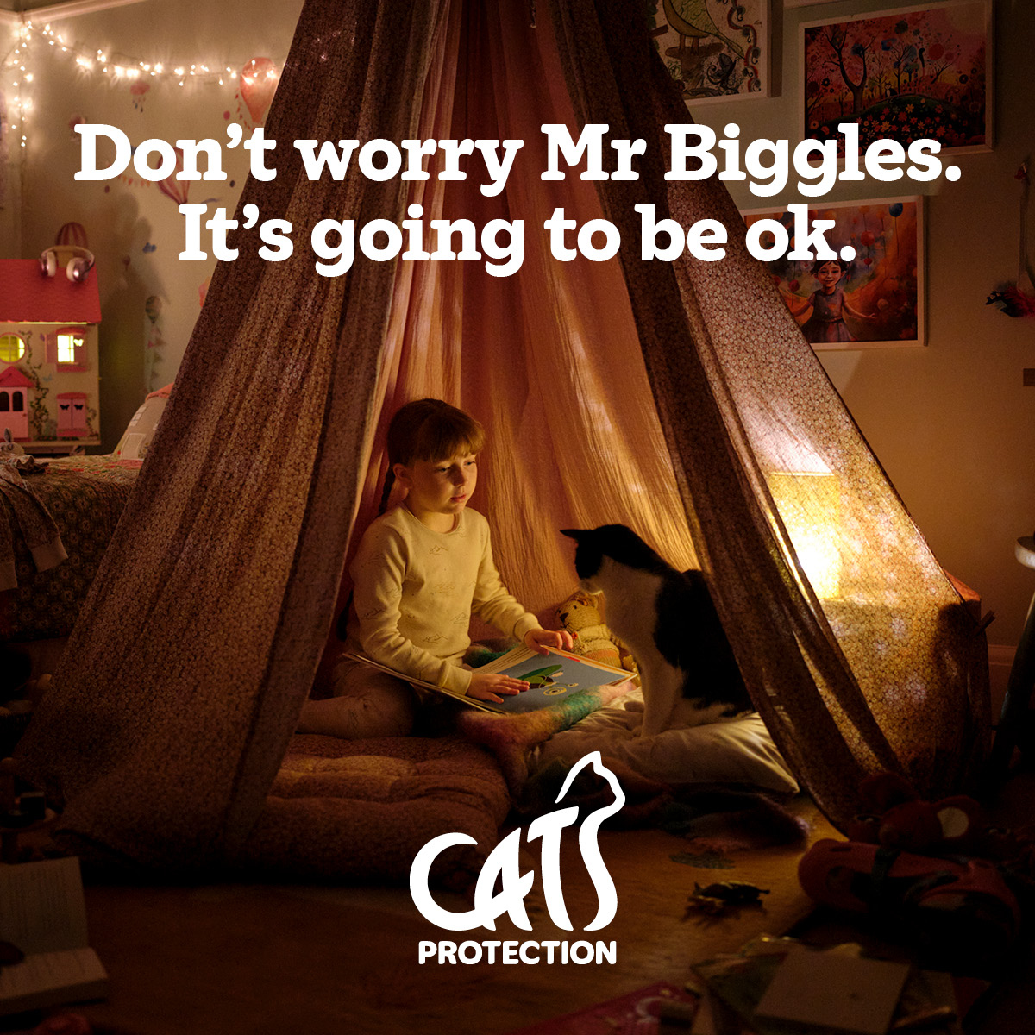
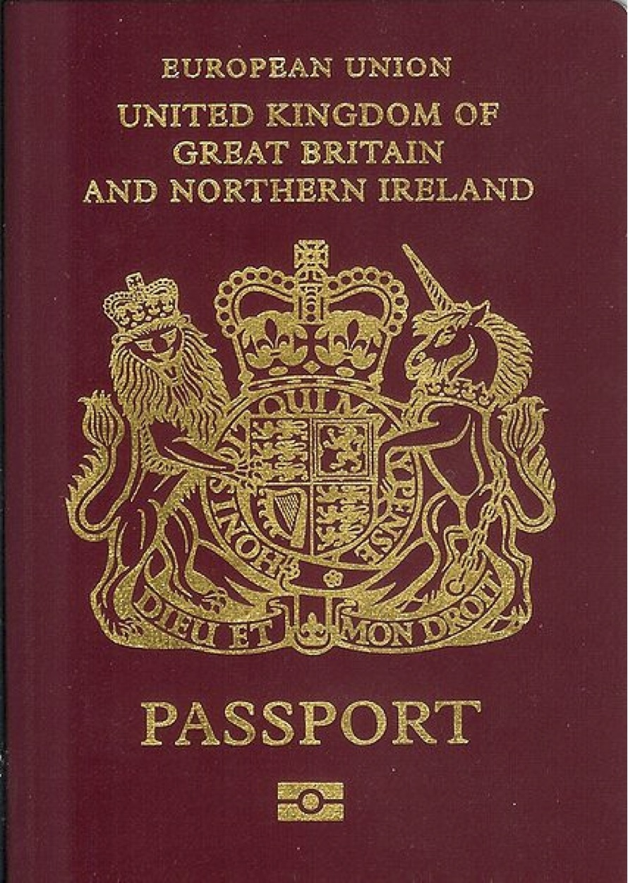

Housing Options
Children
Financials
+ Leaving or staying?
+ Explore housing options.
+ Refuge
+ Safety & home security – what support available, CCTV…
+ Occupation Order.
+ Police (SIG) marker
+ Keeping new address secure – CYP, post, shared papers, social media, streaming & delivery apps..
+ Electoral register- vote anonymously.
+ what3words - location app
+ Pets – Dogs Trust, Cat’s Protection etc.
+ Who has PR/custody?
+ Third parties & support network – set code words?
+ Safe child contact – contact centres, public hand overs etc.
+ Support to talk to CYP.
+ Schools: Op Encompass disclosures / access to support.
+ Places of safety.
+ Who has CYP means of escape/instruments of control?
+ Ongoing support for CYP – KIDVA?
+ be alert to AP using CYP as means of control – stalking, social media, spending apps.
+ Access to benefits
+ DWP range of support
+ Debts & vulnerabilities – arrears,
+ Immigration - MVDAC, NRPF etc.
+ Banks and access to banking – talk to financial institutions, joint accounts, tracing/stalking by tracking payments.
+ Access to means of escape – money, passports, NI etc.
+ Employment and Employers
+ Welfare and access to essentials (flexi –fund).
+ Consider aspects of economic abuse such as modern slavery, exploitation etc.
Notes:
5 mins – more things to consider…
Recording videos at school events – just be aware that sometimes there could be a child who is at risk and has escaped an abusive home at the event – if a parent records an event and then publishes the recording they could unwittingly expose that child and their family to risk. Identifying their school etc. Follow the rules! They are there for a reason!

Slide 11

Legal protections
Restraining order imposed in criminal cases such as Stalking, Coercive Control, Assault offences, with restrictions depending on severity.
Occupation Order (civil) states who can live in a property and is tailored to individual circumstances.
Prohibited Steps Order (civil) granted to prevent perpetrator from taking children away from victim’s care and control & determines how contact can be safely maintained.
Forced Marriage Protection Order (FMPO) protects a person from any attempt to be forced into marriage and those who have been forced into a marriage.
Female Genital Mutilation Protection Order (FGMPO) granted by a court and are unique to each case.
Legal Aid you're on a low income and your case is serious, legal aid might pay some or all legal costs. Check whether someone qualifies at: https://www.gov.uk/check-legal-aid
Domestic Violence/Abuse Protection Order (DVPO) DAPO introduced in some areas from April 2024. Used by Police to offer protection. DVPO can prevent the perpetrator from having contact with the victim for up to 28 days. DAPO can impose restrictions on a perpetrator and can also require a perpetrator to meet certain requirements and can be better tailored to meet individual victim’s needs.
Domestic Violence Disclosure Scheme (Clare’s Law) gives any individual the right to ask and the right to know if their partner may pose a risk to them. Apply on-line to police.
Stalking Protection Order (SPO) civil order used by police through magistrate’s court to protect the victim from the risk of stalking.
Non-Molestation Order is a civil order granted to stop offender attacking, threatening, harassing etc. a victim. it covers individual & children and takes personal circumstances into account & can be made ‘ex-parte’ (in absence of perpetrator).
Notes:
There is an increasing range of legal orders that can be used to protect survivors of domestic abuse.
mention FGMPO and FMPO – through family court
You can get an emergency order (an ‘ex-parte’ or ‘without notice’ order) to protect you immediately without the person you’re making the order against being involved in getting the order.
Most survivors of domestic abuse would have a solicitor who would apply on their behalf for one of these orders. Most solicitors would offer you a free initial consultation to help you understand the legal process. These cases are heard at a family proceedings court, and the judges and magistrates are specially trained in family law.
However, you can also apply directly to the court yourself.
You may qualify for legal aid; and can find out whether you will be eligible, where you will also find templates for letters and applications if you decide to represent yourself. Your local domestic violence agency (including Victim Support) can help you complete these applications.
Enforcing the orders 
If the court grants an order, it needs to be ‘served’ on the abuser if they’re not at court (i.e. delivered to them in person). The order can only be enforced if there is proof that it has been served on the abuser.
A copy of the order also needs to be given to the local police station so that they are aware that it exists. It may also be useful to provide copies of prohibited steps orders to your children’s school to ensure that they cannot be removed without your permission.

Slide 12
Basic Safety Planning advice for all.
If you feel that you or someone else is in danger, please always call 999. If you cannot speak then cough or make a noise, then tap 55 on keypad and follow instructions for a silent call.
Keep your phone charged and with you and check you have signal at home.
Agree a code word NOW with a trusted friend/family member/neighbour to let them know you are safe or to signal that you need them to call for help.
Plan your escape route(s) and think about where you would go if you needed to leave in a hurry.
Think about varying your routines and consider changing your timings or routes when leaving the home or workplace.
Think about your home security (smoke alarms, door chain, change locks, CCTV, video doorbell).
Prepare an emergency bag with important documents, keys, essential clothing, and other items (toiletries, toys, some cash/card) for yourself and your children and keep in a safe place or with a trusted person.
Avoid rooms in the home where your abuser could access a weapon (kitchen, shed etc.) or where they could lock you in.
If safe to do so update your Wi-Fi, social media, banking, shopping, delivery, gaming, entertainment, email & computer privacy password settings.
Do not threaten to leave. Separation significantly increases your risk. Get advice about how to leave safely.
Mute, don’t block the perpetrator.
Stalking is serious. Name it and report it.
It’s never too early to safety plan, but it can be too late!

Slide 13
Important documents – visa, work permits, passports, birth certs, ID for you & CYP.
Copy documents on to USB/cloud – check who has access.
Housing - mortgage details or lease and rental agreements.
Insurance documents.
Mobile phone and charger.
School & medical records.
Telephone numbers for school, GP, etc.
Prescribed medication, mobility and/or hearing aids.
Money including bank account details, bank logins, credit and debit cards.
Child benefit docs and any other welfare benefits.
Driving licence, car registration and insurance details.
Keys for your house, car and workplace.
Workplace security pass.
Contact details of friends and family, your address book.
Small sentimental items like family photographs, your diary, jewellery.
Your children’s favourite small toys.
Clothing & essential toiletries for you and CYP.
Dentures.
Do not put yourself in danger getting these items, pack what you can.
What’s in the bag?
https://www.womensaid.org.uk/information-support/the-survivors-handbook/
Notes:
You might have to make a decision quickly to leave – What are you going to take with you when you leave?
You might not be thinking practically – which is why early safety planning is so important!! Everyone should have some idea of how to keep themselves and their children safe.
Here’s some suggestions about what could be in your emergency bag.
For more advice go to: https://www.womensaid.org.uk/information-support/the-survivors-handbook/

Slide 14



Safety all summed up
What are the victim’s needs (adults & children)?
Who has access to the victim and the children?
What do we know about current risks? Have we completed a risk assessment (DASH)?
Is it safe for them to keep copy of plan; leaving or staying?
Does victim have a support network? It’s much harder with no support….
Manage their (and your) expectations.
Don’t forget to also signpost or refer to the services available.#
Be curious!
Be aware of who you are sharing victim’s info with. Be aware of accidental sharing with the perpetrator.
Think about general safety of meetings. Is it safe/is there a need for both partners to be there?
Be alert for Counter Allegations/DARVO and grooming by Perpetrator.
Consider any triggers that could cause an escalation/change in thinking (HTL).
How trauma informed are you?
Notes:
Here are some considerations that maybe are more specific to social care professionals….Can delegates think of any more?
Recent example from HR client – social worker arranged separate Core Group Meetings for Victim and AP however then sent minutes of meetings to both parties.
Is the perpetrator a parent? Do they need to be at the meeting?
Be aware that protected characteristics can make individual more vulnerable to abuse – sexuality, gender, disability etc.
DASH is a specific DA risk assessment – 27 questions linked to known high risk factors. Not essential in assessing risk but very helpful and provides professionals with a standardized tool and language to use when discussing and responding to risk.
DARVO – deny, attack reverse victim & offender - Jennifer Freyd (1997) first began using this term to address power dynamics in relationships. DARVO is an acronym used to describe a pattern of emotional abuse sometimes present in relationships; DARVO is a way that an abuser gaslights his or her partner, shifting blame from self to the other. Professionals and support networks can also be groomed by an abuser – professing to be the victim, leading to reduced support for the true primary victim and potentially criminalising them/counter allegations.

Slide 15
Quick trip back to the toolkit…
Referral pathway and signposting

Slide 16
Bedfordshire DA referral pathway
Standard risk DA
Establish needs & refer to local support services. Provide safety advice.
www.bedsdv.org.uk
For directory of local & national services.
Refer CYP to Children’s Safeguarding / MASH team.
Signpost adults to DA services.
DASH Score 0-9
DARA assessment of risk is Standard
Disclosure of abuse & DASH Risk Assessment completed
Refer to Children’s Safeguarding / MASH.
Consider Adults Safeguarding Referral.
Medium Risk DA
Establish needs & refer to appropriate service. Provide safety advice.
www.bedsdv.org.uk
THINK Safeguarding!
DASH Score 10 – 13
DARA Medium
Refer to Adults & Children’s Safeguarding / MASH
High Risk DA
Refer to MARAC/IDVA Service.
www.bedsdv.org.uk
DASH Score 14 – 27
DARA High
Notes:
1 mins
Included steps that all professionals should take – DA is a category of abuse and it is a MUST that a safeguarding referral is raised either with childrens or adults as may be appropriate.
Infogram of DA risk assessment pathway once disclosure made.
DARA Initial Assessment of Risk
Standard = There appears to be no pattern of abusive behaviour, or control of one person by another.
Current evidence does not indicate likelihood of causing serious harm.
Medium = There appears to be a pattern of abuse/control of one person by another, and/or frequent
physical violence. The offender has the potential to cause serious harm but is unlikely to do so
unless there is a change in circumstances, such as the victim attempting to leave.
High = There is an extreme level of control of one person by another and/or very frequent and severe
physical violence. There is a serious threat of harm posed to the victim by the perpetrator. The
potential event could happen at any time and the impact would be serious.

Slide 17
Multi agency risk assessment conference (MARAC)
Any high-risk victim must be referred to the local Multi Agency Risk Assessment Conference (MARAC) & IDVA service.
  to safeguard victims who are at high risk of future DA;
  to make links with other public protection arrangements in relation to children, people causing harm and vulnerable adults;
  to safeguard agency staff;
  to work towards addressing and managing the behaviour of the person causing harm (the perpetrator).
At the heart of a MARAC is a working assumption that no single agency or individual can see the complete picture of the life of a person who is at risk but together will have insights that are crucial to their safety, as part of the coordinated community response to domestic abuse.
Ensuring that the victim is supported throughout and their needs represented at the MARAC is crucial to managing risk, improving and maintaining safety, and reducing repeat victimization.
IDVA provide victim survivors with safety planning and specialist support across a range of issues including providing the voice of the victim at MARAC.
Notes:
1 mins
Aims of the marac – leads to role of the IDVA
Multi-Agency Risk Assessment Conferences (MARACs) are regular local meetings where information about high risk domestic abuse victims (those at risk of murder or serious harm) is shared between local agencies.
By bringing all agencies together at a MARAC, and ensuring that whenever possible the voice of the victim is represented by the IDVA, a risk focused, co-ordinated safety plan can be drawn up to support the victim. There are currently over 270 MARACs are operating across England, Wales, Scotland and Northern Ireland managing more than 64,000 cases a year.

Slide 18
Local & national support
National 24h Domestic Abuse Helpline: 0808 2000 247 (live chat available)
Men’s Advice line: 0808 801 0327 (web chat available)
LGBTQ+ DV Helpline: 0300 999 5428 (live chat available)
Honour Based Abuse Helpline: 0800 5999 247
National Stalking Helpline: 0808 802 0300
Revenge Porn Helpline: 0345 6000 459
Respect phone-line: 0808 802 4040 (for those who want to change their behaviour)
Child line: 0800 1111 (provides night chat service)
Victim Support 24hr Support Line: 0808 16 89 111 (offers live chat service)
Police non-emergency: 101 if you don’t want to talk, you can report online at Bedfordshire Police
________________________
Bedfordshire Victim Care Service: 0800 028 2887 provides support for any victim of crime, including domestic abuse and can carry out a risk assessment and help someone explore their options.
The Ebonista Project: 07306 088816 (support for female survivors of abuse, and men wanting to change behaviours)
Luton All Women’s Centre: 01582 416783 (provides women with a range of support and programmes)
Stepping Stones Luton: 01582 457114 (provides women with a range of support and programmes)
Women’s Aid in Luton: 01582 391856 (support for women & children who have experienced domestic abuse)
Embrace KIDVA: service works with children at high-risk of harm from domestic abuse.
ECP IDVA and Therapeutic Service: 0300 131 7154 a standard to medium risk service which offers free and confidential support for children & adults living in Bedfordshire experiencing domestic abuse.
Chrysalis Centre: provides support for those wanting to change their behaviours.

Slide 19
Myths & Misconceptions…
The victim and perpetrator don’t have to be living together for it to be considered DA.
Children & Young People living in an abusive household are victim survivors too, not ‘just’ witnesses…
Post separation abuse is a form of coercive control.
It usually happens in private or in the home, but it can happen anywhere.
It can be very difficult to recognise or talk about.
Non-physical abuse is as harmful as physical violence and abuse.
Anyone can be a victim of domestic abuse, everyone can become vulnerable at different stages of their lives or their relationships.
There is no safe way to choke someone (Non-Fatal Strangulation is an offence).
Men are not immune to domestic abuse.
There are many barriers to disclosure. Some are barriers that we have put in place.
The perpetrator is the only one who can stop the abuse, though the survivor can get support to end the relationship.
A survivor should never leave or threaten to leave without getting some advice to do that safely.
The survivor/victim is NOT to blame for the abuse.
A protective order does not necessarily prevent further abuse…neither does Police bail.
Domestic abuse is everyone’s business…it’s not just a family matter.
You can and do make a difference. Keep going.
It’s never too early to safety plan! ☺
Notes:
The outcome of these myths and misconceptions can frequently be that we may ask about relationships and abuse but a victim might not tell us – they might not trust us, they may be scared of consequences, what could happen if the perp finds out they’ve talked etc?
Remember DA is about power and control and FEAR.
Post-separation abuse is a real thing!
There are soooo many barriers to disclosure! – shame, embarrassment, language, consequences, fear, not recognised etc. In fact in a recent survey by ONS based on CSEW they found that around 50% of victims of CC did not realise that what was happening was actually abuse. Maybe because of the very common misconception that there was little or no physical violence?

Slide 20
Thank you for listening.
Got a question? Please get in touch: jenny.bull@luton.gov.uk

