Slide 1
Trauma Informed Practice: Principles, Importance and Practice Meaghan Kall - Public Health Registrar ELFT Conference 26 November 2025
Notes:
Good morning everyone, and thank you for the opportunity to speak today and share our experience in refreshing the Luton Domestic Abuse Strategy and how we’ve sought to embed a public health approach

Slide 2
Session Aims
Explain the core principles of trauma-informed practice
Understand why trauma awareness is critical in health and social care
Identify practical ways to embed trauma-informed approaches in everyday work
Reflect on how organisational cultures can either support or undermine trauma-informed care
Notes:
By the end of the session

Slide 3

Disclaimer
This session provides a high-level introduction to trauma-informed practice only.
It does not constitute formal trauma-informed training or clinical qualification. This generally requires at least one full day (up to 8 weeks) of face-to-face facilitated learning
Trauma-informed (TI) training is only one element in the provision of trauma-informed practice (TIP)
Notes:
The aim today is to build shared awareness, language and motivation, not to develop specialist therapeutic skills.

Slide 4
What Do We Mean by Trauma?
“Trauma is not what happens to you, but what happens inside you as a result of what happened to you”
– Bessel van der Kolk
Notes:
Trauma refers to events or experiences that overwhelm a persons ability to cope.
Includes childhood abuse (physical, psychological, sexual), neglect, domestic abuse, violence, discrimination, loss, poverty, systemic trauma, and more.
Can be a one-off event or a sustained experience. Can be directly experienced or indirectly by witnessing a traumatic event. Can be an interpersonal situation or a big situation like war conflict or natural disaster.
Trauma affects:
Neurobiology (fight/flight/freeze responses)
Cognition and memory
Emotional regulation
Relationships and trust

Slide 5
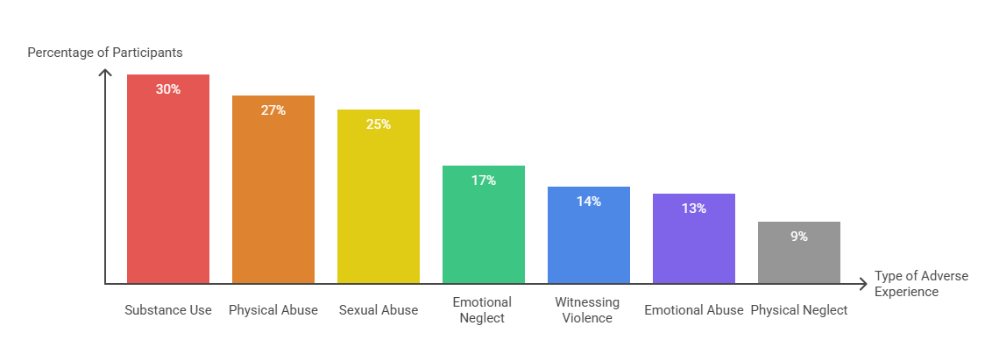
Prevalence of Adverse Childhood Experiences
The seminal Adverse Childhood Experiences (ACE) study of 17,000 adults suggests that childhood trauma is common:
Notes:
Trauma is common:
1 in 3 adults report at least one traumatic experience in childhood.
Trauma is strongly linked to mental ill health, substance use, self-harm, homelessness and social care needs.
Trauma doesn’t stop because you are an adult

Slide 6
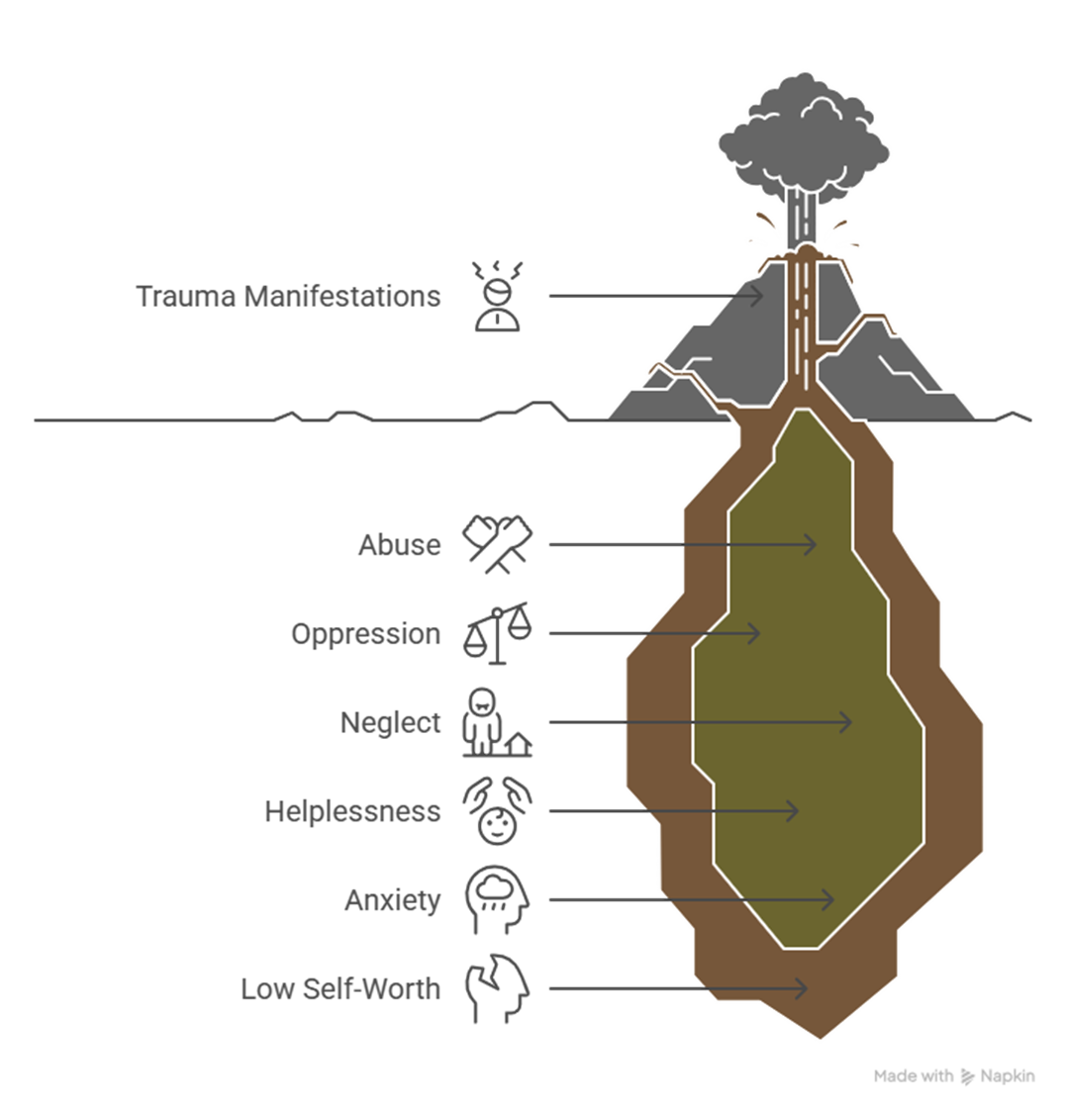
Notes:
A key feature is inescapability – the feeling of being trapped and powerless to protect oneself or loved ones. This lack of control fundamentally distinguishes some traumatic events from merely stressful ones.

Slide 7
What do we mean by “Trauma Informed Practice”?
An approach grounded in the understanding that trauma exposure can impact an individual's neurological, biological, psychological and social development.
Being ‘Trauma Informed’ means being able to see beyond an individual's presenting behaviours and recognise when someone may be affected by trauma and responding appropriately.
Aims to improve patient’s ability to feel safe and develop trusting relationships with health and care services and staff.
Notes:
Includes responding in a way that supports recovery, does not cause further harm, and recognises and supports people’s resilience.
We want people to feel included, nurtured, and safe. We will always search for new, different, improved approaches to preventing harm and supporting recovery, steered by evidence and voices of those with lived experience.
Trauma-informed practice improves:
Safety and trust
Engagement and retention in services
Staff morale and reduced burnout
Outcomes in wellbeing, stability and recovery
It shifts the question from: “What is wrong with you?” → “What happened to you?”

Slide 8
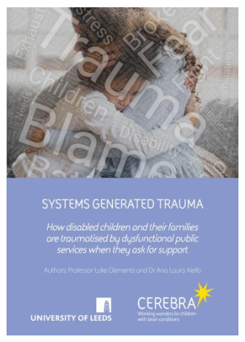
Systems Generated Trauma
Increasing recognition that systems may re-traumatise people by repeating patterns of powerlessness, not being believed, lack of control, or instability.
Examples: having to retell traumatic experiences, long waiting lists and red tape for urgent support, disbelief by professionals, rigid eligibility thresholds, inconsistent decision-making, experiences of racism or institutional bias
Notes:
Definition: Trauma that is caused or intensified by the very systems designed to support people

Slide 9
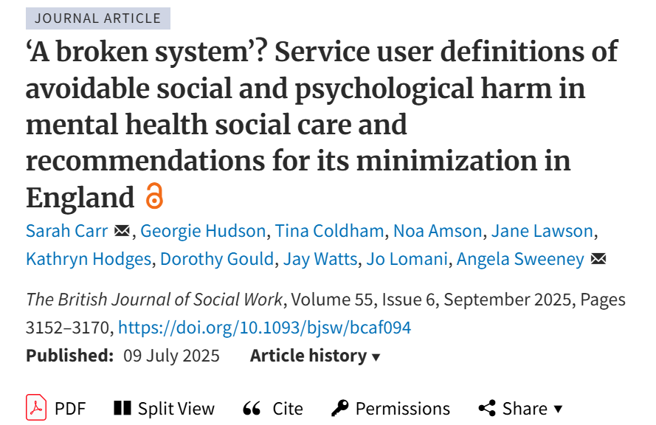
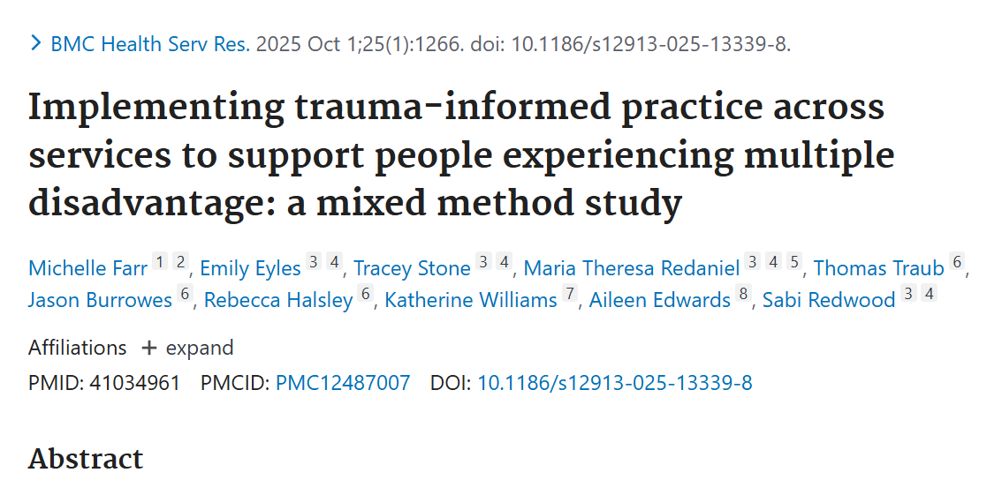
Notes:
A 2025 service-user led study published in The British Journal of Social Work described “avoidable social and psychological harm” in mental health social care arising from systemic issues, including bureaucracy, fragmented services, and oppressive organisational cultures.
The evaluation of the “Changing Futures” programme (2025) — which supports people experiencing multiple disadvantage (homelessness, domestic abuse, substance use) — found that staff with trauma-informed training reported improvements in relational practice, though longer-term and structural challenges (e.g., funding, staff turnover) limited full impact.

Slide 10
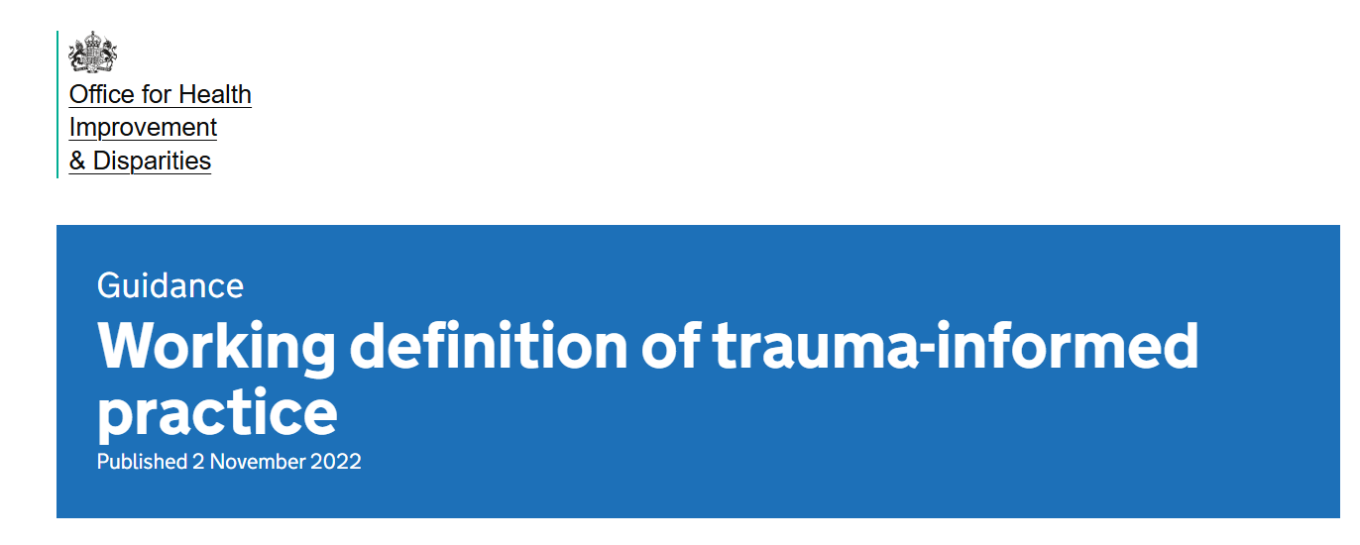
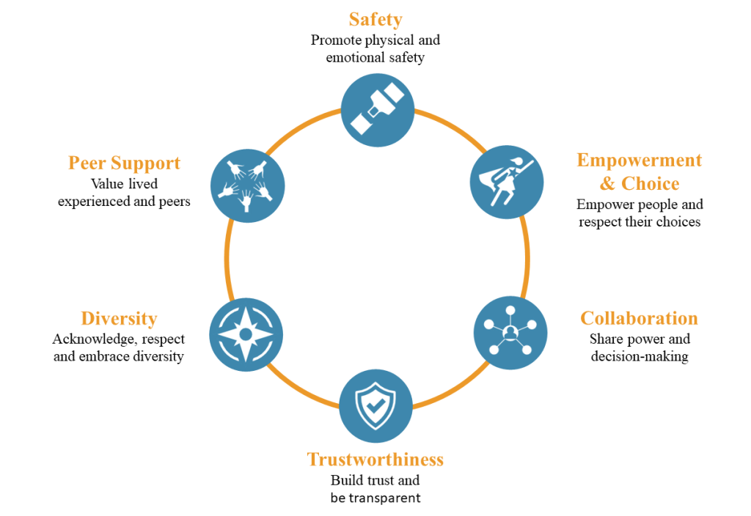
Six core principles of trauma-informed practice
Notes:
1. The safety of service users and staff is prioritised, by people knowing they are safe or asking what they need to feel safe, and putting policies, practices and safeguarding arrangements in place
2. Transparency exists in an organisation’s policies and procedures, with the objective of building trust among staff, service users and the wider community, by organisation and staff explaining what they are doing and why, the organisation and staff doing what they say they will do, expectations being made clear and the organisation and staff not overpromising
3. Choice Service users are supported in shared decision-making, choice and goal setting to determine the plan of action they need to heal and move forward, by organisations and staff listening to the needs and wishes of service users, explaining choices clearly and transparently, acknowledging that people who have experienced trauma may feel a lack of safety or control which can make it harder to developing trusting relationships
4. Collaboration The value of staff and service user experience is recognised in overcoming challenges and improving the system as a whole, by focussing on working alongside and actively involving service users in the delivery of services
Empowerment
Efforts are made to share power and give service users and staff a strong voice in decision-making, at both individual and organisational level, by:
validating feelings and concerns of staff and service users
listening to what a person wants and needs
supporting people to make decisions and take action
acknowledging that people who have experienced or are experiencing trauma may feel powerless to control what happens to them, isolated by their experiences and have feelings of low self-worth
Cultural consideration
Move past cultural stereotypes and biases by offering access to gender responsive services, leveraging the healing value of traditional cultural connections, incorporating policies, protocols and processes that are responsive to the needs of individuals served

Slide 11
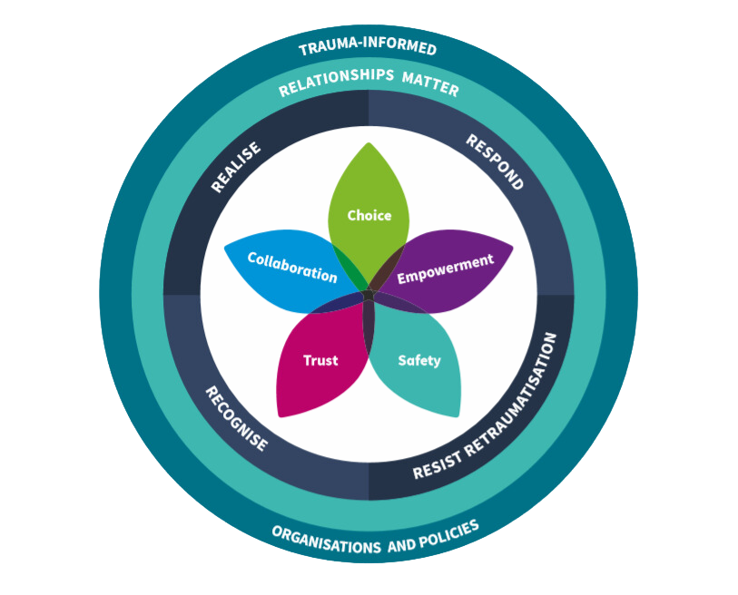
Being 'Trauma-informed' is underpinned by the 5 R’s (the implementation pathway)
Realise how common the experience of trauma is
Recognise the different ways that trauma can affect people
Respond by embedding trauma informed practice
Resist re-traumatisation and offer a greater sense of collaboration, choice and autonomy, and communication
Recognising the central importance of Relationships
Notes:
In DA its important to know where we’ve come from, so a brief history lesson. Community safety

Slide 12
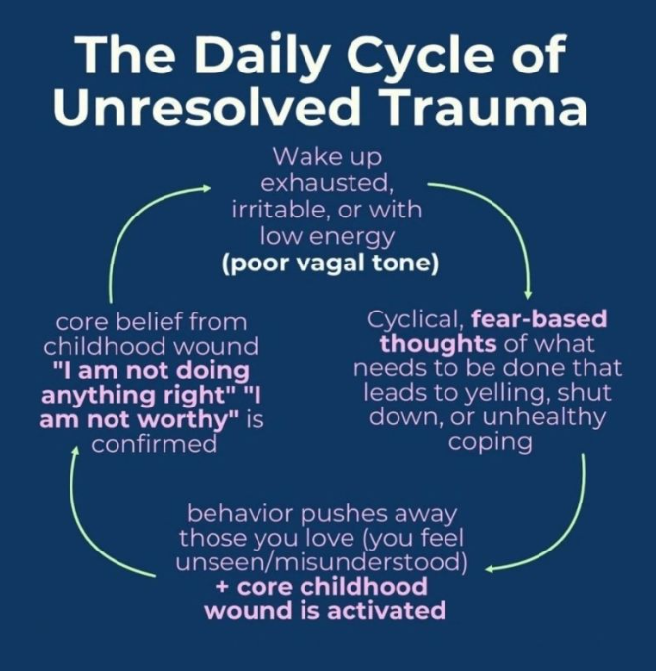
Recognise signs and symptoms of trauma
Irritable
Hair trigger
Fight or flight
Crying
Pain /Headaches
Poor memory and concentration
People pleasing
Avoidant
Notes:
In DA its important to know where we’ve come from, so a brief history lesson. Community safety

Slide 13
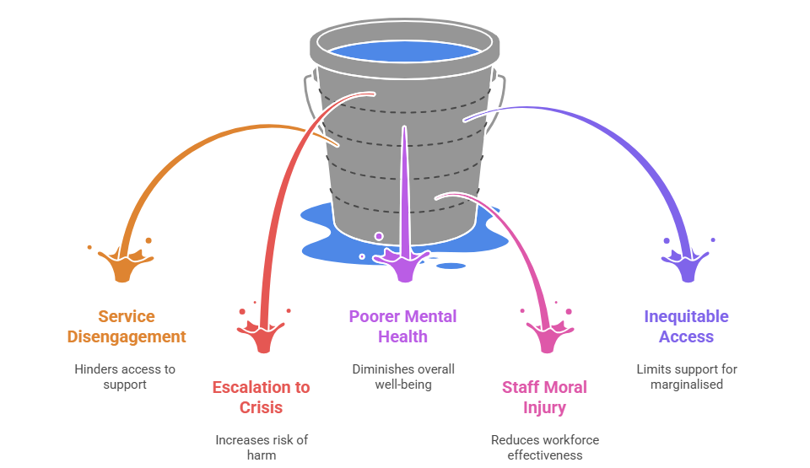
Risks of not being trauma-informed

Slide 14
What Trauma-Informed Practice is Not
Not therapy
Not asking everyone to disclose trauma
Not excusing harmful behaviour
Not a one-time training
Not a tick-box exercise
It is a lens, a culture, and a way of working.
Notes:
In DA its important to know where we’ve come from, so a brief history lesson. Community safety

Slide 15
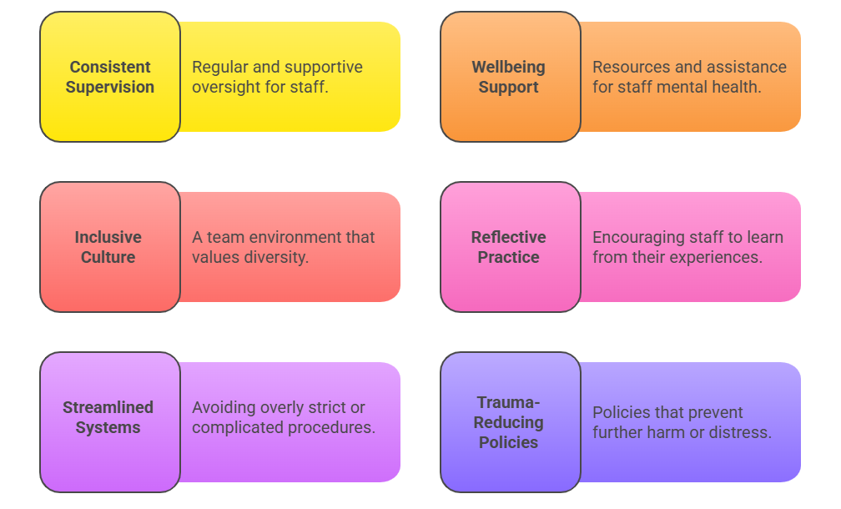
Trauma-Informed Organisations
Truly embedding trauma-informed practice is not just individual professionals but a whole organisation commitment to:
Notes:
There are some key features of a trauma-informed system:
Trauma-informed care is recognised as a positive approach for whole family engagement across the borough.`
Trauma-prevention is prioritised, including avoidance of retraumatisation through the engagement with children, family and community services.
The system works collaboratively to deliver a consistent approach to trauma-informed practice.
Individuals, teams & organisations are supported with this practice, including through creative collaboration and formal support
Secondary trauma for staff (i.e. the emotional stress caused by hearing or witnessing someone else’s traumatic experiences) is recognised and there are effective systems/processes in place to provide support

Slide 16
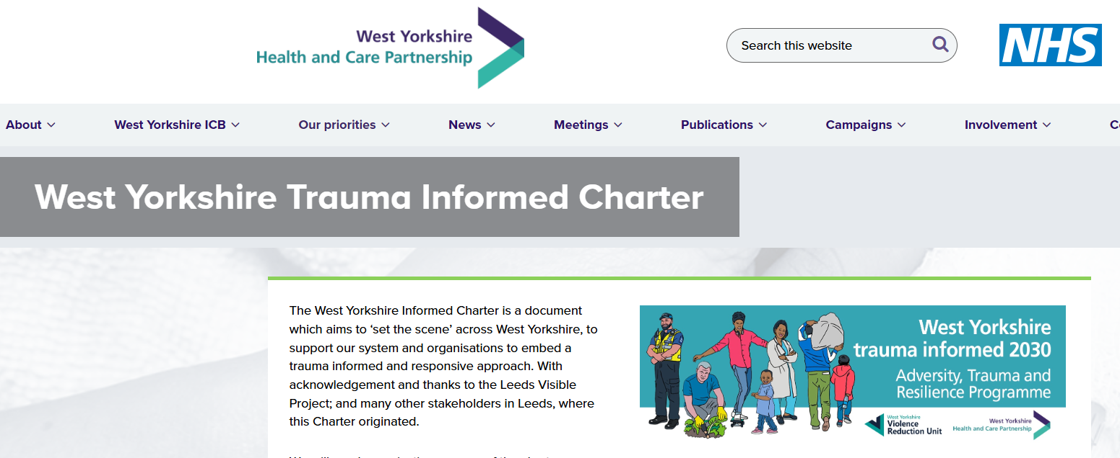
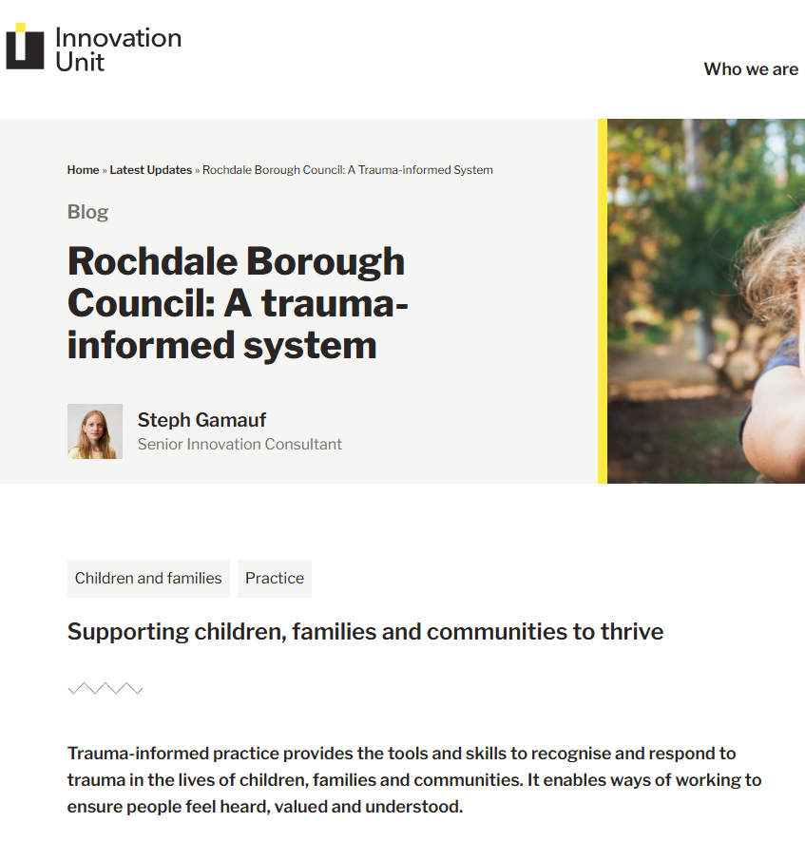
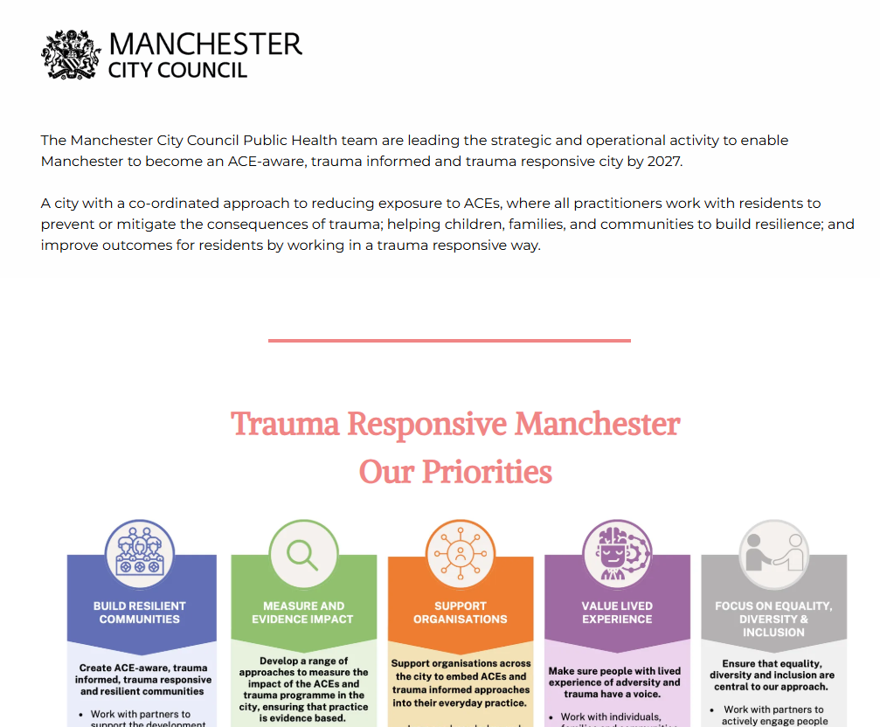
Examples of local authority commitment to Trauma-Informed Practice
Islington Council (London): implemented trauma-informed practice across children’s services and schools; all frontline staff have been trained.
Rochdale Borough Council: has publicly committed to become a “trauma-informed borough,” embedding TIP in their children, families and community services.
Manchester: through “Trauma Responsive Manchester,” the Council are working to make Manchester an ACE-aware, trauma-informed city, with training and a multi-sector strategy.
West Yorkshire ICB: the Violence Reduction Partnership has a stated ambition for the region to become a “trauma-informed and responsive system” by 2030.
South Gloucestershire Council and Bristol City Council: working with a specialist provider (Dignifi) to embed trauma-informed practice across a range of services.
Angus Council (Scotland): has a Trauma Informed Practice (TIP) steering group and a strategic plan to embed trauma-informed culture across local authority, police, health, and community services.
Notes:
In DA its important to know where we’ve come from, so a brief history lesson. Community safety

Slide 17
Embedding in Practice: what you can do as practitioner
Slow down & explain each step
Offer choices (timing, seating, order of tasks)
Use strengths-based, non-blaming language
Be curious, not judgemental
Create safe environments (lighting, tone, predictability)
Reflect in supervision on triggers
Ask-once approaches / warm handovers
Grounding and de-escalation techniques

Slide 18
Final thoughts…
What can you influence from where you sit?
1. In your Daily Practice
How do I create emotional and physical safety in every interaction?
How do I promote choice, control and collaboration?
How do I avoid practices that may re-traumatise?
2. In your Team
Do we have space for reflection, supervision and learning?
How do we support staff wellbeing and psychological safety?
How do we respond when things go wrong?
3. In Systems and Processes
Do our policies and pathways reduce or unintentionally add to trauma?
Where are there barriers, delays or rigid rules that increase distress?
Who is not being reached or is excluded?
4. Lived Experience & Co-Production
How do we meaningfully involve people with lived experience?
How do we use feedback to improve services?
Notes:
Trauma-informed practice is not a single intervention, it is a cultural shift that happens through everyday actions, decisions and leadership at every level.

