Slide 1

Routine Enquiry into Domestic Abuse QI Project– Safeguarding Conference 2025

Slide 2

Objectives of today’s session
Define the difference between routine enquiry and selective enquiry.
Understand why asking about domestic abuse is an essential part of mental health care.
Understand what are the barriers to staff routinely asking about domestic abuse.
Understand what ELFT are doing to implement and strengthen routine enquiry into domestic abuse through our QI project.
Notes:
3. Respond

Slide 3
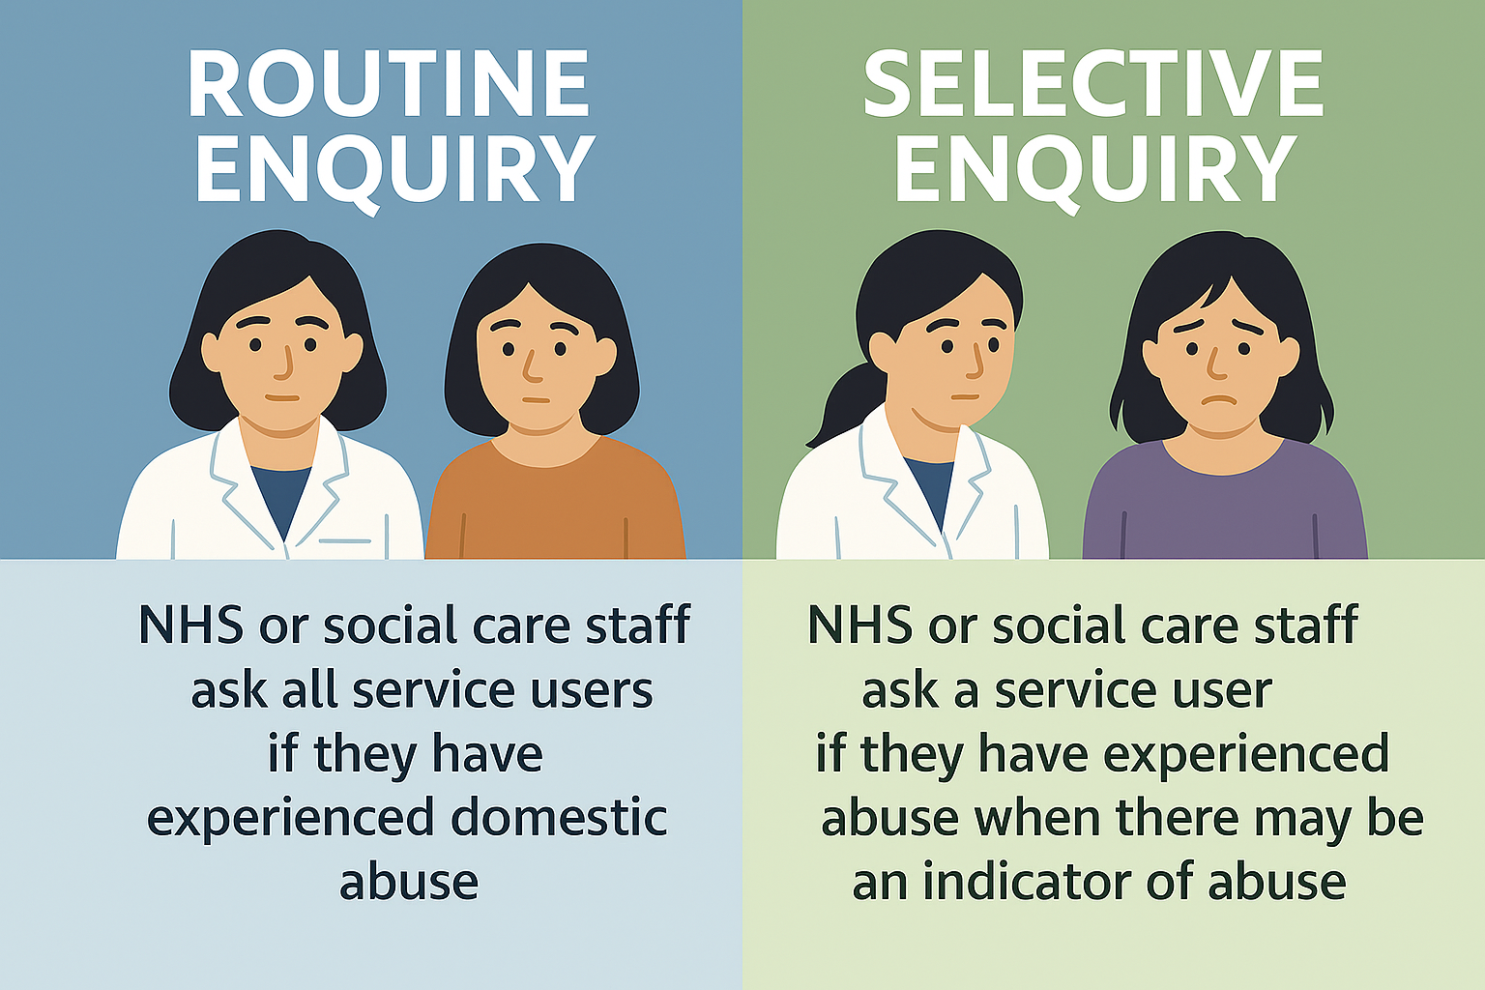
What is Routine Enquiry?
Routine enquiry is the practice of NHS or social care staff regularly asking all service users, regardless of whether there are any visible signs of abuse, if they have experienced domestic abuse.
Selective enquiry into abuse is asking a service user if they have experienced abuse when NHS or social care staff have reason to believe there may be abuse.

Slide 4

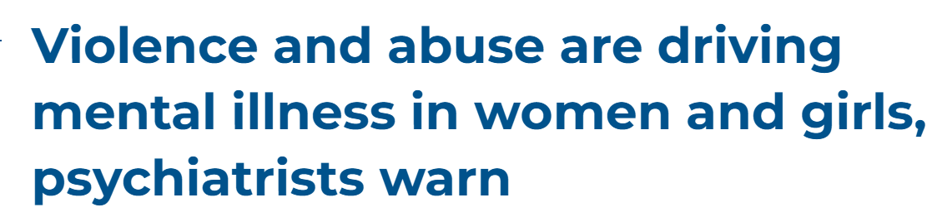
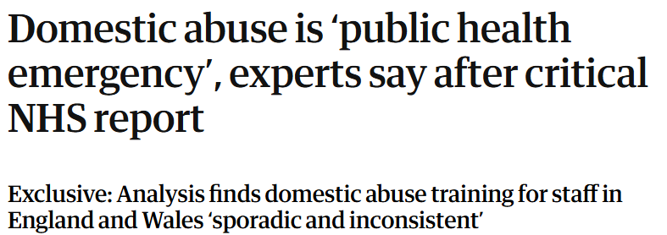

Domestic Abuse – A Public Health Emergency
Anna Bawden
Health and social affairs correspondent for the Guardian
Sunday 22 June 2025
Press Release
March 2024
Notes:
Public health:
Domestic abuse is a public health emergency, experts have claimed, after a report concluded that the NHS is failing victims by not training staff to spot and respond to the signs of domestic violence.
Approximately one in five (20.5%) people aged 16 years and over (9.9 million) had experienced domestic abuse since the age of 16 years.
An estimated 4.8% of people aged 16 years and over (6.6% of women and 3.0% of men) experienced domestic abuse in the last year. This equates to an estimated 2.3 million adults (1.6 million women and 712,000 men).
Analysis shows that the NHS has more contact with victims and perpetrators than any other public service.
RC Psych
The Royal College of Psychiatrists Women’s survey heard from 515 respondents,
The majority of respondents (59%) say violence and abuse are contributing to mental illness in their female patients. This was closely followed by relationship issues (49%), often caused by coercive behaviour, and home and family pressures (48%) which are also causing significant harm.
Members of the Royal College of Psychiatrists were asked to choose the top three influences on mental illness in women and girls from the following list: abuse or violence; home and family pressures; relationship issues; bereavement; isolation or loneliness; workplace/study; financial pressure; addiction; hormonal health; physical conditions; caring responsibilities; body image; social media, and other.
25% of survey respondents said that funding is the most significant challenge preventing services from offering good care for women and girls.

Slide 5
The bi-directional link between mental health and domestic abuse
Victim-survivors of domestic abuse are more likely to develop anxiety, depression and serious mental illness (Chandan et al, 2020)
But – adults with existing mental health conditions are significantly more likely to experience domestic abuse than adults without mental health conditions (Trevillion et al, 2012)
Around one in two people who self-harm and present to services, and one in three people who die by suicide, have been affected by domestic abuse (Knipe et al, 2024)
In England, between 2015-2021, 26% of women under the care of mental health services who died by suicide had experienced domestic abuse (Turnball et al, 2025)
Enquiring about domestic abuse should be a key element of taking a social history of risk formulation (Turnball et al, 2025)
Domestic Abuse
Worsening mental health
Mental ill health
Increased vulnerability
Notes:
Victim-survivors of domestic abuse are more likely to be experiencing serious economic problems such as debt, loss of benefits, unemployment and housing difficulties (Wilson-Garwood, 2025)
Also worth noting, that Turnball et al, 2025 – showed that women under mental health services who completed a suicide were more likely to also be experiencing problems with their finances (debt, benefit loss, unemployment), housing difficulties and have a
Turnball et al, 2025 – highlight how suicide may occur years after the abuse has stopped, demonstrating the ongoing impact and trauma experienced by domestic abuse survivors and need for ongoing awareness by clinicians.

Slide 6
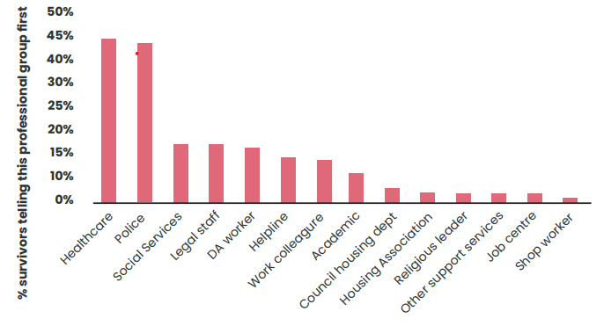
Why should we complete Routine Enquiry?
Victims-survivors are less likely to disclose abuse unless directly asked (Heron and Eisma, 2022)
Victims-survivors most often seek help from healthcare staff first (Feder et al.,2006; Domestic Abuse commissioner, 2022)
Evidence shows that screening improves detection of domestic abuse (Doherty et al., 2014) and when combined with training increases referrals to domestic abuse services (Feder et al, 2011).
NICE Guidance - PH50, recommends that mental health professionals routinely ask service users whether they have experienced domestic abuse even where there are no indicators of abuse
Notes:
Routine enquiry is essential for gaining a comprehensive understanding of patients’ needs, particularly in uncovering hidden or sensitive issues such as domestic abuse. It enables timely, tailored support and intervention.
Identification and support for domestic abuse is essential for effective mental health treatment and there is growing evidence of a link between domestic abuse and suicidality
Evidence shows that effective routine enquiry significantly improves the identification of domestic abuse (Doherty et Al, 2014)
Carlisle et al (2025) show that there a strong evidence base for domestic abuse advocacy and outreach services in the outcome of cessation of abuse at point of case closure.

Slide 7
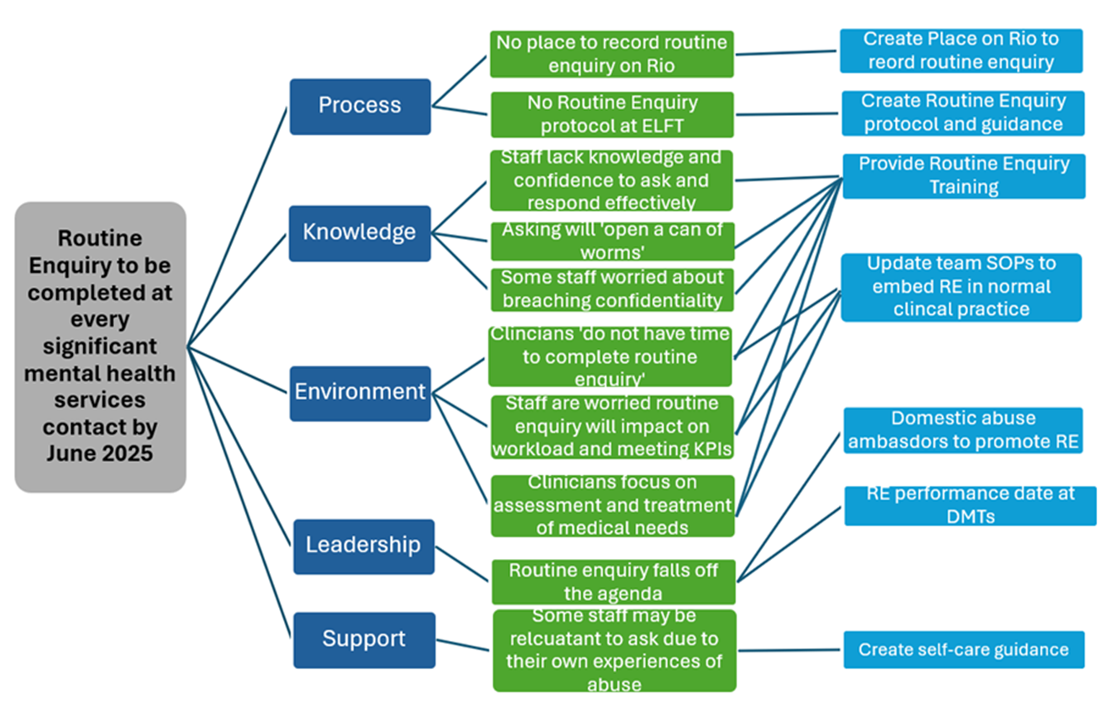
Why don’t staff complete Routine Enquiry
Aim
Primary Driver
Secondary Driver
Change Ideas
Notes:
This is a driver diagram for our QI project.
Through our project we have found there are five primary divers which underly why staff do not ask about domestic abuse.
1. Primary Driver – Process
Secondary Drivers under process:
No place or prompt on clinical system to complete routine enquiry
No protocol or guidance for staff on how to complete routine enquiry
2. Primary Driver – Knowledge
Secondary driver under Knowledge:
Staff lack knowledge and confidence in how to ask and respond effectively
Some staff feel asking will ‘open a can of worms’
Some staff worried asking and having to then breach confidentiality will impact their clinical relationship with the patient
3. Primary Driver – Environment
Secondary driver under environment:
Clinicians feel they do not have time to ask or asking and then having to deal with a disclosure will have too great an impact on their already limited time.
Staff are worried routine enquiry will impact workloads and meeting KPIs
Clinicians focus on assessment and treatment of what they view as more traditional ‘medical needs’.
4. Primary Driver – Leadership
Secondary drivers under leadership
Routine enquiry falls off the agenda
5. Primary Driver – Support
Secondary drivers under support:
- Some staff may be reluctant to ask due to their own experiences of abuse.

Slide 8
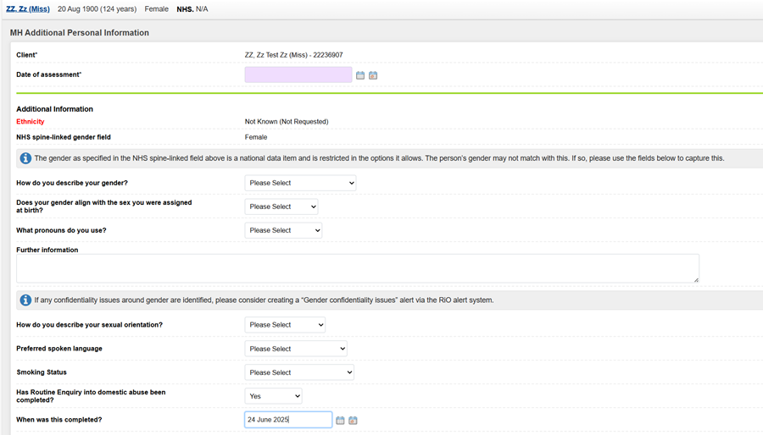
Change Idea 1 – recording routine enquiry on Rio
When you have completed routine enquiry into domestic abuse you must document the enquiry in the patient’s record as follows:
Navigate to the Client Demographic tab.
Start a new MH Additional and Personal Information form.
Scroll down to the routine enquiry box and complete the required fields.

Slide 9
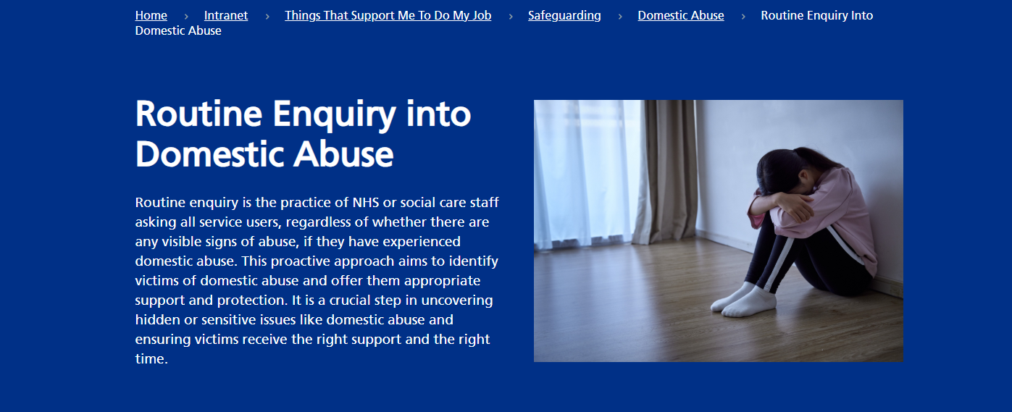
Change Idea 2 – create Routine Enquiry guidance
Routine Enquiry now has its own webpage on the Trust Intranet. This provides full information of why, when and how routine enquiry should be completed and where it should be recorded.
Notes:
https://www.elft.nhs.uk/intranet/things-support-me-do-my-job/safeguarding/domestic-abuse/routine-enquiry-domestic-abuse

Slide 10
The ELFT approach
ELFT has adopted a three-statement approach to routine enquiry:
Why we ask all patients
Limits of confidentiality
The Routine Enquiry Question
Notes:
After reviewing previous research and national reviews on routine enquiry in the NHS, the ELFT Safeguarding Team recommend a three-statement approach:
Why We Ask All Patients
Limits of Confidentiality
The Routine Enquiry Question
The third statement avoids using the term "abuse," recognising that many survivors may not identify their experiences as such. This ensures the enquiry is inclusive and accessible.
Routine Enquiry must take place in a safe and private environment.
Clinicians must ensure that the conversation happens in a private, quiet, and safe setting and not in an environment where others be it other patients or family members may overhear. Clinicians should always use professional interpreters rather than family members or friends to ensure accurate communication, maintain confidentiality, and avoid potential conflicts of interest or undue influence.

Slide 11
Why we ask all patients
Limits of confidentiality
The Routine Enquiry Question
We ask all our patients the following question because research shows that many people experience abuse at some point in their lives, which can impact their physical and emotional health. These questions are part of our routine check-ups to ensure we provide the right support and help to everyone, regardless of their situation.
I want to be clear that while we respect your confidentiality and keep your information private, there are situations where we are legally required to act. If we believe you or someone else is in immediate danger or at risk of serious harm, we may need to share information with the appropriate authorities to ensure safety. We will always discuss this with you and explain what steps will be taken, unless doing so would put you or others at greater risk.
Has anyone hurt you, made you feel bad, scared, or inflicted pain?
Notes:
Statement 1: Why We Ask All Patients
Suggested Phrase:
“We ask all our patients the following question because research shows that many people experience abuse at some point in their lives, which can impact their physical and emotional health. These questions are part of our routine check-ups to ensure we provide the right support and help to everyone, regardless of their situation.”
Alternative question if the patient does not appear to understand:
“We ask everyone this question because sometimes people go through difficult times, and it can affect how they feel or their health. We want to make sure we can help if you need support.”
Statement 2: Limits of Confidentiality
Suggested Phrase:
“I want to be clear that while we respect your confidentiality and keep your information private, there are situations where we are legally required to act. If we believe you or someone else is in immediate danger or at risk of serious harm, we may need to share information with the appropriate authorities to ensure safety. We will always discuss this with you and explain what steps will be taken, unless doing so would put you or others at greater risk.”
Alternative question if the patient does not appear to understand:
Our conversations are confidential and will remain private, but if I think you or someone else may be in danger or not safe, I might need to tell someone to help keep you safe. I will talk to you about this first unless it might put you in more danger.”
Statement 3: Routine Enquiry Question
For statement 3 we recommend using our primary question, to ensure consistency and good practice in how we ask about abuse. If the patient has difficulty understanding or we have specific concerns about a type of abuse we recommend trying one or more of the additional suggested questions.
Primary Question:
“Has anyone hurt you, made you feel bad, scared, or inflicted pain?”
Additional Suggested Questions for Context:
“Has anyone close to you ever made you feel afraid, controlled, or put down?”
“Do you feel free to make your own decisions, or does someone else try to control you, for example, how you spend money or who you can see?”
“Has anyone ever hurt you physically, such as hitting, pushing, or using force in any way?”
“Do you ever feel unsafe at home or around someone close to you?”
“Has anyone ever pressured you into something sexual that you didn’t want to do?”
“Do you feel comfortable saying no to sexual activity if you don’t want to participate?”
“Is anyone contacting you in a way that feels overwhelming, threatening, or unwanted?”
Alternative Questions (if the patient is unsure or hesitant):
“I know this might be difficult to talk about, but I want to check in with you. Has anyone in your life hurt you or made you feel unsafe?”
“Sometimes people go through challenging situations at home, and I want to make sure you’re okay. Has anyone made you feel scared or uncomfortable?”
“I’m asking because I want to help if there’s anything troubling you. Can you tell me if you’ve been hurt or made to feel afraid by someone?”

Slide 12
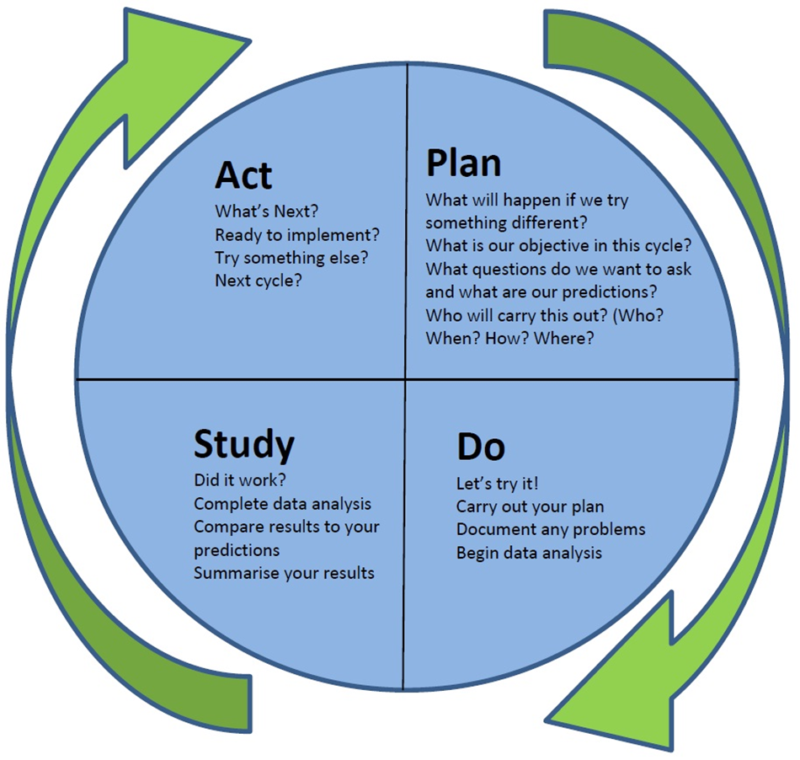
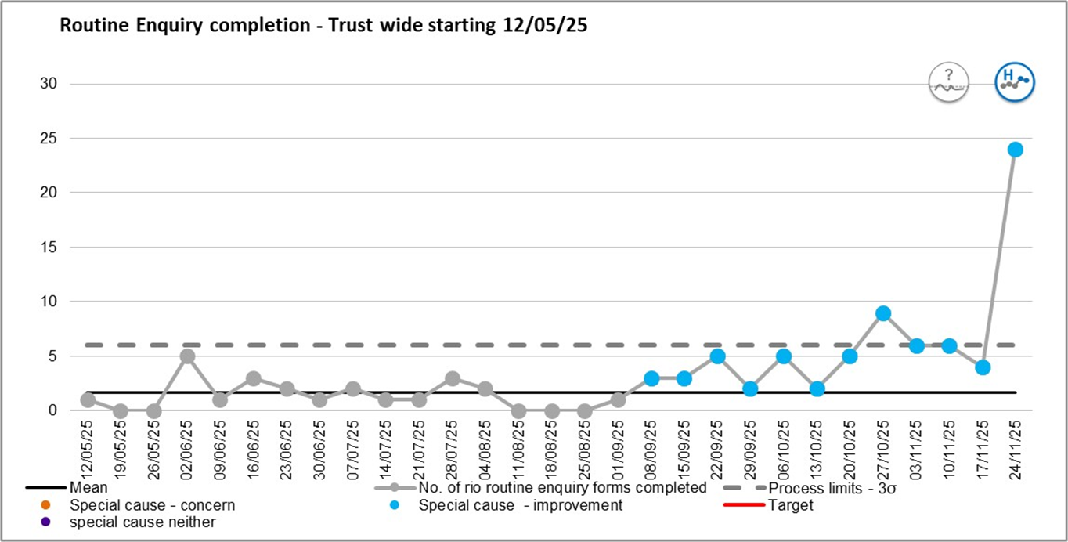
Change Idea 3 – Routine Enquiry Training
Currently delivering in the process of delivering routine enquiry training to every adult mental health team in the trust.
We aim to complete this by the end of March 2026 and are monitoring the effect of the training routine enquiry completion rates and domestic abuse InPhase reports.
RE guidance
RE training starts
Notes:
Routine Enquiry into Domestic Abuse | East London NHS Foundation Trust

Slide 13
Information on support services
Links to Domestic Abuse information in our main local authority areas:
City of London - Domestic Abuse information
London Borough of Hackney Domestic Abuse information
London Borough of Newham Domestic Abuse information
London Borough of Tower Hamlets - Domestic Abuse information
Bedfordshire Domestic Abuse Partnership - information
Luton Borough Council Domestic Abuse information
National Domestic Abuse information:
Forced Marriage Unit
Freephone 24-hour National Domestic Abuse Helpline - 0808 2000 247
Respect Men's Advice Line on 0808 8010 327 (Monday to Friday 10am to 8pm)
Galop - support LGBT+ people who have experienced abuse
Karma Nirvana - honour based abuse helpline on 0800 5999 247 (Monday to Friday 9am to 5pm)

Slide 14
References
Carlisle, S., Bunce, A., Prina, M. et al. Effectiveness of UK-based support interventions and services aimed at adults who have experienced or used domestic and sexual violence and abuse: a systematic review and meta-analysis. BMC Public Health 25, 1003 (2025). https://doi.org/10.1186/s12889-025-21891-5
Chandan JS, Thomas T, Bradbury-Jones C, Russell R, Bandyopadhyay S, Nirantharakumar K, Taylor J. Female survivors of intimate partner violence and risk of depression, anxiety and serious mental illness. Br J Psychiatry. 2020 Oct;217(4):562-567. doi: 10.1192/bjp.2019.124. PMID: 31171045.
Dalton TR, Knipe D, Feder G, et al. Prevalence and correlates of domestic violence among people seeking treatment for self-harm: data from a regional self-harm register. Emergency Medicine Journal 2019;36:407-409.
Doherty L J, Taft A, Hegarty K, Ramsay J, Davidson L L, Feder G et al. Screening women for intimate partner violence in healthcare settings: abridged Cochrane systematic review and meta-analysis BMJ 2014; 348 :g2913 doi:10.1136/bmj.g2913
Domestic Abuse Commissioner, 2022. A Patchwork of Provision: How to meet the needs of victims and survivors across England and Wales.
Feder GS, Hutson M, Ramsay J, Taket AR. Women exposed to intimate partner violence: expectations and experiences when they encounter health care professionals: a meta-analysis of qualitative studies. Arch Intern Med. 2006 Jan 9;166(1):22-37. doi: 10.1001/archinte.166.1.22. PMID: 16401807

Slide 15
References - continued
Feder G, Davies RA, Baird K, Dunne D, Eldridge S, Griffiths C, Gregory A, Howell A, Johnson M, Ramsay J, Rutterford C, Sharp D. Identification and Referral to Improve Safety (IRIS) of women experiencing domestic violence with a primary care training and support programme: a cluster randomised controlled trial. Lancet. 2011 Nov 19;378(9805):1788-95. doi: 10.1016/S0140-6736(11)61179-3. Epub 2011 Oct 12. PMID: 22000683.
Heron RL, Eisma MC. Barriers and facilitators of disclosing domestic violence to the healthcare service: A systematic review of qualitative research. Health Soc Care Community. 2021 May;29(3):612-630. doi: 10.1111/hsc.13282. Epub 2021 Jan 13. PMID: 33440034; PMCID: PMC8248429.
Knipe D, Gregory A, Dangar S, Woodhouse T, Padmanathan P, Kapur N, Moran P, Derges J. 'Once you've opened that can of worms': qualitative study to understand why liaison psychiatry staff are not asking about domestic abuse following self-harm. BJPsych Open. 2024 Oct 11;10(6):e177. doi: 10.1192/bjo.2024.779. PMID: 39391935; PMCID: PMC11536313.
Trevillion K, Oram S, Feder G, Howard LM. Experiences of domestic violence and mental disorders: a systematic review and meta-analysis. PLoS One. 2012;7(12):e51740. doi: 10.1371/journal.pone.0051740. Epub 2012 Dec 26. PMID: 23300562; PMCID: PMC3530507
Turnbull P, Hunt I, Woodhouse T, Monk H, Kapur N, Appleby L. Domestic violence and suicide in women under the care of mental health services in the UK, 2015–2021: a national observational study. The Lancet Regional Health – Europe, Volume 55, 101350

