Slide 1
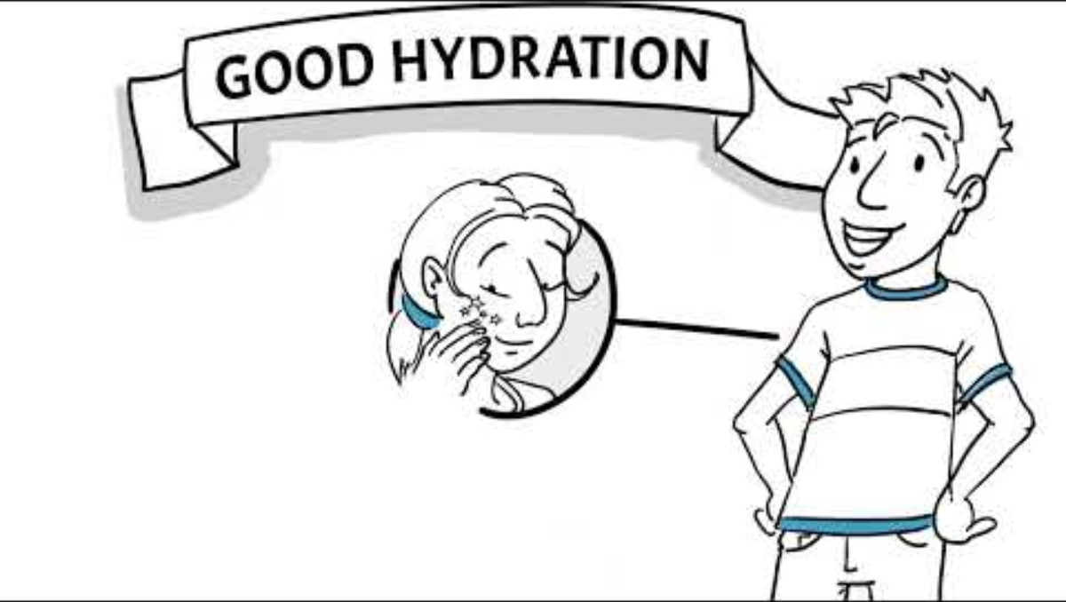
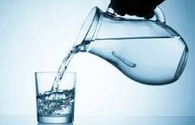
HYDRATION IN HEALTH

Slide 2
FLUID – Function
Body temperature regulation
Transports nutrients via blood
Breaks down food for absorption
Lubricates and cushions joints
Aids digestion and prevent constipation and UTI’s
Helps the kidneys and bowel to remove waste and toxins
Enables medication to be absorbed
Prevents dehydration

Slide 3
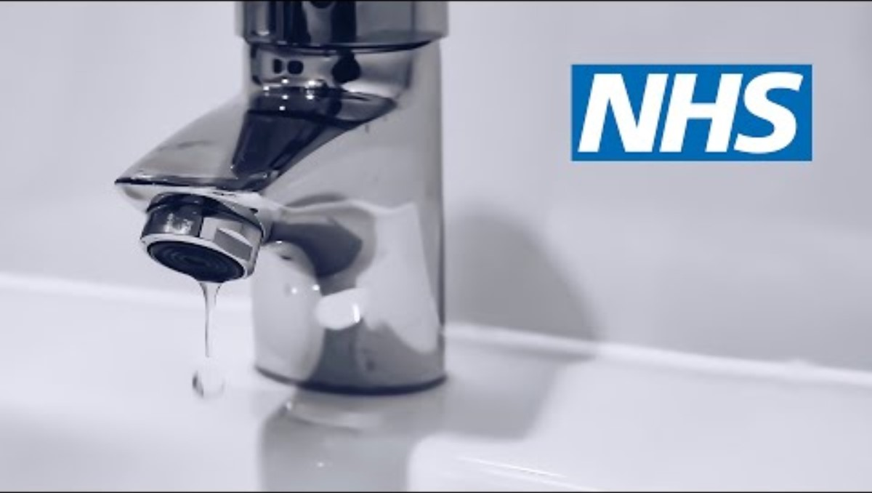
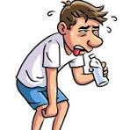
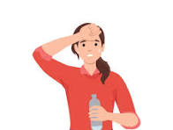
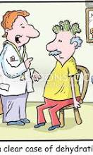
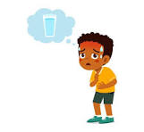
Signs and Symptoms of low fluid levels
Feeling thirsty
Headaches, dizziness and muscle cramps
Rapid heart rate (More than 100 beats/minute)
Poor concentration
Lethargy, feeling tired or irritable
Constipation – See slide notes for definition of constipation (NICE 2025)
Kidney stones and urinary tract infections (UTIs)
Dry skin, dry and sticky mouth, lips, tongue and sunken eyes
Peeing less often than usual
Dark yellow, strong smelling urine
Even mild dehydration can worsen irritability and reduce cognitive control.
Notes:
Constipation: Constipation is defined as having infrequent bowel movements, difficulty passing stools, or a feeling of incomplete emptying. This can mean having fewer than three bowel movements per week, passing stools that are hard, dry, or lumpy, straining during a bowel movement, or feeling like your bowels are not fully emptied.
Further information: https://cks.nice.org.uk/topics/constipation/background-information/definition/

Slide 4
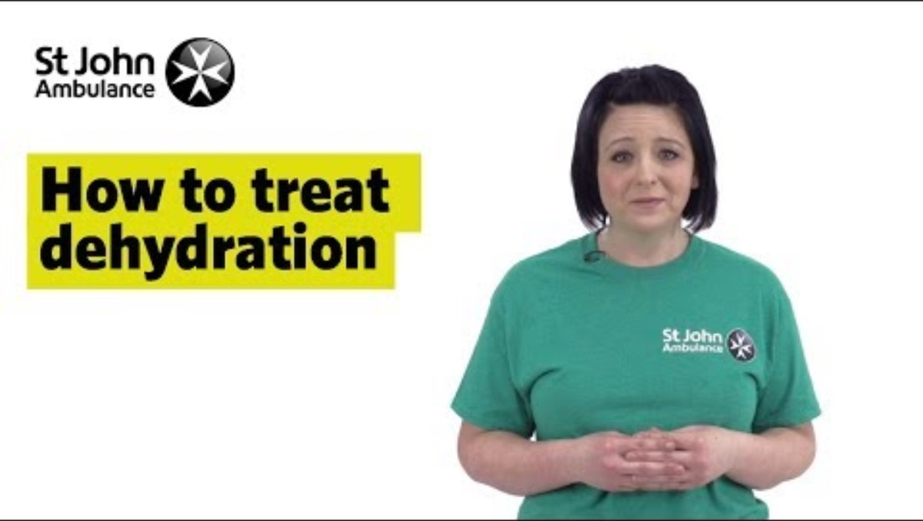

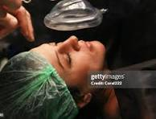
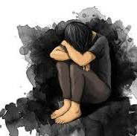
Risk
Service user groups at risk
Babies and children
Tranquilised patients
Patients in pain
Older Adults
Patients presenting with catatonia*, mania, depression, social withdrawal, confusion, acute psychosis, severe agitation, disorientation, communication needs.
Factors increasing dehydration risk
Vomiting, diarrhoea
High temperature
Intense and/ or prolonged exercise – e.g. walking for long periods
Exposure to heat (very hot bedrooms)
Alcohol
Chronic illness – Diabetes, cystic fibrosis, kidney disease
Immobility or restricted movement e.g. bedbound service users, service user in seclusion, service user with physical disabilities.
Poly pharmacy
Diuretic (furosemide) and antacids – always check labels
Chemotherapy drugs
Some antibiotics i.e. trimethoprim
*a neuropsychiatric syndrome where a person is awake but unresponsive to their environment, exhibiting abnormal movements or behaviours.

Slide 5

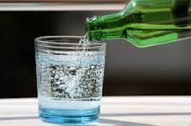
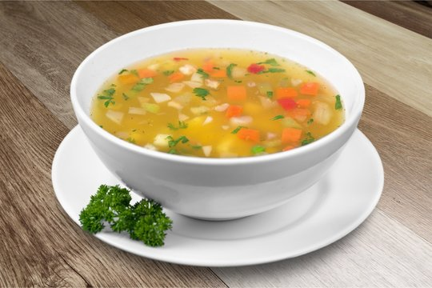
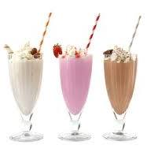
Food and drink to stay hydrated
Drinks provide 80% of daily fluid intake
WATER, still or sparkling - it is noted that not everyone likes to drink plain water.
No added sugar juice, squash, flavoured water, juice style drinks, sports drinks, fizzy drink.
Milk and diary alternative drinks.
Hot or cold tea, coffee, chocolate drinks – Choose low caffeine tea and coffee
Be mindful of regular consumption of high or addes sugar dinks e.g. fruit juice, fizzy drinks, milkshakes etc.
Food provides 20% of daily fluid intake
Broths, soups, jellies
Fresh fruits and vegetable e.g tomato, cucumbers, oranges, melons etc.
Ice popsicles

Slide 6
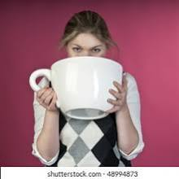
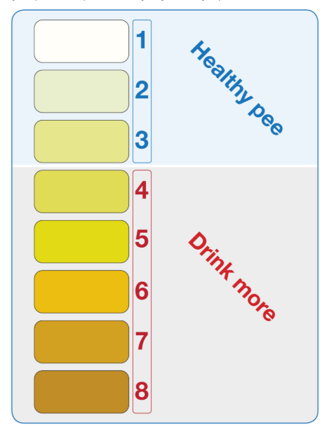
How much fluid does the body need
Drink 6 to 8 cups or glasses of fluid a day (1cup/glass = 250ml) (Eatwell Guide).
Monitor your urine colour, aim for clear pale yellow colour (NHS Inform)
You may need to drink more fluids if you're:
pregnant or breastfeeding
in a hot environment
physically active for long periods
ill or recovering from illness
Too much fluid
Drinking excessive amount of fluids can harm the kidneys and dilute the sodium content of blood causing Hyponatremia*.
Symptoms of Hyponatremia: headaches, cramp, fatigue, confusion, fatigue can lead to seizures.
*a medical condition where the concentration of sodium in the blood is lower than normal

Slide 7
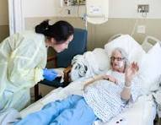
Tips on how to stay hydrated
Educate and raise awareness of dehydration risks amongst your patients
Easy access - Leave whole jugs of water etc. near the patient so that you can gauge how much has been drank, encourage patient to carry water bottles, ensure water fountains and hot water dispensers are in good working order. Leave water, cordial and squash drinks within easy reach
Set reminders and make it social - Encourage drink rounds, especially to patients who are bed bound, have water readily available at ward meetings, group activities, and appointments.
Make it enjoyable – Flavour water with fruit slices or berries, prepare soups, smoothies or juices. Jelly, ice cream, ice lollies, yogurt and fruit can be tempting when patients are not eating or drinking very well.
Little and often - Offer drinks with all meals, encourage small sips throughout the day.
Equipment - Offer straws or easily held vessels for patients with disabilities
Safety - Follow guidance to thicken fluids for those with swallowing difficulties
Intra-venous fluids maybe necessary for re-hydration.
Give a glass of water when giving medication

Slide 8
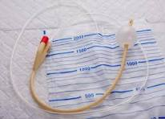

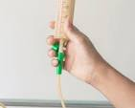
Food and fluid chart
What is a food and fluid chart?
A chart to monitor both nutritional intake (food) and hydration (fluids) for overall nutritional assessment.
When are food and fluid charts recommended?
Any patient at risk of dehydration or at medium or high nutrition risk (SANSI or MUST)
Bed bound patients
Fluid overload = too much fluid in the body tissues and blood
Vomiting
Diarrhoea
High temperature
Patient has catheter or drains
AKI – acute kidney damage – monitor renal function
Patients requiring tube feeding

Slide 9
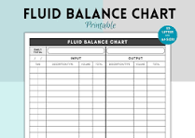
Fluid balance chart RMN or Doctor will prescribe when to use a paper chart
What is a fluid balance chart?
Fluid balance means that input and output are equal.
Fluid balance charts may need to be in place for short periods or throughout the patients stay.
Remember fluid includes all fluids e.g. soup, gravy, broth, smoothie, tea, coffee, milkshakes, nutritional supplement drinks etc.
Calculates fluid input against urine output
When are fluid balance charts prescribed?
To treat dehydration
To check your patient is drinking adequately
Check patients urine output
Monitor catheterisation, and urine bag output
Ensure kidneys are working well
Other
Check vital signs at least daily – low blood pressure = hypotension and rapid heart rate=tachycardia may indicate dehydration

Slide 10
Fluid balance chart
 | Fluid Balance Chart | Food and Fluid Chart
Purpose | To monitor a patient’s fluid intake and output to assess hydration status and detect fluid imbalance. | To monitor both nutritional intake (food) and hydration (fluids) for overall nutritional assessment.
Focus | Strictly on fluids only (oral, IV, urine output, vomit, etc.). | Includes food and drink, assessing both quantity and quality of intake.
Measurements | Recorded in millilitres (mL) for all inputs and outputs. | Food may be recorded as percentages eaten or portion sizes, fluids in mL.
Used For | Patients at risk of dehydration, fluid overload, renal or cardiac issues. | Patients requiring nutritional monitoring, e.g. poor appetite, eating disorders, or underweight.
Frequency of Recording | Hourly or every shift. Totalled every 24 hours. | At every meal and snack time, throughout the day. Totalled at the end of the day.
Who Completes It | Usually nursing staff, sometimes with input from medical team. | Nursing staff, support workers, or dietitians may complete collaboratively.
Outcome/Use | Helps guide clinical decisions on IV fluids, diuretics, etc. | Helps guide dietary plans and nutritional interventions.

Slide 11
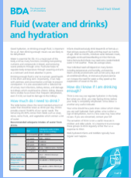

Resources
NHS Inform Hydration chart: https://www.nhsinform.scot/campaigns/hydration/#:~:text=Signs%20of%20dehydration%20include:%20*%20Dark%20and,particularly%20with%20a%20fever%2C%20vomiting%2C%20or%20diarrhea
British Dietetic Association Fluid and hydration: https://www.bda.uk.com/static/ae2e9a5c-81b2-4507-81457ba68e72ffbf/BDAFluid-and-hydrationFINAL-0325-003.pdf
NHS Hydrate to Feel Great Easy Read Information about drinking more: https://www.sussex.ics.nhs.uk/wp-content/uploads/sites/9/2025/06/ERUK-v2s-UPDATE-My-hydration-plan.pdf

Slide 12


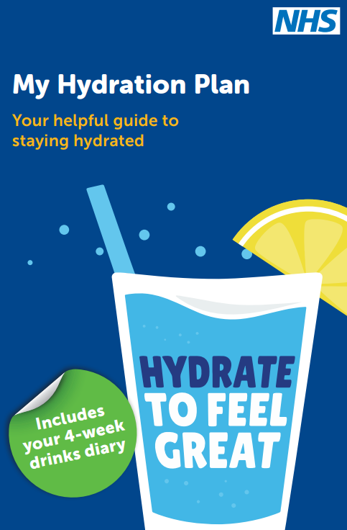
Resources
British Nutrition Foundation - Hydration: https://www.nutrition.org.uk/nutritional-information/hydration/
Abbott Hydration and Mental Health: https://www.nutritionnews.abbott/healthy-living/diet-wellness/Hydration-and-Mental-Health--How-Are-They-Related/
NHS My Hydration plan and drinks diary: https://www.sussex.ics.nhs.uk/wp-content/uploads/sites/9/2025/03/My-hydration-plan.pdf

