Slide 1
How do we ensure all services are of high quality and safe:
CQC framework
Presenters:
Claire McKenna, Chief Nurse, ELFT
Dr David Bridle, Chief Medical Officer, ELFT

Slide 2
CQC Briefing
CQC are the regulator for health and social care in England. They measure 5 key questions to understand services quality and safety. They do this through inspection.
The last two times CQC have inspected us, they have inspected our inpatient mental health services.
Are they safe?
Are they effective?
Are they caring?
Are they responsive?
Are they well led?

Slide 3
The Key Questions and Statements
SAFE
Learning Culture
Safe systems, pathways and transitions
Safeguarding
Involving people to manage risks
Safe environments
Safe and effective staffing
Infection prevention and control
Medicines optimisation
EFFECTIVE
Assessing needs
Delivering evidence-based care and treatment
How staff, teams and services work together
Supporting people to live healthier lives
Monitoring and improving outcomes
Consent to care and treatment
CARING
Kindness, compassion and dignity
Treating people as individuals
Independence, choice and control
Responding to people’s needs
Workforce, wellbeing and enablement
RESPONSIVE
Person-centred care
Care provision, integration, and continuity
Providing information
Listening to and involving people
Equity in access
Equity in experiences and outcomes
Planning for the future
WELL–LED
Shared direction and culture
Capable, compassionate and inclusive leaders
Freedom to speak up
Governance and assurance
Partnerships and communities
Learning, improvement and innovation
Environmental sustainability
Workforce, equality, diversity and inclusion

Slide 4
Types of Evidence
People’s experience
Phone calls, emails received by CQC
Feedback from staff and leaders
Results from staff surveys and feedback from staff to their employer
Feedback from partners
Commissioners
Interviews with people and local organisations who represent them or act on their behalf survey results
Feedback from the public and people who use services obtained by community and voluntary groups, health and care providers and local authorities
Individual interviews or focus groups with staff
Interviews with leaders
Other local providers
Professional regulators
accreditation bodies
Royal colleges
Multi-agency bodies
Observation
Most observations will be carried out on the premises by CQC inspectors and Specialist Professional Advisors (SpAs)
Processes
Examples: findings and learning from safety incidents, access times for treatment and care, case note reviews of people's care or clinical records
Outcomes
Staff training
Waiting times
Use of restraint
Use of out of area beds

Slide 5
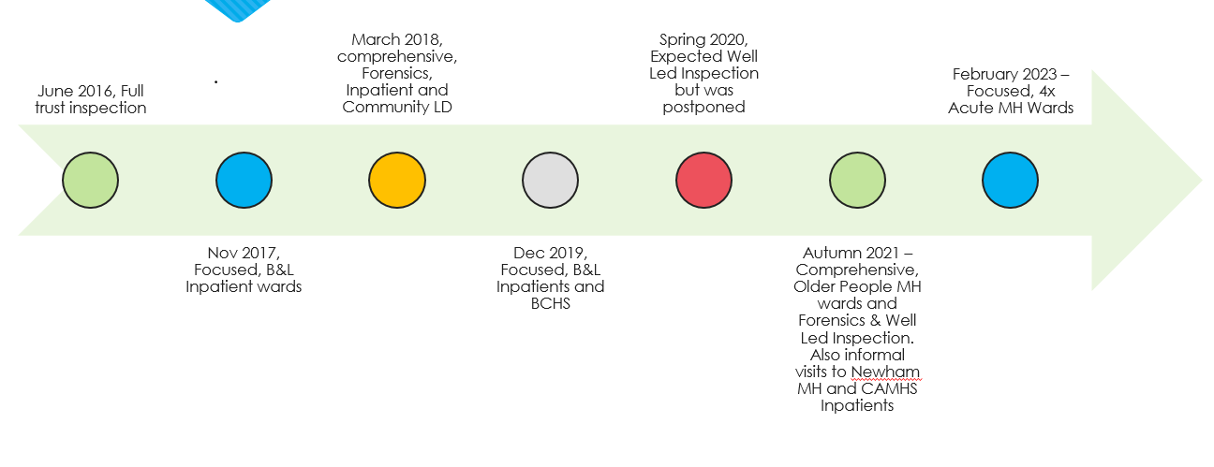
Trust’s History of CQC Inspections

Slide 6
Feedback from CQC Visits 2025/26
What’s going well?
Kind Caring Staff
Teams well managed with innovation (QI)
Focus on equity for communities
Areas to work on
Variation
Consistency of physical health monitoring
Environment

Slide 7
CQC Well-Led
What is the purpose?
Having good leadership enables better care for patients, a better experience for staff and a more sustainable health and care service.
A ‘Well Led inspection’ aims to assess the leadership of the Trust and check the Trust is well-led, well-governed, and focused on safe, high-quality care.

Slide 8
Shared Direction & Culture
Freedom to speak up
Workforce equality, diversity and inclusion
Capable, compassionate, and inclusive leaders
Governance, management and sustainability
Partnerships and communities
Learning, improvement and innovation
Environmental sustainability
Notes:
Shared Direction & Culture - We have a shared vision, strategy and culture. This is based on transparency, equity, equality and human rights, diversity and inclusion, engagement, and understanding challenges and the needs of people and our communities in order to meet these.
Capable, compassionate, and inclusive leaders - We have inclusive leaders at all levels who understand the context in which we deliver care, treatment and support and embody the culture and values of their workforce and organisation. They have the skills, knowledge, experience and credibility to lead effectively and do so with integrity, openness and honesty.
Freedom to speak up - We foster a positive culture where people feel that they can speak up and that their voice will be heard.
Workforce equality, diversity and inclusion - We value diversity in our workforce. We work towards an inclusive and fair culture by improving equality and equity for people who work for us.
Governance, management and sustainability - We have clear responsibilities, roles, systems of accountability and good governance to manage and deliver good quality, sustainable care, treatment and support. We act on the best information about risk, performance and outcomes, and we share this securely with others when appropriate.
Partnerships and communities - We understand our duty to collaborate and work in partnership, so our services work seamlessly for people. We share information and learning with partners and collaborate for improvement.
Learning, improvement and innovation - We focus on continuous learning, innovation and improvement across our organisation and the local system. We encourage creative ways of delivering equality of experience, outcome and quality of life for people. We actively contribute to safe, effective practice and research.
Environmental sustainability - We understand any negative impact of our activities on the environment and we strive to make a positive contribution in reducing it and support people to do the same.

Slide 9
Beyond CQC
CQC framework provides a helpful approach to ensuring quality
CQC inspections bring a helpful lens at a point in time
What really matters is an ongoing focus on quality and safety on a day-to-day basis, all the time
‘CQC preparation’ is time well spent on improvements – need to ensure these are sustained
Relevant to both clinical and non-clinical staff and services
To do this, local and widespread ownership of quality and safety is important and necessary

Slide 10
Menti Question
What approaches and mechanisms have you found useful to ensure that quality and safety issues are continuously focused on and addressed/improved as far as possible within your team/work setting?
Please share what works well for you with others here.

