Slide 1







Children’s
Physiotherapy
Universal Training

Slide 2
Children’s Physio
Children’s physiotherapists work with children to help them develop and learn. They support patients who have multiple issues such as cerebral palsy, developmental delay and syndromes. They use their understanding of child development to provide effective treatments.

Slide 3
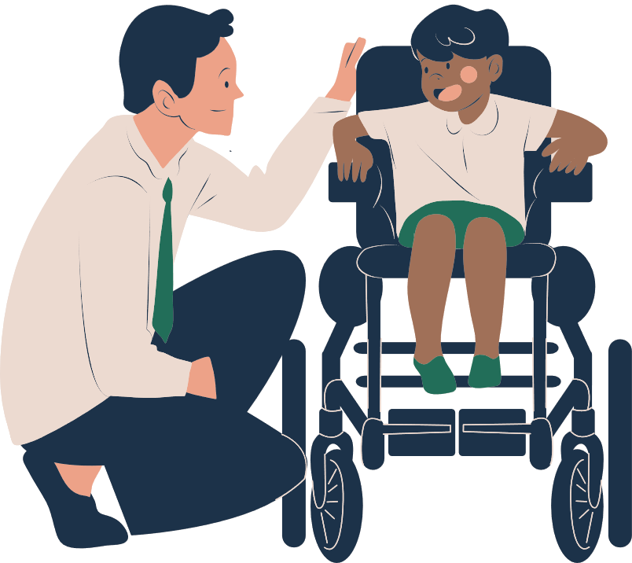
Who are we?
We are the Children’s Physiotherapy team and are responsible for the treatment and care of babies, children and young people from birth to 19 years.

Slide 4

Who and why do we see children at school?
Some children require support with movement and posture to help them access the curriculum.
We see all children with such needs, who attend a Newham school.

Slide 5

Question
What is your role?
Carry out equipment and exercise programmes
Your input into physiotherapy reviews and treatment sessions are essential.
Part of the team

Slide 6
Conditions we come across
Cerebral Palsy
Developmental Delay
Downs Syndrome
Muscular Dystrophy
Spina Bifida
Arthritis

Slide 7
Conditions we come across
Hypermobility
Brain Injury
Epilepsy
Childhood Stroke
Scoliosis
Spinal Deformity

Slide 8

Question
What is muscle tone and how does it affect posture?
Basically means ‘muscle tension’
Too much or too little involuntary tension can make restrict movement and the ability to maintain posture

Slide 9
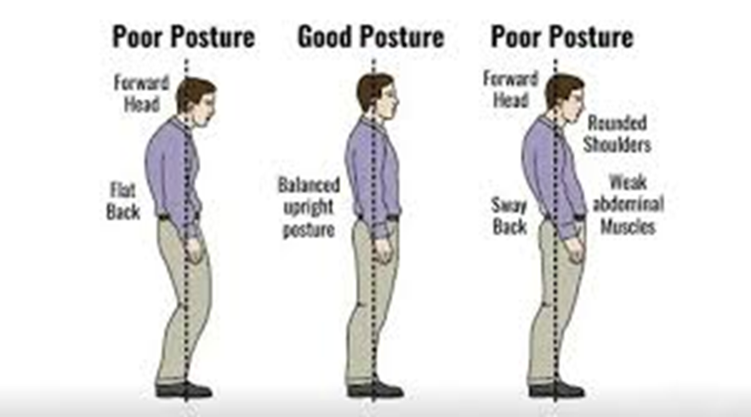
What is
posture?
Posture simply refers to the position of our body segments in any given space. For most of us, it is continually interchanging.

Slide 10
Movement disorder can cause:
Muscles stop being stretched and become tight.
Development of muscle and joint deformities.
Reduction of
movement and lack of postural variety.

Slide 11
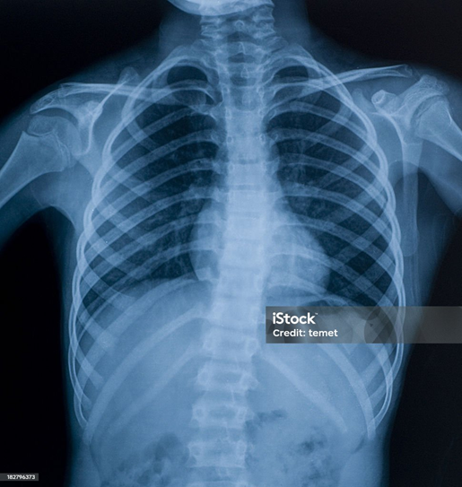
Links between positioning and deformity
Children with limited movement often adopt habitual, compensatory positions.
These limited positions together with the way gravity reacts on the body can cause the body to become ‘stuck’ in that position.

Slide 12
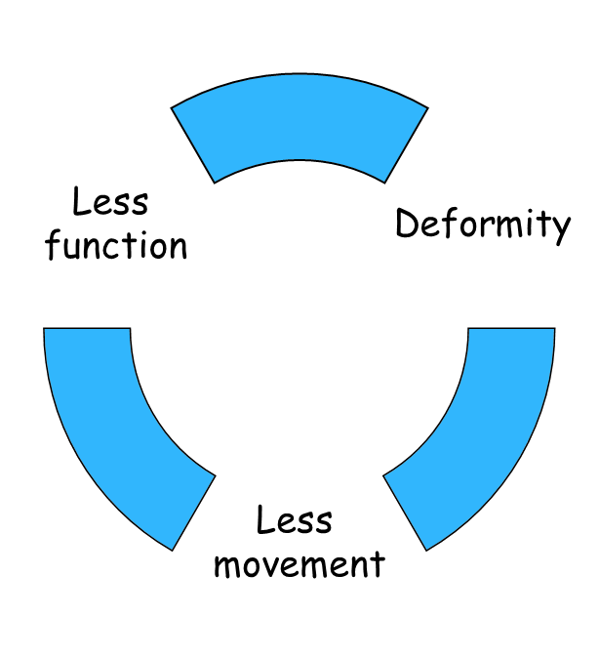
Link between deformity and movement
A negative cycle occurs when a child has a deformity because they are unable to move, which causes further contractures and deformity.

Slide 13
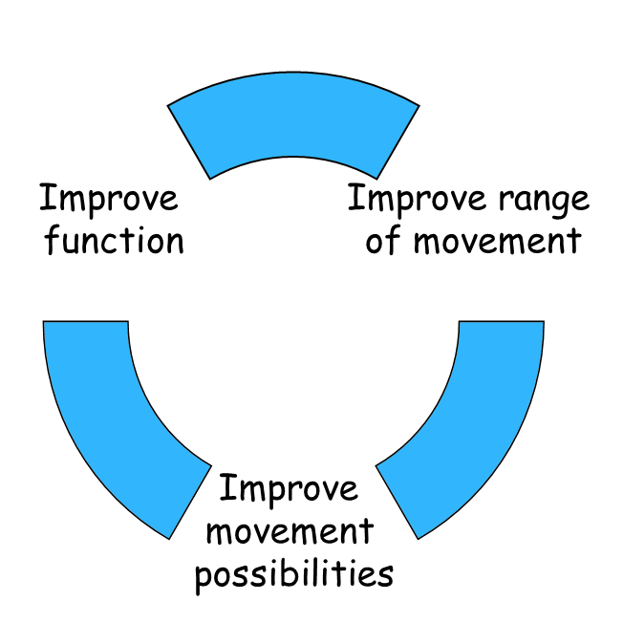
Link between movement and function
Physiotherapy aims to improve or maintain movement of the joints and muscles to give the child the best scope for movement, thereby improving their functional ability.

Slide 14
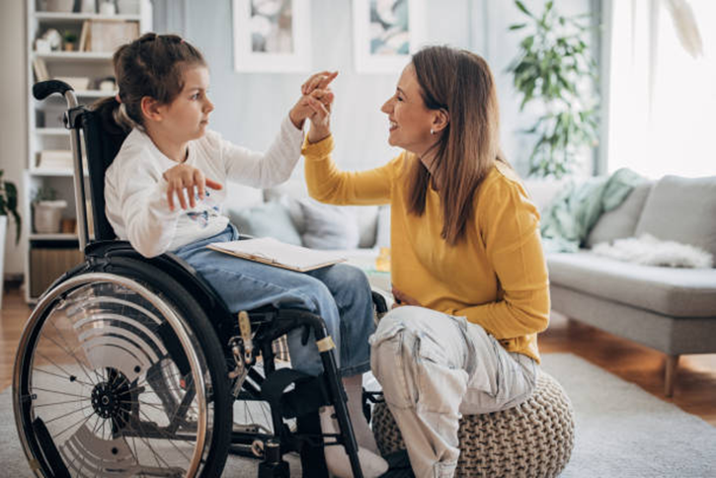
What can we do about it?
Design a Positioning program to help access play and school curriculum e.g. long sitting or lying on the tummy on a wedge

Slide 16
Equipment to support mobility and posture
Children’s Physiotherapy Team | Children’s Occupational Therapy Team | Wheelchair Services
Standing Frames Walkers Leg and Foot Splints Gaiters | Seating systems Hand splints | Wheelchairs

Slide 17
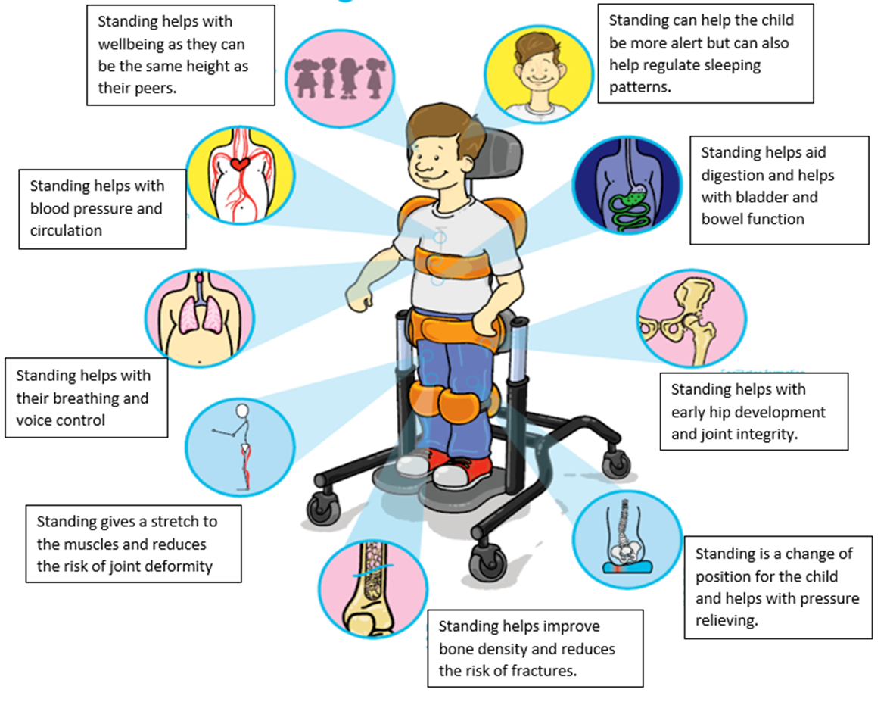
Standing
frames

Slide 18
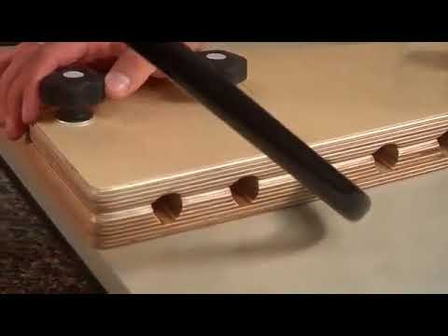
How to check if Standing frame is outgrown?
*Is the child upright and not slouched over the tray?
*Is the child’s spine straight and not bending to the side?
*Are the knee blocks just under the knee cap?
*Are their hips and knees straight and not bent?
Video guide: https://www.youtube.com/watch?v=FiTiSROoNEs

Slide 19
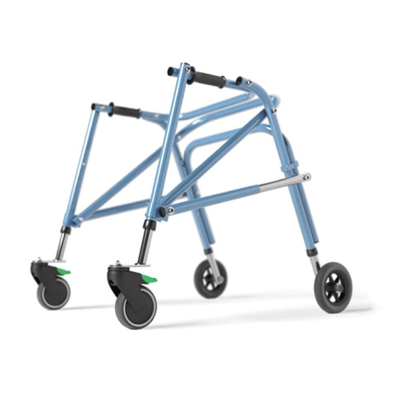
Helps with blood pressure and circulation
Walkers
Is very good cardiovascular activity.
Improves bone density and reduces the risk of fractures
Helps with early hip development and joint integrity
Walking helps with wellbeing as child can access different areas of the school with their friends during playtime
Helps the child be more alert and can help regulate sleep patterns
Helps with muscles stretch and reduces the risk of joint deformity
Walking aids digestion and helps with bladder and bowel functions
Change of position helps with pressure relief
Helps with breathing
Helps with balance

Slide 20
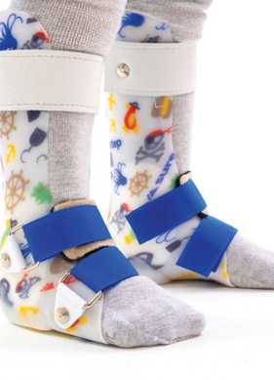
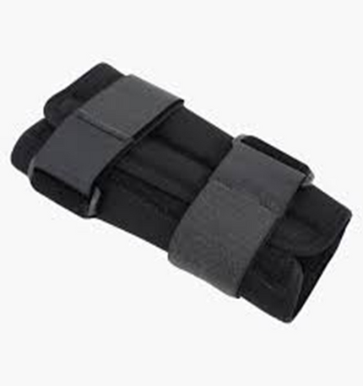
Orthotics
Ankle foot Orthosis
Gaiters

Slide 21
Alternate
positioning
It is important that every child changes their position every 2 hours.
Positioning program will be provided by Physiotherapist for appropriate child. Physiotherapist will train school staff to perform it and how to use equipment safely.

Slide 22
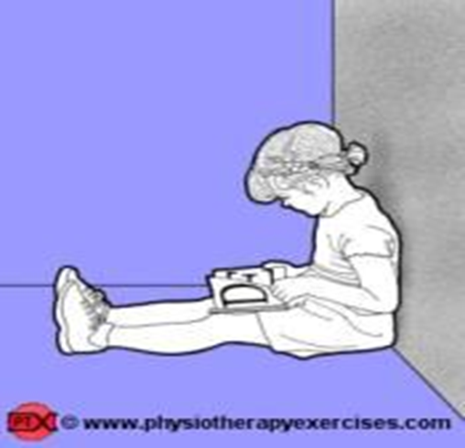
Commonly used positions:
Long sitting
-Helps stretching the muscles behind your knees.
-Strengthens your core muscles.

Slide 23
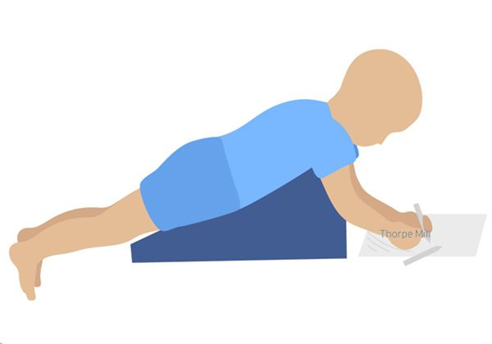
Prone lying over a wedge or pillows
-Helps stretch the front of your hips and knees.
-Helps stretch the spine.
-Helps with strengthening the neck muscles and neck control.

Slide 24
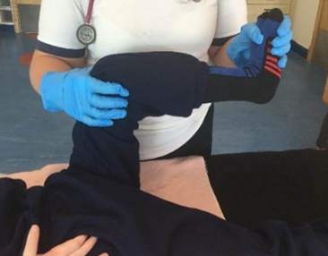
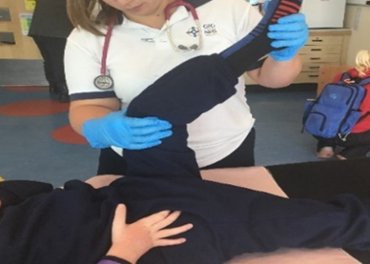
Gentle stretching exercises
Hamstring stretch:
Hold the knee and the ankle so the leg is bend to 90 degrees. Now gently straighten the knee, whilst keeping the thigh in place. Hold for 10-30 counts. Repeat 5-10 times on each side.

Slide 25
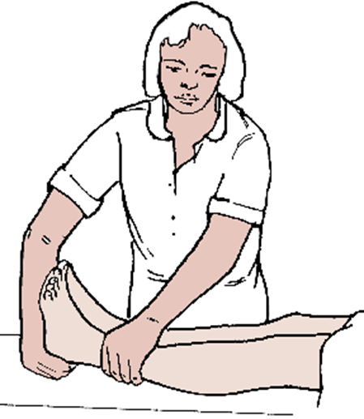
Gentle stretching exercises
Ankle stretch:
Hold the foot with your hand keeping the knee straight. Now stretch the ankle so the foot come up. Hold for 10-30 counts. Repeat 5-10 times on each side.

Slide 26
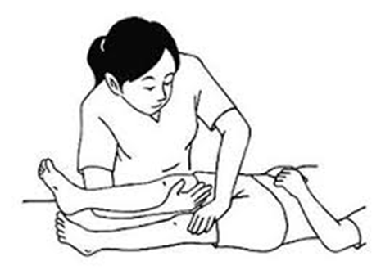
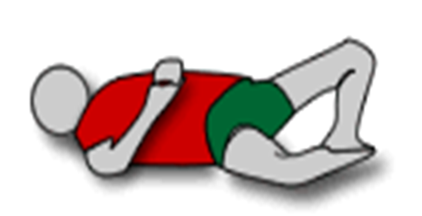
Gentle stretching exercises
Hip muscle stretch:
Open up the legs into a butterfly position, like you might do when changing a nappy. Hold for 10-30 counts. Repeat 5-10 times on each side.

Slide 27
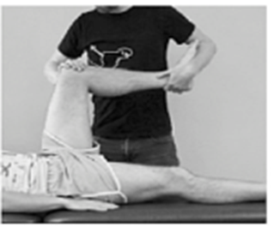
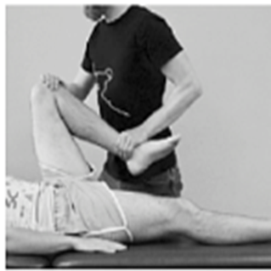
Gentle stretching exercises
Glute stretch:
Gently bend one hip and knee up to their tummy, while gently holding the other leg down.

Slide 28
Modification of PE at school
All children must participate in PE. PE must be modified for children who may not be able to participate in all activities
e.g. Use a larger ball for ball activities, children can sit in their wheelchair or stand with their walker to play football.

Slide 29

When to
contact us?
We review the children every 3-6 months depending on their needs and provide treatment blocks to some children to work on a particular skill or strengthening.
We can be contacted at:
Children’s Physiotherapy Department
West Ham Lane Health Centre
84 West Ham Lane
Stratford
E15 4PT
Tel 02085866380

Slide 30
Thank you for listening

