Slide 1


AI Trust Talk Live
Hosted by
Philippa Graves CDO
Edwin Ndlovu COO
February 25th, 2026

Slide 2



Types of AI – Capability & Functional
1. Narrow AI ( Weak AI) This is the only AI type in real-world use today. It is designed for a specific task and cannot generalize beyond its training. Examples include ChatGPT, Alexa, Google Maps, and Netflix’s recommendation engine. Narrow AI excels in its domain but fails outside it.
2. General AI ( Strong AI) A theoretical AI that could match human intelligence across diverse tasks, transferring knowledge between domains and reasoning in unfamiliar contexts. No AGI exists yet, but it remains a major research goal.
3. Superintelligent AI (Artificial Superintelligence) A hypothetical AI surpassing human intelligence in all areas—scientific creativity, emotional understanding, and decision-making. It raises significant ethical and safety considerations and is not yet realized.
4. Reactive Machines A functionality-based type with no memory—it reacts only to current inputs. It cannot learn from past experiences. Example: Basic spam filters. Useful for fixed, rule-based decision-making.
5. Limited Memory AI The most common functional type today. It uses historical data plus current inputs to make better decisions. Examples: self-driving cars, predictive analytics, and chatbots. It improves over time but does not store long-term experiential knowledge.
6. Generative AI – is a specialised subset of AI focussed on new content.

Slide 3

Feedback from the big conversation
Digital requirements:
  Resilient + joined-up systems
  Training and support
  Simpler systems design
  Accessible single source of truth
  Streamlined workflows & admin
  AI tools & decision support

Slide 4

Fit for the Future: 10-year Health Plan for England
The 10-year plan is built around three major shifts:
From hospital to community
From analogue to digital
From sickness to prevention
AI will enable these strategic changes by:
Free up clinical time via automated documentation
Improve referral triage and risk assessment
Enable early intervention through predictive analytics
Support 24/7 mental health support via virtual agents
Extend community care via remote monitoring
Improve outcomes through personalised care plans
Enhance patient navigation through the NHS App
Strengthen quality & safety systems
Accelerate integration of health and social care
Empower staff with AI training and role redesign

Slide 5
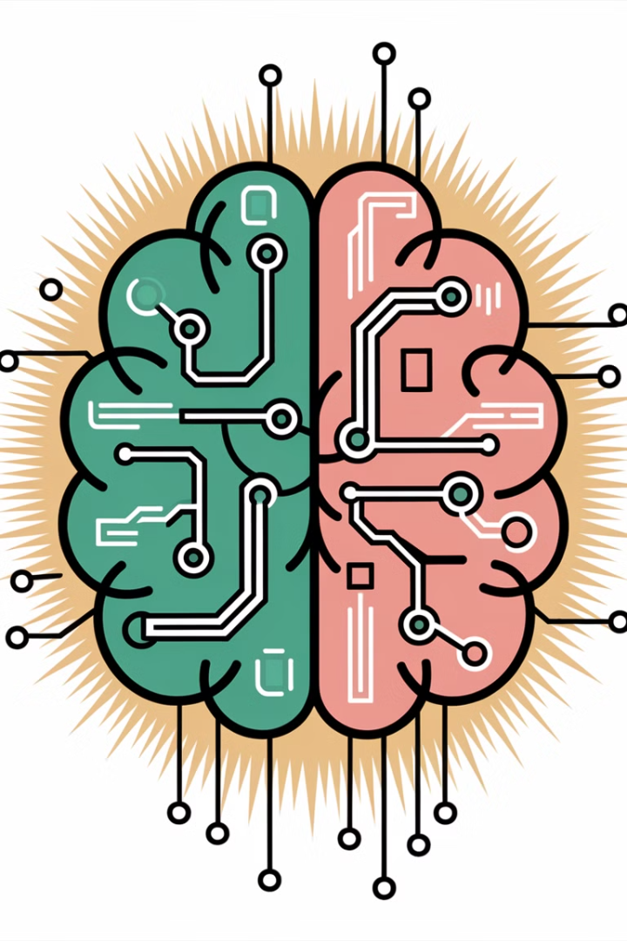


ELFT AI Journey
What is Generative AI?
Gen AI is specialized sub-set of AI focused on creating new content, such as text, images, music or code. It creates outputs leveraging large language models.
Advantages – unique and personalized content, enhances productivity by automating tasks such as summarizing documents or drafting emails and is adaptive as it continuously refines its output based on feedback.
Limitations – its creations are based on data it was trained on and there are ethical concerns about the ownership and authenticity of generated content. It may also produce misleading or biased outputs.

Slide 6

Ask the audience – Mentimeter code xxxxxx
Q1. What do you think AI will do for you in your role?
Q2. What AI tools are you using now and to do what?

Slide 7
ELFT AI Journey
Foundations
Governance
Strategy
National Guidance
Collaboration
Horizon Scanning
Business Change
Current Initiatives
Non-clinical meeting summaries
Non-clinical GenAI
Clinical Ambient Scribe Technology
Scoping Use Cases
Translation
Non-clinical GenAI expansion
Potential Future Use Cases
Clinical Decision Support
Conversational AI and Digital Therapists
Population Health and Risk Stratification
Remote Monitoring and Digital Phenotyping
Research and Clinical Trials
Staff Support and Burnout Prevention

Slide 8
What are the opportunities for us?
Streamline Processes
Enhanced Analysis & Forecasting
AI automates tasks, reduces errors, and provides real-time insights.
AI enables predictive analytics and scenario modeling for more informed decision-making.
Data-Driven Decision Making
Fraud Detection and Risk Management
AI aggregates and analyzes large datasets, providing actionable insights for strategic planning.
AI identifies anomalies, detects fraud, and helps assess and monitor financial risks.
Improved Reporting and Compliance
Expense and Cost Management
AI automates financial statements, legal work, tax filings and regulatory reports, ensuring compliance.
AI categorizes expenses, identifies cost-saving opportunities, and optimizes procurement.
Strategic Decision Support
Workforce Productivity
AI assists in evaluating mergers, acquisitions, investments, and simulating market trends.
AI reduces time spent on routine tasks, allowing teams to focus on strategy.

Slide 9

Benefits vs Cost - the Hype Cycle
Whilst the potential benefits of successful and careful AI implementation could be transformative, we must balance these with the costs & benefits we will realise.
Whilst many of the tools available currently may claim to be ‘free’ these versions do not include sufficient safety processes to be used for clinical care or ‘hidden costs’ of use.
Enterprise level solutions are expensive – the average price of ambient scribe products cost around 6x the cost of a clinical system licence annually. To roll out these products effectively we must focus on implementing them where the most benefit will be realized to justify such a significant investment.
We also need to consider the sustainability costs of implementation as AI has a significant environmental footprint, driven by high electricity consumption, water usage and hardware demands, which contribute to carbon emissions and ecological strain.

Slide 10
What are the risks?
Data Privacy & Security Concerns
Model Bias and Errors
Handling sensitive data in AI systems increases the risk of breaches and leaks.
AI models trained on biased or incomplete data can produce misleading results, eroding trust.
Over-Reliance on Automation
Integration Challenges
Excessive reliance on AI can erode human judgment and lead to undetected errors in processes.
Legacy systems may struggle to integrate with modern AI tools, requiring significant upfront costs and effort.
Regulatory and Compliance Risks
Job Displacement and Skills Gap
AI systems may not fully align with regulatory requirements, exposing companies to legal penalties.
AI automation may lead to job displacement, requiring significant reskilling efforts for professionals.
Environmental Impact
Resistance to Change
Large-scale AI implementation can increase energy consumption and carbon footprints.
Employees may resist adopting AI solutions, slowing down the transition to AI-driven work. This is an opportunity for development approached informatively.

Slide 11
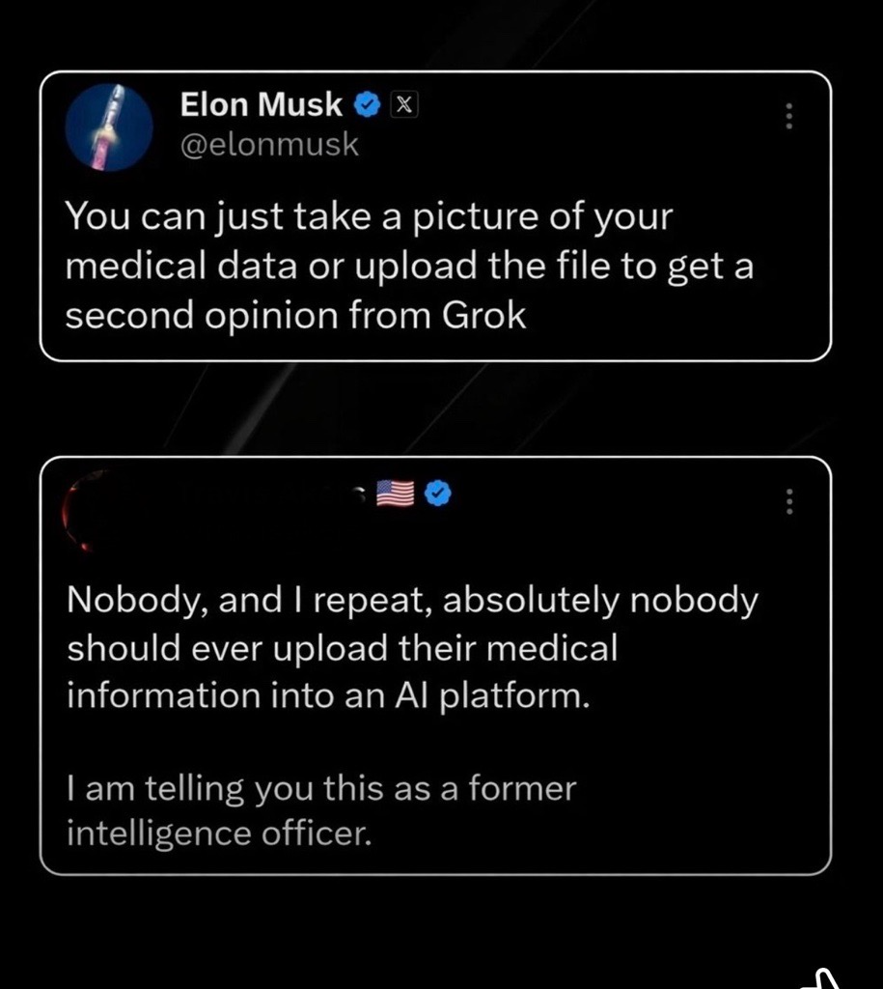
Thought for the day

Slide 12
Working with AI is hard
2 Core AI skills:
AI Prompting
Write effective prompts for a variety of complex situations
AI Checking
Check answers and discard below-standard AI work
Doing this well takes effort, training and practice

Slide 13
Staff survey on feedback about AI
To fully understand the Trusts requirement, we ran a survey to try and capture user's feedback and feelings about AI. This will help to ensure that any future use of these tools is shaped by the needs of ELFT staff and patients. There were 6 key themes:
Meeting & Task Management
Note-taking during meetings and populating action points.
Keeping track of priorities and tasks.
Drafting agendas and writing minutes.
Collating statistics and authenticating information.
Administrative Tasks
Locating documents on shared drives.
Using templates for letters and emails.
Drafting emails that could be automated.
Managing repetitive tasks like pathway changes and medication info.
Communication & Correspondence
Answering and managing emails (including sending attachments individually).
Writing letters and clinic correspondence.
Booking appointments and calling patients for assessments.
Responding to psychology referrals and general inquiries.
System & Data Management
Inputting notes into RIO and SystmOne.
Searching clinical records for relevant details (e.g., medical history, complaint investigations).
Reviewing notes for redactions before access requests.
Checking data entry accuracy and chasing incomplete tasks.
Documentation & Reporting
Writing reports (assessment, discharge, clinic letters).
Documenting care plans and meeting notes.
Writing patient notes after reviews or assessments.
Inputting outcome measures and questionnaires.
Progress notes and transcribing clinical information.
Challenges & Observations
Reading large volumes of clinical information.
Investigating complaints (time-consuming).
Frustration with repetitive admin tasks and editing letters.

Slide 14
Current AI Initiatives
Non- Clinical Meeting Summaries – initial pilot of MS Teams Intelligent Recap functionality conducted with 21 users. DPIA approved in preparation of wider roll out. Guidance drafted. 200 licences purchased for roll out to admin staff across the trust.
Non-Clinical GenAI – Copilot Chat for the NHSmail national tenant enabled. DPIA approved. Comms to all users. Sharing of national training resources. Limited to in browser or teams access not full M365 copilot functionality.
Clinical Ambient Scribe Technology – working on commercials with several vendors to conduct localised pilots. Small initial cohort to confirm benefits case and guidance. MHRA approval confirmed and use of NHSE approved supplier list for selection.

Slide 15
What is Intelligent Recap?
Microsoft Premium is an add-on license to enhance the standard Teams experience. The ‘Intelligent Recap’ functionality provides AI features such as meeting summaries, real-time translation, and advanced protection, enabling better engagement in staff meetings.
Key Features of Intelligent Recap
Meeting Summary: An Automatic summary of the discussion topics and key decisions made
Action Items: AI Identifies the key tasks assigned to each participant and automatically generates a to-do list
Benefits
Automatically generates summary meeting notes, which must be reviewed and edited to ensure the context and summary is accurate prior to being reshared with the group
Reduces admin time spent generating meeting notes and summarising actions
Overall summary of meeting is available within 15mins of the meeting ending
Participants can focus on the meeting rather than taking notes to improve engagement
The use of intelligent recap and the action list provides participants with subject headers and notes captured, enabling them to quickly assimilate the context and review the main points
Auto note taking can reduce stress for the staff chairing meetings

Slide 16
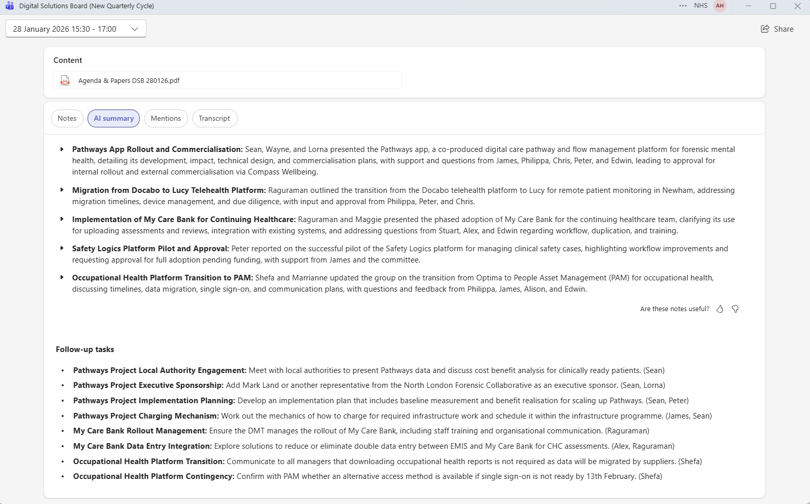
Example of Intelligent Recap from Digital Solutions Board

Slide 17
What is Copilot Chat?
Copilot Chat is an AI chat tool built specifically for work. It uses the latest AI models and data from the web to answer your questions, generate content and ideas, and find information. You can even upload a file from your computer to have AI analyse and transform your content.
It is protected by the same security and governance measures as your nhs.net email and files in Microsoft 365 and does not store data or share your information.

Slide 18
What are the benefits of Copilot Chat?
Boosts productivity – Quick answers, task automation, and time-saving support
Enhances writing – Helps draft, edit, and polish content fast
Supports creativity – Great for brainstorming ideas and creating content
Aids learning – Explains complex topics clearly and helps with research
Adapts to you – Learns your style and works across topics
Multilingual – Communicates in many languages

Slide 19
Practical examples for using Copilot Chat
Rewrite text in Plain English “Rewrite this text in clear, simple Plain English for frontline staff:[paste your text].”
Turn rough notes into a structured summary “Turn these rough notes into a tidy summary with headings and bullet points:[paste your notes].”
Draft a professional email “Write a polite, professional email explaining: [insert purpose]. Keep it friendly and concise.”
Create a step‑by‑step guide “Create step‑by‑step instructions for how to [insert task], written for someone new to the process.”
Make a checklist “Create a simple, clear checklist for [task or activity] that staff can follow.”
Turn information into a poster or notice “Create text for a friendly poster reminding staff to [insert behaviour, task, or reminder].”
Summarise a long policy or guidance document “Summarise this HR/IT/Estates policy in 5 bullet points for busy staff:[paste policy text or upload full document].”
Plan a team meeting agenda “Create a 45‑minute meeting agenda on [topic], including timings and outcomes.”
Draft welcome / orientation information “Write a friendly welcome message explaining what happens when someone arrives at our service.”
Brainstorm improvement ideas “List practical ideas for improving [environment / process / communication] in a _______ service .”
Create a communication plan “Draft a communication plan for informing staff about [change/event], including key messages and channels.”
Turn text into an FAQ “Turn this information into a short FAQ for staff or service users:[paste text].”
Generate training materials “Create a short training handout explaining how to use [tool/process], with bullet points and a simple structure.”
Help prioritise workload “Sort these tasks into ‘urgent’, ‘this week’ and ‘nice to have’:[paste your tasks].”

Slide 20
Ambient Voice Technology (Ambient Scribe)
How it works:
Device with microphone is used to capture the spoken conversation which is converted into text clinical notes
The AI tool summarises the information into a pre-defined template and/or letter
Clinician must act as the ‘human in the loop’ to review and approve the content of the summary before sending to EPR or creating letter

Slide 21

Ambient Voice Technology (Ambient Scribe)
Key questions:
What benefits do we expect?
    productivity, wellbeing, safety, data quality
How do we choose which AI tool is best for ELFT?
    not ‘one size fits’ all, differing maturity and focus of different systems
    integration into EPR is key
How do we make sure it’s safe?
    cyber, IG, clinical safety assurance
    careful at-scale implementation only, not ad hoc use
How do we make it work for your services?
    Commitment to standardise documentation to enable AVT templates which work across ELFT services

Slide 22

Where are we looking next?
Translation – potential for a replacement for traditional interpreter models – limited marketplace currently – multiple languages required across varying geographies – use case for sign language – challenging to keep the human in the loop without linguistics expertise.
Non-Clinical GenAI – Full Copilot pilot has been concluded by the NHSmail national tenant and report shared. Refinement of use cases locally needed to justify the benefits case. Small local pilot will be needed to test potential use cases.

Slide 23
Potential Future Initiatives Pipeline
Clinical Decision Support - AI tools assist clinicians in diagnosing, monitoring, and predicting mental health conditions using patient data, including EPRs and wearable data.
Conversational AI and Digital Therapists - AI chatbots and virtual agents provide low-intensity psychological support, CBT-based interventions, and triage.
Population Health and Risk Stratification - AI analyses population-level data to identify at-risk individuals and optimise resource allocation.
Remote Monitoring and Digital Phenotyping - AI analyses data from wearables, smartphones, and digital interactions to monitor mental health in real time.
Research and Clinical Trials - AI accelerates mental health research by identifying trial candidates, analysing outcomes, and simulating interventions.
Staff Support and Burnout Prevention - AI tools support NHS staff mental health and workload management.

Slide 24

What should we look at next? – Mentimeter code xxxx
Question 3.
What do you think we should be investigating next for AI use cases in the trust?

Slide 25

Process for new AI requests & More information
Send an email to elft.digitalpio@nhs.net
Discovery meeting booked to understand requirements
Request reviewed against existing use case matrix
Funnelled through the clinical review group
Added to the AI roadmap
Launched today on the ELFT Intranet
ELFT GenAI guidance
GenAI refers to Artificial Intelligence tools capable of producing new content, including images, text, and audio.
Click here to see a summary of ELFT’s guidance on the use of GenAI, along with access to the full guidance document.

Slide 26
AI Q & A Time with our panel

