Slide 1
CEO Discussion Group
National Staff Survey Results 2025
March 2026
V1

Slide 2
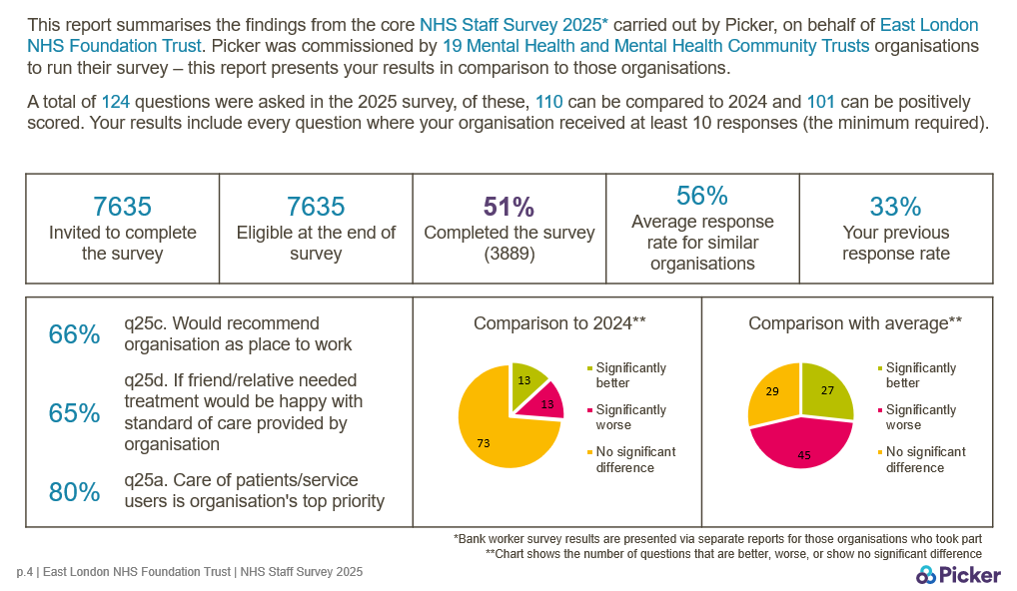
NHS SS 2025 – March 2026
Notes:
The National NHS Staff Survey 2025 took place during October and November 2025. As with previous years, we used the provider Picker to conduct the survey. We have recently received the results and I’ll provide a high level analysis over the next few slides.
There are 19 mental health and community Trusts in our comparator group.
We received a 51% response rate, an increase of 18% since last year’s survey which is phenomenal.
The 2 recommendation questions….
Compared to 2024, we did significantly better in 13 questions, but significantly worse in 13 questions too.
In 27 questions we did significantly better than our comparator group, and significantly worse in 45 questions which isn’t great.

Slide 3
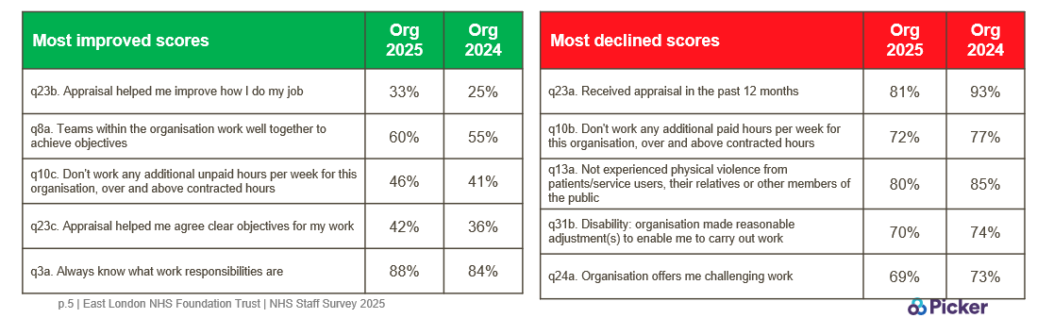
NHS SS 2025 – March 2026
Notes:
Using a summary table provided by Picker, these are the 5 most and least improved questions when compared to only ELFT answers from 2024.
Even though these are most & least improved, it’s still important to recognise the scores. It can be a poor score in the green column and a good score in the red.
Read off the slide starting on the left, green.

Slide 4
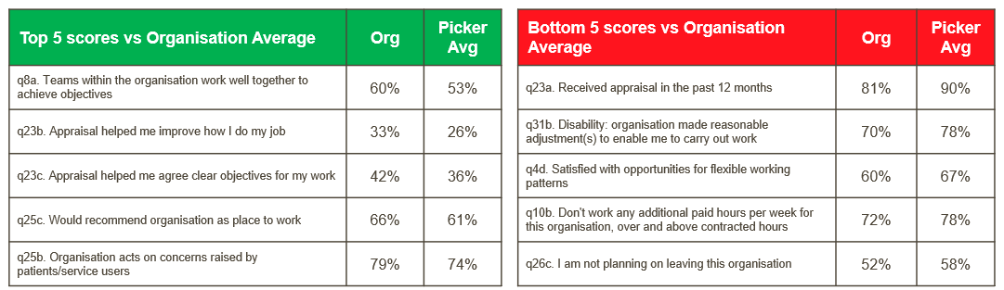
NHS SS 2025 – March 2026
Notes:
Again, using a summary table provided by Picker, these are the 5 questions that came out better & worse when compared to other Trusts in our comparison group.
Again important to note the scores.
Read green column then red.

Slide 5
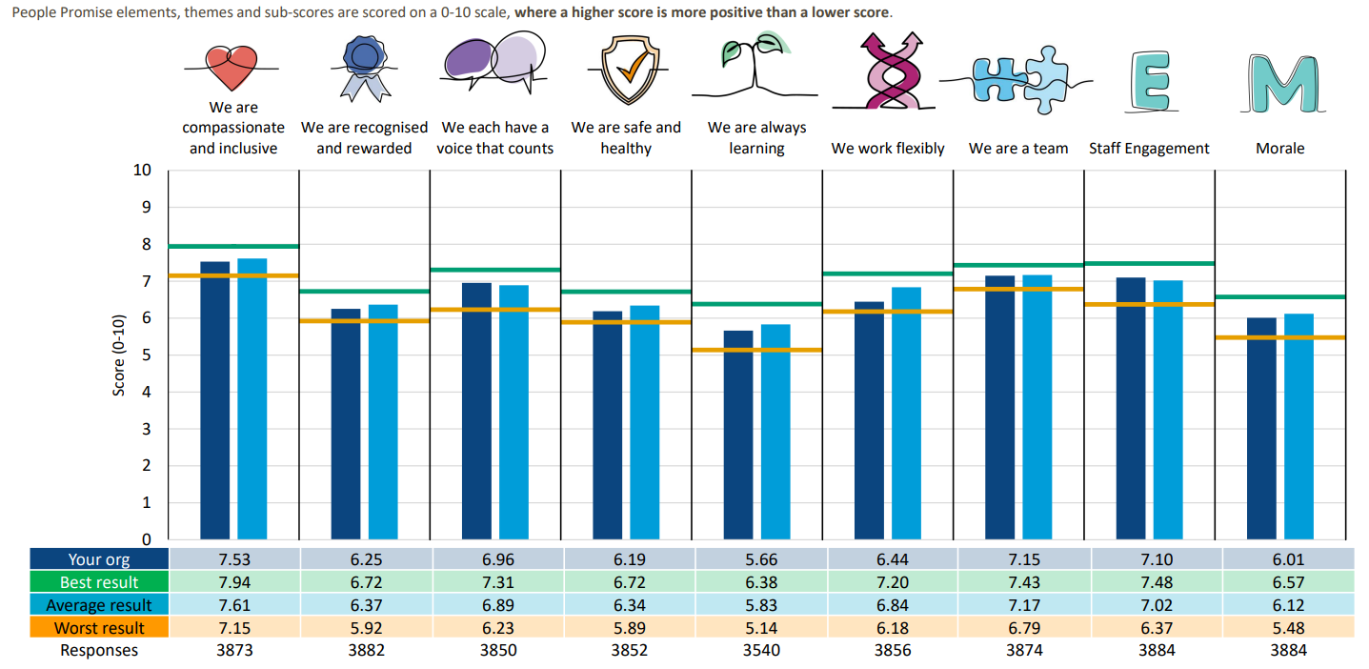
NHS SS 2025 – March 2026
Notes:
Staying with the comparison against other Trusts, all 124 survey questions have been placed into 9 themes based on the NHS People Promise elements.
So we are the dark blue column, the average in our comparator group is the light blue column, the horizontal green line is the best result in our comparator group and the orange horizontal line is the worst score in the group.
Across the People Promise questions, for the most part, the Trust response is slightly below the national average barring 2 elements. These elements are 1) we each have a voice that counts and 2) staff engagement.

Slide 6
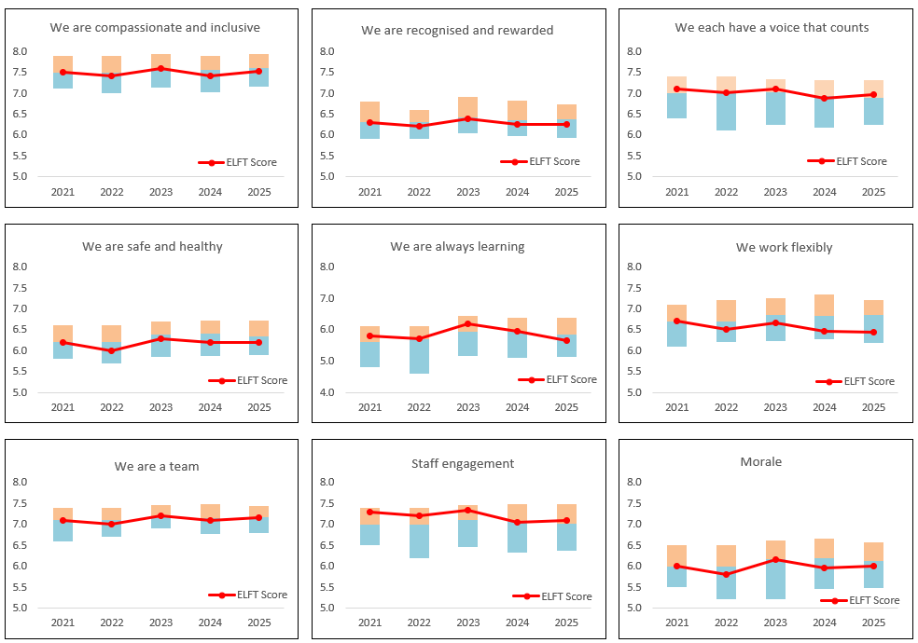
NHS SS 2025 – March 2026
Notes:
Thanks to the QI team, we now have an additional analysis of the People Promise elements based on ELFT’s trend over the past 5 years that the People Promise elements have been around.
Since last year we have increased in compassion & inclusion, each have a voice that counts, we are a team, staff engagement & morale
Stayed fairly consistent in recognised and rewarded, safe & healthy,
And declined in always learning and working flexibly.
The orange blocks showcases those organisations in our comparator group that score above average, the blue are those below. For most parts you can see ELFT trends along the average line, perhaps barring staff engagement.

Slide 7
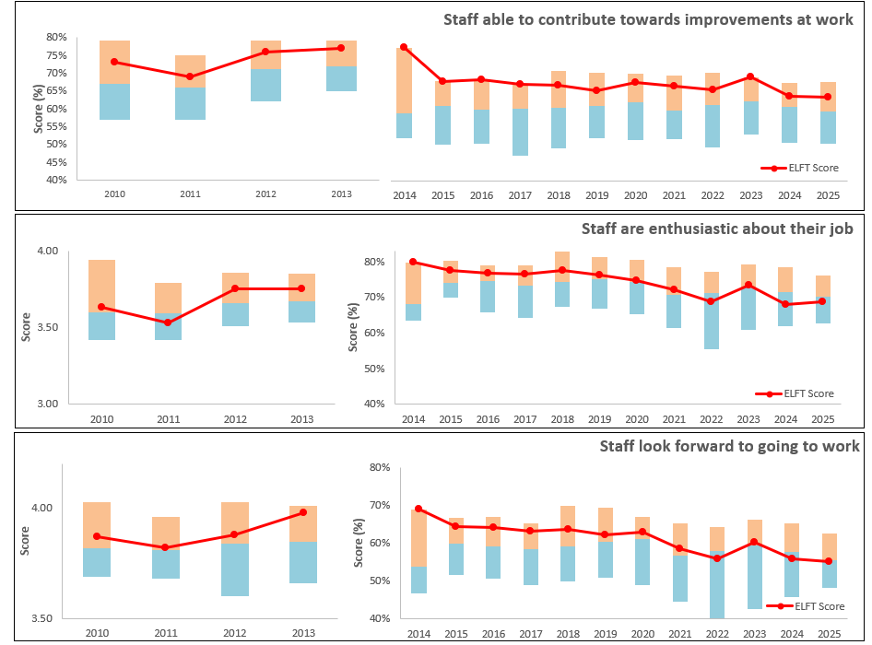
NHS SS 2025 – March 2026
Notes:
If we look over a longer trajectory, from 2010, specifically for these 3 questions, staff are able to contribute towards improvements at work, staff are enthusiastic about their job and staff look forward to going to work. The first question has stayed fairly consistent, whilst we have seen a gradual decline in the other 2 over the years.

Slide 8
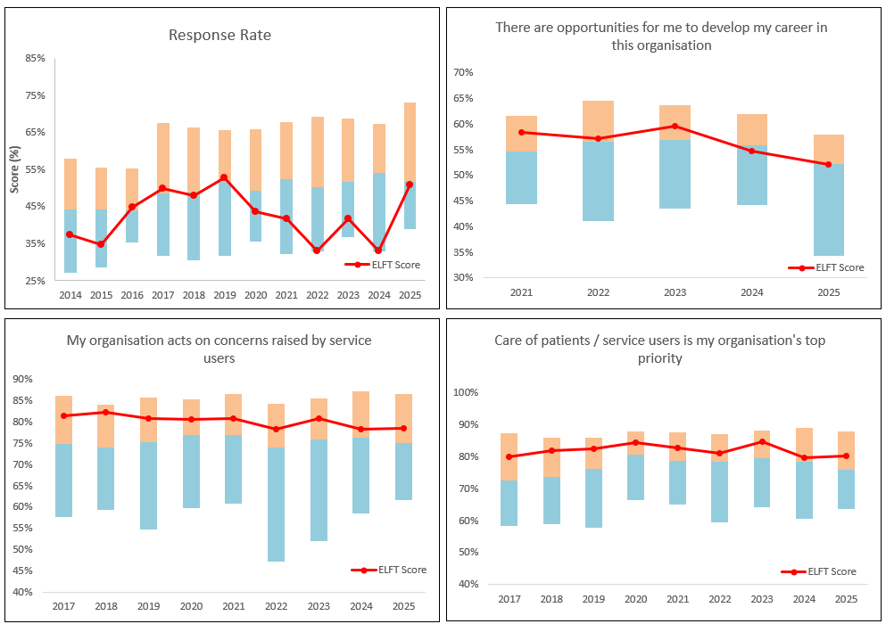
NHS SS 2025 – March 2026
Notes:
Again looking at a few other important trajectories. Response rate has been a bit all over the place the last 10 years. A large declining factor would have been covid, and then we have struggled to pull this back up again, until this past year we were are now much closer to the national average. And that was hugely due to all your involvement.
If we look at if there are opportunities for me to develop in my career, that has declined slightly over the last 5 years.
And the organisation acting on concerns raised by service users as well as the care of service users bring a top priority for ELFT have remained fairly consistent and above the national average for the past 10 years.

Slide 9
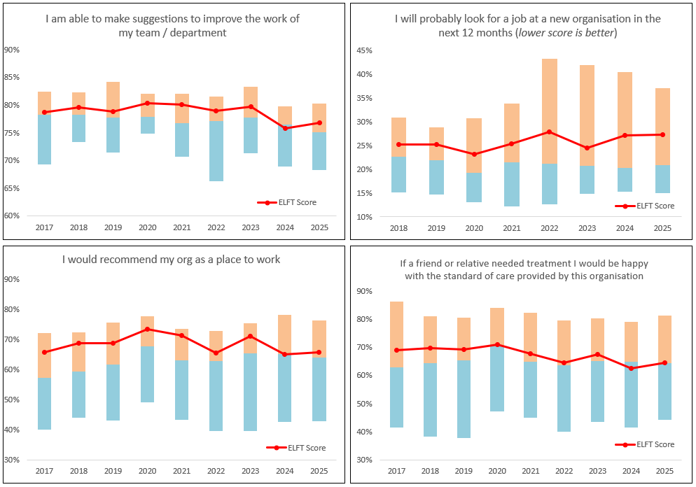
NHS SS 2025 – March 2026
Notes:
And the last 4 questions that we’ll look at over a 10 year curve.
Able to make suggestions to improve work in my team/department. Stable with an ever so slight decline over the last 2 years.
Staff looking for another job in the next 12 months. Has increased slightly in the last 2 years, which in this case, isn’t a good sign.
And the 2 recommendation questions, recommending ELFT as a place to work and a place to received care have remained fairly consistent, again perhaps a slight decline in the last 2 years.

Slide 10
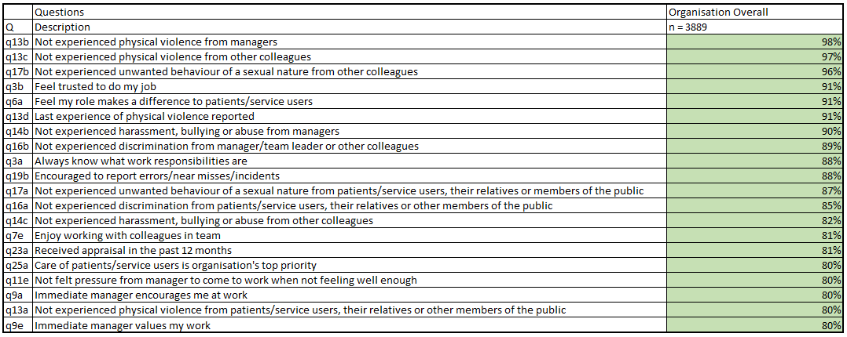
NHS SS 2025 – March 2026
Notes:
These last 2 slides are quite interesting in that they show our top 20 scoring questions overall. I used to only show top 10, but I feel that you get more insight into a top 20. I will leave this here for you to read through for a couple of minutes.

Slide 11
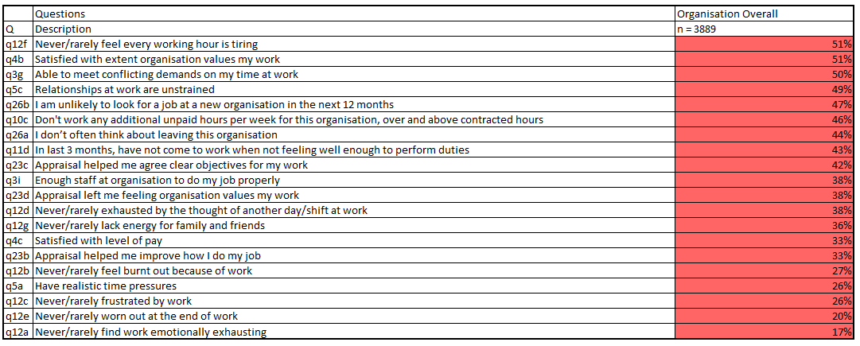
NHS SS 2025 – March 2026
Notes:
And again for our lowest scoring questions from the survey.

Slide 12
NHS SS 2025 – March 2026
The Staff Experience Programme will begin reviewing the 2025 staff survey data through the Data & Intelligence Workstream, with a particular focus on Trust-wide survey themes.

Slide 13
NHS SS 2025 – March 2026
Question 1: How can your team use insights from the staff survey to guide day-to-day decisions that will meaningfully improve future staff survey outcomes (beyond just increasing response rates)?
15 minutes discussion | 15 minutes feedback

Slide 14
NHS SS 2025 – March 2026
Question 2: Looking across the staff survey results, are there any key themes or areas where the Trust should focus its efforts to drive improvement in 2026? What approaches or structures might you put in place to make this actionable?
15 minutes discussion | 15 minutes feedback

