Slide 1

Reporting Good Events on InPhase

Slide 2
GOOD EVENT
The Trust implemented NHS England’s LFPSE reporting requirements November 2023, one key innovation was to enable the reporting of Good Care events.
NHSE define “Good Care” ; An example of good care that can be learned from.

Slide 3
Key Aspects of "Good Care" in LFPSE
Purpose: To build a proactive safety culture by identifying and sharing successful practices, rather than focusing solely on errors.
Learning Opportunity: These events represent examples of positive practice that can be studied and applied across the NHS to enhance patient safety.
Context: Unlike patient safety incidents (which involve unexpected or unintended harm), good care events are documented to understand and replicate excellence in care delivery.
Reporting: GOOD is one of the four key types of data recorded in the LFPSE system, alongside incidents, risks, and outcomes.

Slide 4
What to report on the good event form?
Positive learning opportunities, sharing experiences or learning from things that have gone well whilst delivering care.
Consider the following points;
How could this excellence be amplified or recreated in the future?
What were the strength of care, or service delivery points at which something went particularly well in the care of the patient?
What worked well?
How will you share the learning?
What can ELFT do to support you and your team embed this good practice across the organisation?

Slide 5
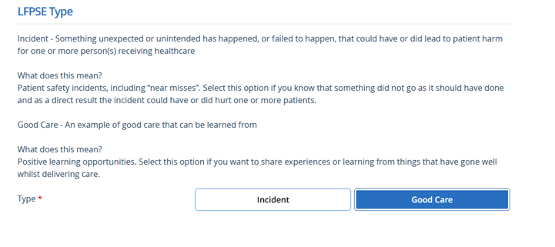
How to access the good event form? Simply select Good Care from the LFPSE Incident Form.

Slide 6
A Good Care event is a positive learning opportunity from care events that have gone well whilst delivering care to and for patients
Important to note this should not be confused with compliments or Greatix.
Example published by NHSE
“pioneering the adoption of elastomeric devices to facilitate early discharge of patients on antibiotics. Since their introduction at the beginning of the year, these devices have saved 1750 bed days for a total of 120 patients, with no increase to the number of readmissions in comparison to the baseline. Further evaluation on satisfaction and outcomes is being carried out and the evidence will be shared with the ICB”.

