Slide 1
Trust strategy update for Trust Talk Live
09/04/26

Slide 2
Phase one – Engagement workshops
Phase two - Survey
Phase three – Deliberative group
Board consideration
How did we get to this point?
Over 1,530 people engaged in workshops, team meetings and webinars between June and September
233 people completed a survey that dug deeper into key themes e.g. digital, prevention and ‘basics’ in October
14 people – service users, carers and staff – have been meeting since November to review insights and develop content
The new strategy was approved in principle at Trust Board on 29th of January 2026

Slide 3
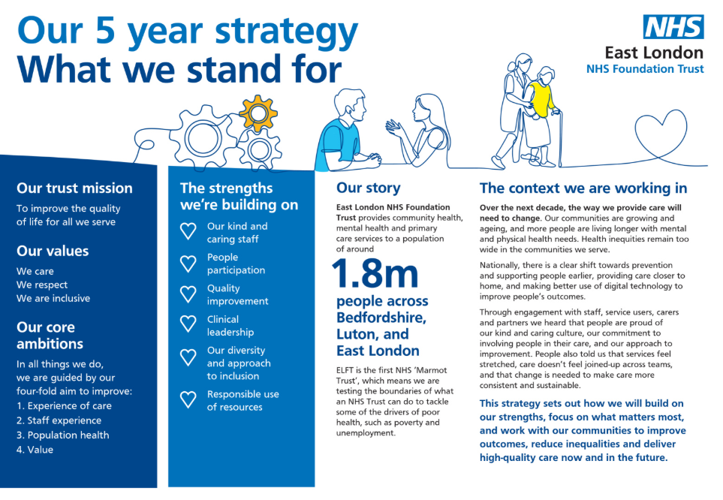
New Strategy
Honours the things that make ELFT, ELFT
Celebrates our unique roll as the first Marmot Trust
Describes the context we’re working in, and the important things we heard in the Big Conversation

Slide 4
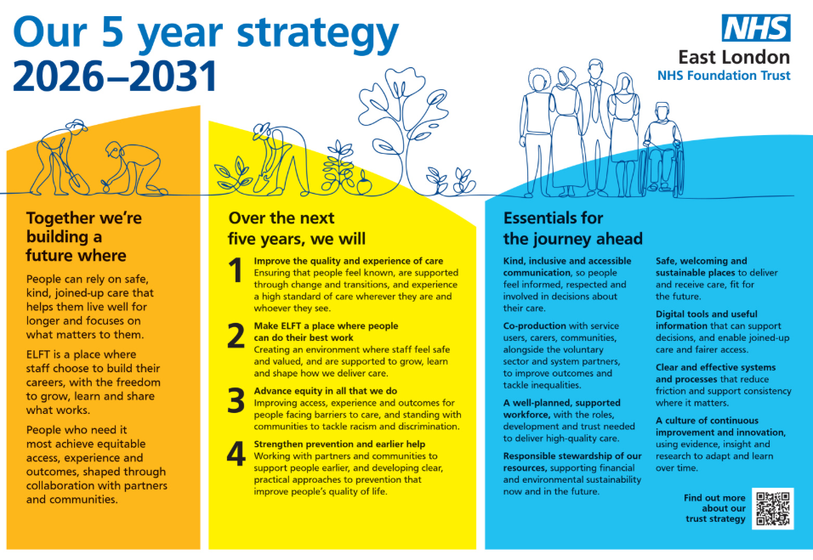
New Strategy
A vision centred on joined-up care, prevention, equity and staff experience
Four priorities that make explicit the actions we will take
A description of the things that need to be in place to achieve our vision

Slide 5
Lessons from the last strategy
We can achieve significant improvements for the people we serve and for our staff when we coordinate efforts and energy
Not everything needs a highly structured approach to be successful
However, if we define specific strategic objectives more clearly in the future, we will be able to focus improvement work over time more effectively
Linked to this, we can be clearer about what we are aiming for and how we will know when we get there

Slide 6
What will we do differently this time?
Strategy Delivery Framework
Integration between our strategy and organisational plans
On-going engagement and conversations

