Slide 1
Trust Talk Live:
Improving the quality and experience of care
14/05/26

Slide 2
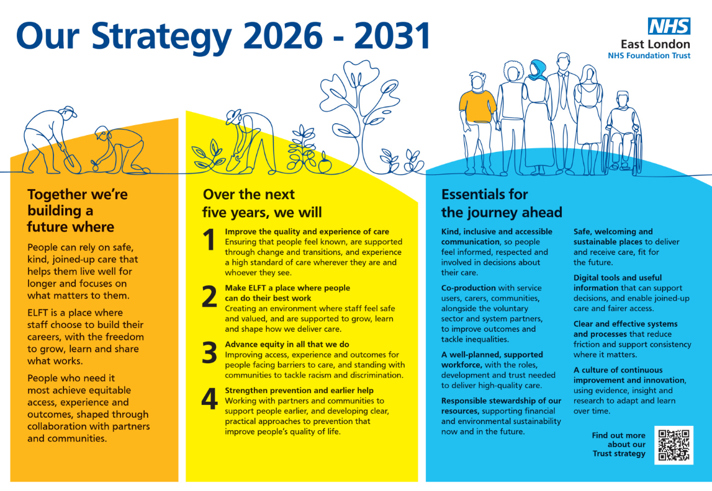
Trust Strategy: what is the vision?
The strategic vision for our new Trust Strategy 2026-2031 describes a future in which care is consistently:
Kind
Safe
Joined-up
Person-centred
Preventative
Equitable

Slide 3
Priority one: improve the quality and experience of care
The first priority in our new Trust Strategy is to:
Improve the quality and experience of care
Ensuring that people feel known, are supported through change and transitions, and experience a high standard of care wherever they are and whoever they see

Slide 4
Big Conversation insights that shaped this priority
Throughout the Big Conversation we heard about great care, where the trust values were clear in how service users and carers experienced our services.
However, we also heard about people:
Having to retell their stories multiple times
Struggling with transitions, and changes in needs linked to their age / stage of life
Being given conflicting information by different team members
Receiving care that focused on separate conditions (not holistic)
Not knowing when they would be seen or what would happen next
Noticing unfair differences in what support you can access depending on where you live
Being given information that was wrong, not accessible, or confusing

