Slide 1

Overview

Slide 2

Our charity was started by Sir Oswald Stoll, who witnessed soldiers returning from the First World War.
Our aim is to provide the housing and support that enables vulnerable veterans to lead independent lives.
Support Team undertakes Assessments for referrals, Support Plans and Risk Assessments.
Veterans are offered housing for up to 5 years .
Community Connections Team offers a range of activities and close links to specialist Mental Health Services.

Slide 3
Stoll Sites
The Mansions and Kings Road Park
Banstead Court
Centenary Lodge
Chiswick War Memorial Homes
Countess of Wessex House

Slide 4
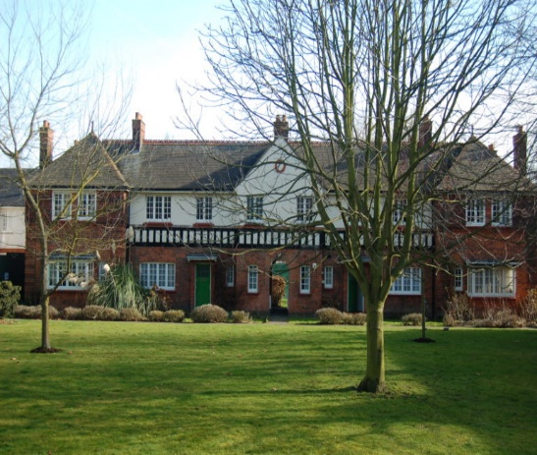
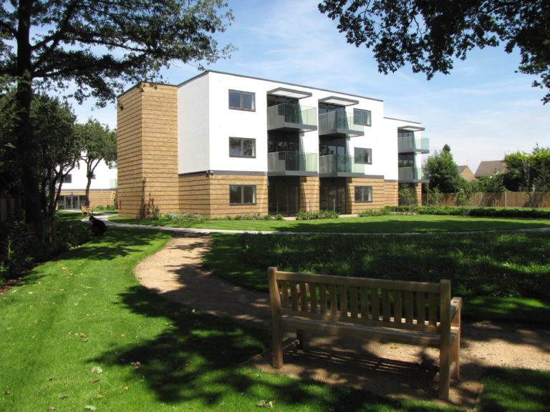
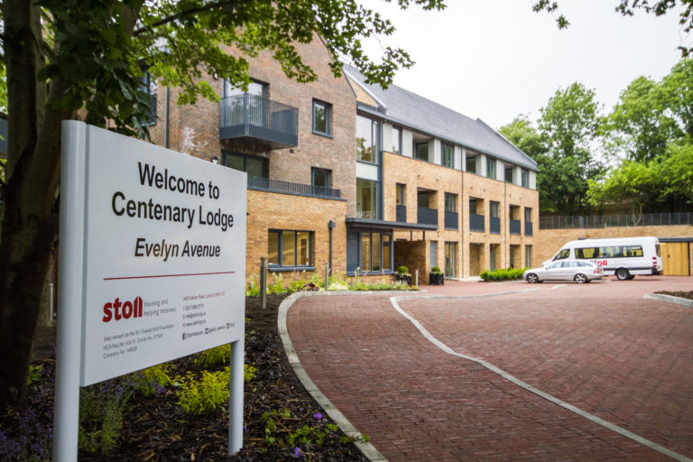
West London and Aldershot Sites (WLA)
Chiswick War Memorial Homes, Chiswick, West London ​
This attractive scheme was originally built in 1940 and renovated in 2010. This site provides 36 properties and residents are able to benefit from a community hub, wellbeing activities and spacious private and communal gardens.
Countess of Wessex House, Bedfont, West London​
This scheme was completed in July 2014 and provides 36 spacious, modern homes. There are 29 one-bedroom flats, four family flats and three flats designed for disabled residents.
Centenary Lodge, ​
Aldershot ​
Built in 2018 this award-winning development provides 34 purpose-built spacious homes, set in lovely communal grounds with allotments and on-site parking. Centenary Lodge is home to a community of Veterans of different ages, their partners and families.

Slide 5

Thank you for listening!
Time for any questions?

