Slide 1

Developing a Structured Falls Management and Prevention Programme
(In line with NICE Falls Guidelines)
Eleanor Mata
Deputy Head Unplanned Care and Therapies, TH CHS, ELFT
April 2026

Slide 2

Background
NICE guideline for Falls was updated on 29th April 2025 providing new recommendations for assessing and preventing falls in older people and those aged 50-64 at higher risk. The changes aims to reduce the risk and incidence of falls, and the associated distress, pain, injury, loss of confidence, loss of independence and mortality. TH CHS Senior Therapists met to review current Falls management and prevention service delivery in June 2025 and map the pathway. Identified inconsistency in managing falls across the therapy pathways with no clear escalation plan for individuals identified to have complex frailty and falls needs Initiated work around developing a Falls pathway aim to deliver consistent and structured falls management and prevention programme including delivering exercise classes.

Slide 3
Challenges
Lack of therapy resource to facilitate Stronger and Steady Group Classes Lack of appropriate location to facilitate exercises classes Lack of clinical space for out-patient assessments There is no consistent data recording within TH CHS for the number of Falls related injury as often referrals are coded based on referral source and need of intervention EMIS For RLH Clinic – 70-80% of referrals from GPs are for Falls, but previously no dedicated Falls clinic

Slide 4
Therapy Pathways in Community under ELFT
Referral via SPA
Urgent Community Response
Older People Service
Community Therapy Team
Intermediate Care Pathway
Admission Avoidance Team (A&E, RLH) Pathway
Falls Pick Up and Rapid Response Pathway
Frailty Clinic
Falls Clinic
Falls Prevention Pathway
Accepts Direct referral
Integrated Physio in Reablement ASC

Slide 5
NICE NG21 and QS86 Falls in Older Key Updates
No Standalone risk prediction tools
Comprehensive personalized assessment
Focus on exercise interventions
Expanded Scope (home, hospital, and residential homes)
Assessment for Falls after a Fall
Clearer roles for professionals (home hazard checks)
NICE NG21 and QS86 Falls in Older People Key Requirements
NICE NG21 and QS86 Falls in Older People Key Requirements

Slide 6
NICE Falls Guidelines Alignment
Multifactorial Risk Assessment for those at risk
Personalised exercise programmes focusing on strength and balance
Integrated pathways linking health, therapy, and primary care, voluntary sectors
Ongoing review of exit planning for sustained outcomes
NICE NG21 and QS86 Falls in Older People Key Requirements
NICE NG21 and QS86 Falls in Older People Key Requirements

Slide 7
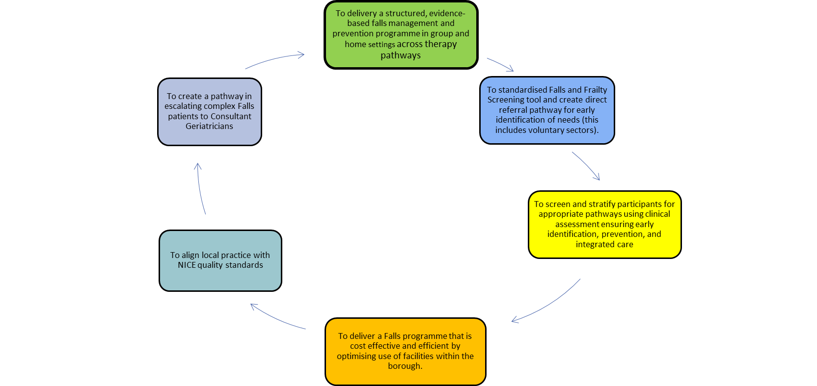
Falls Pathway Programme Objective within Therapy provision

Slide 8
Falls Pathway Programme Objective within Older People's Services
Community Therapy Team Referral
GP/others via Single Point of Access
LinkAge Screening
Falls Pathway
for
Tower Hamlets
Older People's Clinic Falls Referral
GP via eReferral System Advice and Guidance
Others via Bhnt.opc@nhs.net
Falls Prevention exercise programme
1 Fall in the last year
Unsteady on their feet and/or slow gait (Timed up and go greater than 15s)
Fear of falling
Multifactorial Assessment and Intervention
+/- exercise
2 or more falls in the last year
Frailty (CFS 5 or more)
Injury that required medical treatment
Loss of consciousness
Unable to get up without help
If any 1 present: May be suitable for OPC
Age criteria:
65 and over, or 50-64 with a diagnosed significant medical condition
Assessment by Therapists
​(within 2 weeks)
Home hazards assessment where required
Enrolment in Exercise programme:
Stronger and Steady group
1 to 1 Home exercise
Advice/self-directed exercise
Falls Pathway MDT Meeting (Weekly)
Possible Outcomes:
Home Comprehensive Geriatric Assessment
Investigations started where appropriate
Urgent or Routine OPC appointment
Advice to the GP
Concerns identified for MDT (including patients not already referred to OPC) e.g. postural hypotension, memory

Slide 9
Assessments available via Older People's Services
CTT have direct access to refer via Falls Pathway MDT and Falls Lead PT
Falls OPC will also see patients with dizziness, unsteadiness or reduced mobility that requires further investigation
Patients who risk requiring admission/need urgent review: Refer to either the Rapid Response team (via SPA), or Virtual Frailty Ward for admission avoidance
(bartshealth.thfrailtyvw@nhs.net)
We offer a general Comprehensive Geriatric Assessment OPC for patients living with frailty and other presentations (not falls)

Slide 10
Exercise Programme Model Flow
Referral and screening (standardized tool)
Exit Plan – onward referral, community exercise or self-management
Integration – data sharing with partners (review of service delivery)
Triage by Falls Lead and Therapist (Home vs Group Pathway)
Multifactorial Falls Risk Assessment (medical, mobility, environment, cognition, medication, vision, footwear)
Exercise Delivery
-Home based OTAGO programme
Group Classes at Sonali Gardens and Sundial Center

Slide 11
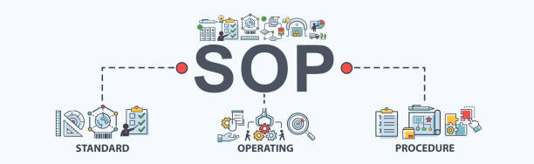
Development of Standard Operating Procedure
This SOP provides clear guidance for the safe, consistent, and effective co-delivery of the Falls Exercise Programme, co-delivered in partnership with Tower Hamlets Community Health Service - East London Foundation Trust (ELFT), Barts Health Acute Medicine and Older People Services Emergency Care and Trauma – Royal London hospital, and Linkage Plus. This programme includes both community group sessions and home based delivery for those unable to attend group sessions.

Slide 12
NICE NG21 and QS86 Falls in Older People Key Requirements
NICE NG21 and QS86 Falls in Older People Key Requirements

Slide 13
Health Promotion Topic Discussion on Group Classes
Week 1: Benefits of physical activity and Exercise
Week 2: Home Hazards
Week 3: Coping with a Fall and Anxiety and Managing Fear of Falling
Week 4: Medication Management
Week 5: Continence and Falls
Week 6: Diabetes and Falls
Week 7: Bone Health
Week 8: Importance of Foot care and Footwear in Falls prevention

Slide 14

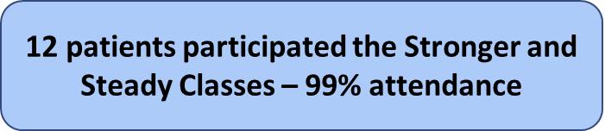
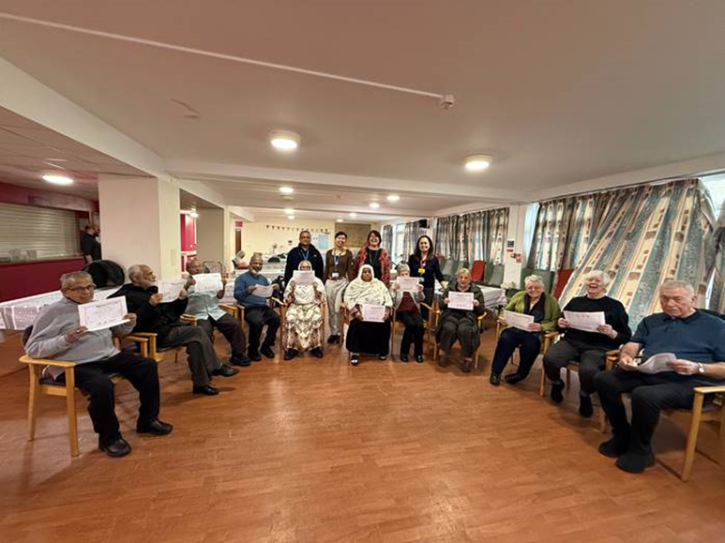
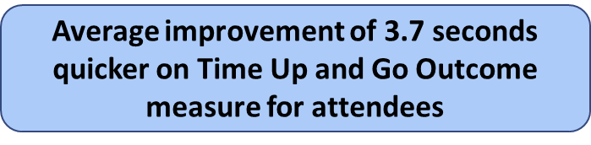
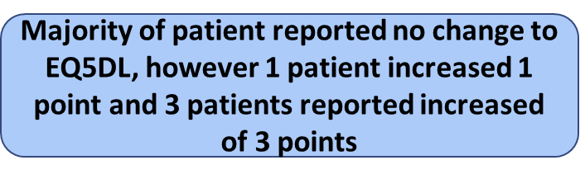
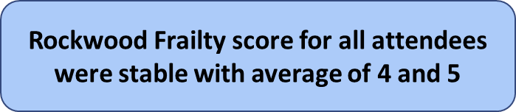
Outcome of First Stronger and Steady Class in Sonali Gardens

Slide 15
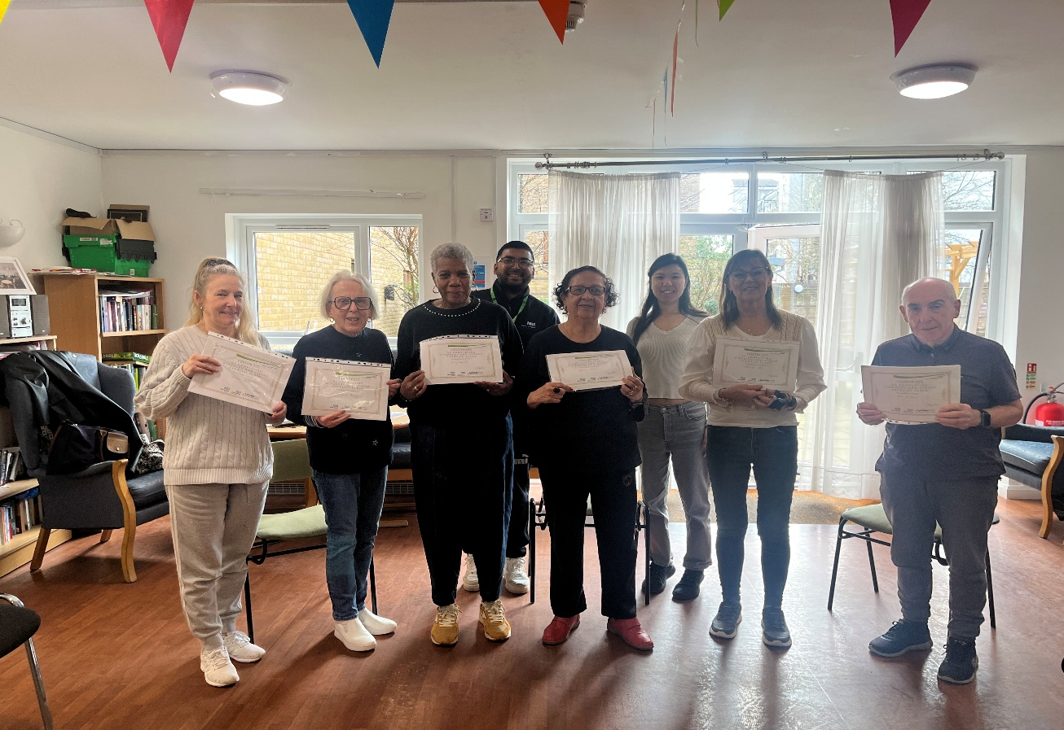
Outcome of Second Stronger and Steady Class in Sonali Gardens
Second Cohort at Sonali Garden
TUG: 6.8 seconds quicker
EQ5DL: 0.6 improvement (level sum score)
Rockwood frailty score: Average of 3 to 4
Qualitative feedback: patient reported overall improvement in their mobility and balance and enjoyed the social aspect in attending classes as well as the health topic we covered in classes.

Slide 16
Outcome of First Stronger and Steady Class at Sundial Centre
First Cohort at Sundial Centre
TUG: 9.47 seconds quicker
EQ5DL: 3.6 improvement (level sum score)
Qualitative feedback: patients reported this class is the only class enjoyed of all the other sessions they attended as the methods of delivery is balanced.
Since October 2025, we have received a total of 123 referrals to Integrated Falls Pathway.
57 – were referred by Linkage Plus
66 – have been refered by other oragnisation as part of the partnership working.
Out of the total 123 service users (as above), 98 are suitable for the Stronger and Steady Falls Class. 25 are suitable for only home exercise programme.

Slide 17
Proactive Prevention Pilot Project with PCN 1 - 5 months temporary funded project
Since November 2025, we started partnership working with PCN1 (4 GP practices in Tower Hamlets – Mission Practice, Bethnal Green, Sutton Wharf, and Strouts Place). A B6 Physio and B6 OT with support from Falls Lead has reviewed list of patients identified to have mild, moderate, and severe frailty with the following results. 125 patients were identified tohave mild frailty, 207 with moderate frailty, and 162 with severe frailty based on Electornic Frailty Index used in primary care.
Overall outcome:
259 - service users screened using Falls Screening Tool
59 - requires multifactorial falls risk assessment
25 - requires home exercise programme and received therapy intervention
34 - requires equipment provision to minimise risk of falls and support their rehabilitation plan
15 - requires referral to other services following multifactorial falls risk assessment and intervention (i.e social services, voluntary sectors, telecare)

Slide 18
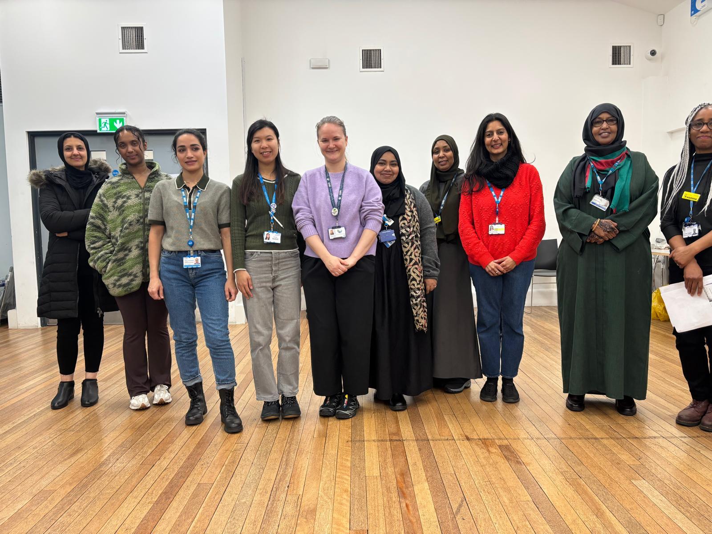
Outreach programme
In collaboration with PCN1, we have done health checks and health promotion focusing on managing frailty and falls for Bengali and Somali Men and Women Group.
With use of the Falls Risk Assessment tool we were able to identify 24 service users requiring further therapy intervention for mobility assessment, provision of walking aid, and home risk assessment.

Slide 19
Next Steps
Ongoing plan to set up ‘Higher Level’ Stronger and Stready Classes at Sonali and Sundial Centre to further improve resilience to falls and prmotie aging well principle
Initiated discussion with Neighbours in Poplar to set up 3rd site of Stronger and Steady Class
Ongoing plan to work closely with other PCN for proactive identification of mild to moderate frail patients for assessment and intervention.
Falls Prevention and Management talks at Ocean Women at Stepney in June 2026
Ongoing plans to work closely with Care Homes for falls prevention and management programme

Slide 20
THANK YOU

