Slide 1
Trust Strategy Delivery Framework
14/05/2026

Slide 2
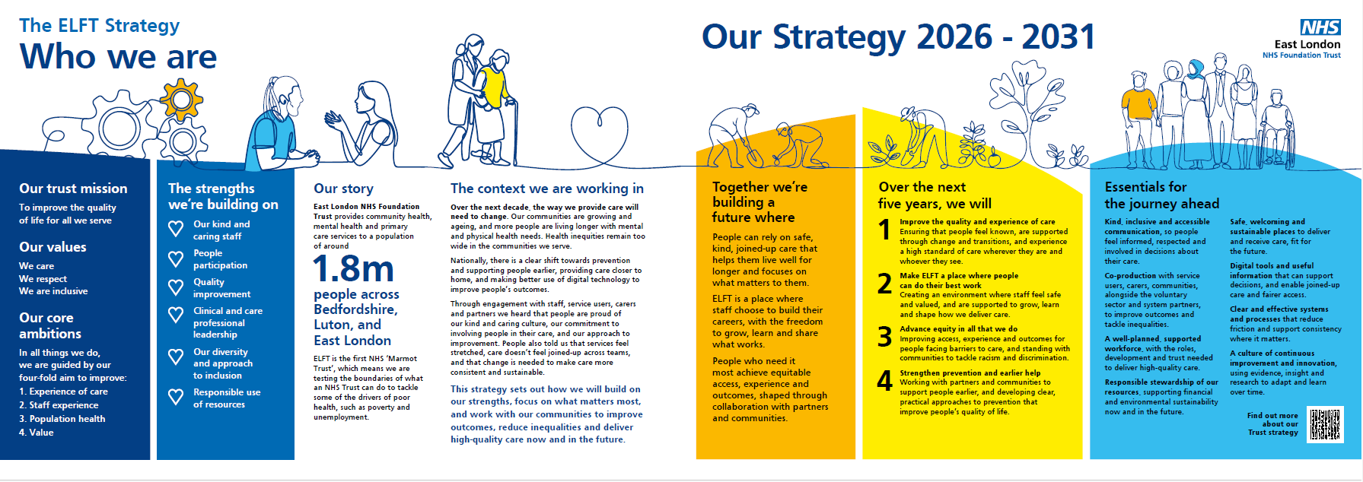
Introduction
The Strategy Delivery Framework is orientated towards the delivery of the new Trust Strategy (2026 – 2031)

Slide 3
Contents
What the Strategy Delivery Framework is for
Delivery Framework Core Components
What the new strategy means for care at ELFT (the Translation Layer)
Where we will focus energy and attention first (2026/27)
How delivery evolves over time
How we will work together
Communications and engagement
How we will measure and monitor progress
How we will learn, improve and change course when we need to
How we will align support and resources to strategic priorities

Slide 4
1. What the Strategy Delivery Framework is for
This framework explains how we will turn our strategy into real change.
It describes the interconnecting elements that will help us focus on what matters most, work in a more joined-up way, and use our time and resources well.
It is not a detailed plan for everything. Instead, it sets out a clear direction, the priorities we will focus on, and how we will learn and adapt as we go.
It is there to support teams across the Trust to make decisions, take action, and improve care in a consistent way.
Most importantly, it will hold us accountable so that what we said we would do in our strategy actually happens in practice — for our staff, our service users and carers, and the communities we serve.

Slide 5
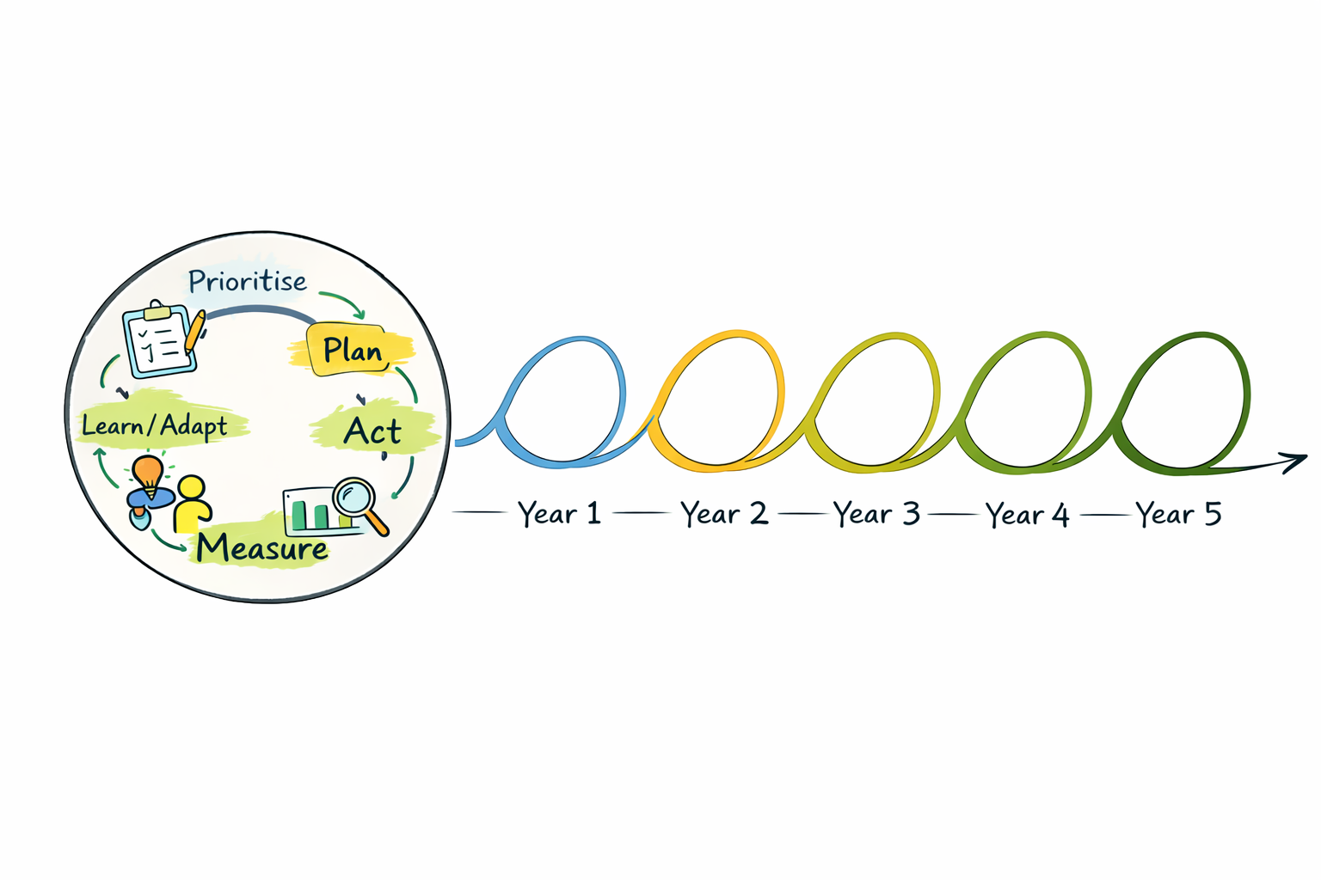
2. Delivery Framework Core Components
Repeating annual cycle - Each year follows this cycle, with learning shaping the next year’s priorities
Over-arching delivery rhythm and annual process
Organisational Design & Resources
Improvement and support infrastructure aligned to strategic priorities
Leadership of key programmes
Governance, Assurance & Learning
Quality Management System
Balanced scorecard
Learning systems to support improvement, spread & scaling
Leadership & Ways of Working
Accountability framework
OD and leadership
Behaviours
Core components that work together to enable and hold delivery to account
Communications & Engagement
Roll-out
On-going engagement
Feedback loops
Direction & Prioritisation
Annual priorities
Planning rhythm
Sequencing plan

Slide 6
3. What the new strategy means for care at ELFT
This section translates the Trust’s 2026–2031 strategy into a clearer picture of what success will look and feel like in practice. It sits between the strategy (our ambition) and the delivery framework (how we will get there).
It is designed to help frontline and corporate teams see their part in our collective endeavour and bring our strategy to life through their actions. This includes care and support delivered across mental health, community health, primary care and specialist services, and should make sense to teams working in both mainstream and highly specialised settings.
Our strategy has four priorities. The following slides set out what each priority means in practice, our ambition for 2031, and what people who use our services, carers and staff should notice if we deliver well.

Slide 7
3. What the new strategy means for care at ELFT
- Improve the quality and experience of care
What this means in practice: • Care is more joined up and continuous between teams and organisations; particularly for those with complex, long-term or multi-agency needs where continuity, coordination and clear transitions matter most. • Care is more consistent and reliable. We agree core ways of working where they matter most, and we reduce unwarranted variation across the Trust. • Access and waiting is easier to understand. People receive clear, proactive updates about what happens next and who to contact.
If we get this right, service users and carers will say: | If we get this right, staff and teams will say: | Our ambitions for 2031 are…
“People talk to each other — I don’t have to keep repeating my story.” “I’m not left on my own when I move between teams — someone helps me through it and follows up with me.” “I know what’s happening, what I’m waiting for, and who to contact.” “I feel safe, listened to, and treated like a person.” | “We take shared responsibility for transitions. We do not hand people off.” “We know which parts of care must be consistent and where local flexibility is expected.” “We communicate proactively with people who are waiting. It is part of care.” “We can solve problems across team boundaries more quickly.” | To join up pathways of care where it matters most across primary care, community health, mental health and specialist services; with fewer hand-offs between services To make waiting less uncertain for service users and carers with shorter waits and kind, proactive communication Reduce escalations in need through proactive management of care, and keep hospital length of stay as low as possible Strengthen safety for service users and staff, including a more consistent approach to care planning (e.g. DIALOG+) To reduce variation in access, experience and outcomes
Essentials for the journey ahead that most support this priority: Kind, inclusive and accessible communication: proactive updates while people are waiting and accessible information Clear and effective systems and processes: to simplify and standardise where it matters to reduce delays and duplication Digital tools and useful information: joined-up information, visibility of waits, and good quality outcomes data (CHS outcomes and DIALOG) A culture of continuous improvement and innovation: helping to reduce unwarranted variation and make sure what works in one place becomes strength everywhere.

Slide 8
3. What the new strategy means for care at ELFT
- Make ELFT a place where people can do their best work
What this means in practice: • Staff have more time to care, with less time spent on workarounds, duplicated tasks, and unnecessary administration • Supervision, development, and support are equitable, consistent, and protected. Key capabilities grow over time, including leadership skills. • When people raise concerns or share ideas, they see what changed, or they understand why it could not.
If we get this right, service users and carers will say: | If we get this right, staff and teams will say: | Our ambitions for 2031 are…
“I feel like staff have the time to really listen to me and understand what matters to me.” “I know the people who help me, and they remember me.” “People follow through on what they say they will do.” “I get clear updates and communication that I can understand, including when I’m waiting.” | “I can spend my time helping people, not fighting the system.” “When I raise a problem, something happens — and I can see what changed.” “I understand what matters most, and I’m not being asked to do everything at once.” “My role is clear and makes good use of my skills, and I’m supported to build new skills and take the next step in my career.” “ELFT cares about my health and wellbeing.” | To enable people to work to the top of their competence and reach their potential, through good role design, skill mix, development routes and career pathways To make supervision, training and development routine and reliable, and to be assured that opportunities to grow, learn and develop are equitable across groups. To have embedded ‘freedom within a framework’, so teams can learn from each other and make deliberate choices about what to prioritise and what to stop. To make kindness, care, respect and inclusion visible in day-to-day behaviours, and reflected in people’s experience of care.
Essentials for the journey ahead that most support this priority: A well-planned, supported workforce: including workforce planning, quality supervision, development, role clarity and OD / capability building Kind, inclusive and accessible communication: to help people feel connected, learn from others, and see that their feedback is taken seriously Clear and effective systems and processes: removing friction and ensuring staff time is not consumed by unnecessary tasks Digital tools and useful information: making tasks easier, reducing burden and helping staff to do the right thing first time

Slide 9
3. What the new strategy means for care at ELFT
- Advance equity in all we do
What this means in practice: Equity is both a priority and a thread. We apply an equity lens in all that we do Care improves for people and communities who are poorly served by standard models, face multiple disadvantage, or are less likely to access timely help through mainstream routes We use data and lived experience to identify inequities in access, experience and outcomes, and we coproduce solutions with those most affected Action on racism and discrimination is visible in our governance, behaviours and outcomes (we live by our anti-racism strategy)
If we get this right, service users and carers will say: | If we get this right, staff and teams will say: | Our ambitions for 2031 are…
“Care feels fair. It is not easier for some people to get help than others.” “The Trust understands the barriers people face and acts on them.” “I’m involved in decisions about my care, and services look like me and sound like me.” “Staff understand my culture, and do not make assumptions about me.” | “Equity is built into our measures and improvement work.” “We use data to identify inequity and act on it, and we test whether changes narrow or widen gaps.” “ELFT is committed to inclusion, and I can see that chances to develop and progress are equitable.” | Make inequities visible and actionable. Teams routinely look at access, experience and outcomes by group, and they act on disproportionalities Deliver sustained progress on equity commitments, including our anti-racism strategy and PCREF, so improvement is consistent over time Strengthen fairness and inclusion in staff experience, evidenced in qualitative and quantitative data, including WRES and WDES measures Show measurable improvement in reducing disproportionalities in access, experience and outcomes for racialised communities
Essentials for the journey ahead that most support this priority: Co-production with service users, carers and communities: the people most affected by inequities help design solutions and shape priorities. Digital tools and useful information: stratified measures and good insights so inequities are visible; digital inclusion for service users and carers A culture of continuous improvement and innovation: testing changes with communities, learning quickly and spreading what works. Kind, inclusive and accessible communication: accessible communication supporting equity by design

Slide 10
3. What the new strategy means for care at ELFT
- Strengthen prevention and earlier help
What this means in practice: Teams know how to help people live well for longer, and think holistically about physical health, mental health and the wider determinants of health We work together with communities, other health organisations, social care, local authority teams, the voluntary and community sector and schools to support healthier neighbourhoods We shift more effort upstream so people get help earlier, avoid escalation into crisis, and avoid admissions that could have been prevented
If we get this right, service users and carers will say: | If we get this right, staff and teams will say: | Our ambitions for 2031 are…
“I get help earlier — not just when things have already got worse.” “I can get support closer to home – I don’t have to go to hospital to see someone.” “Services work better with the other organisations around me — it feels joined up.” “Equal attention is paid to my physical and mental health.” | “We’re spending more time upstream and can describe what prevention means in our pathway.” “We work across boundaries as standard, with clearer coordination and fewer hand-offs.” “We have better alternatives to hospital” “We are confident talking to people about their social circumstances (employment, finances etc.) and can support them to get help” | To make neighbourhood working the default way we coordinate care for people and families with multiple and complex needs To have effective admission avoidance pathways so more people can receive their care in the community, rather than in hospital To have high quality schools-based mental health support and early help partnerships in all our places To have a consistently high quality of care in all our community mental health services: with a robust assertive community support offer and spreading the learning from the 24/7 mental health pilot To have strengthened urgent mental health assessment environments, including MHED models where commissioned / enabled, reducing reliance on A&E for mental health care
Essentials for the journey ahead that most support this priority: Co-production and partnerships: co-designed approaches to neighbourhood care so support wraps around people’s lives A well-planned, supported workforce: workforce planning and OD needed to enable integrated care and preventative approaches Digital tools and useful information: to facilitate joined-up care in multi-agency, multi-disciplinary teams, and to understand local needs Safe, welcoming and sustainable places: spaces that facilitate co-location, joint working, local access, therapeutic support and smoother transitions

Slide 11
4. Where we will focus energy and attention first (2026/27)
Successful delivery depends on being clear about what matters now and what matters next, so we can align our efforts around shared priorities.
Each year, we will use our planning process and delivery rhythm to agree a small number of collective priorities. This will help us focus our time and resources where they will have the greatest impact.
The table on the next page sets out the proposed priorities for Year 1. It distinguishes between areas that require collective effort across the Trust and those that are specific to particular services, pathways or populations.
These priorities have been shaped by our Medium-Term Plan, colleague engagement (including strategy roadshows), and discussions with clinical and care professional leaders and the executive team.
They link directly to the measures set out in the balanced scorecard (chapter 8).

Slide 12
4. Where we will focus energy and attention first (2026/27)
Strategic priorities | Trust-wide areas of focus (collective effort) | Service and pathway-specific areas of focus, including corporate and enabling services (differentiated effort)
1. Improve the quality and experience of care | Making communication kinder and more accessible, including for people waiting to receive help | Clinical services: Improving access in key pathways (e.g. neurodiversity, CAMHS, MSK, SLT) Ensuring mental health crisis / acute care is timely, safe and delivered as close to home as possible Helping people in key populations to avoid hospitalisation (e.g. homeless people, over 65s) Improve physical health outcomes for key groups (e.g. LD, forensics) Implementing a consistent outcomes recording system for CHS Improving consistency and reducing duplication in care planning (e.g. DIALOG+, Care Act)
2. Make ELFT a place where people can do their best work | Improving staff wellbeing and experience (aligned to the Staff Experience Programme) | Clinical services, supported by corporate / enabling services: Prioritising interventions and projects that simplify workflows and remove unnecessary steps and give people time back (digital and system / process improvement work) Taking targeted action on the practical causes of poor staff experience, based on team-level staff survey results and staff feedback
3. Advance equity in all we do | Delivering our new Anti-Racism Strategy | Clinical services, supported by corporate / enabling services: Using stratified data to identify and act on inequities in access, experience and outcomes Making targeted accessibility improvements in local services
4. Strengthen prevention and earlier help | Developing a shared understanding of what prevention means in practice (aligned to the prevention framework) | Clinical services: Working with system partners to bring care closer to peoples' homes and their local communities Developing a consistent approach to community mental health support for people who find it hard to engage with mainstream services, and sharing the learning from our 24/7 mental health pilot Using the prevention framework to identify practical actions teams can take
Strengthening the essentials for the journey ahead | Demonstrating responsible stewardship of our resources (aligned to GFGT plans) | Clinical services, supported by corporate / enabling services: Delivering financial balance in 2026/27 Ensuring we have the right organisational structure, resources aligned to priorities and the right implementation and governance arrangements to support delivery of the Trust Strategy

Slide 13
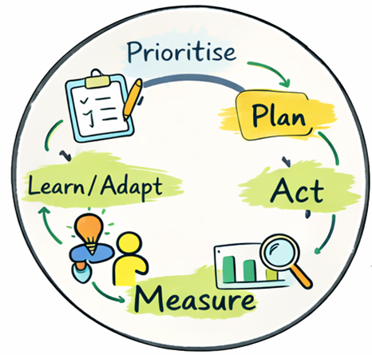
5. How delivery evolves over time
Focus & equip
Learn & improve
Broaden & scale
Embed & renew
Five-year delivery arc -
Different priorities and pathways will be at different stages at any one time.
Spread
Each year follows the same delivery cycle - Learning shapes the next set of priorities.
Prioritising effectively
Confident leadership and ways of working (e.g. accountability)
Learning system maturity and scale/spread capability
Capabilities that are developed early and mature over time.
Communications and engagement
Allocating resources according to our priorities

Slide 14
6. How we will work together
These Freedom Within a Framework principles have been coproduced with directorate management teams and senior leaders across the trust and will form the basis of our new accountability framework.
Clarity enables autonomy
Autonomy comes with accountability
Autonomy is earned through capability, trust and delivery
Focus and prioritisation
We cannot give everything equal energy and attention at the same time
We share accountability where outcomes can only be achieved through collective effort
Implication: freedom comes with responsibility for outcomes.
Strategic focus enables alignment and meaningful delivery.
Implication: we will concentrate effort on a smaller number of shared priorities and sequence our work.
Transparency and learning
Alignment grows through dialogue and shared decision-making, not mandate
We learn from each other so excellence in one area becomes strength everywhere
Implication: we will review progress regularly, make clear decisions, and adjust based on learning.
We adapt our modes of change intentionally
Freedom and alignment are not opposites
Clarity of purpose, shared outcomes and boundaries allow teams to act confidently and adapt for local nuance
Implication: we will be explicit about what matters most.
In practice, this means teams will be clear on their priorities, supported to act, and expected to review progress and adapt based on what they learn.

Slide 15
7. Communications and engagement
An integrated communications and engagement plan has been developed to enable delivery of the new strategy by fostering local buy in and meaningfully connecting to the day-to-day delivery of care.
Key principles include:
Foster trust by listening, enabling feedback loops and demonstrating visible action in response to feedback
Audience focussed: Embed the strategy in everyday practice, making it relevant and meaningful for teams who deliver care, and involving service users and carers at every step
Equip managers and local leaders to confidently lead delivery and have honest conversations about the strategy and its delivery with service users and carers, local communities and system partners
Not ‘once and done’: Maintain a consistent rhythm of engagement that demonstrates follow-through and accountability
Storytelling: Telling the story of how the strategy is influencing day-to-day delivery and enabling high-quality care
Agile development of comms and engagement that works alongside the emerging strategy delivery framework

Slide 16
7. Communications and engagement
The Strategic Communications and Engagement Plan has, at its heart, a growing group of staff and service users who are champions for the new strategy. These champions have been recruited through the Representative Group, the strategy roadshows, and other events, helping to build a movement for change. The high-level year one engagement plan is as follows:
Trust Talk Live (TTL) 8th of April
Place-based Trust Strategy Roadshows
DMT-level, and professional lead-led engagements, wash up sessions i.e. night shift workers and line manager briefings
15th June public launch of Strategy & Delivery Framework (co-produce local launch and roll-out plans)
Locally-owned community engagement activity (reaching out to service users, communities and system partners)
Roadshow ‘alumni’ (and others) feed into the performance and planning processes
Annual strategy engagement on the coming year’s focus

Slide 17
8. How we will measure and monitor progress
A balanced scorecard is a tool to focus Board and executive attention on the outcomes that matter most in our strategy, and to support good questions and timely course‑correction.
Board assurance will not be taken from the scorecard alone; it will be developed through triangulation with other evidence (risk and controls, quality governance, internal and external assurance, and the lived experiences of staff and people who use our services).
Our balanced scorecard will use our quadruple aim as the four domains. These are deliberately distinct from the four strategic priorities, which describe where we will focus our effort to achieve those outcomes.
Balance across the scorecard is achieved through the four domains but also through careful calibration of different types of measures, balance across care groups, and balance between internal and external priorities.
It is proposed that some measures should be fixed for 5 years to support visibility of progress across years, while others will be replaced after 12-24 months, in accordance with decisions taken to shift our focus and priorities.

Slide 18
8. How we will measure and monitor progress
DRAFT Balanced Scorecard Measures – 2026/27
Improved Population Health Fixed: Improved physical health outcomes for key groups (forensics, people with a learning disability, people with a serious mental illness, homeless people) Improved employment outcomes (LD and SMI employment indicators) Supporting children and families with mental health and emotional wellbeing earlier (Mental Health Support Team coverage in schools) Rotational: Reduced smoking rates (smoking cessation uptake) Addressing racial inequity in mental health admissions (admission rates for Black men) | Improved Experience of Care Fixed: People’s experience of care is positive overall (PREM data) People have timely access to support in priority pathways (waiting times for neurodiversity, CAMHS, MSK, SLT) People receive safe and timely urgent mental health care (ED cubicle hours and average length of stay) Rotational: We are consistently using person-centred care planning approaches to improve safety and continuity (e.g. DIALOG+) People experience kind, accessible communication from services (built into service user accreditation process)
Improved Staff Experience Fixed: How staff feel connected to ELFT (staff survey engagement score) Staff feel safe and listened to (staff survey raising concerns) Quality of day-to-day management (staff survey line management score) Rotational: People are not under excessive strain (staff survey burnout score) We are giving people time back (add question to quarterly pulse: “I can spend enough of my time on work that really matters”) Our systems and processes are equitable (WRES Indicator 3: relative likelihood of BME staff entering the formal disciplinary process) | Improved Value Fixed: We are acting as good financial stewards (financial position against plan) We are acting as good environmental stewards (carbon reduction against Green Plan) We have sustainable workforce deployment (agency spend/use trend) Rotational: Digital adoption and innovation is helping to free up time to care, and improve productivity (specific measure to be identified) Whether we are supporting the left shift from hospitals to communities (avoidable admission rate)

Slide 19
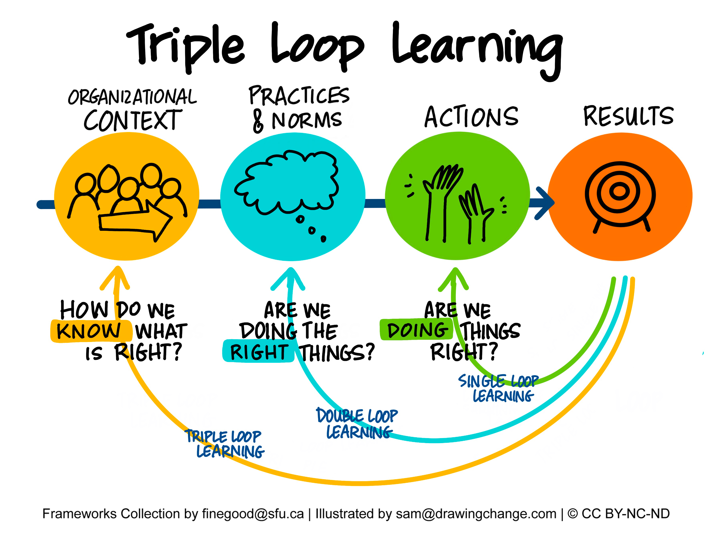
9. How we will learn, improve and change course when we need to
Strategy delivery will be treated as a learning and improvement process as well as an implementation task.
We will establish a light, regular rhythm of collective review that brings together quantitative indicators (outcomes, performance, workforce and value) with qualitative insight (service user and staff experience, feedback, operational learning and learning from improvement work) to help us understand progress, identify emerging issues and support timely course correction.
For some strategic priorities, this will include more structured learning systems that support local testing, shared learning, adaptation and spread across teams and places.
This will help us make clearer decisions about:
What should be strengthened or accelerated
What should be adapted locally
What should be spread more consistently
What should be paused, stopped or redesigned
Over time, we will strengthen the Trust’s organisational learning infrastructure; including how improvement support, engagement, governance, measurement and learning systems work together to support strategic delivery.

Slide 20
10. How we will align support and resources to strategic priorities
As part of the Strategy Delivery Framework, we will increasingly take a more explicit and disciplined approach to how organisational resource, improvement support and leadership attention are aligned to strategic priorities over time.
This approach recognises that:
Some priorities require trust-wide coordination and collective effort
Some are best supported through shared learning and enabling infrastructure
Some are most effective when led locally by services and teams
Organisational approach | What this means in practice | Typical characteristics
Make it happen | Priorities requiring strong organisational sponsorship, coordinated delivery and aligned corporate support | High strategic importance, significant risk, trust-wide impact, regulatory or operational urgency, need for consistency or rapid improvement
Help it happen | Priorities where teams and places lead delivery locally, supported by shared learning systems, improvement support, enabling infrastructure and coordination across the organisation | Cross-cutting priorities, opportunities for spread and scale, areas benefiting from shared learning and collective problem-solving
Let it happen | Priorities primarily led locally by services and teams, with greater flexibility to adapt approaches to local context and need | Locally-owned improvement, innovation, adaptation to place or population need, areas not requiring significant trust-wide coordination
Where work is not aligned to current priorities, or where organisational capacity is unavailable, we may need to pause, stop or sequence work for later
This approach is intended to support clearer prioritisation and sequencing, more disciplined use of organisational support and improvement infrastructure, stronger alignment between strategy, planning and delivery and greater clarity about where consistency is required and where local flexibility is expected. Different priorities may move between these categories over time as the context evolves.

Slide 21
Version control
Version no. | Date | Approved by | Changes since previous version
V1.0 | 21/05/2026 | Trust Board in Public | n/a

