Slide 1






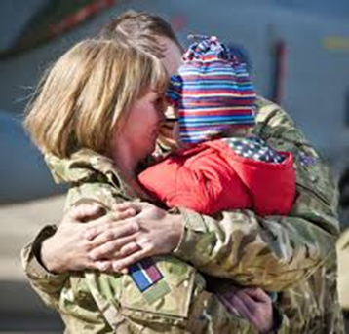

ELFT ARMED FORCES ALLIANCE

Slide 2
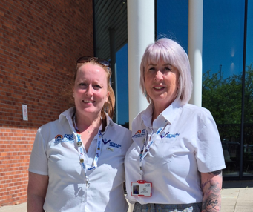

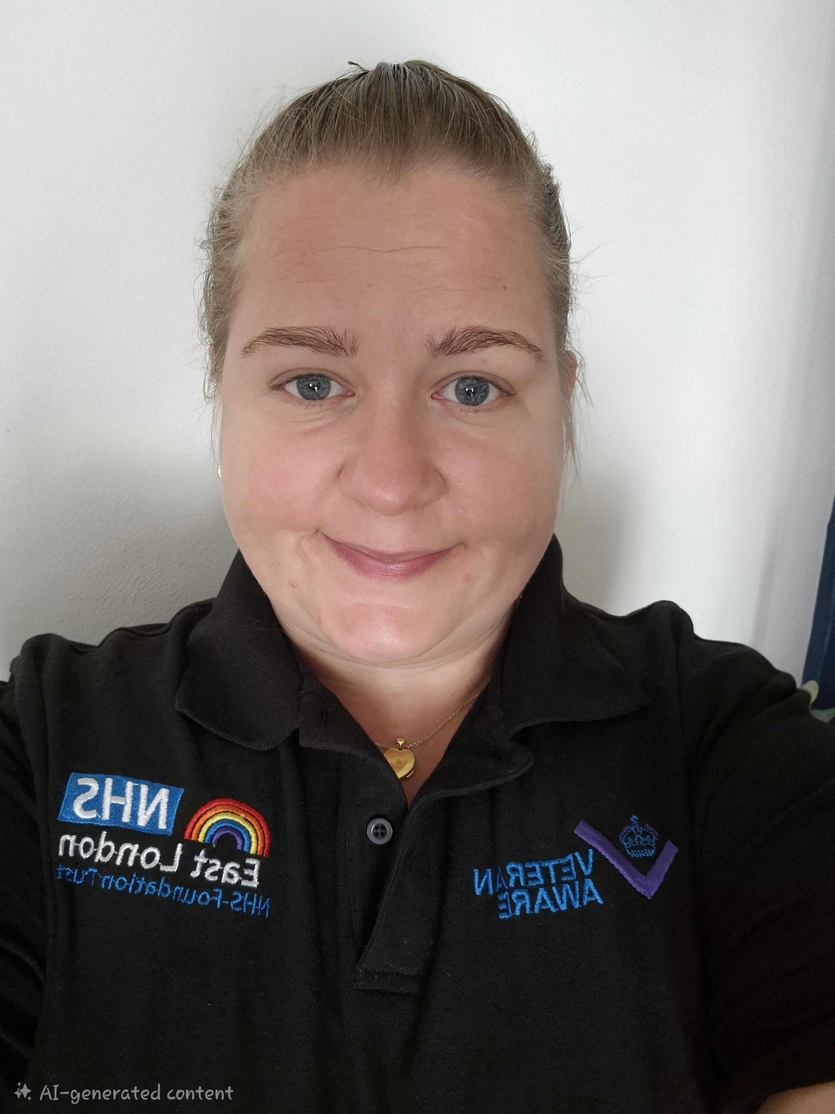
THE ELFT TEAM
Jane Kelly – ELFT Armed Forces Community Clinical Lead
ELFT Clinical Lead for Recovery (including the Personal Health Budget Pathway)
Unite the Union Vice Chair ELFT
Sharon Deans - Armed Forces Accreditation Lead
Shelly Obeng-Frimpong-
ELFT Armed Forces Communication Lead
Epilepsy Clinical Nurse Specialist
Contacts:
jane.kelly10@nhs.net
sharon.deans8@nhs.net
shelley.obeng-frimpong@nhs.net

Slide 3
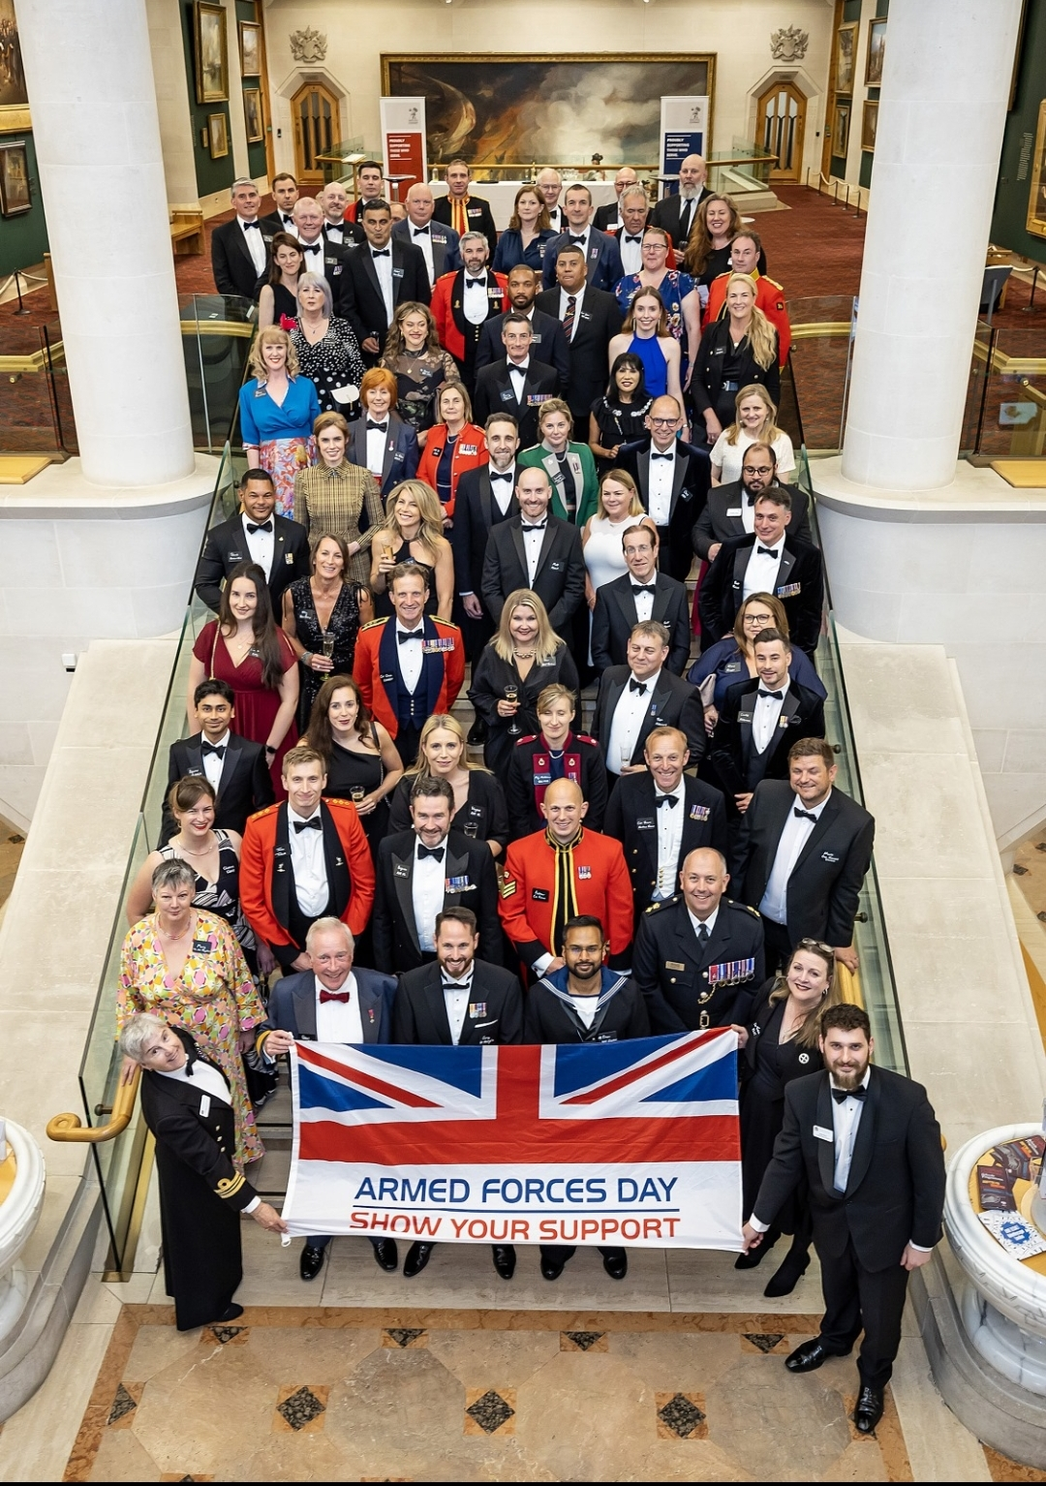
Milestones: Our Journey so far :
Signed the Armed Forces Covenant Legislation as part of AF Bill
Set up ELFT Armed Forces Alliance Project Board
Gained the Veterans Covenant Health Alliance (VHCA) Accreditation and GOLD DERS Award
Started the Quality Improvement (QI) Triple Aim journey- Pursuing Equity
Set up the Local Accreditation Scheme

Slide 4
Key points-
NHSE recognises that Veterans are considered a group at risk of experiencing health inequalities. Source: https://www.england.nhs.uk/wp-content/uploads/2017/01/armedforces-participation-frmwrk.pdf
Loss of a sense of belonging. After leaving the armed forces, people may be returning to a community where support networks, social networks, friendships and connections have been lost or are tenuous as a result of serving in the armed or civilian services, age or disability.
Estimates indicate that up to 3500 to 7000 veterans experience homelessness or living in unstable housing across the UK
In places like London , veterans make up to around 1.3 to 5% of the street sleeping population
In services we still struggle to identify our armed forces community but across all services we will have veterans who are currently in hospital waiting accommodation and may be a delayed discharge – patient flow is a essential element of Trust business
It's essential that as a Trust we identify those service users who are from an armed forces community on our clinical system and have a clear understanding on what resources are available

Slide 5
Armed Forces Act 2021 legislation and wider Armed Forces Covenant
Under the Armed Forces Act, local authorities must not disadvantage service personnel or veterans due to their mobile lifestyle. [1, 2, 3]
Local Connection: Councils can no longer disqualify serving or former armed forces members from joining the housing register simply because they do not meet local residency or connection requirements. [1]
Additional Preference: Veterans, serving personnel, and bereaved spouses are granted 'additional preference' for social housing if they fall into urgent housing need categories. [1, 2]
Duty to Refer : MOD legally obligated to refer AF personnel who may be homeless or at risk within 56 days to local authority of their choice.

Slide 6
Legislation AFC and housing
Legal Framework
Housing Act 1996, s.160ZA – Local authorities can set qualification criteria for social housing.
Allocation of Housing (Qualification Criteria for Armed Forces) (England) (Amendment) Regulations 2024 – Strengthened protections for veterans.
Who is Exempt from Local Connection Requirements?
Serving members of the Regular Armed Forces.
All former members of the Regular Armed Forces (veterans).
Bereaved spouses/civil partners leaving MOD accommodation following a service-related death.
Injured or disabled serving/former Reservists whose condition is attributable to service.
Key Change (2024)
Exemption now applies to all veterans, removing the previous 5-year limit after discharge

Slide 7
Government Guidance to Councils
Exempt divorced or separated military spouses/civil partners who must leave MOD accommodation.
Consider exceptional circumstances arising from military service (e.g., frequent relocations affecting family members).
Disregard service-related compensation payments when assessing eligibility where appropriate.
Take a sympathetic approach to MOD-related housing debts (mesne profit charges).
Policy & Statutory Context
Housing Act 1996, Part 6 – Social housing allocations framework.
Armed Forces Covenant (created under the Armed Forces Act 2011) – Service personnel, veterans and families should face no disadvantage in access to public services, including housing.
Practical Impact
Armed Forces applicants should not be excluded from social housing because military service has prevented them from establishing a local connection.
Councils are expected to recognise the unique housing challenges faced by military families and veterans.

Slide 8

Royal Star and Garter
Providing care and support since 1916 to support severely injured veterans returning from World War I . Founded following Queen Mary’s vision for a permanent home for disabled servicemen. Originally based at the former Star & Garter Hotel in Richmond
The organisation demonstrates how specialist housing, care, and community services can work together to support veterans to live safely, independently, and with dignity while reducing social isolation
Provide a range of care and support from nursing care through to telephone support.
Provisions in High Wycombe, Surbiton, Solihull and Worthing.
Offers support for Veterans and immediate family.

Slide 9
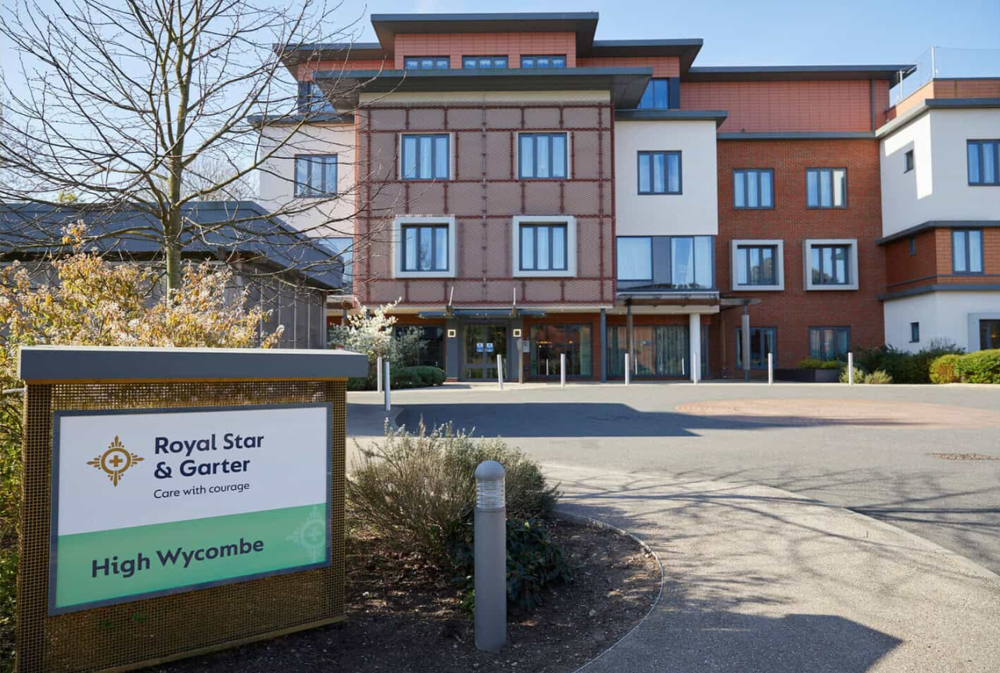
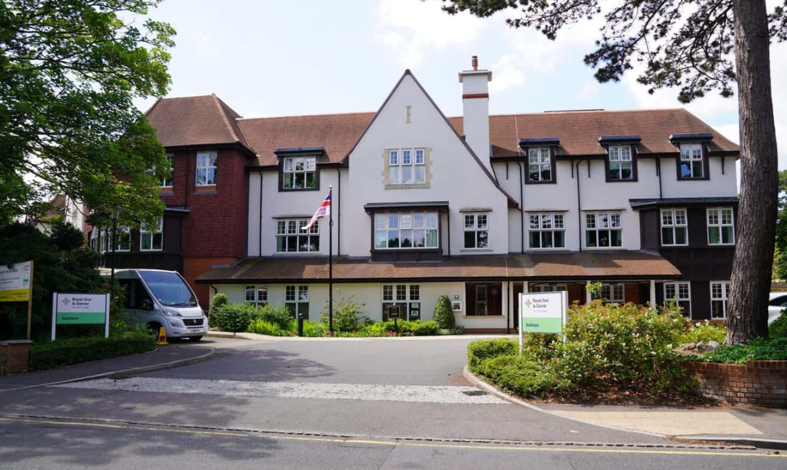
Locations
High Wycombe
-Nursing care
-Dementia Care
-Short Break
- Day care
Surbiton
Nursing care
Dementia Care
Short Break
Younger Veterans care

Slide 10
Additional services
Lunch time clubs – offered at all locations, £10 per a meal and guests are welcome (ie nok or friend). All veterans of all ages welcome.
Telephone Friendship – Anyone who has served in His Majesty’s Armed Forces, including Reservists and those who completed National Service are welcome to use the service. This includes partners and widows / widowers of veterans. Free to use.

Slide 11
Referral criteria and funding streams
Serving personnel of all ranks, and veterans who have previously served, upon completion of at least one days’ service after basic training
Members of the regular Forces, those who have served in the Reserves or Auxiliary services or completed National Service, as well as those who served in the Merchant Navy in hostile waters
The partners of any service person, whether married, widowed, civil partner, or in any long-term enduring relationship. And Worthing Home only, also support the children and parents of serving personnel and veterans.
No age restrictions for services, typically younger veterans services is for those under 65 years old.
Funding can be accessed through main stream services (Self Funding, LA, FNC and CHC).
Veterans UK funding – for short-break care -Applicants in receipt of 100 per cent War Disability Pensions and a full attendance allowance may apply to Veterans UK for consideration for funding for short-break care.

Slide 12
Costings and referrals
Costings for nursing care range from £1,895 to £2,090 per a week
Costings for dementia care range from £2,100 to £2,350 per a week
For day services, short breaks and day care contact the service directly.
Referrals are made directly through to the care provider.
High Wycombe: Email - hw.enquiries@starandgarter.org Telephone - 01494 927 555
Surbiton: Email - surbiton.enquiries@starandgarter.org
Telephone - 020 8339 5100

Slide 13
Q&A….

Slide 14
Further signposting and resources
https://www.elft.nhs.uk/service-users-and-carers/support-armed-forces-communities
Forces connect - https://www.forcesconnect.co.uk/
https://www.bedford.gov.uk/your-council/about-council/armed-forces-0/directory-armed-forces-support-services
https://www.centralbedfordshire.gov.uk/info/42/stronger_communities/280/armed_forces_covenant
https://www.gov.uk/support-for-veterans?veterans_support_organisation_region_england%5B%5D=london

