Slide 1

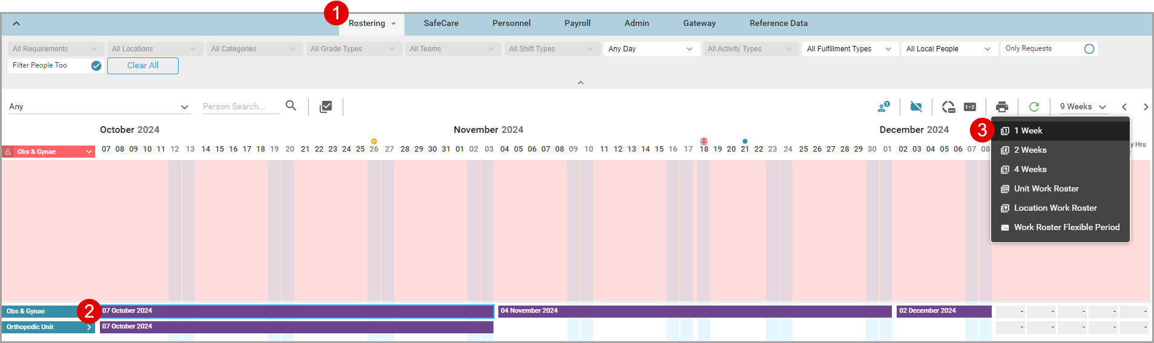
Print A Roster
HealthRoster Suite | V12.0.3 HealthRoster
Allocate Optima allows you to print a roster.
1. Navigate to Rostering > View Rosters > View Rosters.
2. Select the roster you want.
3. Select the print icon, then select the duration you want to print.

Slide 2
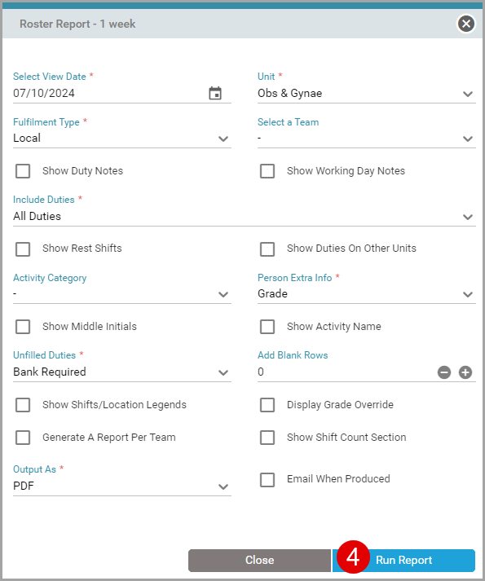
Print A Roster
HealthRoster Suite | V12 HealthRoster
4. In the form that opens, complete the fields you want, then select Run Report.
Note: You can export this report via Excel, Word, or PDF.
Vimeo link - https://vimeo.com/459900087/abe67b67ad

