Slide 1
ELFT Training Packages for Primary Care
ADHD and autism
Responsible Clinician for contact:
Frank Röhricht
Associate Medical Director

Slide 2
What is ADHD?
Inattention
Hyperactivity
Impulsivity
Notes:
The core symptoms of ADHD, as defined in the DSM-IV¹ and ICD-10² diagnostic criteria, are inattention, impulsivity and hyperactivity.
The differences between these diagnostic criteria will be outlined later.
References
Diagnostic criteria for ADHD (DSM-IV). www.turnertoys.com/ADHD/APA_diagCriteria.htm
The impact of classification on pharmacologic interventions. www.medscape.com/viewarticle/445220?src=search

Slide 3
Symptom groups
Inattention | Hyperactivity | Impulsivity
Does not pay attention Avoids sustained effort Doesn’t seem to listen when spoken to Fails to finish tasks Can’t organise Loses things, ‘forgetful’ Easily distracted | Fidgets Leaves seat in class Runs/climbs excessively Cannot play/work quietly Always ‘on the go’ Talks excessively | Talks excessively Blurts out answers Cannot await turn Interrupts others Intrudes on others
Notes:
The core symptoms of ADHD and hyperkinetic disorder (HKD), a more severe form of ADHD, are developmentally inappropriate levels of inattention, hyperactivity and impulsivity.
A diagnosis of ADHD by the DSM-IV requires the presence of six or more symptoms from at least one symptom group (inattention or hyperactivity–impulsivity).
A diagnosis of HKD by the ICD-10 requires symptoms to be present in all three categories and in more than one situation (home, school, etc.).
The ICD-10 criteria for HKD therefore describe a more severe condition that the DSM-IV criteria for ADHD.
References
Diagnostic criteria for ADHD (DSM-IV). www.turnertoys.com/ADHD/APA_diagCriteria.htm
The impact of classification on pharmacologic interventions. www.medscape.com/viewarticle/445220?src=search

Slide 4
Also……
Present for >6/12
Present from before age of 6-7 years
Pervasive across settings
Causing significant impairment
Not better explained by alternative diagnosis

Slide 5
Developmental impact of ADHD
Academic problems
Difficulty with social interactions
Self-esteem issues
Legal issues, smoking
and injury
Occupational failure
Self-esteem issues
Relationship problems
Injury/accidents
Substance abuse
Behavioural
disturbance
Pre-school Adolescent Adult
School-age College-age
Behavioural disturbance
Academic problems
Difficulty with social interactions
Self-esteem issues
Academic failure
Occupational difficulties
Self-esteem issues
Substance abuse
Injury/accidents
Notes:
Up to 60% of childhood ADHD has been shown to continue into adulthood.¹
Reference
Baren M. ADHD in adolescents: Will you know it when you see it? Contemporary Pediatrics 2002; 19: 124-141.

Slide 6
Just a childhood disorder?
Inattention persists in 50-60%
  If 5-10% in children, then 3-6% in adults
Impact in adults
  Socioeconomic
    Academic, employment, relationships, driving
  Psychological
    Low self-esteem, unhappiness, ‘ups and downs’, stress
Comorbidities

Slide 7
Diagnostic criteria (DSM-IV-TR)
  Inattention symptoms
  Hyperactivity/impulsivity symptoms
  Before 7y/o
  Impairment in at least two settings (study, work, relationships, family/friends etc.)
  Can’t be better explained by another disorder
Consider amending the criteria for adults
  Reduce severity/number of required symptoms
  Increase variety of symptoms, less hyperactivity, more inattention

Slide 8
Diagnostic Criteria
Hyperkinetic Disorder
ICD-10
Inattention and hyperactivity/impulsivity
6/12 +
< 6 years
Symptoms present in > 1 setting
Significant impairment
Absence of other disorder
1.5% prevalence
ADHD
DSM-IV
Inattention and/or hyperactivity/impulsivity
6/12 +
< 7 years
Some impairment in > 1 setting
Significant impairment
Not better explained by another disorder
5% prevalence

Slide 9
Diagnosis NICE Sept 2008
Should only be made by a specialist psychiatrist, paediatrician or other healthcare professional with expertise in ADHD
Full clinical and psychosocial assessment
Full developmental and psychiatric history
Observer reports and MSE
Assessment of needs, comorbidity, psychosocial circumstances, physical health
Assessment of parents’ mental health

Slide 10
ADHD Assessment - Newham CFCS
family interview
child interview
physical examination
psychometric assessment
school liaison +/- classroom observation
parent and teacher rating scales
feedback to parent and child

Slide 11
Family interview
History of presenting complaint
Information about school performance
Assess for alternate or co-morbid disorders
Obstetric history
Developmental history
Family history and functioning
Past Medical / Psychiatric history
Observations within the session

Slide 12
2. Child interview
functioning within the family, school and peer group
general evaluation of psychopathology
child’s attitude to and coping with their difficulties
social skills deficits
ability to concentrate and persist
evidence of language disorder
Internalising symptoms

Slide 13
3. Physical examination
Assessment of underlying medical problems contributing to presentation
Assessment for potential contraindications to pharmacological intervention
Baseline measurements of height, weight and blood pressure may be conveniently completed at this time
The child should be accompanied by their parent or carer for such examination

Slide 14
4. Psychometric assessment
no psychological test which decisively characterises ADHD
basic assessment of the child’s cognitive functioning
more formal psychometric testing
(eg WISC) if cognitive delay suspected

Slide 15
5a. School - liaison
Talk to class teacher or SENCO
Information re core ADHD symptoms
Other symptoms
Peer and adult relationships
Learning
Statement / Level of extra help provided
Teacher’s opinion of problem behaviour

Slide 16
5b. School - observation
Observation of 2 different types of activity e.g. structured work and playtime.
Symptoms of overactivity and inattention
Attention-seeking behaviour
Peer relationships
Baseline activity level of whole class
Actions of teaching staff to help contain behaviour
Is this a typical day for this child?

Slide 17
6. Rating scales
Parent Strengths & Difficulties Questionnaire (SDQ)
Conners Parent Rating Scale (Short or Long)
Self SDQ
Conners-Wells’ Self-Report Scale (Short or Long)
Teacher SDQ
Conners Teacher Rating Scale (Short or Long)
Children’s Global Assessment Scale (CGAS)

Slide 18
7. Feedback to parent and child
diagnoses & management plan agreed
follow-up arrangements made
referral on to specialist services if needed
letter or report sent to GP and parent +/- child
brief summary sent to the school

Slide 19
Adult ADHD – future dx changes
Changes in DSM – V
  Increasing the required age of onset for symptoms to age 12 or earlier (previously age 7 or earlier)
  Inclusion of additional examples of how symptoms typically look in older adolescents and adults
  Elimination of required “impairment”
    “There is clear evidence that the symptoms interfere with, or reduce, the quality of social, academic, or occupational functioning.”

Slide 20
Differential Dx
‘Cornerstones’ of diagnosis
  Detailed clinical interview (+coping strategies)
  Symptom rating scales
  Collateral information – need evidence of developmental symptoms
  Assess comorbidities
Diagnostic dilemma for symptoms first noticed in adulthood
  Is it due to another disorder that overlaps (comorbidity) OR is it ADHD undiagnosed in childhood?

Slide 21
Initial Presentation
‘I did an online form’
‘my kid has it’
‘I use drugs’
‘I have feel unfulfilled for years’
‘I get into trouble’
‘I never get things right’

Slide 22
What Doctors worry about
It’s just a popular fad
It’s a ‘choice’, not a illness
Stimulants are just used to improve studying
Stimulants are addictive
Stimulants are not licensed
Stimulant market value
Monitoring is complicated
Treatment is expensive

Slide 23
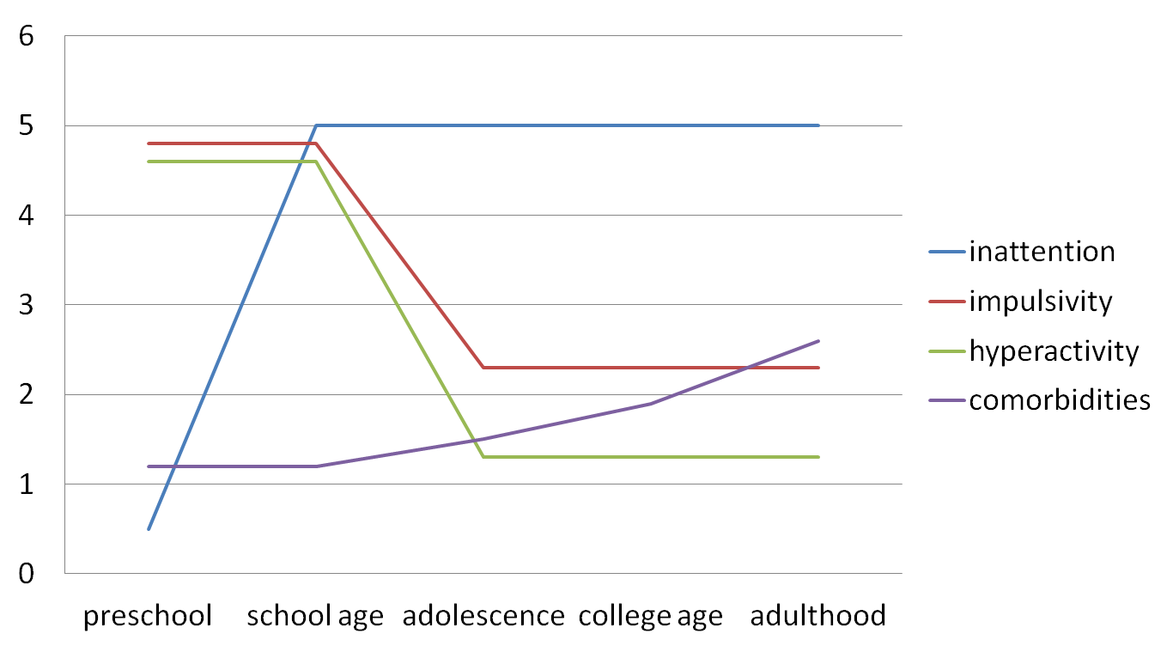
Evolution of ADHD symptoms with age
(adapted from Stahl’s Essential Psychopharmacology, 2013)

Slide 24
Advice after Diagnosis NICE Sept 2008
Self-instruction manuals for parents and other materials based on behavioural techniques
Stress value of balanced diet and regular exercise
Dietary change generally not recommended
Dietary fatty acids not recommended

Slide 25
Pre-school children NICE Sept 2008
Drug treatment not recommended
Parent-training / education programme
If effective, monitor for recurrence of symptoms
If ineffective, consider referral to tertiary service

Slide 26
School-age, mod ADHD, mod impairment
NICE Sept 2008
Drug treatment not indicated as first-line treatment
Parent-training / education programme +/- group treatment (CBT/social skills training for child
Consider individual psychological interventions for older adolescents
If effective, review for comorbid problems
If ineffective, consider drug treatment

Slide 27
School-age, severe ADHD, severe impairment
NICE Sept 2008
Offer drug treatment as first-line treatment
Parent-training / education programme

Slide 28
Stimulants
Methylphenidate
Sustained release
  Concerta XL (70/30)
  Medikinet XL (50/50)
  Equasym XL (50/50)
Immediate release
  Ritalin
  Methylphanidate HCL

Slide 29
Choice of Drug Treatment NICE Sept 2008
Methylphenidate, atomoxetine and dexamfetamine
Consider:
Comorbidities (eg tics, epilepsy)
Different adverse effects
Potential problems with compliance
Potential for drug diversion and misuse
Family / child preference
Cost

Slide 30
Behavioural & Psychological interventions
Parent-training / education programmes
  1st line for < 6yrs or not severe ADHD
  associated with lower levels of medication
  useful in the treatment of comorbid disorders particularly oppositional or conduct disorders
  group or individual based
Group CBT and social skills training
  Social skills with peers
  Problem solving
  Self-control
  Listening skills
  Dealing with expressing feelings

Slide 31
Treatment – Newham CFCS
Psychoeducation
Pharmacotherapy
- 1st line
- 2nd line
- practicalities
- others medications
Psychosocial interventions
Treatment Algorithms

Slide 32
Psychoeducation
information to child, parents and teachers
symptoms of the condition, aetiology, treatment options, management advice, medication effects and side-effects, expected course and prognostic features
information leaflets or booklets on ADHD and co-morbid diagnoses
specific teaching and management recommendations
Parent Support Group

Slide 33
Stimulants-2
Amphetamines
Sustained Release
– Elvanse (newly licensed)
- Adderall (USA)
Immediate Release
Dexamphetamine
Modafinil - histamine agonist??

Slide 34
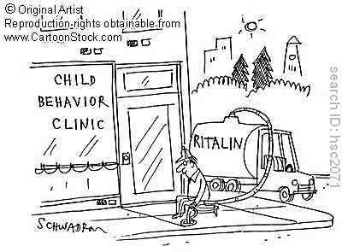
Pharmacotherapy – 1st line
immediate-release methylphenidate
  Equasym®
  Ritalin®
modified-release methylphenidate
  Concerta XL®
  Equasym XL®
  Medikinet XL®

Slide 35
Pharmacotherapy – 2nd & 3rd line
Atomoxetine (Strattera®)
Dexamfetamine sulphate
  Immediate-release (Dexedrine®)
Dexamfetamine dimesylate
  Prodrug (Elvanse®)

Slide 36
1. Physical screen
Assessment of history of exercise syncope, undue SOB and other CVS symptoms
Family history of heart disease or sudden death in young person
Height & weight
Pulse & blood pressure & heart sounds
If there are concerns regarding the child’s physical state, consider ECG or referral to GP or paediatrician for further assessment
Risk assessment for substance misuse and drug diversion
All examination results should be recorded in the medical notes

Slide 37
2a. Initiation of treatment Methylphenidate-IR
Dose titration over 4-6 wks
- lowest effective dose / maximum therapeutic effect / minimum adverse effects
response to MPH variable and cannot be predicted on a dose/body weight basis
Commenced at a low level (0.2 mg/kg/dose) and be increased until either a good result is achieved, or adverse effects appear, or a ceiling of 0.7 mg/kg/dose t.d.s.

Slide 38
2b. Initiation of treatment Methylphenidate-IR
For most children, the starting dose of MPH will be 5 mgs b.d or t.d.s.
Children with comorbid developmental disorders may require even lower starting doses
Within 2 weeks of commencing treatment or adjusting dose, contact with parent to enquire about effect and side effects of treatment at home and at school
The total dose of MPH should not normally exceed 60 mgs daily,
(may go up to max of 90 mgs MPH-IR daily if poor response)

Slide 39
2c. Initiation of treatment Methylphenidate-MR
Concerta XL®, Equasym XL®, Medikinet XL® may also be used from the start of therapy - avoids stigma at school, improved compliance, but less dose flexibility
Starting dose of 18 mg/day (Concerta XL®) or 10 mg/day (Equasym XL®, Medikinet XL®)
If treatment commenced with MPH-IR, once a stable dose is achieved, treatment may switch to MPH-MR

Slide 40
3a. Ongoing Monitoring
Effects and side-effects of medication should be monitored at each appointment
Feedback should be obtained from both parents and teachers
Abbreviated Conner’s Rating Scales and Strengths & Difficulties Questionnaires
Height & weight should be monitored at month 3 and 6, then every 6 months and recorded on a centile chart
Pulse & blood pressure should be monitored every 3 months and recorded on centile chart
Blood testing & ECG only if clinically indicated
Annual review to assess ongoing need for meds
Consider comorbidities and treat where appropriate

Slide 41
3b. Monitoring - Side Effects
Headache / stomach ache / nausea
Appetite suppression
Increased emotionality
Tachycardia & Hypertension
Delayed sleep onset
Tics
Psychosis
Suicidal thoughts / Self-harm and liver damage (Atomoxetine)
Drug misuse and diversion

Slide 42
5. Termination of treatment
In the UK it is common to tail off medication as the young person completes their schooling. Should be gradual to avoid rebound effects
In some cases, patients may require continuing medication into adulthood
Transition policy with adult services

Slide 43
Psychosocial Interventions
Brief parent-training / education
ADHD Parenting Group
Community Parent Support Group
EP advice to schools
Systemic therapy
Other CAMHS therapeutic interventions

Slide 44
Non-stimulants
Benefit is not as pronounced and takes longer to manifest; No addiction/diversion risk
Role in specific comorbidities
Atomoxetine (NRI - only Rx licensed in adult ADHD)
Reboxetine (NRI)
Bupropion (NDRI)
Duloxetine (SNRI)
Venlafaxine (SNRI)
Nortriptiline (TCA)

Slide 45
Monitoring and follow up
BP
Pulse
Weight
Initial ECG
Monitor for anxiety, elated mood, psychosis
Need to avoid caffeine
CBT

Slide 46
Adult ADHD
Just a childhood disorder?
Inattention persists in 50-60%
  If 5-10% in children, then 3-6% in adults
Impact in adults
  Socioeconomic
    Academic, employment, relationships, driving
  Psychological
    Low self-esteem, unhappiness, ‘ups and downs’, stress
Comorbidities in up to ¾ adults

Slide 47
Adult ADHD
Diagnostic criteria (DSM-IV-TR)
  Inattention symptoms
  Hyperactivity/impulsivity symptoms
  Before 7y/o
  Impairment in at least two settings (study, work, relationships, family/friends etc.)
  Can’t be better explained by another disorder
Consider amending the criteria for adults
  Reduce severity/number of required symptoms
  Increase variety of symptoms

Slide 48
Adult ADHD
Changes in DSM – V
  Increasing the required age of onset for symptoms to age 12 or earlier (previously age 7 or earlier)
  Inclusion of additional examples of how symptoms typically look in older adolescents and adults
  Elimination of required “impairment”
    “There is clear evidence that the symptoms interfere with, or reduce, the quality of social, academic, or occupational functioning.”

Slide 49
Evolution of ADHD symptoms with age
(adapted from Stahl’s Essential Psychopharmacology, 2013)

Slide 50
Adult ADHD
‘Cornerstones’ of diagnosis
  Detailed clinical interview (+coping strategies)
  Symptom rating scales
  Collateral information
  Assess comorbidities
Diagnostic dilemma for symptoms first noticed in adulthood
  Is it due to another disorder that overlaps (comorbidity) OR is it ADHD undiagnosed in childhood?

Slide 51
Initial presentation
‘I did an online form’
‘my kid has it’
‘I use drugs’
‘I have feel unfulfilled for years’
‘I get into trouble’
‘I never get things right’
‘I was OK at school but felt an outcast’

Slide 52
What doctors worry about
It’s just a popular fad
It’s a ‘choice’, not a illness
Stimulants are just used to improve studying
Stimulants are addictive
Stimulants are not licensed
Stimulant diversion
Monitoring is complicated
Treatment is expensive
It’s all a conspiracy by ‘big pharma’

Slide 53
‘Unpacking’ the syndrome and its biological corelates
Individual symptom domains corelate with cortico-striato-thalano-cortical ‘loops’ involving different parts of the PFC
Sustained attention – Dorsolateral prefrontal cortex
Selective attention – Anterior cingulate cortex
Hyperactivity – Prefrontal motor cortex
Impulsivity – Orbitofrontal cortex
Comorbid conditions have similar corelates in nearby prefrontal/limbic CSTC loops

Slide 54
It’s a ‘tuning’ problem
It’s about efficient information processing...or not as the case may be!
Dopamine – regulates ‘noise’ strength
Noradrenaline – regulates ‘signal’ strength
Too little or too much of either creates a ‘tuning’ problem (inverted bell curve model)

Slide 55
How best to ‘tune’
Sustained release
Tonic DA firing
-Sustained benefit during working day
-Low addiction risk
-Low risk of diversion
Immediate release
Phasic DA firing
-Short lived benefit
-Higher addiction risk
-Higher risk of diversion

Slide 56
Stimulants
Licensed in children but unlicensed for adults
Prescribed in adults under specialist supervision/advice
Controlled drug prescribing – hassle!!
Methylphenidate
Sustained release
  Concerta XL (70/30)
  Medikinet XL (50/50)
  Equasym XL (50/50)
Immediate release
  Ritalin
  Methylphanidate HCL
Amphetamines
Sustained release
  Elvanse (newly licensed)
  Adderall (USA)
Immediate release
  Dexamfetamine
Modafinil - Histamine agonist??

Slide 57
Non-stimulants
Benefit is not as pronounced and takes longer to manifest
No addiction/diversion risk
Role in specific comorbidities
Rx with NRI function
Atomoxetine (NRI - only Rx licensed in adult ADHD)
Reboxetine (NRI)
Bupropion (NDRI)
Duloxetine (SNRI)
Venlafaxine (SNRI)
Nortriptiline (TCA)
a2A adrenergic agonists
Clonidine (a2A, a2B, a2C, imidazoline)
Guanfacine (a2A)

Slide 58
What to treat first ?- comorbidities
Substance misuse
Bipolar disorder
Anxiety disorder
ADHD
Depression
Nicotine dependence

Slide 59
Introduction
What are the Autism Spectrum Disorders?
What are the diagnostic criteria?
What are the eligibility requirements for Special Education in Minnesota?

Slide 60
Autism Spectrum Disorders
(Also known as pervasive developmental disorders)
Pervasive Developmental Disorder Not Otherwise Specified (or atypical autism)
Rett Syndrome
Childhood Disintegrative Disorder
Asperger Syndrome
Autism

Slide 61
What is Autism?
Four ways to “define” autism
  DSM-IV
  Parents with a child with autism
  Individuals with autism
  What we know (i.e. stereotypes of autism)
Let’s take a look at each one to get a more comprehensive idea of this disorder

Slide 62
DSM-IV criteria
First, important to note that autism is a spectrum disorder characterized by:
  Impairments in social interaction
  Impairments in communication
  Presence of restricted, repetitive behaviors (RRBs)
Spectrum = variability within and across these areas
1 in 150 children diagnosed with autism includes the entire spectrum

Slide 63
DSM-IV criteria (continued)
Umbrella term is really Pervasive Developmental Disorders (PDD)
  5 different subtypes of PDD
    Autistic Disorder
    Asperger’s Disorder
    PDD-NOS
    Rhett’s Disorder
    Childhood Disintegrative Disorder
Autism Spectrum Disorders

Slide 64
Story from a Teenager with ASD
“The characteristics of people with Asperger's are the perfect ones to make obtaining friends difficult. Asperger's Syndrome is part of a spectrum of autistic disorders, all linked by a level of non-communication. At the lowest level, we have cases like my brother Eric, a person trapped in a void where communication is only at the most rudimentary level, about the level of a non-expressive two or three year old. Then among several forms at the highest level, we have Asperger's syndrome. Those with Asperger's often suffer from a plethora of symptoms. The most prominent ones are difficulty with reading people's body language, a singular interest in a subject or several subjects (from my own life, I have one major interest in rock music, compulsively looking for new reviews and obsessing over the best quality of sound to listen to them), a slight monotone voice, struggling with proper body distance, and a tendency to use a vocabulary that is of a slightly higher sophistication than most people would use such as when I employ words like vitriolic, inundate, smorgasbord, plethora, paraphernalia, and others of that variety. While obviously every person with the syndrome may not experience each and every single trait, I have experienced all of these symptoms to some degree. Couple that with a fairly shy personality, a shyness that may or may not have anything to do with Asperger's Syndrome, and I am often left feeling like everyone sees me as being quiet and not worth talking to.”
(Autismspeaks.org)

Slide 65
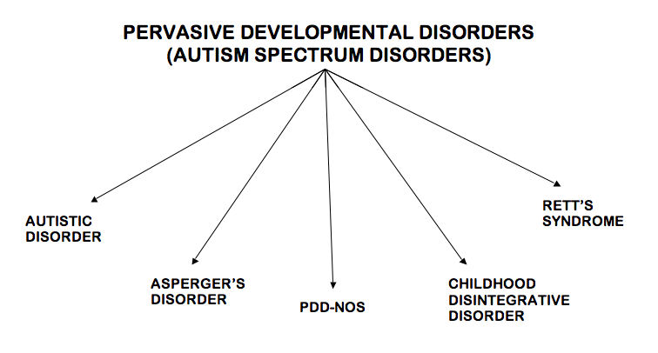

Slide 66
Definition
Autism Spectrum Disorders:
  Disorders are characterized by varying degrees of impairment in:
    (1) Communication skills
    (2) Social interactions
    (3) Repetitive and stereotyped patterns of behavior.

Slide 67
Pervasive Developmental Disorder Not Otherwise Specified (or atypical autism)
Persons who display behaviors typical of autism but to a lesser degree and/or with an onset later than three years of age

Slide 68
Aspergers
Similar to mild autism but without significant impairments in cognition and language.

Slide 69
Autism
Definition from IDEA:
A developmental disability affecting verbal and nonverbal communication and social interaction, generally evident before age 3, that affects a child’s performance. Other characteristics often associated with autism are engagement in repetitive activities and stereotyped movements, resistance to environmental change or change in daily routines, and unusual responses to sensory experiences. The term does not apply if a child’s educational performance is adversely affected primarily because the childe has serious emotional disturbance.
Notes:
IDEA:

Slide 70
Autism Characteristics
Impaired social interaction
  Picked up/cuddled
  Smile/laugh
  Objects vs. people
Impaired communication
  50% thought to be mute
  Robotic, parroting or reverse pronouns
Repetitive and stereotyped patterns of behavior
  Twirling, flapping of hands, rocking
  Restricted range of interest

Slide 71
Causes
Neurological
No single, known cause
Genetic Problems
  Depending on the gene, a child may be more susceptible to the disorder
    Can affect the way brain cells communicate
    Can affect the severity of the symptoms
Environmental Problems
  Causes many other health problems
  Exploring whether or not trigger autism
    ie. air pollutants and viral infections

Slide 72
Vaccines and Autism
No reliable study has shown a link between the MMR vaccine and autism
Avoiding vaccines can place your child at risk for catching serious diseases

Slide 73
Facts
Approximately 1 in 110 children are diagnosed with autism.
Over the last 30 to 40 years there has been great increase in the number of diagnosed cases.
Autism is the fastest-growing serious developmental disability in the U.S.
Sometimes students can be identified as LD or DCD when if fact they have autism.

Slide 74
More Facts
Autism is more prevalent in boys than girls
  Approximately 3:1 or 4:1
Autism is more prevalent in siblings of those with ASD
Autism is more prevalent in those with other developmental disorders such as Fragile X syndrome, Developmental Cognitive Delayed, or Tuberculosis.

Slide 75
Early Signs of Autism
6 months
  No big smiles or warm, joyful expressions
9 months
  No back and forth sharing of sounds, smiles, etc
12 months
  No consistent response to his/her name
  No babbling
  No back and forth gestures, such as pointing showing, reaching, waving, or three-pronged gaze
16 months
  No words
24 months
  No two-word meaningful phrases (without imitation or repeating)

