Slide 1
ELFT Training Packages for Primary Care - Dementia -
Dr. Nick Bass
Senior Lecturer UCL
Honorary Consultant Psychiatrist, Tower Hamlets Diagnostic Memory Clinic
Responsible Clinician for contact: Frank Röhricht
Associate Medical Director

Slide 2
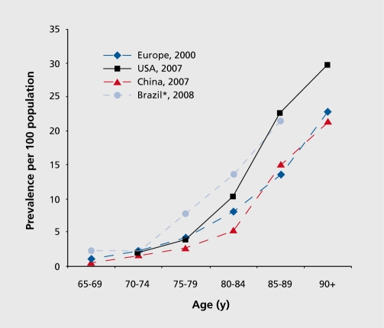
Qui et al. Dialogues Clin Neurosci. 2009

Slide 3
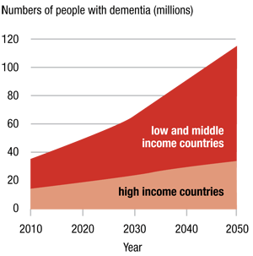
World Alzheimer Report 2010

Slide 4
Some figures
UK: 820,000 (Dementia 2010 report by Alzheimer’s Research Trust and the University of Oxford); 1.4 million by 2040
World: 35.6 million (World Alzheimer Report 2009); 42.3 million by 2020 Feancet 2005)

Slide 5
UK dementia costs
£23 billion per year
Each person with dementia costs the economy £27,647 per year, a value £3,000 higher than the UK median salary
2038 - Over £50 billion

Slide 6
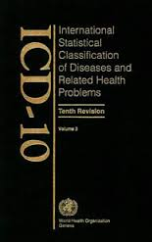
Definition of dementia

Slide 7
Dementia: ICD 10 F00-F03
“..is a syndrome due to disease of the brain, usually of a chronic or progressive nature, in which there is disturbance of multiple higher cortical functions, including memory, thinking, orientation, comprehension, calculation, learning capacity, language, and judgement.
Consciousness is not clouded.
The impairments of cognitive function are commonly accompanied, and occasionally preceded, by deterioration in emotional control, social behaviour, or motivation.
This syndrome occurs in Alzheimer's disease, in cerebrovascular disease, and in other conditions primarily or secondarily affecting the brain.”
Notes:
Sorry overview of demntia through ICd10, looking glass. Zippy trousers

Slide 8
ICD 10 General Criteria for dementia
G1. Evidence of each of the following:
(1) A decline in memory, which is most evident in the learning of new information, although in more severe cases, the recall of previously learned information may be also affected. The impairment applies to both verbal and non-verbal material. The decline should be objectively verified by obtaining a reliable history from an informant, supplemented, if possible, by neuropsychological tests or quantified cognitive assessments.
(2) A decline in other cognitive abilities characterized by deterioration in judgement and thinking, such as planning and organizing, and in the general processing of information. Evidence for this should be obtained when possible from interviewing an informant, supplemented, if possible, by neuropsychological tests or quantified objective assessments. Deterioration from a previously higher level of performance should be established.

Slide 9
Cont.
G2. Preserved awarenenss of the environment (i.e. absence of clouding of consciousness). When there are superimposed episodes of delirium the diagnosis of dementia should be deferred.
G3. A decline in emotional control or motivation, or a change in social behaviour, manifest as at least one of the following:
(1) emotional lability;
(2) irritability;
(3) apathy;
(4) coarsening of social behaviour.

Slide 10
Subdivision of dementia:F00-F03
F00 Dementia in Alzheimer's disease
F01 Vascular dementia
F02 Dementia in other diseases classified elsewhere
F03 Unspecified dementia

Slide 11
F00: Dementia in Alzheimer's disease (AD)

Slide 12
Epidemiology of AD
AD accounts for 53.7% of dementia
(Prevalence of dementia and major subtypes in Europe: A collaborative study of population-based cohorts. Neurologic Diseases in the Elderly Research Group. Neurology. 2000)
Early onset AD - rare

Slide 13
ICD 10 Criteria
The general criteria for dementia (G1 to G4) must be met:
There is no evidence from the history, physical examination or special investigations for any other possible cause of dementia (e.g. cerebrovascular disease, Parkinson's disease, Huntington's disease, normal pressure hydrocephalus), a sysytemic disorder (e.g. hypothyroidism, vit. B12 or folic acid deficiency, hypercalcaemia), or alcohol- or drug-abuse.

Slide 14
Dementia in AD with early onset (F00.0): Clinical features
< 65
relatively rapid onset and progression
evidence of temporal/parietal and/or frontal lobe involvement

Slide 15
Dementia in AD with late onset(F00.1): Clinical features
> 65 (onset usually in the late 70s)
very gradual onset and progression
memory impairment predominates

Slide 16
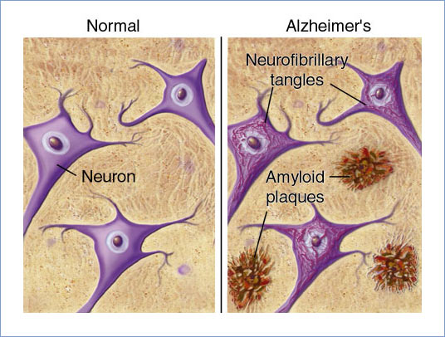

Slide 17
AD: Macroscopic neuropathological features
Cortical cerebral atrophy particularly affecting:
medial temporal lobe (hippocampus)
parietal cortex
frontal cortex
Atrophy seen as:
brain shrinkage
increased ventricular size
widening of sulci/narrowing of gyri

Slide 18
Neurochemical features
Decreased levels of acetylcholine
Decreased choline acetyltransferase activity
Decreased levels of other neurotransmitters and neuromodulators
Notes:
reduced activity of the cholinergic marker enzyme choline acetyltransferase in the cerebral cortex, but cortical concentrations of noradrenaline, gamma-aminobutyric acid, and somatostatin were also significantly reduced. ? Regional differences in the neurochemical changes.

Slide 19
Aetiology of Alzheimer’s disease?

Slide 20
Autosomal dominant AD
Usually early onset....but not invariably
Approximately 10% of early onset dementia familial

Slide 21
Age & Genetics
65-69 : prevalence 1.5% (dementia)
95-99 : prevalence 45% (dementia)
Family history : 3-4 x risk, first degree relative with AD

Slide 22
Late onset Alzheimer’s: Other risk factors and protective factors

Slide 23
Vascular pathway hypothesis
Risk factors:
- midlife high blood pressure
- high BMI
- diabetes
- cerebrovascular disease
- smoking
Protective factors:
- light-to-moderate alcohol consumption
- antihypertensive therapy
- physical activity
(Qui et al Dialogues Clin Neurosci. 2009)

Slide 24
Psychosocial hypothesis
Protective factors:
- high educational attainment
- mentally stimulating activities
- social activity and enriched social network
(Qui et al Dialogues Clin Neurosci. 2009)

Slide 25
Treatment of AD and what is treatment?

Slide 26
Prevention
Modification of risk factors/protective factors in middle-aged and older people

Slide 27
Treatment: Memory pills or “Promoting and maintaining independence of people with dementia”
Social
Psychological
drugs

Slide 28
Group Cognitive Stimulation Therapy
http://www.cstdementia.com/index.php
Manualised
14 sessions of themed activities (Physical games, Sound, Childhood, Food, Current affairs, Faces / scenes, Word association, Being creative, Categorising objects, Orientation, Using money, Number games, Word games, Team quiz)
“.........to actively stimulate and engage people with dementia, whilst providing an optimal learning environment and the social benefits of a group.”

Slide 29
Group Cognitive Stimulation Therapy
Mild to moderate dementia.
+/- anti-dementia medication
Availability?

Slide 30
Pharmacopeia for AD
NICE 2011:
Acetylcholinesterase (AChE) inhibitors (donepezil, galantamine and rivastigmine) mild as well as moderate Alzheimer’s disease
Memantine - option for moderate Alzheimer’s disease for people who cannot take AChE inhibitors, for severe Alzheimer’s disease.

Slide 31
Acetylcholine and Alzheimer’s
Acetylcholine blockade - amnesia
Post -mortem studies - decreased acetylcholine in various areas including hippocampus
Decreased choline acetyltransferase activity
Decreased number of cholinergic neurons
? Relationship between acetyl choline loss and amyloid plaques

Slide 32
(Fairly predictable) General cautions: AChE
Respiratory disease (asthma, COPD)
Cardiac disease (sick sinus syndrome, other supraventricular conduction abnormalities i.e. bradycardia)
Gastrointestinal disease (peptic ulcers)
Hepatic impairment

Slide 33
(Less predicatble) Additional cautions
Galantamine: unstable angina, congestive heart failure, electrolyte disturbances, pulmonary infection, urinary retention/surgery, GI obstruction/surgery, renal impairment, seizures
Rivastigmine: low body weight, seizures, renal impairment, bladder outflow obstruction

Slide 34
Investigations prior to prescribing?
ECG
LFTs
BMI

Slide 35
Glutamate neurotransmission and the NMDA receptor in dementia

Slide 36
Glutamate
It is one the major excitatory neurotransmitters
It is considered a master switch as it can turn on all CNS neurons

Slide 37
Over-excited NMDA receptors in AD?
Amyloid
Calcium
Excitation of NMDA receptors
Neuronal damage
Cognitive defects

Slide 38
Memantine (Ebixa)
Non-competitive low-affinity antagonist of the NMDA receptor, t(1/2) of 70 h.
Mainly eliminated unchanged via the kidneys.

Slide 39
Cautions: Memantine
History of seizures
Renal impairment
Hepatic impairment

Slide 40
Investigations prior to prescribing?
U&Es

Slide 41
Pros: AChE inhibitors and memantine
Efficacy: very small improvement in cognition over 6 months

Slide 42
Cons: Common side effects with AChE inhibitors
Loss of appetite
Nausea, vomiting
Stomach cramps
Diarrhoea
Headaches
Dizziness
Faints
Fatigue
Insomnia
Vivid dreams

Slide 43
Cons: Memantine
Dizziness
Headaches
Tiredness
Increased blood pressure
Constipation

Slide 44
Dosing and concordance
Formulations
Practicalities

Slide 45
Review
History – efficacy, side-effects, concordance
Examination – cognitive testing?, pulse?, BP? weight?
Investigations – ?

Slide 46
When assessing a patient with the features of early dementia which of the following would suggest a sub-cortical rather than a cortical cause?
a) Absence of dysarthria
b) Calculation preserved
c) Euthymic mood
d) Mild aphasia
e) Normal speed of cognitive processes

