Slide 1
ELFT Training Packages for Primary Care - Vascular & other Dementia
Dr. Nick Bass
Senior Lecturer UCL
Honorary Consultant Psychiatrist, Tower Hamlets Diagnostic Memory Clinic
Responsible Clinician for contact: Frank Röhricht
Associate Medical Director

Slide 2
Epidemiology
15-20% of dementia?

Slide 3
ICD 10 Criteria
The general criteria for dementia must be met
Unequal distribution of deficits in higher cognitive functions, with some affected and others relatively spared. Thus memory may be quite markedly affected while thinking, reasoning and information processing may show only mild decline.
There is clinical evidence of focal brain damage, manifest as at least one of the following:
(1) unilateral spastic weakness of the limbs;
(2) unilaterally increased tendon reflexes;
(3) an extensor plantar response;
(4) pseudobulbar palsy.
There is evidence from the history, examination, or tests, of a significant cerebrovascular disease, which may reasonably be judged to be etiologically related to the dementia (e.g. a history of stroke; evidence of cerebral infarction).

Slide 4
F01.2: Subcortical vascular dementia
Includes cases with a history of hypertension and foci of ischaemic destruction in the deep white matter of the cerebral hemispheres
The cerebral cortex is usually preserved and this contrasts with the clinical picture which may closely resemble that of dementia in Alzheimer's disease

Slide 5
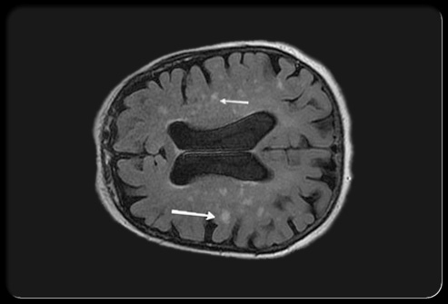
Notes:
? Multi-infarct dementia, ? subcortical

Slide 6
Risk factors
Age
PMH: MI, CVA ,TIAs
Cholesterol
BP (high and low)
Diabetes
Smoking
Obesity
Atrial fibrillation
Sleep apnoea
African-Caribbean, Indian, Bangladeshi, Pakistani or Sri Lankan ethnic background
Alcohol (high intake)
Physical exercise (little)

Slide 7
Treatment: Modification of risk factors
Primary prevention
Alteration of natural history

Slide 8
F02.0: Dementia in other diseases classified elsewhere
F02.0 Dementia in Pick's disease
F02.1 Dementia in Creutzfeldt-Jakob disease
F02.2 Dementia in Huntington's disease F02.3 Dementia in Parkinson's disease
F02.4 Dementia in human immunodeficiency virus [HIV] disease

Slide 9
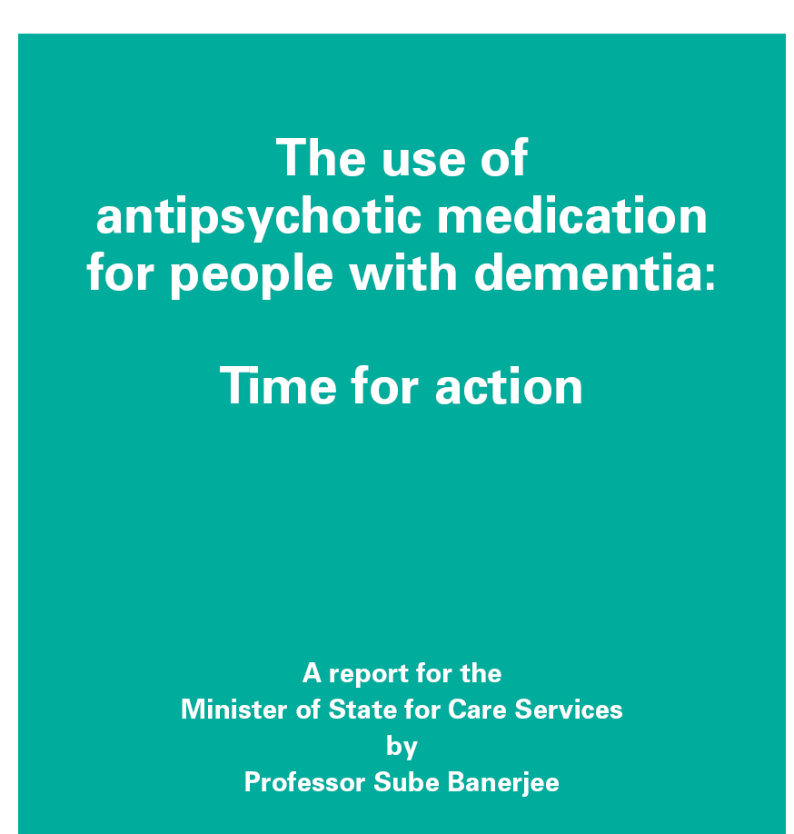
2009

Slide 11
Non pharmacological treatments
Behavioural management techniques*
Carer giver psychoeducation*
Music therapy **
Snoezelen**
Aromatherapy - maybe
Hand massage
Reflexology
*Some evidence for persisting efficacy
**acutely effective, but not long term
Notes:
Snoezelen – sensory rooms

Slide 12
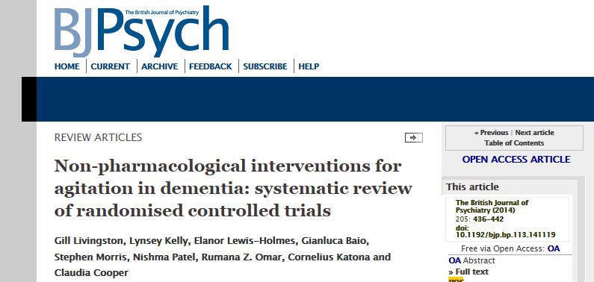
Person-centred care, communication skills training , adapted dementia care mapping, activities, music therapy by protocol and sensory interventions

Slide 14
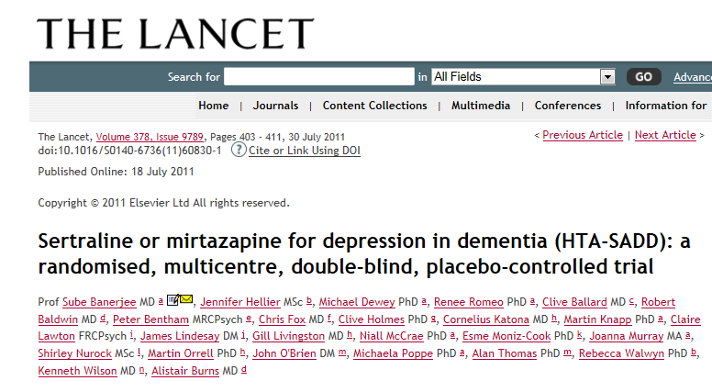

Slide 15
Antipsychotics revisited
Risperidone licensed for short term treatment (6 weeks) of persistent aggression in moderate severe Alzheimer's’ unresponsive to non – pharmacological intervention where risk to self or others
Effect size v small, poorly tolerated
No other drugs licensed for behavioural disturbance
Antipsychotic probably effective, maybe SGA more effective the FGA

Slide 17
F02.4: Dementia in human immunodeficiency virus [HIV] disease
Dementia developing in the course of HIV disease, in the absence of a concurrent illness or condition other than HIV infection that could explain the clinical features

Slide 18
Dementia in [HIV] disease
Brain macrophages, microglia, and multinucleated giant cells infected
HIV infected cells release neurotoxins
25% of patients develop dementia
Variable presentation: concentration, memory, mental slowing, coordination, weakness , balance
Rapid progression to death if untreated
? Effectiveness of anti-retrovirals

Slide 19
ICD 11
2015

Slide 20
Disturbed higher cortical function: a common symptom
Delirium *
Mood disorders
Schizophrenia
Drugs and alcohol
Anxiety disorders
Organic amnesic syndromes
Learning disability
Disorders of psychological development
etc……..
Notes:
Wide differential, non exhaustive list, i.e. most of chapter 5 of ICD 10 then some. Specific developmental disorders of speech and language, Specific developmental disorders of scholastic skills, Pervasive developmental disorders

Slide 21
Mental Capacity Act 2005: A bit of background
No statue law regarding people who lack capacity just case law
Mental capacity act – to address this lack of legislation, to protect people without capacity and people making decisions for those people
Notes:
I am no lawyer. People constantly making decisions. A&E …give im haloperidol and lorazepam in best interests under common law

Slide 22
MCA 2005: Principles
A person must be assumed to have capacity unless it is established that he lacks capacity
A person is not to be treated as unable to make a decision unless all practicable steps to help him to do so have been taken without success
A person is not to be treated as unable to make a decision merely because he makes an unwise decision
An act done, or decision made, under this Act for or on behalf of a person who lacks capacity must be done, or made, in his best interests
Before the act is done, or the decision is made, regard must be had to whether the purpose for which it is needed can be as effectively achieved in a way that is less restrictive of the person’s rights and freedom of action

Slide 23
Assessment of Capacity: two stage test
1st stage
“For the purposes of this Act, a person lacks capacity in relation to a matter if at the material time he is unable to make a decision for himself in relation to the matter because of an impairment of, or a disturbance in the functioning of, the mind or brain.”

Slide 24
Assessment of Capacity:
2nd stage:
“For the purposes of section 2, a person is unable to make a decision for himself if he is unable—
(a) to understand the information relevant to the decision,
(b) to retain that information,
(c) to use or weigh that information as part of the process of making the decision, or
(d) to communicate his decision (whether by talking, using sign language or any other means).”

Slide 25
Lasting powers of attorney
“A lasting power of attorney is a power of attorney under which the donor (“P”) confers on the donee (or donees) authority to make decisions about all or any of the following —
(a) P’s personal welfare or specified matters concerning P’s personal welfare, and
(b) P’s property and affairs or specified matters concerning P’s property and affairs,
and which includes authority to make such decisions in circumstances where P no longer has capacity.”
Replaces enduring power of attorney

Slide 26
Independent Mental Capacity Advocates
No advocate (can be friend rather than family)
Major decision (medical or social)
IMCA must be requested

Slide 27
The Court of Protection and the Public Guardian
Court of Protection
not new
can make decisions and appoint deputies for people lacking capacity
New office of the Public Guardian established

Slide 28
Advance decisions
You can make them and you need to respect them (most of the time)!
To be valid an advance decision relating to life-sustaining treatment
must state that treatment is refused even if this puts life at risk
must be written, signed and witnessed
Some exclusions e.g. treatment for mental illness

Slide 29
The Mental Capacity Act Deprivation of Liberty safeguards (DOLS)
Government’s response to “Bournewood gap”
Implemented April 2009
Applies to hospitals and care homes
Technically the procedural safeguards that have been introduced to protect people whose liberty has been deprived in their best interests to protect them from harm
Notes:
Please tell me that you know all about the Bournewood gap

Slide 30
The Mental Capacity Act Deprivation of Liberty safeguards (DOLS)
The practice
The detaining authority (e.g. manager of care home) has to consider if liberty may be being deprived
Request a DOLS assessment form the local authority (DOLS assessors)
Deprivation of liberty authorised or not authorised
Recommendations and review

Slide 31
Alcohol related cognitive problems

Slide 32
Delirium tremens
Alcohol withdrawal a cause of delirium
-classified separately from F05
-F10.4 Mental and behavioural disorders due to use of alcohol, withdrawal state with delirium
Needs urgent medical treatment

Slide 33
Wernicke's encephalopathy
Sudden onset:
Classically triad of:
-Confusion
-Ataxia (usually gait)
-Ophthalmoplegia
(nystagmus +/- palsies)
Thiamine (B1) deficiency
Not always due to alcohol
Classified in Chapter IV: Endocrine, nutritional and metabolic diseases, Other nutritional deficiencies, E51.2

Slide 34
The Korsakoff syndrome
Usually related to preceding Wernicke's encephalopathy
But can occur without Wernicke’s
Amnesic (memory) disorder:
Episodic memory - severe deficits
'Implicit' memory - preserved
New learning (semantic) - variable deficits
F10.6 : Mental and behavioural disorders due to use of alcohol, Amnesic syndrome

Slide 35
Alcohol related dementia: does it exist?
Clinically dementia in the context of long term alcohol misuse seems common but not recognised in ICD 10, clinical criteria proposed by Oslin et al, International Journal of Geriatric Psychiatry 1998
Alcohol-related dementia: a 21st-century silent epidemic? Gupta S, Warner J. Br J Psychiatry. 2008

Slide 36
Excluding other causes of cognitive impairment
Delirium
Depression

Slide 37
The old age psychiatry liaison referral: delirium versus dementia?
F05: Delirium, not induced by alcohol and other psychoactive substances:
“An etiologically nonspecific organic cerebral syndrome characterized by concurrent disturbances of consciousness and attention, perception, thinking, memory, psychomotor behaviour, emotion, and the sleep-wake schedule. The duration is variable and the degree of severity ranges from mild to very severe.”
Notes:
That old chestnut

Slide 38
Delirium versus dementia: Is the MSE helpful?
Disturbances of consciousness* - not a feature of dementia
Abnormalities of attention and perception PERHAPS more prominent.

Slide 39
Making a diagnosis of delirium
-TAKE A PROPER HISTORY
-Do a proper physical examination
-Do some more tests
Notes:
Establish onset and associated symptoms, collateral history.

Slide 40
Delirium miscellany
Causes – many and varied! Often is UTI or pneumonia in elderly
High mortality
Don’t miss a sub-dural haemorrhage
Notes:
Name some causes of delirium. Mortality rates depend on population being e.g. patients admitted with delirium, patients who develop delirium in hospital. Length of follow up.

Slide 41
Depression versus dementia
Pseudo dementia
History – temporal order
MSE – psychomotor retardation, poor concentration, effort to answer, “don’t know answers”
House method
Notes:
Mood symptoms likely to precede cognitive impairment. Decreased motor activity, delayed responses to questions also seen in dementia. Clasically give “don’t know answers”. Give a trail of antidepressants and repeat MMSE.

Slide 42
Multiplying confusions
Conditions disturbing higher cortical functions not mutually exclusive
Dementia is risk factor for delirium
Relationship between dementia and depression
complex
Notes:
In the general hospital – acute on chronic confusion common, delirium may be the first presentation of dementia. People with dementia often get depressed. ? Is depression a risk factor for dementia. ? Role of vascular depression. People with learning disability get dementia ( particularly with trisomy 21. very little data on epidemology of dementia in context of schizophrenia – probably because very hard to disentangle. How would you do it?

Slide 43
Standardised cognitive assessments
MMSE – Folstein et al.1975
Information –Memory – Concentration (IMC) Test - performance correlates reasonably with neuropathological stage of Alzheimer’s
CAMCOG – battery of tests MMSE, IMC, ideational fluency test, visual reasoning test, tests widest range of cognitive functions of any battery
Addenbrooke’s Cognitive Examination (ACE-R) – detection of early AD, progressive supranuclear palsy, corticobasal degeneration, multiple system atrophy differentiation of AD and FTD, differentiation organic brain disease and psychiatric disease

Slide 44
Bedside frontal lobe tests
Verbal fluency - letter or category based
Proverb interpretation
Cognitive estimates
Motor sequence - Luria, alternating hand movements
Release signs - grasping, pouting, gabellar tap, palmo-mental response

Slide 45
NICE recommended Investigations: Others
Routinely
FBC, U+E’s, BFTs, random glucose, LFTs, TFTs , B12 and Folate
Depending on clinical picture
MSU (delirium), CXR, ECG, syphilis serology, HIV, CSF(? CJD), EEG (?Delirium /FTD/CJD/associated seizure disorder)
Brain biopsy – only consider if potentially reversible cause that cannot be diagnosed in any other way

Slide 46
Some documents to have heard of
NICE clinical guideline 42 - Dementia: Supporting people with dementia and their carers in health and social care ,November 2006 (amended March 2011)
DOH - Living well with dementia: A National Dementia Strategy 3 February 2009 http://www.dh.gov.uk/en/Publicationsandstatistics/Publications/PublicationsPolicyAndGuidance/DH_094058
Age discrimination in mental health services: making equality a reality, Royal College of Psychiatrists’ position statement PS2/2009

Slide 47
Good books
Lishman's Organic Psychiatry: A Textbook of Neuropsychiatry by Antony David, Simon Fleminger, Michael Kopelman, Simon Lovestone, John Mellers
Cognitive Assessment for Clinicians by John R Hodges

