Slide 1
ELFT Training Packages for Primary Care
- Depression -
Responsible Clinician for contact:
Frank Röhricht
Associate Medical Director

Slide 2
What Is Depression?
A Continuum
Normal Mood Lowering
Abnormal Mood Lowering
Abnormal mood lowering and loss of function

Slide 3
Depression - symptom range
  Negative views
  Worthlessness
  Incapacity
  Guilt
  Sleep disturbance
  Diurnal mood variation
  Loss of energy
  Impaired concentration

Slide 4
Depression symptoms- cont.
  Impaired work ability
  Poor social functioning
  Psychomotor retardation
  Pessimism
  Better off dead
  Thoughts of suicide
  Suicide / action
  Fear / belief of bodily illness

Slide 5
What Is Depression?
Depressive disorder
  Pervasive
  Persistent
  Wide range of symptoms

Slide 6
Depression – the syndrome
“Depression is a change in mood and behaviour characterised by feelings of sadness, low self-worth and a loss of enjoyment in life with less motivation and energy. Other common symptoms include sleep and appetite disruption and a loss of interest in sexual activity” (Nutt, 2010)

Slide 7
Depression – other symptoms
“masked depression”: somatisation
Alteration in thinking process: Lack of concentration and attention, negative/pessimistic thought pattern
Overlap with anxiety syndromes (worrying & 'catastrophising thoughts
Depersonalisation / derealisation symptoms common in moderate to severe depression

Slide 8
DSM-IV Diagnosis
Sub-threshold depressive symptoms:
  Fewer than 5 symptoms
Mild depression:
  few, if any, symptoms in excess of the 5 required to make the diagnosis, and symptoms result in only minor functional impairment
Moderate depression:
  symptoms or functional impairment are between 'mild' and 'severe'
Severe depression:
  most symptoms, and the symptoms markedly interfere with functioning. Can occur with or without psychotic symptoms.

Slide 9
Symptoms and Criteria for a Major Depressive Episode
Depressed mood or loss of interest or pleasure for a 2-week period (or irritability among children and adolescents), plus:
Four or more of the following symptoms in the same 2-week period:
  Significant weight loss (when not dieting) or weight gain
  Insomnia or hypersomnia nearly every day
  Being restless or being slow (psychomotor agitation or retardation)
  Fatigue or loss of energy nearly every day
  Feelings of worthlessness or excessive or inappropriate guilt
  Inability to concentrate
  Recurrent thoughts of death or suicide ideations or plans

Slide 10
Depression – epidemiology
Affects appr. 8-12% of global population
Currently leading cause of disability worldwide (years lost due to disability)
Following first episode appr. 22% of patients have symptoms after a year
Up to 85% have two or more episodes
Prognosis worse: being single, having a low income, old age

Slide 11
Depression and somatisation
'vital symptoms' of a heavy lump or tightness in the chest characteristic of depression
Dizziness is occasionally a symptom or presentation of a Depressive Disorder

Slide 12
Depression and physical health
Significant co-morbidity with medical Long term conditions (CHD, Diabetes, other)

Slide 13
Co-Morbidity: Medical Illness / Depression
Illness % with Depression
Cancer 40 – 50%
Heart Disease 18 – 26%
Diabetes 33%
Multi-infarct Dementia 27 – 60%
Multiple Sclerosis 30 – 60%
Parkinson’s Disease 40%
Stroke 30 – 50%

Slide 14
What causes depression?
Psychosocial (childhood adversity / deprivation, loss, isolation, traumata, etc.)
Genetics
Medication (e.g. Corticosteroids, Interferon, Methyldopa, …)
Physical illness (e.g. Thyroid dysf.,Diabetes, Hypercalcaemia, B12/folate deficiency, etc)
Substance abuse
Brain biology

Slide 15
The Stress-Vulnerability Model: Vulnerability Threshold Research
Greater
Resilience
Unwell
Vulnerability:
Biological
Psychological
Vulnerability
Threshold
Well
Greater
Vulnerability
Time

Slide 16
Depression – the biology
Dysregulation of the adrenergic AND serotonergic systems in the limbic area
Downregulation of the 5-HT reuptake site
Stimulation of pre-synaptic alpha-2 receptors leading to further suppression of NE and 5-HT release
As a result overall diminished neurotransmission with diminished intracellular production of brain-derived neurotropic factors (BDNF)
BDNF deficiency, loss of neural plasticity

Slide 17
Primary Care Mental Health
281 million consultations in Primary Care annually
30% of all GP consultations have a Mental Health component
90% Mental Health Problems managed by Primary Care

Slide 18
CG90 NICE Depression guidance
Depression: review of assessment
Emphasis on psychological interventions
Pharmacological interventions
new information
efficacy and cost effectiveness
augmenting
Relapse prevention
GP key role

Slide 19
Principles for assessment
The guidelines discourage over reliance on the number of symptoms. Instead:
Distress
Duration
Disability
If the patient’s symptoms have been distressing and have been present for 2 weeks or more at a level where they have affected their ability to function normally then it is likely that they are significant

Slide 20
Identification& assessment
  Be alert to possible depression
  Particularly in people with a past history of depression
  or a chronic physical health problem with associated functional impairment.
  Consider asking people who may have depression two questions, specifically:
  During the last month, have you often been bothered by feeling down, depressed or hopeless?
  During the last month, have you often been bothered by having little interest or pleasure in doing things?
  (PHQ2)
  “Is this something with which you would like help”?

Slide 21
Role of the General Practitioner
GPs ideally placed to detect depression
“Watchful waiting” vs GP involvement in all steps of the model
CG 90 not so explicit about boundaries primary care/ specialist care
But: dangers of false diagnosis and medicalisation of distress

Slide 22
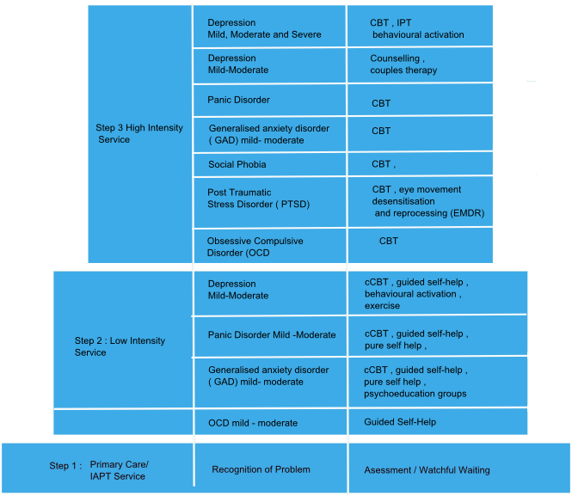
Stepped Care
Notes:
High Intensit - Usually 6-20 sessions
- Face to face therapy
- Skilled to deliver CBT
- And other NICE approved Rx e.g. IPT couples behavioural rx
Low Intensity (PWP)
- Up to 4-5 sessions
- Face to face or telephone
- Skilled to deliver a variety of evidence based interventions

Slide 23
Referral Criteria
Problems suitable for Talking Therapies
Depression
Generalised anxiety disorder
Psychological problems arising from long term medical conditions
Panic disorder
Social phobia
Specific phobias
OCD Obsessive compulsive disorder
PTSD Post- traumatic stress disorder –moderate/single trauma e.g. RTA
Health anxiety
Medically Unexplained Physical Symptoms
Post natal depression (mild/moderate)
Employment stress, support required to stay in or obtain work.

Slide 24
Not suitable:
Children
Psychosis
Actively suicidal
Complex problems eg PD, Severe PTSD, Moderate/Severe Eating disorders
Drug/Alcohol problems
Under Secondary Care Services

Slide 25
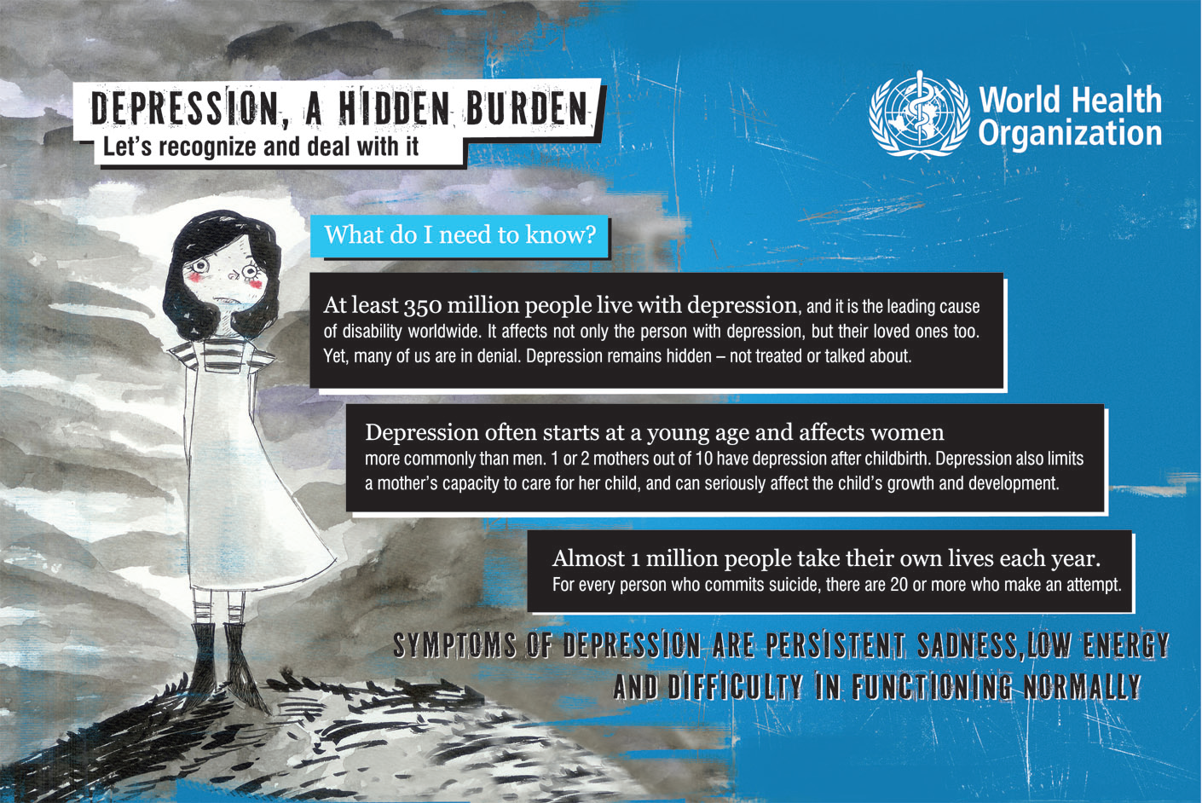

Slide 26
Mental/Physical Health Link –
Example 1: Diabetes and Depression
Patients with diabetes have double the population incidence of depression – for reasons which are poorly understood
Depressed patients are three times more likely not to comply with medical treatment
Outcome of co-morbid diabetes/depression – poorer diet, more hyperglycaemia, greater disability, higher healthcare costs
BUT… treatment of depression/anxiety in diabetic patients results in dramatically improved mental and physical health outcomes, lower secondary care costs – the treatment pays for itself within 1 year
Notes:
The relationship between diabetes and depression provides a fascinating case in point – complex inter-relationship of I disease state with another; physiological basis not fully understood, changes in health behaviour a key intervening variable causing dramatically worse outcome.
The key point here is that with the early diagnosis and effective treatment proposed by WHO report, outcome is dramatically better

Slide 27
Mental/Physical Health Link –
Example 2: Depression and Heart Disease
Depression predicts the incidence of heart disease
Depressed patients have greater than three times the risk of a cardiac event, in particular MI
Depressed patients have reduced post-MI survival, poorer adjustment, slower return to function, increased disability, increased medical costs
Treatment of co-morbid depression results in improved mental and physical health outcomes, and lower secondary care costs – the treatment pays for itself
Notes:
In the case of heart disease and depression, again a complex inter-relationship in which the physiological basis is not fully understood
Again, outcome uniformly poorer, BUT much improved with early diagnosis, and access to effective treatment

Slide 28
Self-Management
Key to improved outcomes in depression as in all chronic conditions
Use of information resources, care plans – negotiate agreed plan, follow-up re progress with this
Start small/achievable and build from there
Expect it will require fine tuning over time

Slide 29
Six Principles of
Self-Management
Activities that protect & promote health (Live a healthier lifestyle)
Monitor signs/symptoms of illness and take appropriate action to respond
Know and understand your health condition
4. Be actively involved in decision making
5. Manage the social / emotional and physical impact
6. Follow a care plan that is agreed with your health professionals
(Battersby, 2005)
Notes:
Self mgt programmes tend to be based on the following 6 principles
& they assist populations with chronic disease to engage in activities that protects and promote health, monitoring and managing symptoms and signs of illness,
To know & understand their health condition

Slide 30
Exercise in Depression
Must be vigorous exercise (for age/fitness)
Some evidence that balance of aerobic and resistance exercise ideal
Integrate into Activity Scheduling
Evidence that in elderly (over 60) exercise programme has same efficacy as antidepressants

Slide 31
Brief Problem Solving
Proven effective in mild-moderate depression
Focus is on mobilising the patient’s coping and problem-solving capacity, to overcome the issues that are causing stress/inducing depression
Uses structured approach, increases sense of mastery and reverses “helplessness – hopelessness”

Slide 32
Evidence based treatment?
Two recently published studies significantly challenge widely accepted views regarding the efficacy of antidepressant medications
Kirsch et al. 2008: “Initial Severity and Antidepressant Benefits: A Meta-Analysis…” Drug–placebo differences in antidepressant efficacy increase as a function of baseline severity, but are relatively small even for severely depressed patients.
Turner et al. 2008: “Selective Publication of Antidepressant Trials and Its Influence on Apparent Efficacy”: publication bias of data from U.S. Food and Drug (FDA) registration trials results in an inaccurate characterization of AD efficacy

Slide 33
Conclusions:
AD only recommended for patients whose depression is of at least moderate severity
Appr. 20% of these patients will recover with no treatment at all (within 4-8 weeks)
Appr. 30% will respond to placebo and about 50% will respond to AD drug treatment
For mild or subsyndromal patients side effects outweigh clinical effects
AD effect often seen by 2 weeks; if effective should be taken for 6 months after recovery from episode

Slide 34
NICE Stepped Care

