Slide 1
ELFT Training Packages for Primary Care ‘CAMHS and the Under 5’s’
CAMHS ELFT
Graeme Lamb
Clinical Director

Slide 2
Learning outcomes:
Describe the presentation of a difficulty in an under 5 child and how this presentation may be influenced by family factors and environmental factors.
Be aware of how to assess common presentations in this age group.
Be able to recognise the ‘red flags’ that might suggest underlying more serious difficulties.
Be familiar with common treatment strategies and be able to describe treatment options to a family.

Slide 3
Overview
Early childhood development
Common conditions
Autism spectrum disorders (brief recap)
Overview of treatment approaches

Slide 4
Developmental tasks of childhood
The journey from being part of one person (the mother) to being a separate person in his/her own right.
Development occurs across a number of domains
Physical
Psychological
Emotional
Social
The infant and parent both have innate, inherited behavioural repertoires that help in the process first of attaching to one another, and then separating, physically, whilst remaining attached psychologically, socially and emotionally.
The environment plays an important part in affecting the quality first of the attachment process and then of the separation process.

Slide 5
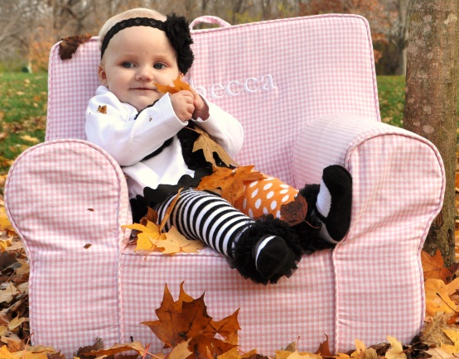
Transitions
Birth-6 months: The physical separation of birth and the umbilical cord being severed. This is accompanied by biological and psychological processes that encourage a strong social bond between care-giver and infant.
6-12 months: The baby is beginning to develop capacity to move as a separate individual, gaining body strength and a curiosity to discover the potential of the physical and social world around them (smiling, babbling, mirroring etc)
12-24 Months: The baby learns to walk and separate from the care giver; the baby begins to master complex communication processes through language development.

Slide 6
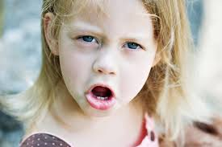
Transitions
24-36 Months: The baby is rapidly developing his/her own desires and interests that may conflict with the care giver’s– experienced through the ‘tantrum’ stage.
36-64 months – The child will have an increasing periods of time away from the care giver’s and spend more time in the company of their peers and other adults

Slide 7
Common Difficulties that can occur
Biological: Physical injury, medical illness and slow or unusual development can all influence the way this process occurs – for example, illness leading to organic damage to the child;
Environmental: The physical environment, for example; poor housing, domestic violence, social stressors-raising parental stress, leading to a disruption in the quality of the relationship between infant and care-givers.
Psychological: Mental health problems in the parent that influences their style of interaction with the child.

Slide 8
What conditions do we see in under 5s?
Habit problems eg toileting
Failure to develop routines eg sleep and feeding
Abuse. Emotional/behavioural consequences of. This can be physical, sexual or emotional abuse.
Attachment Difficulties
Temper Tantrums
Autism/Social Communication Problems
ADHD. A child who is hyperactive, impulsive and unable to concentrate.
Anxiety, including separation anxiety

Slide 9
Red Flags
What kind of concerns might you have with each of these presentations?
A very overactive child
A child at risk of accident due to hyperactivity
A persistently irritable child
A persistently unhappy child
A child who shows little social interaction

Slide 10
Developmental red flags
Any unusual physical features eg microcephaly
Developmental delays
speech
motor
Hearing or visual impairment
Unusual communication
Unusual or restricted play
REGRESSION OF SKILLS at any age
Parental or professional concerns

Slide 11
Autism Spectrum Disorders
What aspects of social communication do you see here?

Slide 12
Autistic Spectrum Disorder
A child on the autistic spectrum may have difficulties in two main areas:
Difficulties in social communication (includes social reciprocity, difficulties developing peer relationships, verbal and non verbal communication)
Restrictive and repetitive behaviours (includes routines, restricted play, stereotyped mannerisms, preoccupation with particular objects or part of objects)

Slide 13
Features of Autistic spectrum disorder at this age
Features to identify in early childhood
Does the child show a lack of babbling or have any speech delay?.
Does the child show a lack of social interaction including limited smiles and facial expression?
Is the child’s play restricted, for example lining up toys by their size or colour. Does the child have any other restricted interests or routines?
Does the child have any unusual behaviours such as spinning or hand flapping
Practice point: Always note any loss of skills eg speech at any stage

Slide 14
Under Fives Treatments that can be offered by CAMHS
Parent Infant work
Family therapy
Behaviour therapy
Play therapy
All approaches stress the importance of psycho-education, and support linking with other agencies.

Slide 15
Parent-Infant work
A clinician will spend time with the parent and infant, observing their interactions together, observing, making suggestions and asking questions about how the parent understands their child and the reasons why the child behaves the way she does.
VIG Video Interactive Guidance

Slide 16
Parent Training Programmes
Interventions such as Incredible Years Programme
Group parenting training intervention
Short Term Aims
Improve parent-child interactions – building positive relationships
Improved parental functioning – less harsh, more nurturing. Increase parental problem solving
Prevention, reduction and treatment of early onset conduct and emotional problems
Promotion of child social competence
Long Term Aims: Reduction in conduct disorders, delinquency, violence and drug abuse

Slide 17
Play therapy
The child will spend time with a clinician on her own and engage in therapeutic play-based activities. The way the child plays and interacts in the room will be understood by the clinician as reflecting her inner emotional world – therapeutic play in the clinic space gives the child a chance to express her feelings/emotions in a safe and contained way.

Slide 18
Further Reading
Mental Health and Growing up. Royal College of Psychiatrists factsheets. RCPsych 2012
The Young Mind ed Bailey S and Shooter M. Bantam Press RCPsych 2009
The Incredible Years Webster -Stratton,C 2006
What Every Parent Needs to Know: The Incredible Effects of Love, Nurture and Play on Your Child's Development - Margot Sunderland, 07/06/2007, Dorling Kindersley Publishers Ltd
Mind Ed website www.minded.org.uk

