Slide 1

Antidepressants and Benzodiazepines February 2015

Slide 2
Classification of Antidepressants
Monoamine Reuptake Inhibitors
(MARIs)
Complex
TCA
SSRI
NRI
SNRI
NaSSA
SARI
Amitriptyline
Fluvoxamine
Reboxetine
Venlafaxine
Mirtazapine
Trazodone
Imipramine
Fluoxetine
(Atomoxetine)
Duloxetine
Agomelatine
Clomipramine
Paroxetine
Vortioxetine
Dothiepin
Sertraline
Lofepramine
Citalopram
Es-citalopram

Slide 3
Pharmacological Mechanisms of Antidepressants
Block serotonin reuptake
Block noradrenaline reuptake
Block DA reuptake
Block 5HT &/or NA-alpha receptors
Block AcCh-M receptors
Block Na⁺ channels
Release amines (amphetamine-like)
Block Ach receptors (nicotinic/muscarinic)

Slide 4
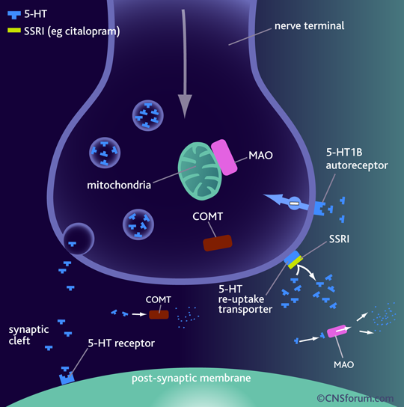
SSRI Mechanisms

Slide 5
Side Effects of Fluoxetine: More than 5% incidence above placebo
Nausea 10-30%
Anorexia 7%
Insomnia 7%
Nervousness 7%
Fine Tremor 10%
Drowsiness 6%
Diarrhoea 5%
Sexual Dysfunction
- loss of libido
- erectile/lubrication
- orgasm/ejaculation

Slide 6
Side Effects of Fluoxetine: Less Common
Headache
Increased sweating
Akathisia, Dystonia, Parkinsonism
Rash/allergy/vasculitis
Inappropriate ADH secretion
Prolonged seizures in ECT
Bradycardia
Yawning, spontaneous orgasm
Psychiatric reactions – mania , psychosis

Slide 7
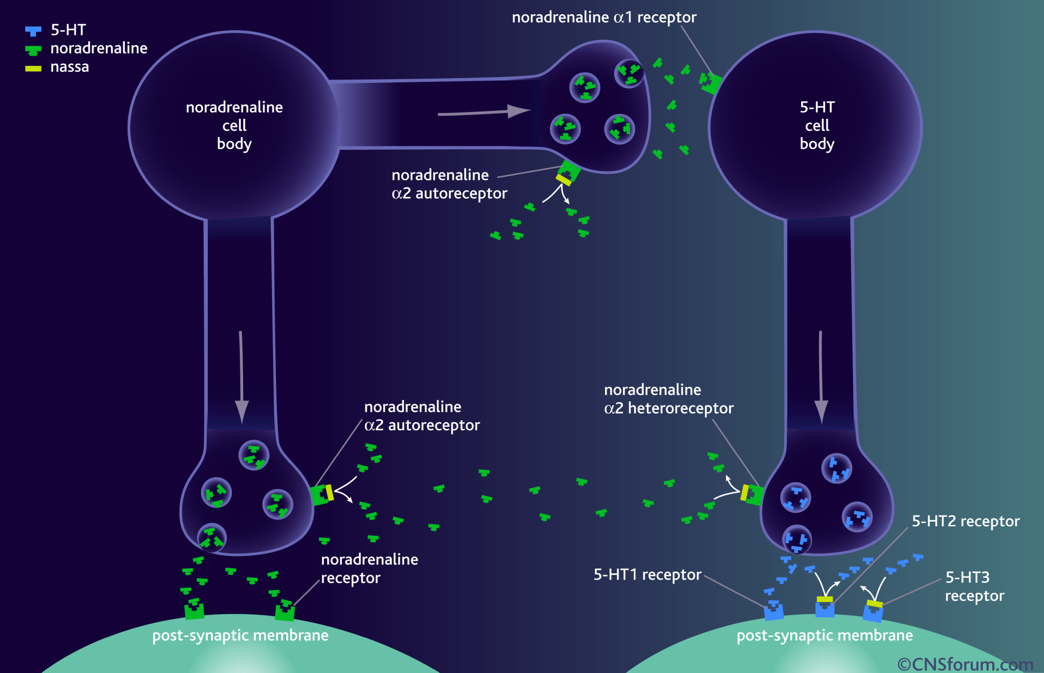
NaSSA Mechanisms

Slide 8
SSRIs Half Lives
Fluoxetine 5 days
Nor-fluoxetine 15 days (longer in elderly)
Citalopram 33 hours (longer in elderly) Sertraline 26 hours
Paroxetine 10 hours acute
Fluvoxamine 10 hours acute
(Venlafaxine 4 hours; active metabolite 8 hours)

Slide 9
Discontinuation Symptoms – SSRIs
Dizziness, vertigo
Headaches, nausea, fatigue, flu-like symptoms
Nervousness, insomnia
Paraesthesiae, electric shock feelings
These may also occur during treatment

Slide 10
PHARMACOLOGICAL SIDE EFFECTS OF ANTIDEPRESSANTS
1.Anti-Muscarinic ( ACh)
Dry mouth
Constipation
Urinary retention
Blurred vision
Cognitive impairment
Worsen tardive dyskinesia
2.NA ReuptakeBlockade
Dry Mouth
Constipation
Urinary retention
Blurred vision
Tachycardia
Raised blood pressure
3.NA alpha-one Blockade
Postural hypotension
Ejaculatory impotence

Slide 11
PHARMACOLOGICAL SIDE EFFECTS OF ANTIDEPRESSANTS
Histamine Blockade (H-1)
Sedation
Cognitive impairment
Falls
5HT Reuptake Blockade
Diarrhoea
Headache
Drowsiness
5HT-1:Serotonin syndrome
5HT-2:Nervousness, insomnia
Anorexia
Sexual dysfunction
Akathisia
Parkinsonism,
dystonia
5HT-3:Nausea
5HT-2C Blockade
Weight gain

Slide 12
PHARMACOLOGICAL SIDE EFFECTS OF ANTIDEPRESSANTS
DA Reuptake Blockade
Nausea
Activation
Antiparkinsonian
Psychosis
Complex / Unclear
Fine tremor
Sweating
Myoclonus
SIADH
Epilepsy
Mania / Rapid cycling
Membrane-stabilisation
Cardiac dysrhythmia
Asystole

Slide 13
Agomelatine
Improves sleep quality
Lacks sexual side effects
Lacks discontinuation syndrome
Well tolerated, dizziness (8%) and nausea (5%) being the most frequently reported side effects
(c.f. 3% and 2% for placebo)
Monitor LFTs

Slide 14
Zyban (bupropion)
Dose-related risk of seizure
0.1% on 300mg/day
Insomnia is a very common adverse event
Also reported:more outgoing behavior, worsening of depression, auditory and visual hallucinations

Slide 15
Multiple meta-analysis of antidepressants
Cipriani et al, 2009:Lancet

Slide 16
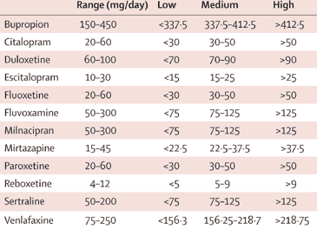
Table 1: Dosing classification based on lower and upper dosing range quartiles
Cipriani et al, 2009:Lancet

Slide 17
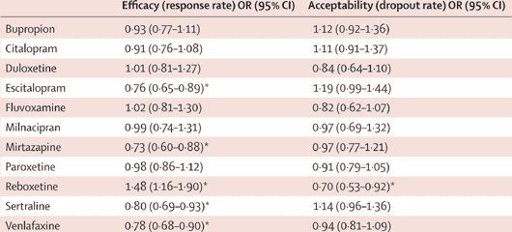
Table 4: Efficacy and acceptability using fluoxetine as reference compound
Cipriani et al, 2009:Lancet
OR=odds ratio. CI=credibilty interval.
* p<0·05. For efficacy, OR higher than 1 favours fluoxetine. For acceptability, OR lower than 1 favours fluoxetine.

Slide 18

Conclusions:
Escitalopram and sertraline showed the best profile of acceptability, with fewer discontinuations
Sertraline: the best choice when starting treatment for moderate to severe depression in adults: best balance between benefits and acceptability

Slide 19
Treating Depression

Slide 20
Phases of Depression
Full Recovery
Remission
Recurrence
No Depression
Relapse
X
Relapse
X
Severity
Symptoms
Response
Syndrome
Progression
to Disorder
Acute
Continuation
Maintenance
Treatment Phases
Time
Kupfer DJ. J Clin Psychiatry. 1991;52(suppl):28-34. WPA/PTD Educational Program on Depressive Disorders.
Notes:
This slide graphically presents the treatment phases in the management of depressive disorders: relapse, remission, recovery, and recurrence.
In many cases, depressive disorders are recurrent. Thus, their treatment is viewed in 3 phases:
The acute phase: relief of symptoms
The continuation phase: to allow more complete resolution and to prevent relapse
The long-term maintenance phase: dependent on prior episodes, risk factors, etc.
A view of the phases of depressive disorders across the spectrum of treatment and relapse underscores the need for maintenance therapy in many patients.

Slide 21
Phases of Treatment for Depression
Acute phase: achieve remission
Continuation phase: prevent relapse - 6 months after remission
Maintenance phase: prevent recurrence – if previous episodes
Kupfer DJ, Frank E. Clin Neuropharmacol. 1992;15(suppl 1 pt A):446A-447A.
Notes:
Treatment is viewed in 3 phases:
The acute phase: relief of symptoms
The continuation phase: to allow more complete resolution and to prevent relapse
The long-term maintenance phase: dependent on prior episodes, risk factors, etc.

Slide 22
Antidepressants and suicidality in young people

Slide 23
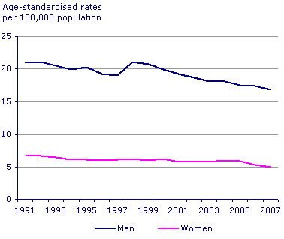
NSF Target: Bringing down the suicide rate by at least a fifth by 2010

Slide 24
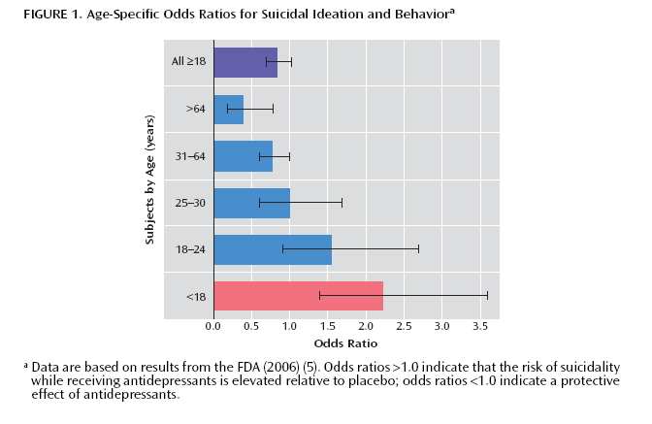
FDA analysis of suicidal thoughts in SSRI trials Leading to Black Box warning in 2004

Slide 25
FDA adviser 2007
“The black box warning is not meant to discourage the prescription of antidepressants…. Instead, it is meant to promote monitoring of patients who commence antidepressants.”

Slide 26
Miller, Swanson, Azrael, Pate. Stürmer, 2014. Antidepressant Dose, Age, and the Risk of Deliberate Self-harm. JAMA Intern Med. doi:10.1001/jamainternmed. 1053 Published online April 28, 2014.

Slide 27
Benzodiazepine: Side effects and interactions
Impairment of mental ability, amnesia, decreased psychomotor reactions and coordination
In some personalities they result in disinhibition and aggression
Avoid prescribing for personalities prone to dependency
Alcohol interacts with benzodiazepines, and they potentiate one another
Benzodiazepines can cause some respiratory depression, particularly in the elderly, and those with emphysema

Slide 28
Benzodiazepine Dependence
If treatment continues after dependence begins, therapeutic effects are partly lost
As each dose wears off the patient experiences “rebound” exacerbation of the pre-existing condition
Attacks of panic may occur when a short-acting drug such as lorazepam is wearing off

Slide 29
Benzodiazepine: Dependence
Abrupt withdrawal, after high doses or long use:
disorientation and delirium, paranoid psychosis, convulsions
Rapid withdrawal from low dose:
insomnia, anxiety, tremor, sweating
Other symptoms
nausea, heightened sensitivity to light and sound, sense of imbalance as on a rocking boat, frightening sensory illusions, tinnitus, paraesthesia,
Depersonalisation, derealisation.
Can last for weeks; full recovery may take two years
Slow and phased withdrawal, with a self-help group
Reduce the dose by one tenth every two weeks in outpatients

