Slide 1
The treatment of patients with medically unexplained symptoms in primary care: a review of the literature
Professor Gabriel Ivbijaro MBE JP
MBBS, FRCGP, FWACPsych, MMedSci, DFFP, MA, IDFAPA
President WFMH
Family Doctor, Waltham Forest, London, UK
Visiting Professor Population Health, NOVA University, Lisbon, Portugal
Friday 6th May 2016
Somatic Symptom Disorder ‘Medically Unexplained Symptoms’ in Primary Care
Morris Lecture Theatre St Bartholomew’s Hospital London EC1A 7BE

Slide 2
Acknowledgements
Co-presenters
Participants
Our patients whose experience enriches our learning
The Waltham Forest and NOVA University teams

Slide 3
My collaborators

Slide 4
Some key evidence
EDWARDS, T. M., STERN, A., CLARKE, D. D., IVBIJARO, G. & KASNEY, L. M. 2010. The treatment of patients with medically unexplained symptoms in primary care: a review of the literature. Mental Health Fam Med, 7, 209-21.
BERMINGHAM, S. L., COHEN, A., HAGUE, J. & PARSONAGE, M. 2010. The cost of somatisation among the working-age population in England for the year 2008-2009. Ment Health Fam Med, 7, 71-84.
DE GUCHT, V. & HEISER, W. 2003. Alexithymia and somatisation: quantitative review of the literature. J Psychosom Res, 54, 425-34.
DWAMENA, F. C., LYLES, J. S., FRANKEL, R. M. & SMITH, R. C. 2009. In their own words: qualitative study of high-utilising primary care patients with medically unexplained symptoms. BMC Fam Pract, 10, 67.
HAWKES, N. 2011. Dangers of research into chronic fatigue syndrome. BMJ, 342, d3780.
KROENKE, K. & MANGELSDORFF, A. D. 1989. Common symptoms in ambulatory care: incidence, evaluation, therapy, and outcome. Am J Med, 86, 262-6.
STEINBRECHER, N., KOERBER, S., FRIESER, D. & HILLER, W. 2011. The prevalence of medically unexplained symptoms in primary care. Psychosomatics, 52, 263-71.
TAYLOR, R. E., MARSHALL, T., MANN, A. & GOLDBERG, D. P. 2012. Insecure attachment and frequent attendance in primary care: a longitudinal cohort study of medically unexplained symptom presentations in ten UK general practices. Psychol Med, 42, 855-64.

Slide 5
Plan
Why this condition is important in primary care
What is the scale of the problem
Types of patients seen in primary care
Addressing the stigma associated with ‘medically unexplained symptoms’

Slide 6
Why is this condition important in primary care?

Slide 7
Ms JD
White 38 yr old separated mother of two
Moved to a new practice 18 month ago
Complaining of dissatisfaction with previous GP practice
Chronic pelvic pain
Attending gynaecology clinic > 5yrs
GU clinic multiple attender
Dyspareunia
1 episode of candida otherwise all investigations negative including pelvic USS

Slide 8
Ms JD
Since registering 18/12 ago:
Attends GP out of hours x 1 weekly for non specific abdominal pain
Attends GP emergency appt x 1 weekly
Attends A&E x 1 every 2 months for acute abdomen
New diagnosis ? oesophageal reflux & rule out gall bladder disease
Referred to secondary care for further investigation

Slide 9
Ms JD
Summary of consultant letter:
Pleasant lady, looks anxious, nothing serious found on investigation except marginally elevated glucose level. Please investigate and advise patient
GP review with GP trainee
GTT requested – normal
Patient advised that IAPT may help

Slide 10
High rate users of healthcare
Multiple often expensive investigations
Unnecessary tests
Unnecessary treatments
GP frustration
Difficult not to be sceptical
Need to do something
Fear of missing serious illness
Poor mental health knowledge
Biomedical model unsuitable –separates mind from body
Encounter often unrewarding
Many symptoms of low predictive value (<25%)
Co-morbidity common
Barsky et al 1995; Margo & Margo 1994; Aiarzaguena et al 2008; Kerwick et al 1997

Slide 11
Multiple somatic complaints
n=156; 81% women
Median = 15 active somatic symptoms 12 unexplained / 3 explained
83% associated with mental health conditions: anxiety & depression
Aiarzaguena et al 2008

Slide 12
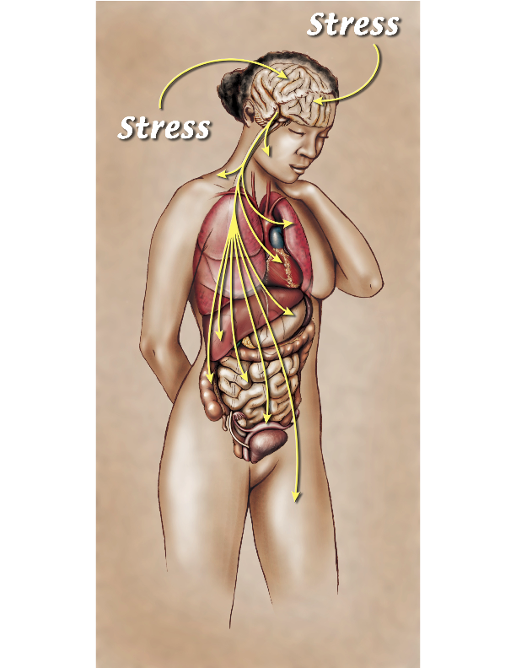
A wide range of presentations
1/3 physical
1/3
mental
1/3 combined
Notes:
The variety of presentations of Stress Illness is remarkable including but not limited to Headache, Dizziness, Dyspnea, Cough, Tinnitus, Globus, TMJ pain, Fibromyalgia, Chest Pain, Back Pain, Repeated Shoulder Dislocations (!), IBS, Dyspepsia, Abdominal Pain, Diarrhea, Constipation, Interstitial Cystitis, Pelvic Pain, Paresthesias. The more symptoms a patient reports (particularly if six or more), the more likely they have stress illness. A common presentation is the patient who is perceived as “difficult”, the kind where you find yourself looking for a way out of the exam room. Though most practitioners identify only about 15% of their patients this way, they contribute disproportionately to clinician job dissatisfaction.

Slide 13
Types of symptoms
Mental health
Physical health
Depression
Anxiety
Anxiety with depression
Combined mental & physical
One or more - 97%
Two or more – 78%
Three or more – 53%
Four or more -22%
Five or more – 5%
Headache
Excessive gas
Gastric pain
Back pain
Dyspnoea
Palpitations
Articular pains
Lower limb pains
Numbness
Chest pain

Slide 14
Doctors Communication
Psychol Med. 2007 Feb;37(2):283-94. Epub 2006 Dec 13.
A randomized controlled clinical trial of a psychosocial and communication intervention carried out by GPs for patients with medically unexplained symptoms
Aiarzaguena JM1, Grandes G, Gaminde I, Salazar A, Sánchez A, Ariño J.
Conclusions:
Communication techniques were found to have a clinically relevant impact on body pain

Slide 15
Family communication & frustrations
Journal of Psychosomatic Research Volume 36, Issue 3, April 1992, Pages 211–217
The knowledge and beliefs of family care givers about chronic pain patients
Sidney Benjamin, Judith Mawer, Sean Lennon
Patients who perceive their families to be less supportive, more irritated & more upset are more likely to complete behavioural treatment
High concordance between patient & family regarding nature of pain results in worse behavioural treatment outcomes

Slide 16
Summary of the literature
Frequent use of services, frequent attenders
Multiple complaints
Long term problems - a chronic problem
Difficult patients and relationships: “heartsink patients” “chronic neurotics”
Complex problems involving their families and others

Slide 17
Characteristics & needs of patients with MUS
Characteristics:
Needs:
Frequent use of services
Multiple complaints
Long term problems
Difficult patients and relationships
Complex problems, involving their families
Accessible care
Comprehensive approach
Coordination of services
Continuity
Personal care
Context of family and community
Primary care needs to be equipped to manage this better

Slide 18
What do GP’s say about the patients
They are:
Difficult
Heartsink
Frequent attenders
Demanding
Exotic
…the failure of modern medicine

Slide 19
What the GP’s think about the patients
They get:
Medication
Examinations
Referrals
Hospitalizations
Unnecessary treatments
…and some anger, based on frustration

Slide 20
What the patients need
They need:
Acceptance
Understanding
Holistic approach
Investment in time
A different approach
…a humane and open-minded approach from their doctor

Slide 21
Primary care treatments

Slide 22
Outline
An overview of the psychotherapy literature pertaining to MUS, with an emphasis on practical methods
A review of research highlights on collaborative care

Slide 23
Cognitive-behavioral therapy
5 to 20 individual and group sessions have demonstrated modest impact, especially on severity of symptoms
Three key components:
Psycho education
Systematic relaxation training
Discussion of dysfunctional beliefs
Could be addressed through groups in primary care

Slide 24
Central treatment goal
To help patients gradually learn to view their symptoms in more psychological and less catastrophic ways
“we emphasized that while the pain was ‘real’, it was not necessarily caused by serious organic pathology. It might result from, or be made worse by, excessive nervous and physical tension due to external stresses.”
Klimes et al, 1990
(

Slide 25
Daily Diary Keeping
GP can ask patient to keep a diary
Patient notes symptoms along with feelings & thoughts
Doctor offers benign alternative explanations during diary review
Doctor can offer an example: the thought “I am having a heart attack” can be countered by “I tense up and get chest wall pain as a result”
After 1 or 2 sessions educating the patient about counter thoughts the patient can begin writing these in the diary after the more alarmist thoughts

Slide 26
Extended single session CBT: collaborative care
A longer single session by a GP, psychologist, social worker vs. typical 10-15 session CBT
Three to four hours
Psychoeducation, relaxation techniques and discussion of dysfunctional beliefs
Encouragement of physical activity to counter the avoidance of symptoms and activity
Frequency of visits to GP reduced by half for the next six months

Slide 27
A single one hour interview: collaborative/integrated care
Reduced health care costs
Conducted jointly by GP and mental health clinician
Components of the interview:
Curiosity about symptoms with empathic listening
Opportunities to suggest alternative explanations for symptoms and decisions
Identification of maladaptive relationships through constructing a family genogram

Slide 28
Your letter can make a difference
Psychiatrist’s letter to GP starts by telling the GP that the patient meets criteria for somatization disorder and describes it as a chronic relapsing disorder that is an expression of unconscious processes
It then lists a few simple treatment recommendations:
To avoid telling the patient “It’s all in your head”
Regular brief appointments every four to six weeks instead of “as needed”
A brief focal physical exam at each visit
Following year results in improved patient physical functioning and decreased medical costs

Slide 29
Medication options

Slide 30
Medication options for MUS
Antidepressants useful in MUS with co-morbid major depression or dysthymia
In sub threshold depression antidepressants can improve the associated mood or anxiety symptoms
Antidepressants can result in improvement in the severity of pain
There is a lesser effect on other somatic complaints

Slide 31
Other medication
Benzodiazepines have not been shown to be effective.

Slide 32
What is important when using medication?
Full history
Good assessment
Good mental state assessment
Good record keeping
Empathic engagement
The need to understand where the patients is coming from
Search for co-morbidity
Treat threshold cases of mood disorder
Anti depressant can be useful for some symptoms in sub threshold depression
Avoid benzodiazepines as much as possible

Slide 33
Family considerations in treatment

Slide 34
Family research
Patients with somatization report:
Higher levels of family conflict
Lower levels of family cohesion
Frequent arguments
Poor social support

Slide 35
Families and MUS
MUS can create centrifugal motion in families creating distance and isolation
Related to beliefs that the symptomatic member is “faking it” or “crazy”
Isolation can fracture families

Slide 36
Helping families
Involve them in treatment
Possible barriers
They provide valuable information about causes and possible cures
Family interactions can be observed
Strengths can be identified to facilitate healing
Understand the effects of MUS on the family e.g. role changes
Facilitate communication about physical and psychological concerns to reduce isolation

Slide 37
Helping families
Help family members recognize symptoms as both physical and psychological “bodies don’t lie”
Help them tolerate uncertainty and practice patience
Elicit any recent stressful events, life cycle transitions or unresolved family problems

Slide 38
The link with childhood stress
Dr David Clark - Portland Oregon

Slide 39
A baffling illness
Notes:
A 54 year old woman with a 15 year hx of days-long attacks of nausea, vomiting & headache six to ten times annually. She felt well between attacks. After 60 admissions to a University Hospital there was no diagnosis and no effective treatment. By knowing what to look for, the cause of her illness was found and successfully treated in a little over an hour. She never had another attack. Her diagnosis? Stress Illness.
(Throughout the presentation I use stock photos matched by age and gender to the real patient. Details of the hx are altered to protect privacy.)

Slide 40
A stress illness
Illness caused by past or present psycho-social stress
Notes:
This condition has many synonyms (hysteria, hypochondria, psychosomatic illness, somatoform disorder, somatization). The term Stress Illness is more acceptable to patients and is easier for a lay person to understand.

Slide 41
Women undergoing laparoscopy
Notes:
This is a study of women undergoing laparoscopy, half of them for chronic pelvic pain and the other half for infertility (these were pain-free). As you can see, the incidence of childhood sexual abuse was three-fold higher in the pain group.
Also of interest, abnormal pelvic findings were found in about 1/3 of each group. It is tempting to attribute pain to these abnormalities yet the group without pain had these findings just as often.

Slide 42
Symptoms relieved after a nine month negative work-up
Notes:
A middle-aged woman with abdominal pain due to stress caused by a physically abusive partner. She endured a prolonged, expensive and entirely negative diagnostic evaluation. Her clinician failed to inquire about psycho-social issues. Despite her problems, this patient, like most stress illness patients, did not appear particularly stressed. With help from a domestic violence intervention she ended the relationship and her physical symptoms completely resolved. When her referring physician learned of this he sent a note with the words on the next slide.

Slide 43
A note from the referring physician
“Thank you for helping her. It is reassuring to know that I didn’t miss anything important.”
Notes:
The medical profession needs a cultural change to accept responsibility for finding the cause of stress illness symptoms.

Slide 44
Treatment of childhood stress
Support groups work in all age groups
Notes:
Many churches, Al-Anons and YWCAs offer support groups for childhood stress survivors. Information about local resources may be available from a social worker or librarian.

Slide 45
Empathy skills
How does it feel to be the patient?
Help to fight the stigma
Notes:
A 36 year old woman with nine admissions in one year for nausea & vomiting.

Slide 46
The label is a problem in primary care
Symptoms are not a barrier to recovery, attitude is
Notes:
A 32 year old man with ulcerative colitis had a flare documented by colonoscopy two months prior to admission. When he failed to improve he was hospitalized for 2 weeks but his intractable diarrhea persisted. Procto-colectomy was scheduled. His doctor noticed that the timing of his diarrhea was atypical and so, prior to the surgery, colonoscopy was repeated. His colon proved to be entirely normal. Surgery was canceled and a stress medicine consultation requested.

Slide 47
Mrs CD

Slide 48
Mrs CD

Slide 49
Lack of concordance
Patients often have something wrong
They don’t like the label MUS ‘medically unexplained symptoms’
The diagnosis leads to prejudice from clinical staff
Health care investment in MUS does not reflect the cost of managing the problems
Not enough primary care training & awareness
IAPT can integrate better with primary care
A&E and out of hours services need to integrate better

Slide 50
May be easier to access health funding
May reduce frustration between patients and doctors
Better family understanding
More acceptable diagnosis

Slide 51
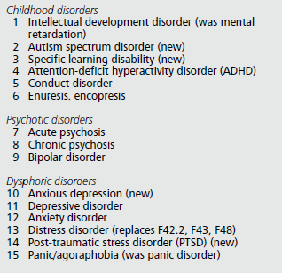
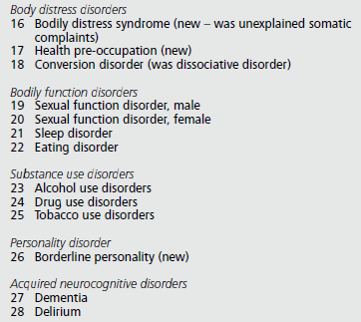
Classification: future WHO ICD11-PHC

Slide 52
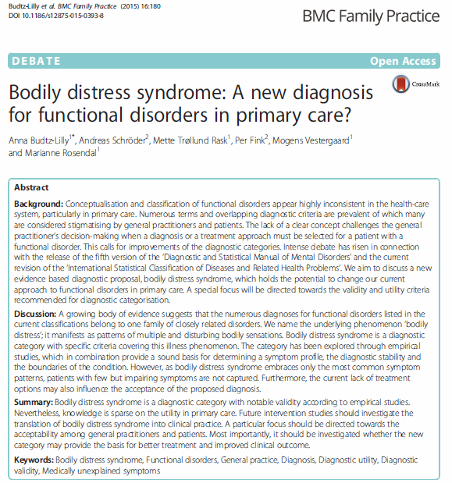

Slide 53
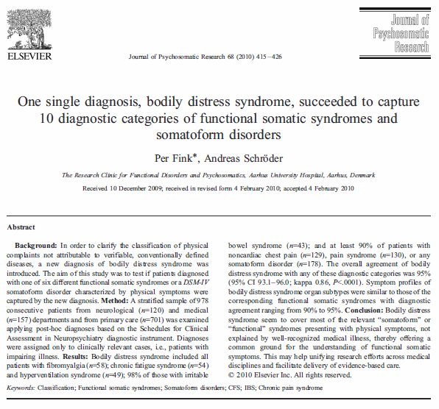

Slide 54
Thank you
gabriel.ivbijaro@gmail.com
www.worlddignityproject.com

