Slide 1
MUS-Information Events for Service Users
Frank RÖhricht
&
Ivan Zammit

Slide 2
What is my health condition about?
Many people are faced with problems linked to having to live and cope with physical symptoms that don’t get better with medical treatment.
You may experience these symptoms as being disabling, you may also suffer pain and discomfort.
Your doctor/ nurse may have been unable to explain why you are suffering with your symptoms.
Sometimes it may have felt as if the realities of your symptoms are being doubted.
This may have affected your relationship with the doctors and nurses trying to help you.

Slide 3
What is it called when symptoms can not be explained?
Medically unexplained symptoms
Somatoform disorder
Functional disorder
Health anxiety
Psychosomatic disorder

Slide 4
Example 1
“I am always at the doctor’s surgery. That is because I often worry about having something wrong with me. Last week it was tingling in my hands and arms. I thought it was the first sign of something like M.S. The doctor did some tests and said it was nothing to worry about. At first I felt better, but this week I have had a headache too, maybe I should go back just to make sure...”

Slide 5
Example 2
“I often have worrying symptoms that must be the sign of something serious. The doctors have found nothing yet. I make sure that I rest a lot so I don’t strain myself. I don’t travel away from my own town, I want to be near our own doctors. My wife tells me nothing is wrong but that only makes me feel better for a few minutes. I just feel I must keep checking how I am every day...”

Slide 6
The vicious circle: Body symptoms & Stress
Every symptom such as pain or tension causes stress
Every human has a response to stress that is either learned or genetically implanted. Almost all of this response will be triggered by a “survival instinct” to help you to fight off or flee this stress/danger.
The body reacts: Increased heart rate, Breathing usually becomes more rapid, Stress hormones are released, Blood pressure can go up, Muscles that you would use to fight or flee often become very tight
All of your senses are heightened when under stress

Slide 7
Health anxiety
These are the thoughts of two people who suffer from health anxiety. That means that they worry a lot about their health. This focus on health makes their symptoms seem worse. Much of their time is taken up with these worries and reassurance from a doctor that nothing is wrong doesn’t seem to help for long.
If you find yourself with many troublesome worries about your health you may be experiencing health anxiety.

Slide 8
When does worrying about our health become a problem?
We all worry about our health from time to time, for example, if we had to go into hospital for an operation, or if we are recalled by our doctor following tests.
Health worries become a problem when they begin to get in the way of normal life even though there is no reason to think that anything is seriously wrong.
You may find you are checking your body for symptoms, and that the more you check, the more you seem to notice strange feelings or lumps in your body.
You may avoid certain activities as if you were ill, and you may avoid anything to do with illness e.g. information or medical programes on the television.

Slide 9
Are there multiple reasons for why people can experience physical symptoms?
There are identifiable physical causes that can be diagnosed.
Research found that strong feelings and stress can be experienced as physical symptoms and pain
A large amount of research has found that experiences of trauma have negative effects on physical health.
Researchers have found that heightened bodily sensitivity is found in many people with irritable bowel syndrome, Fibromyalgia and chronic fatigue syndrome.

Slide 10
Triggers: life events, stress, information from media, etc.
Emotional Feelings:
sad, angry, confused
Physical Feelings:
tired, tense, headaches
What you do - Behaviours/Actions:
ignore phone calls, stop going out, spend time alone
Thoughts:
Why me? My health problems stop me from doing anything - I don't have a life anymore

Slide 11
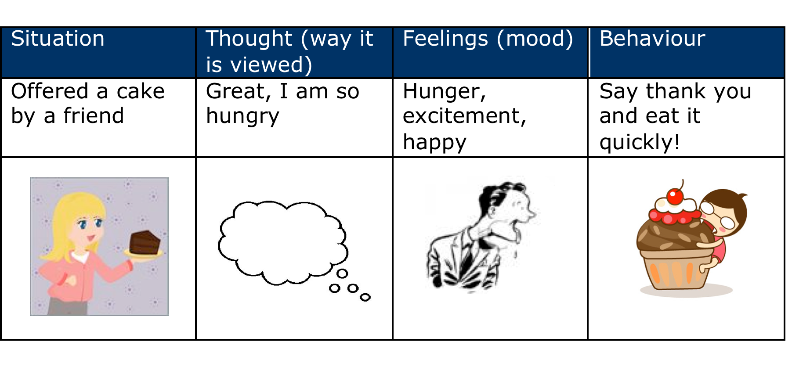

Slide 12
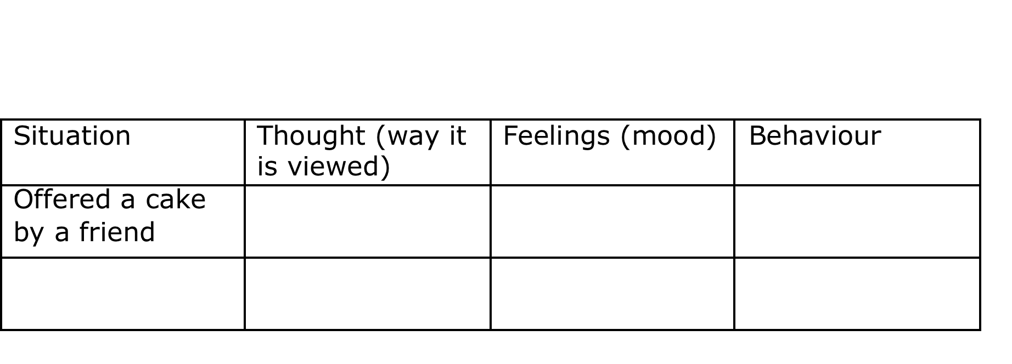

Slide 13
Different views, different feelings/actions
However, the same situation can be viewed (thought about) very differently by different people or by the same person depending on their mood and circumstance. Think about the thoughts, feelings and behaviour the above person would have if they were worried about their heart or were trying to loose weight! Have a go at filling in the words and/or pictures below

Slide 14
The vicious cycle of sleep
Sleep is an automatic process and cannot be achieved ‘on demand’. (Think about someone you know who has good sleep – what would happen if, in the middle of the day you asked them to go to sleep within the next 10 seconds, could they do it? Most people wouldn’t be able to!)
Whilst it is possible to control factors and attitudes that encourage good sleep, it is not possible to control sleep itself.
So, as the vicious cycle of sleep below shows, trying very hard to fall asleep keeps you awake

Slide 15
As we have discussed, each person’s experience of his/her symptoms is different. It can be helpful to create a personal version of what it’s like for you – the blank diagram below can help you to do this.
Think back over the past few weeks or months – what have you been feeling? Are there particular ideas/feelings that come into your mind a lot? What are the physical symptoms that you experience?
What have you been doing differently, or not doing at all? Write in the boxes what your own experience has been.

Slide 16
Emotional Feelings
Physical Feelings
What you do - Actions/Behaviours
Thoughts

Slide 17
Arousal
Anxiety around not sleeping
Arousal
Trying to get to sleep

Slide 18
Thoughts
'I won't sleep'
Behaviour
Stay in bed longer
Toss and turn
Sleep during the day
Physical Symptoms
Restless, tense
Emotions
Anxious, Frustrated, Angry

Slide 19
Thoughts
"I've no control over any of this"
"The pain is stopping me from doing anything"
Body
More pain
Behaviour
Do less, withdraw from social situations
Emotions
fear, anxiety

Slide 20
Journaling homework (15 mins per day):
In what situation did the symptom occur?
What seemed to trigger the symptom?
What thoughts did the symptom produce?
What feelings did your thoughts produce?
What action did you take

Slide 21
How you think
Constant worrying about health
Imagining the worst and dwelling on it
Thoughts about illnesses and symptoms
Concentrating on parts of your body and symptoms
Thinking that (only) the doctor may be able to help
Worrying that the doctor may have missed something
A belief that unless you keep an eye on things you may miss signs of a serious illness
Strong wish you could consult the doctor but fear he or she now thinks of you as a time waster or does not take you seriously

Slide 22
What you do
Go to the doctor’s surgery frequently
Ask family and friends for reassurance about your symptoms
Frequently check your body for symptoms such as lumps or bumps, tingling and pain
Focus on one area of the body for changing sensations
Avoid information on serious illnesses (e.g. TV)
Seek out any information on serious illnesses, and check for those symptoms (books, Internet, TV)
Act as if you were ill, for example, avoiding exertion or exercise, keeping near to home, resting

Slide 23
What happens to your body?
❑ “Odd’ sensations in various parts of body
❑ Body aching
❑ Tense muscles
❑ Breathing changes
❑ Chest feels tight or painful
❑ Dizzy, light headed
❑ Feeling jumpy or restless
❑ Having to go to the toilet frequently
❑ Headache
❑ Heart pounds, races, skips a beat
❑ Stomach churning, “butterflies”
❑ Sweating

Slide 24
Working to increase activity
For many people living with physical symptoms the issue of taking part in activities that require them to take exercise can become troublesome.
Working to increase helpful activity and behavior can help to make lots of physical symptoms to improve and can also help to overcome stress.
Evidence from the Mental Health Foundation document ‘Moving on Up’ published in 2009 lets us know that regular exercise can help you to stay well.
Exercise can also relieve stress by making you feel good about mastering a new skill, as well as improving your fitness and energy levels.

Slide 25
Exercising
Try to exercise for about 20 – 30 minutes, three to five times a week, at a pace that leaves you slightly out of breath. It’s good for you, and forms part of a healthy lifestyle.
Make sure that you enjoy yourself. You will be more likely to keep it up if you do. Ask a friend to join you, or join an exercise class or group. Local libraries and notice boards in shops, supermarkets and surgeries often have information about what is available in your area.
Aim to make exercise part of your weekly routine. Remember exercising in the evening can be very energising and can adversely affect your sleep. Exercise in the morning can be very good for people who struggle with sleep.

